Slide 1
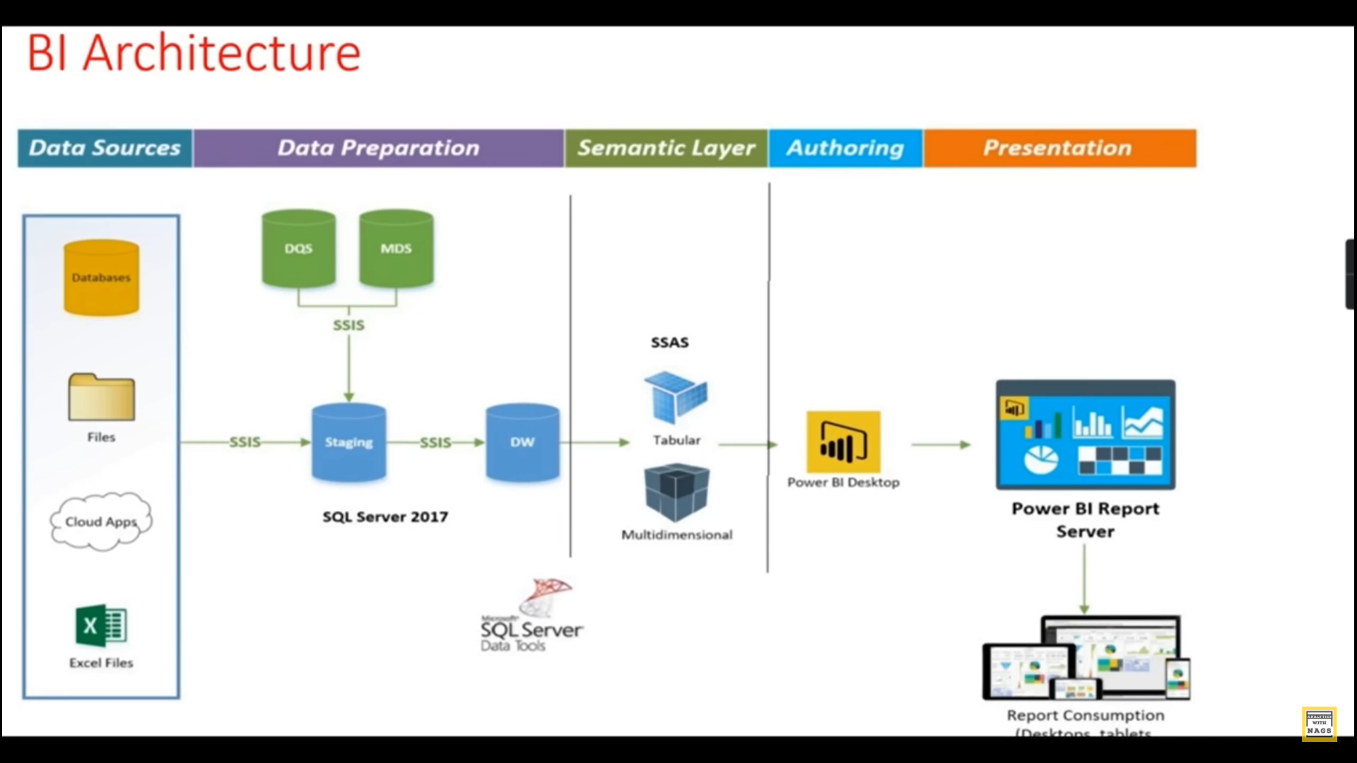

Slide 2
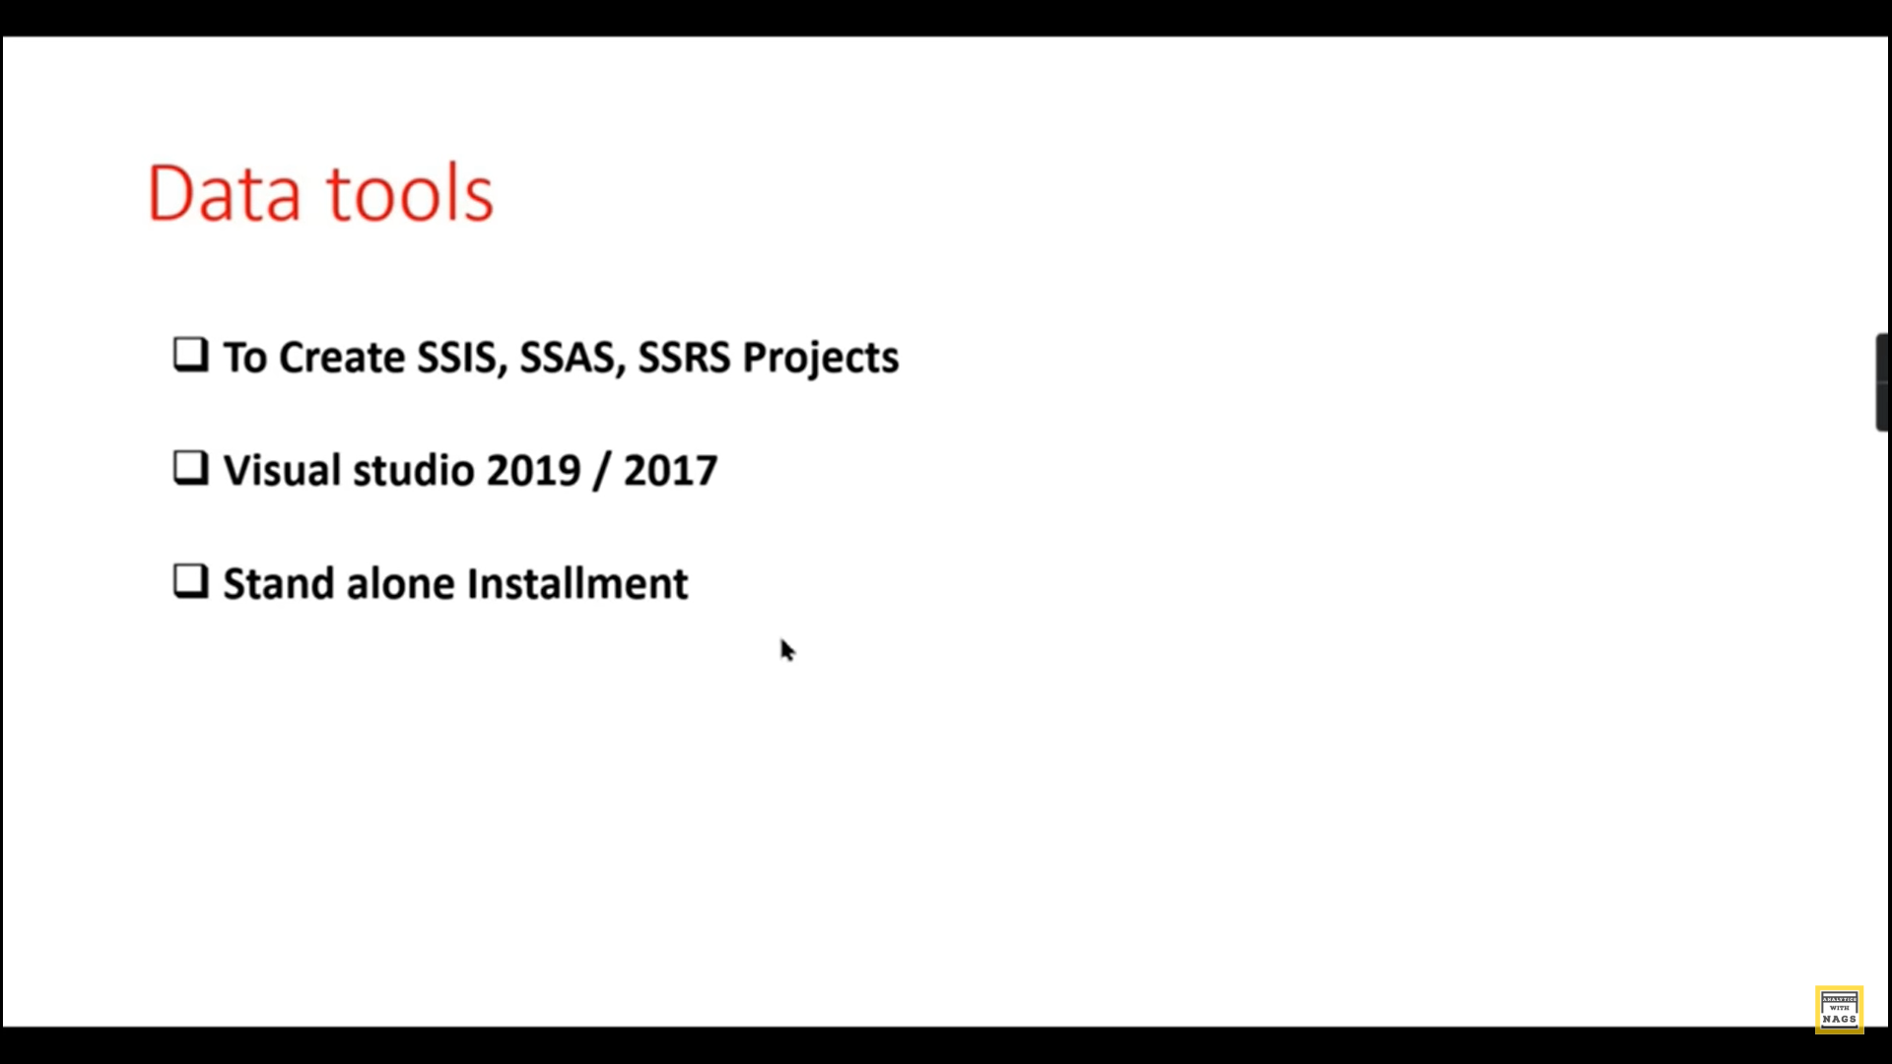

Slide 3
note download ssis with ssdt, visual code 2017 and 2019 or sql developer edition ssdt 1.Data flow is for etl 2.control flow for database backup,jobs 3.ssis if you ok itself table get create and if execute the package or execute task fot etl will start to work and data get inserted .

Slide 4
1. Load the data to ssms with ssis 2.Migrate the table from one db to another using ssis

Slide 5
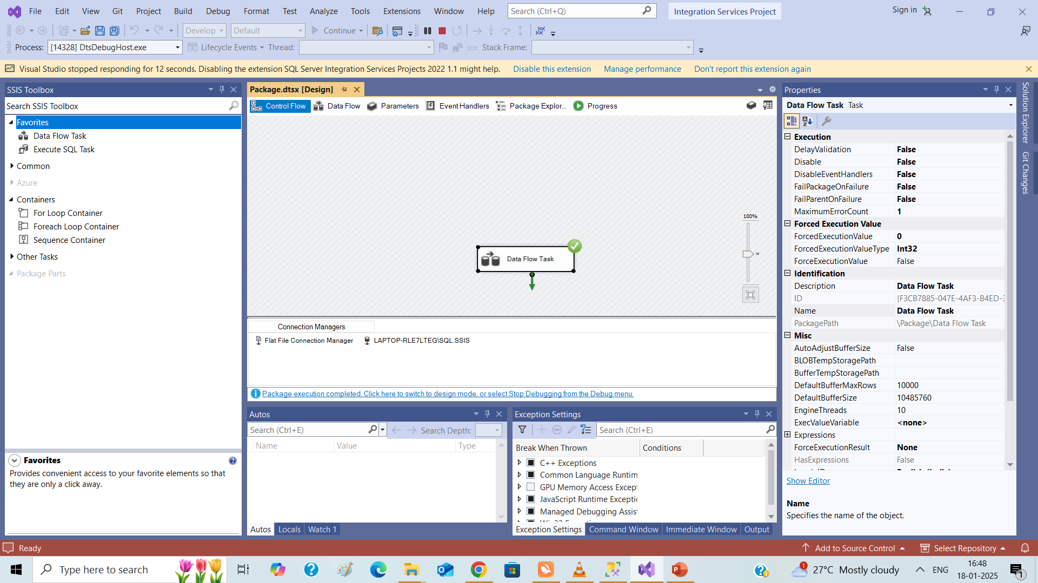

Slide 6
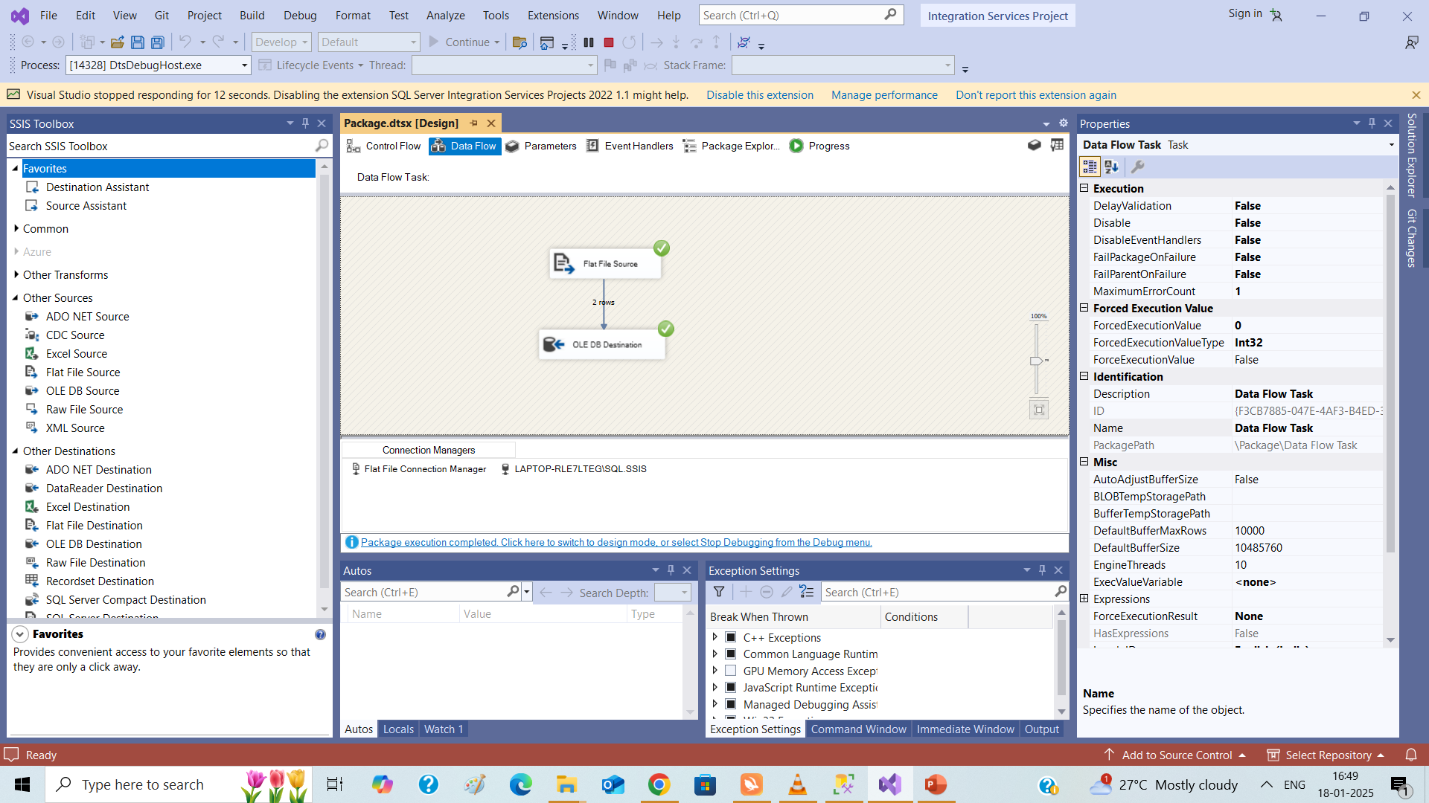

Slide 7
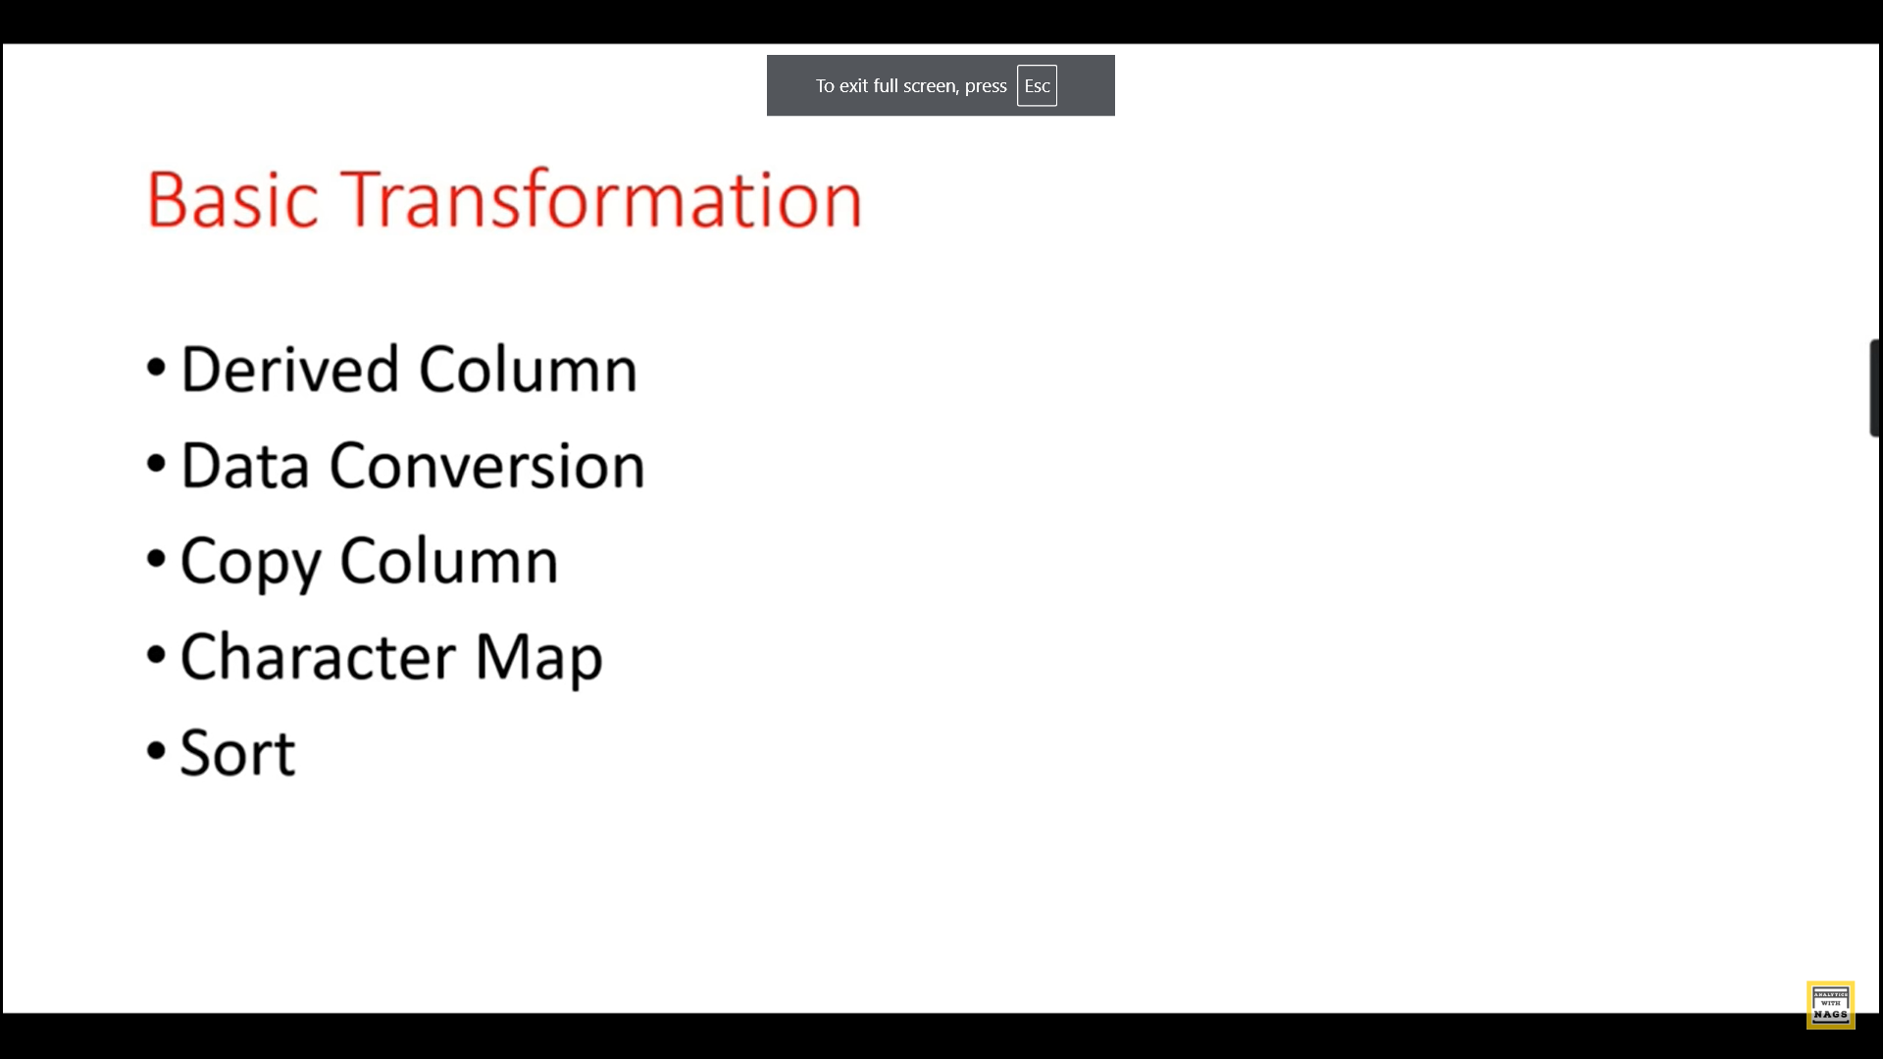
Data flow transformation

