Slide 1
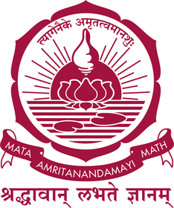

Autonomous Image
Cartoonification
YOLOv8
Object Detection
Using Convolution & Toeplitz Matrix-Based
Filtering in Robot Vision
Toeplitz
Matrix Convolution
K-Means
Authors: Mohan Surendra · Chandana Koduru · Tejaswi Advisor: B. Krithika (Dept. of Mathematics) Institution: Amrita Vishwa Vidyapeetham, Chennai
Color Quantization
Canny
Edge Detection

Slide 2
PROBLEM STATEMENT
What challenge does this research address?
Balancing Act
Uniform Effect Problem
Removing enough detail to appear drawn, while keeping enough to remain recognizable — texture must be removed, color transitions smoothed, but contours preserved.
Existing cartoon rendering applies effects uniformly across the entire frame — unable to intelligently focus on the most visually salient objects.
Computational Overhead
Lack of Mathematical Rigor
Stylizing all detected objects simultaneously in robotic vision systems is counterproductive and computationally wasteful in real-time scenarios.
Prior methods treat cartoonification as pattern matching without formal mathematical grounding, making them non-interpretable and hard to analyze.
2 / 7

Slide 3
What this research achieves
OBJECTIVES
01
Real-Time Cartoonification
Build an autonomous system to cartoonify images in real-time within a robot vision pipeline.
02
Toeplitz Matrix Convolution
Replace standard convolution with LSI-based Toeplitz matrix representation for analytical tractability.
03
Intelligent Region Selection
Use YOLOv8 with a composite weighted scoring function to identify the most salient object per frame.
04
Quantitative Validation
Evaluate stylization quality via Color Simplification Ratio, Edge Preservation Ratio, and MSE-based score.

Slide 4
METHODOLOGY
Mathematical foundations & processing stages
Convolution
Toeplitz Form
Y(i,j) = Σm Σn I(i−m, j−n)·K(m,n)
Y = Tx (T = shift-invariant kernel matrix)
Scoring Function
K-Means Objective
Score = 0.4·Aᵢⁿᵒʳᵐ + 0.3·Cᵢ + 0.3·sᵢ
min Σₖ Σₓ∈Cᵢ ‖x − μᵢ‖²
4-STAGE STYLIZATION PIPELINE
1
2
3
4
Toeplitz
Convolution
Smoothing
Gradient
Edge
Detection
K-Means
Colour
Quantization
Element-wise
Edge
Masking

Slide 5
SYSTEM ARCHITECTURE
Camera
(Live Feed)
YOLOv8
Detection
Weighted
Scoring
Function
Toeplitz
Convolution
(LSI Filter)
Cartoon
Output
K-Means
Quantization
Canny Edge
Detection
QuantitativeMetrics:
Color Simplification Ratio (CSR) | Edge Preservation Ratio (Er) | MSE Structural Score (Sc) | Composite Score S = 0.4·CSR + 0.3·Er + 0.3·Sc

Slide 6
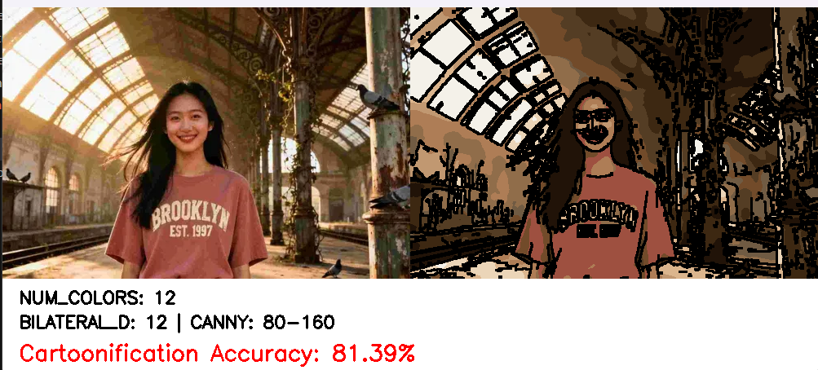
RESULTS & FINDINGS
81.39%
Cartoonification Accuracy
12 Colors
K-Means Colour Clusters
80–160
Canny Edge Threshold
Fig 1. Left: Original Input | Right: Cartoonized Output
✔ Toeplitz smoothing removed high-frequency noise without spatial distortion ✔ Canny edges produced bold, clean cartoon outlines ✔ K-Means achieved flat-shading cartoon aesthetic

Slide 7
CONCLUSION
Mathematically grounded cartoonification framework — every stage has a formal definition.
FUTURE SCOPE
Embedded Deployment
Toeplitz matrix form makes convolution analytically tractable and interpretable.
Port to NVIDIA Jetson series for edge robotic systems.
Adaptive Kernels
Scene-dependent kernel selection for variable lighting.
Composite weighted scoring mimics robotic visual attention — selecting the most salient object.
GPU Acceleration
CUDA-based Toeplitz & K-Means for sub-100ms latency.
Quantitative evaluation confirms good balance of abstraction and structural preservation.
Multi-Object & Neural
Support multiple objects; lightweight neural stylization.

Slide 8
Thank You
Questions & Discussion
Mohan Surendra | Chandana Koduru | Tejaswi

