Slide 1
KEYLOGGER
APSSDC
BHEESETTI
MOHAN

Slide 2

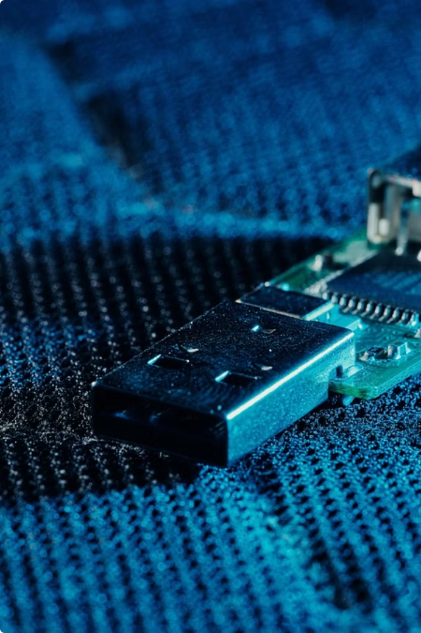
lmokokokokokjihjijiji
Introduction to Keyloggers
Keyloggers are software or hardware tools that record a user's keyboard inputs, including sensitive information like passwords and credit card numbers. Understanding how keyloggers work is crucial for protecting one's digital privacy and security.
by Mohan Bheesetti
MB

Slide 3
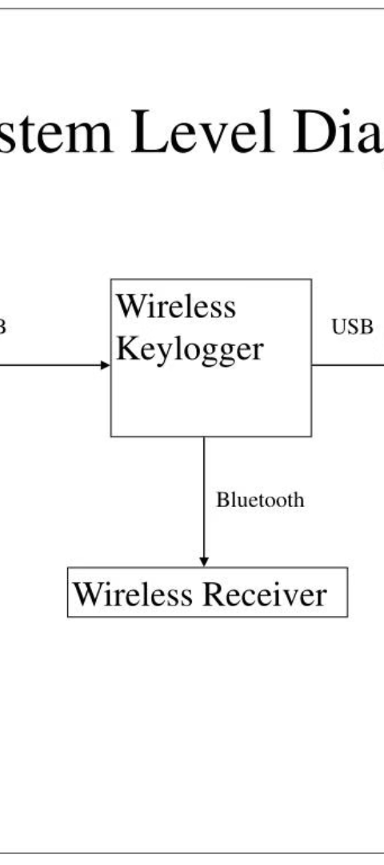
What is a Keylogger?
1
Monitoring Device
2
Capturing Data
A keylogger is a monitoring device that tracks and records every keystroke made on a computer or mobile device.
Keyloggers can capture sensitive information like login credentials, financial details, and confidential messages.
3
Malicious Intent
Keyloggers are often used by cybercriminals to steal personal information for identity theft and financial fraud.

Slide 4
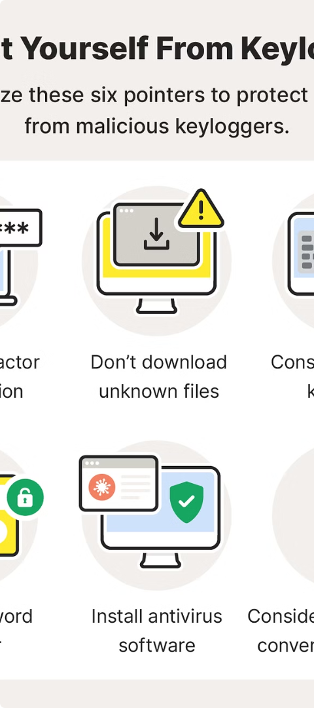
How Keyloggers Work
1
Installation
Keyloggers can be installed as software or hardware devices, often covertly without the user's knowledge.
2
Data Capture
The keylogger records every keystroke, including passwords, credit card numbers, and other sensitive information.
3
Data Transmission
The recorded data is then transmitted to the keylogger's operator, usually through the internet or a physical connection.

Slide 5
Types of Keyloggers
Software Keyloggers
Hardware Keyloggers
Wireless Keyloggers
These are programs installed on a computer that run in the background, recording keyboard input.
These are physical devices that are connected between the keyboard and the computer, capturing data in-line.
These transmit data wirelessly, making them harder to detect and remove than wired keyloggers.

Slide 6
Legitimate Uses of Keyloggers
Parental Monitoring
Employee Monitoring
Keyloggers can be used by parents to monitor their children's online activities and protect them from digital threats.
Employers may use keyloggers to ensure productivity and prevent misuse of company resources.
Forensic Investigations
Personal Security
Law enforcement and digital forensics experts may use keyloggers to gather evidence in criminal cases.
Individuals may use keyloggers to protect their own devices from unauthorized access and information theft.

Slide 7




Risks and Dangers of Keyloggers
Privacy Invasion
Identity Theft
Malware Infection
Unauthorized Access
Keyloggers can compromise the privacy and security of users by stealing sensitive information.
Keyloggers can enable cybercriminals to steal identities and commit financial fraud.
Keyloggers are often distributed as part of malware, putting devices and networks at risk.
Keyloggers can allow attackers to gain remote access to devices and systems.

Slide 8




Protecting Against Keyloggers
Use Anti-Malware
Update Regularly
Avoid Public Computers
Physical Inspection
Keep all software, including the operating system, up-to-date to address security vulnerabilities.
Install reliable antivirus and anti-spyware software to detect and remove keyloggers.
Refrain from entering sensitive information on shared or public devices that may be compromised.
Regularly inspect your devices for any physical hardware that may be a keylogger.

Slide 9

Conclusion and Recommendations
1
Awareness is Key
2
Proactive Measures
Understanding the risks and methods of keyloggers is crucial for maintaining digital security and privacy.
Implement robust security measures, such as antivirus software and physical device inspections, to protect against keyloggers.
3
Responsible Use
Keyloggers should be used only for legitimate purposes, such as parental monitoring or employee productivity, and with the knowledge and consent of all parties involved.

Slide 10
https://github.com/Mohan9581-prog/APSSDC-INTERNSHIP
THANK YOU

