Slide 1


Advanced Tic Tac Toe Game Using Java
Console-Based Application · Object-Oriented Programming
Presented by: [Student Name] | Faculty: [Faculty Name] | [College Name]

Slide 2
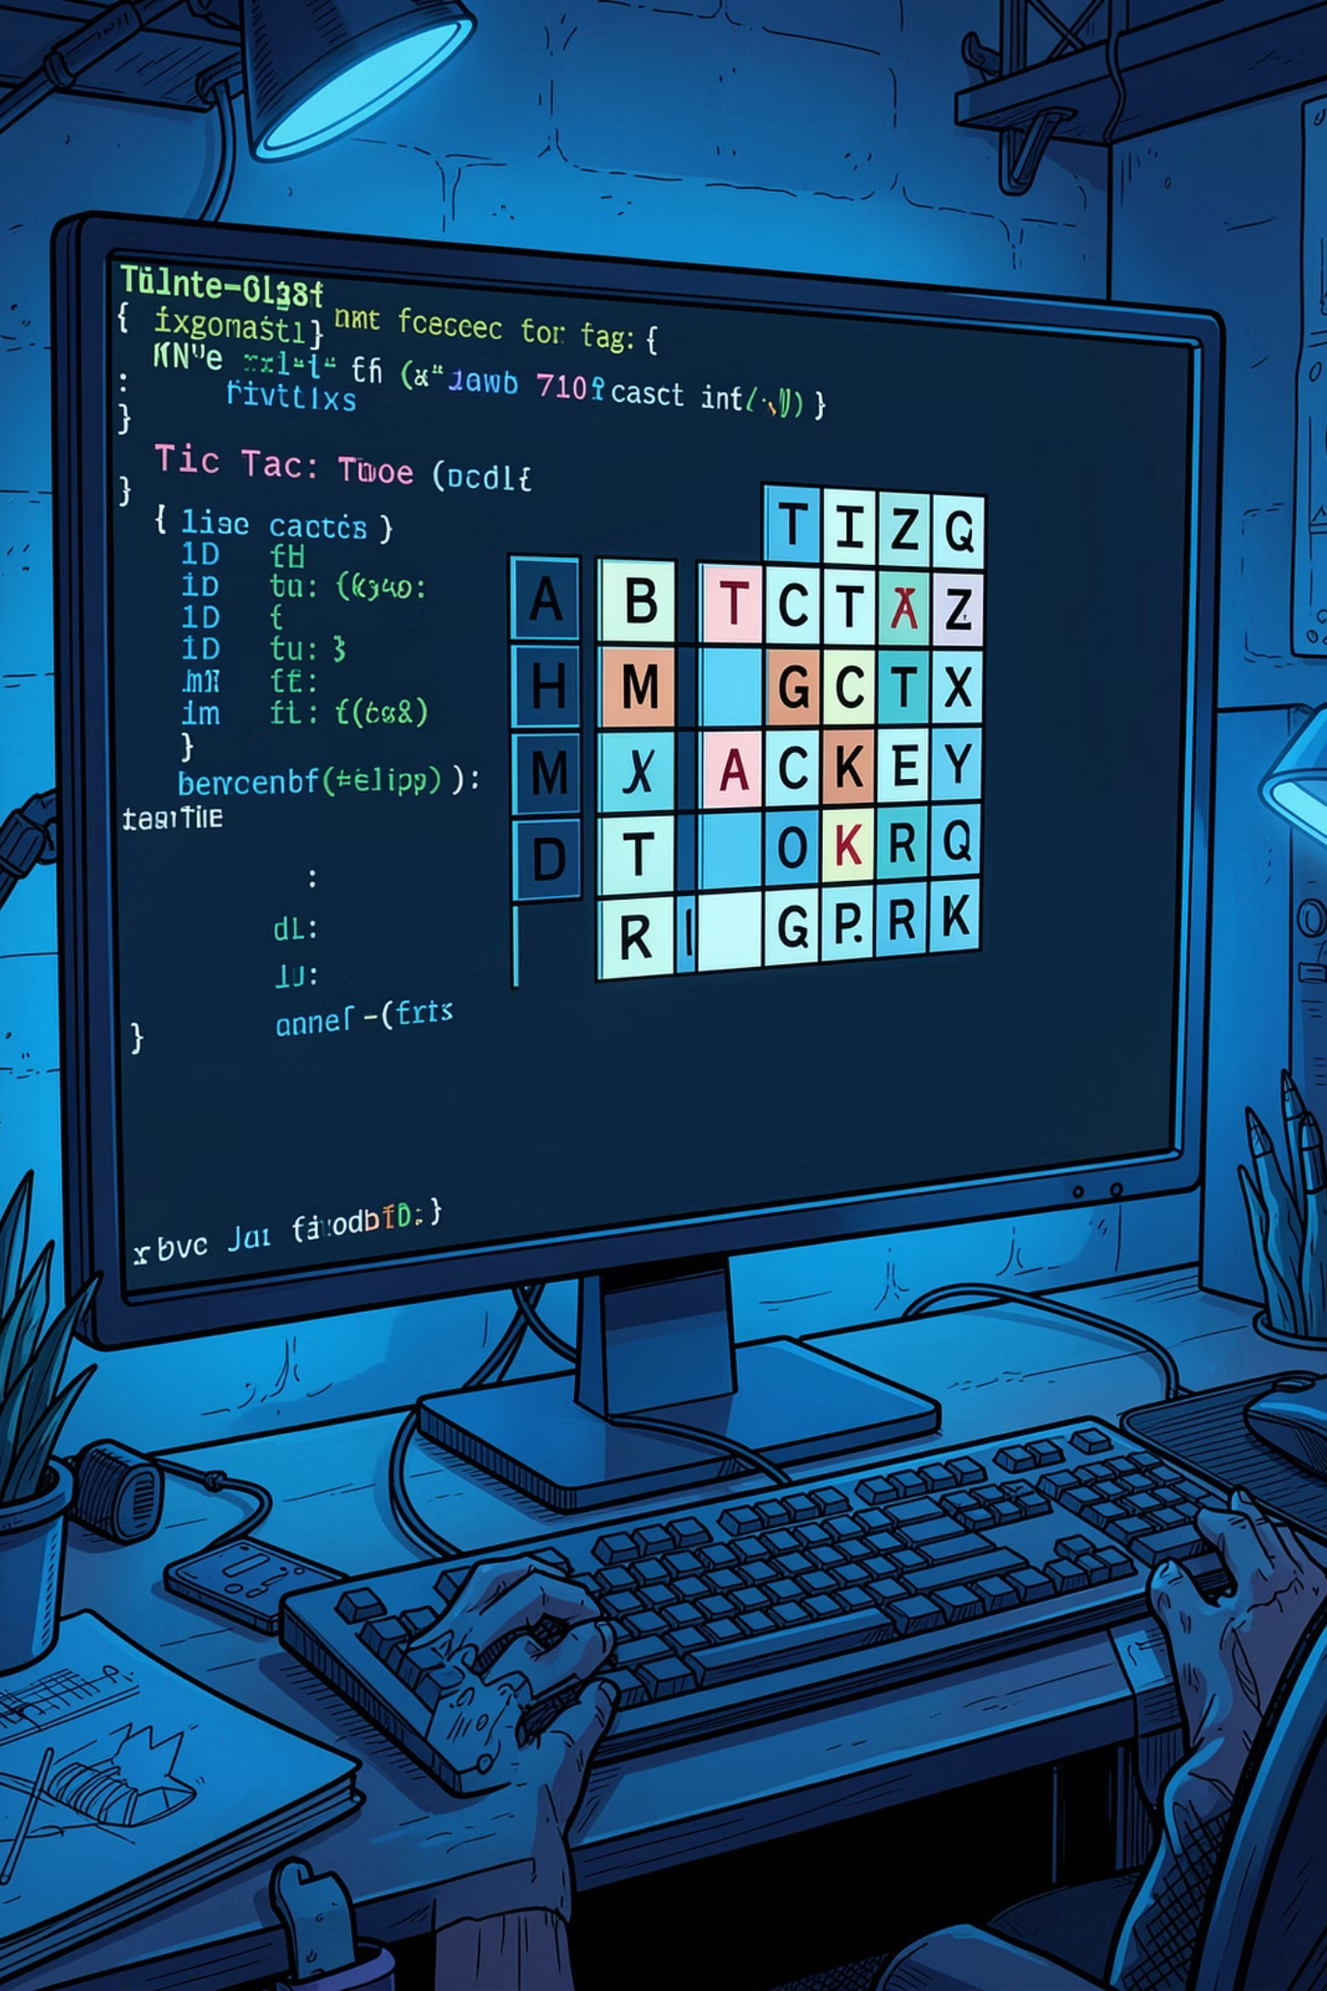
About the Project
A fully functional two-player Tic Tac Toe game built in Java using Object-Oriented Programming principles. Players interact through the console, and the system automatically validates inputs, detects winners, and identifies draw conditions.
🎮 Two Players
✅ Auto-Validation
Alternate turns via console input
Checks moves and win conditions
🏗️ Modular Design
Reusable, well-structured OOP code

Slide 3
Objectives of the Project
1
Two-Player Game
Build a complete interactive game where two players compete through console input.
2
OOP Concepts
Implement encapsulation, abstraction, and class-based design using Java.
3
Input Validation
Ensure all user inputs are safe, valid, and handled gracefully.
4
Win & Draw Detection
Automatically detect winning combinations and draw conditions.
5
Java Proficiency
Strengthen core Java skills through real-world application development.
6
Modular Code
Write clean, reusable, and maintainable code across separate classes.

Slide 4
Technologies Used
Java
Maven
Core language for game logic, OOP structure, and console I/O handling.
Build automation and dependency management for clean project structure.
JUnit
IntelliJ IDEA
Unit testing framework to validate game logic and edge cases reliably.
Professional IDE for Java development, debugging, and code refactoring.

Slide 5
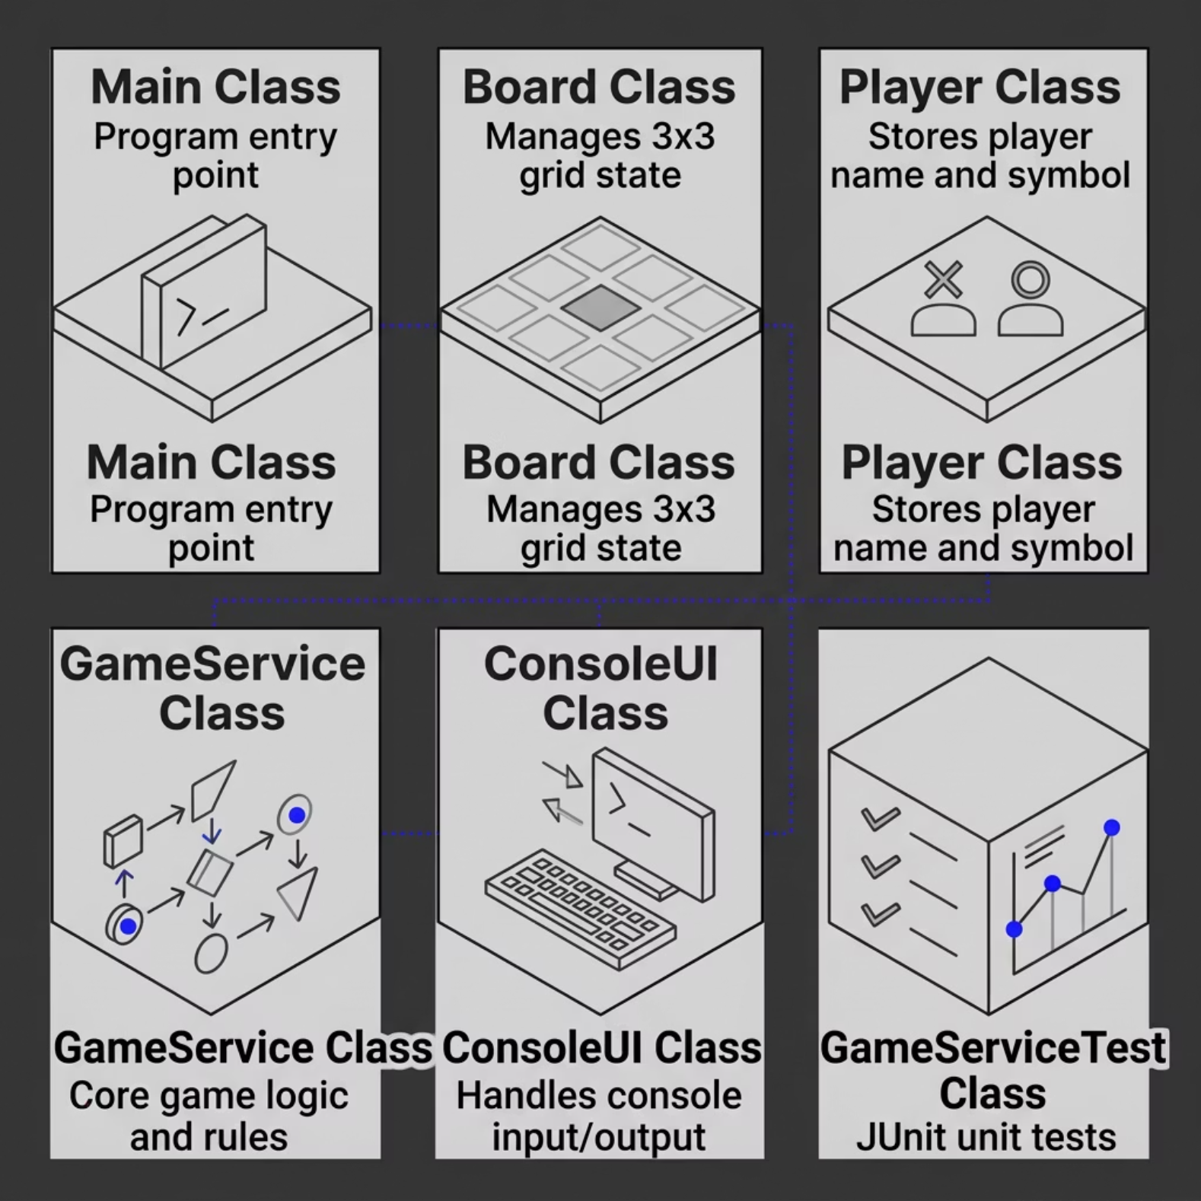


Objects & Classes Used
Class Responsibilities
Main — Launches the application
Board — Stores and updates the grid
Player — Manages player identity
GameService — Orchestrates game flow
ConsoleUI — Reads input, prints output
GameServiceTest — Validates logic via JUnit
Each class has a single responsibility, following the Single Responsibility Principle of OOP.

Slide 6

Working of the Application
Initialize
Input
Update
Finalize
The game loop runs until a winner is found or the board is full. Each phase is encapsulated in its own class method, ensuring clean separation of concerns and easy testability.

Slide 7
Sample Console Output
Below is a live session showing player registration, board display, move input, and winner announcement.
====================================
TIC TAC TOE GAME
====================================
Enter Player 1 Name: Vinay
Enter Player 2 Name: Rahul
| |
--+---+--
| |
--+---+--
| |
Current Player: Vinay
Enter Row: 0
Enter Column: 0
X | |
--+---+--
| |
--+---+--
| |
... (game continues) ...
Winner is: Vinay

Slide 8
Features of the Project
Two-Player Gameplay
Winner Detection
Seamless turn-based competition through console
Checks all rows, columns, and diagonals
Draw Detection
Input Validation
Identifies when the board is full with no winner
Prevents invalid or duplicate moves
Console Interface
Modular OOP Design
Clean, text-based UI for all interactions
Separate classes for UI, logic, and data

Slide 9
Advantages & Future Enhancements
✅ Current Advantages
🚀 Future Enhancements
Beginner-friendly and easy to understand
Clean, reusable code structure
Demonstrates core Java OOP concepts
Fully testable with JUnit
No external dependencies required
GUI Version — JavaFX or Swing interface
AI Opponent — Minimax algorithm for single-player mode
Multiplayer Support — Network-based play
Score Tracking — Persistent win/loss records
Database Integration — Store player stats with JDBC

Slide 10
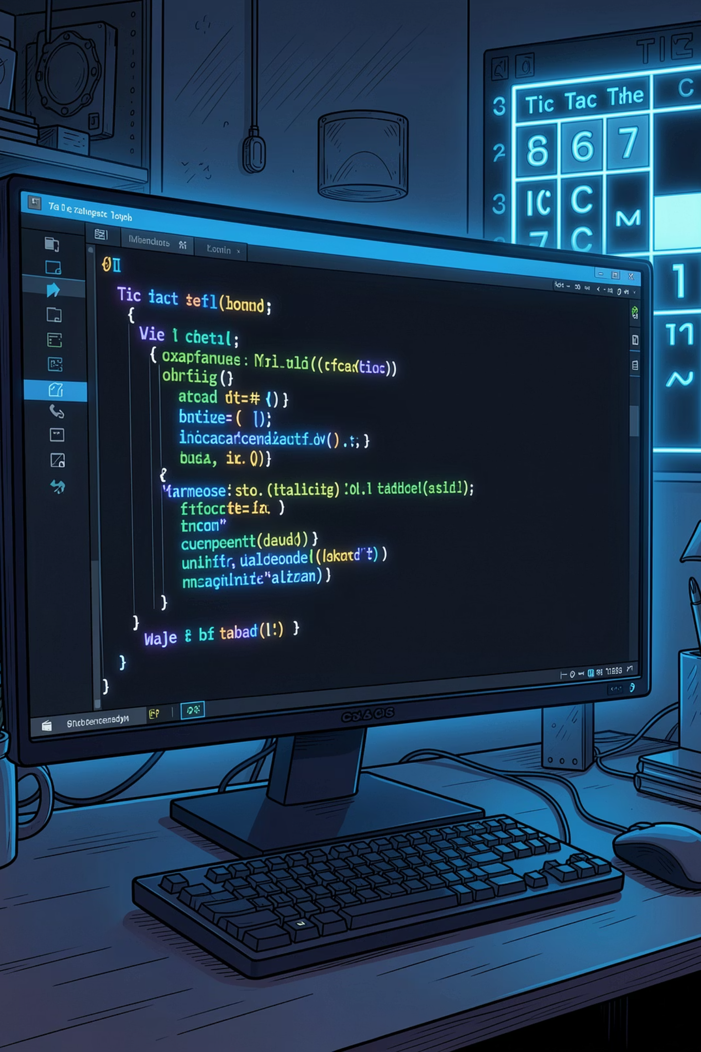
Conclusion
This project successfully demonstrates Java programming proficiency, game logic implementation, and Object-Oriented Design principles in a clean, modular, and testable application. It serves as a strong foundation for more advanced Java projects.
Java Mastery
Clean Architecture
OOP, classes, and logic
Modular & testable code
Game Development
Real interactive application
Thank you for your attention — Questions & Answers are welcome!

