Slide 1


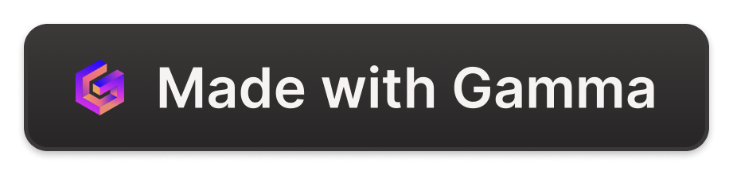
Creating a Phone Book with Python and MySQLite3
Learn how to create a phone book project with Python and MySQLite3 data base and GUI. Connect with your contacts effortlessly.
by Mohan Babu Uttaramalluru

Slide 2
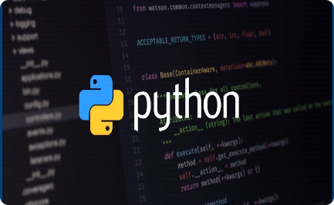
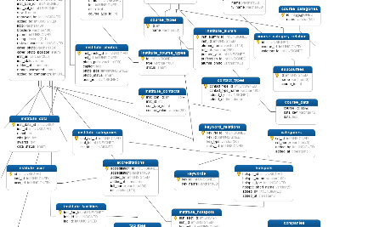
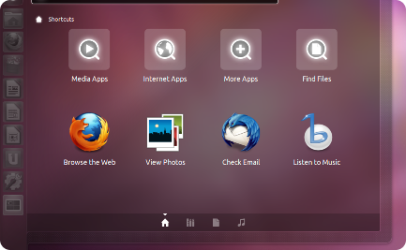
Project Overview
Python
MySQLite3
GUI
Python offers a user-friendly reading syntax, reduces the cost of program maintenance and supports multiple programming paradigms.
MySQLite3 stores data in tables and runs SQL queries which are faster than flat file systems.
GUI makes the phone book user-friendly with ready-to-use features to add, search, update and delete contacts.

Slide 3
Setting Up the Project
Installing Python
Creating a Database Structure
Establishing the GUI Interface
Python is the backbone of the project, download and install it from the official website.
Define the tables in your database and their structure. It ensures that data entered conforms to certain rules.
Use Python modules like tkinter to create the user interface visually.

Slide 4
Functionality of the Phone Book
1
Adding New Contacts
Use the "add contact" button to create a new contact and record details like name, phone number, email address, and other relevant information.
Searching for Contacts
2
You can search by name, phone number or email address. The search function allows you to retrieve records based on the keywords entered.
3
Updating Contact Information
You may want to change phone numbers or email addresses, use the "update contact" button to change the details and save the changes to the database.
Deleting Contacts
4
Use the "delete contact" button to remove an unwanted contact altogether. You can also use a "delete all" button to clear all records from the database.

Slide 5

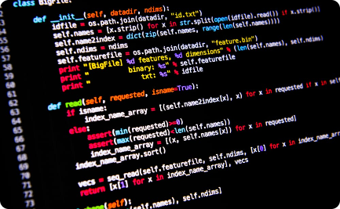

Conclusion
Recap of the Phone Book Project
Benefits of Using Python and MySQLite3
Next Steps and Further Improvements
By using this project as your contact management tool, you can stay organized and updated.
Python and MySQLite3 combination offers flexibility, scalability, and ease of use. You can explore the full functionalities of Python to customize your phone book project.
Expand your project to include functionalities like call logs, text messaging, and importing contacts from external sources. Customize the GUI interface to match your brand and personal style.

