Slide 1


“Movie Ticket Booking Application”
Submitted by: Mohan Geet Chakkani
Submission type : Individual
Name: : Mohan Geet Chakkani
Batch :HDFC API Development program
LMS Id :
Program :HDFC API Development program
Date: 20/04/2023

Slide 2

Table of contents
INTRODUCTION
PROJECT DESCRIPTION
SYSTEM STUDY
EXISTING SYSTEM
PROPOSED SYSTEM
SYSTEM SPECIFICATION
SOFTWARE REQUIREMENTS
HARDWARE REQUIREMENTS
ARCHITECTURE
SPRING
MICROSERVICE
PROJECT ARCHITECTURE
DATA BASE RELATION / ARCHITECTURE
USE CASE DIAGRAM

Slide 3
Project Overview
This project is aimed at developing an online movie ticket booking system website for customers. Online movie ticket booking system is a project developed for booking movie ticket online. This project saves lots of time and reduces the work of the customer . In online movie ticket booking system booking the movie ticket can be done from anywhere and at any time(24*7)
This application will reserve the tickets. This online ticket reservation system provides a website for a cinema hall where any user of internet can access it. User is required to login to the system. User get all the shows playing in the city and cancel ticket any time after booking. Now a days ,everyone has a busy life, and why people have to waste to time standing in the queue for movie tickets. The main purpose of this project is to save peoples time standing in line and to make easy online payments . User can choose the city and select movies which are playing in that city and book ticket easily.

Slide 4
System specification
SYSTEM SPECIFICATIONS
3.1 HARDWARE REQIUREMENTS
The hardware used for the development of the project is:
Processor : Intel or AMD dual core x86 processor.
RAM : 4 GB or above.
Hard Disk : 500 MB of free disk space or more.
3.2 SOFTWARE REQIUREMENTS
The software used for the development of the project is:
Technologies : Spring Boot, & Database
Languages:Java
IDE : Eclipse, Vs code & MySQL Workbench
Operating System : Windows 7/8/10/11, Linux distros, macOS or later.
Backend : MySQL SERVER

Slide 5
4.2 Spring Boot Architecture:
Description:
• The Client makes an HTTP request (GET, PUT, POST, etc.)
• The HTTP request is forwarded to the Controller. The controller maps the request. It
Processes the handles and calls the server logic.
• The business logic is performed in the Service layer. The spring boot performs all the
Logic over the data of the database which is mapped to the spring boot model class through java persistence library (JPA).
• The JSP page is returned as Response from the controller.

Slide 6
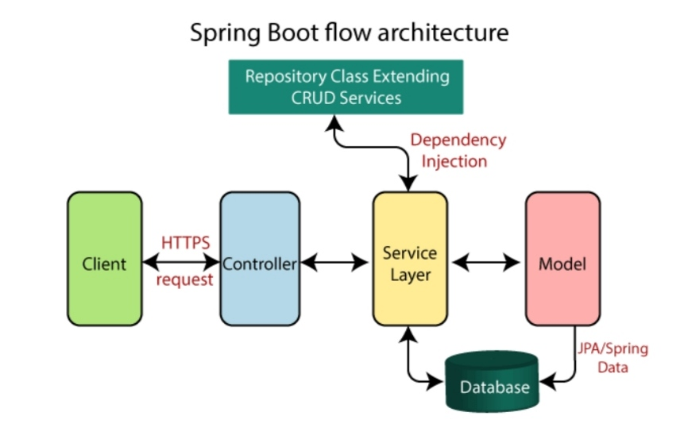
4.2 Spring Boot Architecture:
Description:
• The Client makes an HTTP request (GET, PUT, POST, etc.)
• The HTTP request is forwarded to the Controller. The controller maps the request. It
Processes the handles and calls the server logic.
• The business logic is performed in the Service layer. The spring boot performs all the
Logic over the data of the database which is mapped to the spring boot model class through java persistence library (JPA).
• The JSP page is returned as Response from the controller.

Slide 7
The spring boot consists of the following four layers:
Presentation Layer – Authentication & J Son Translation
Business Layer – Business Logic, Validation & Authorization
Persistence Layer – Storage Logic
Database Layer – Actual Database
4.2.1 Presentation Layer
The presentation layer is the top layer of the spring boot architecture. It consists of views. i.e., the front-end part of the application. It handles the HTTP requests and performs authentication. It is responsible for converting the JSON field’s parameter to Java Objects and vice-versa. Once it performs the authentication of the request it passes it to the next layer. i.e., the business layer.
4.2.2. Business Layer
The business layer contains all the business logic. It consists of services classes. It is responsible for validation and authorization.
4.2.3. Persistence Layer
The persistence layer contains all the database storage logic. It is responsible for
converting business objects to the database row and vice-versa.
4.2.4. Database Layer
The database layer contains all the databases like My SQL. This layer can contain
multiple databases. It is responsible for performing CRUD operations.

Slide 8
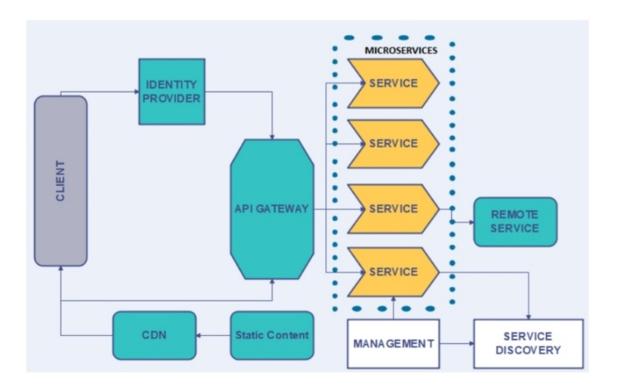
4.3Micro Services Architectures:
Micro service architectures are the 'new normal'. Building small, self-contained, ready to run applications can bring great flexibility and added resilience to your code. Spring Boot's many purpose-built features make it easy to build and run your micro services in production at scale.

Slide 9
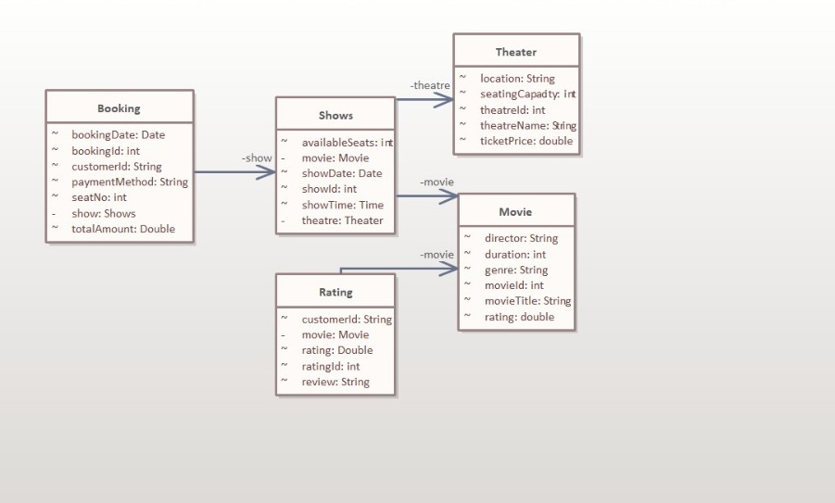
UML Class Diagram

Slide 10
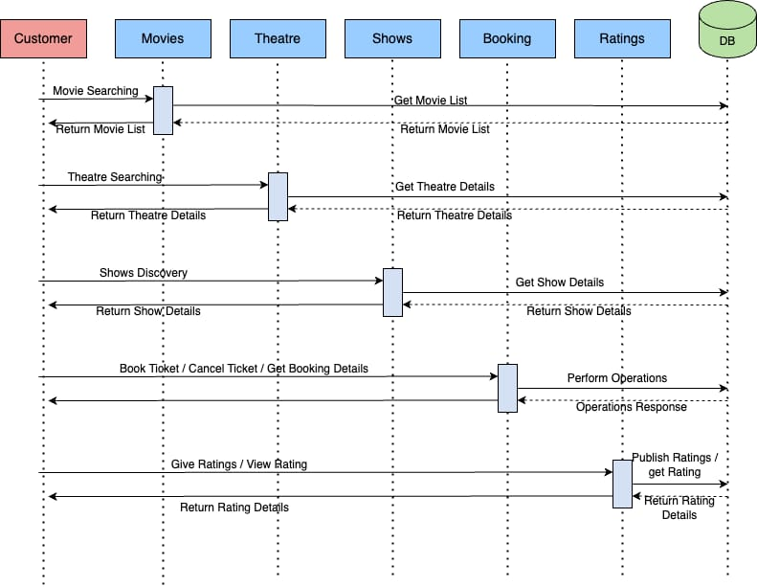
Sequence Diagram

Slide 11
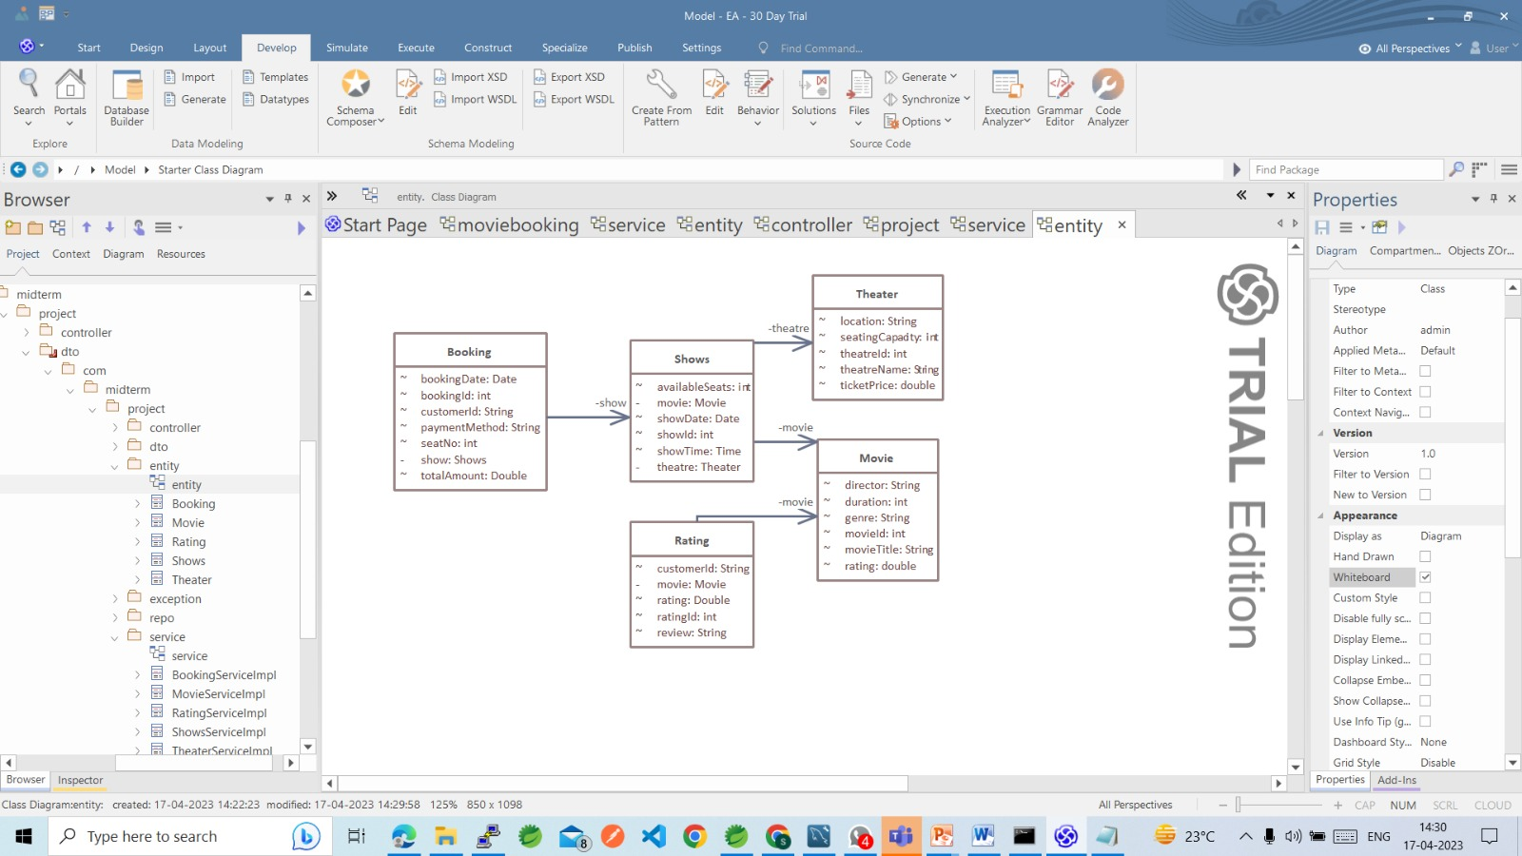
Entity class UML Diagram

Slide 12
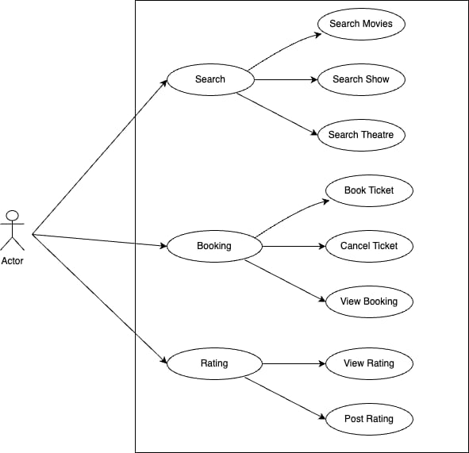
UseCase Diagram

Slide 13
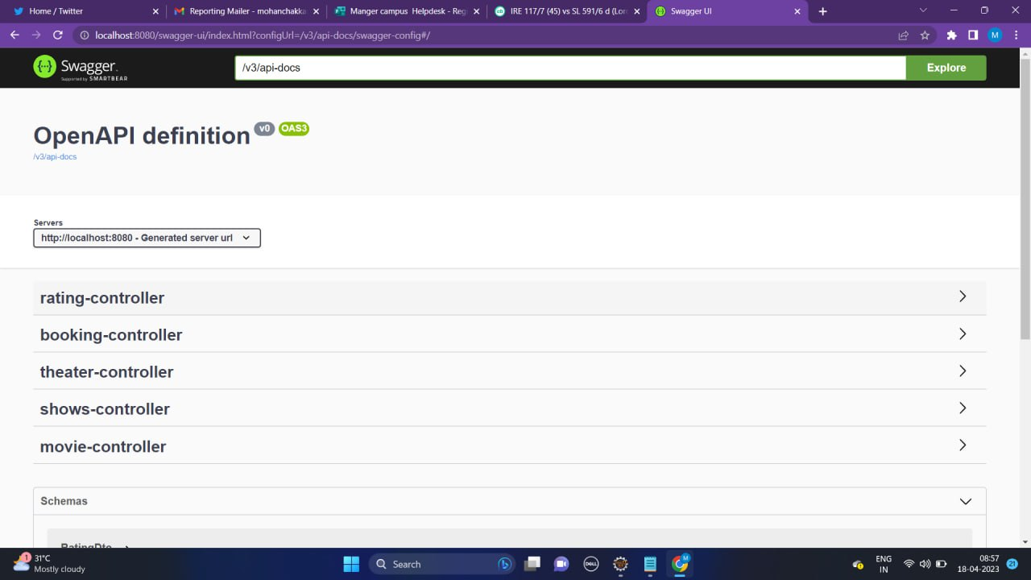

Slide 14
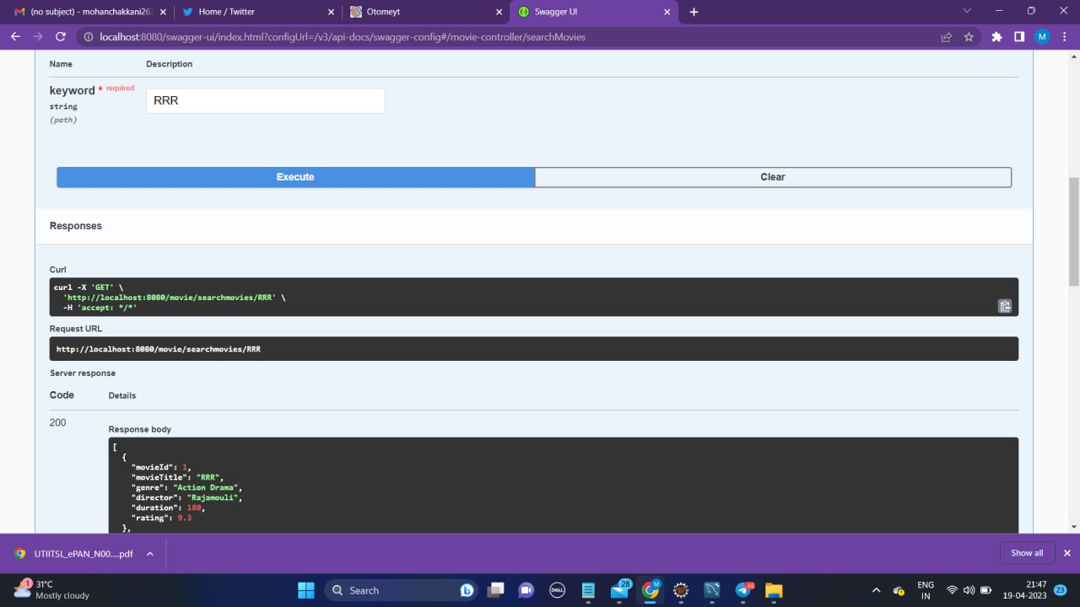

Slide 15
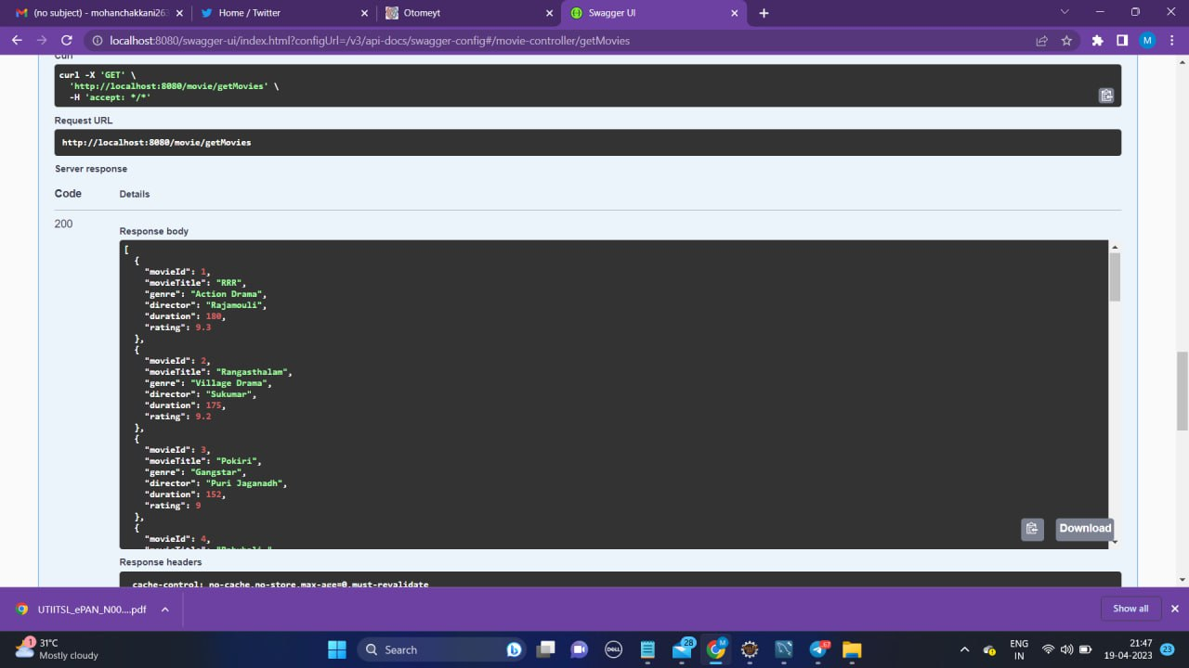

Slide 16
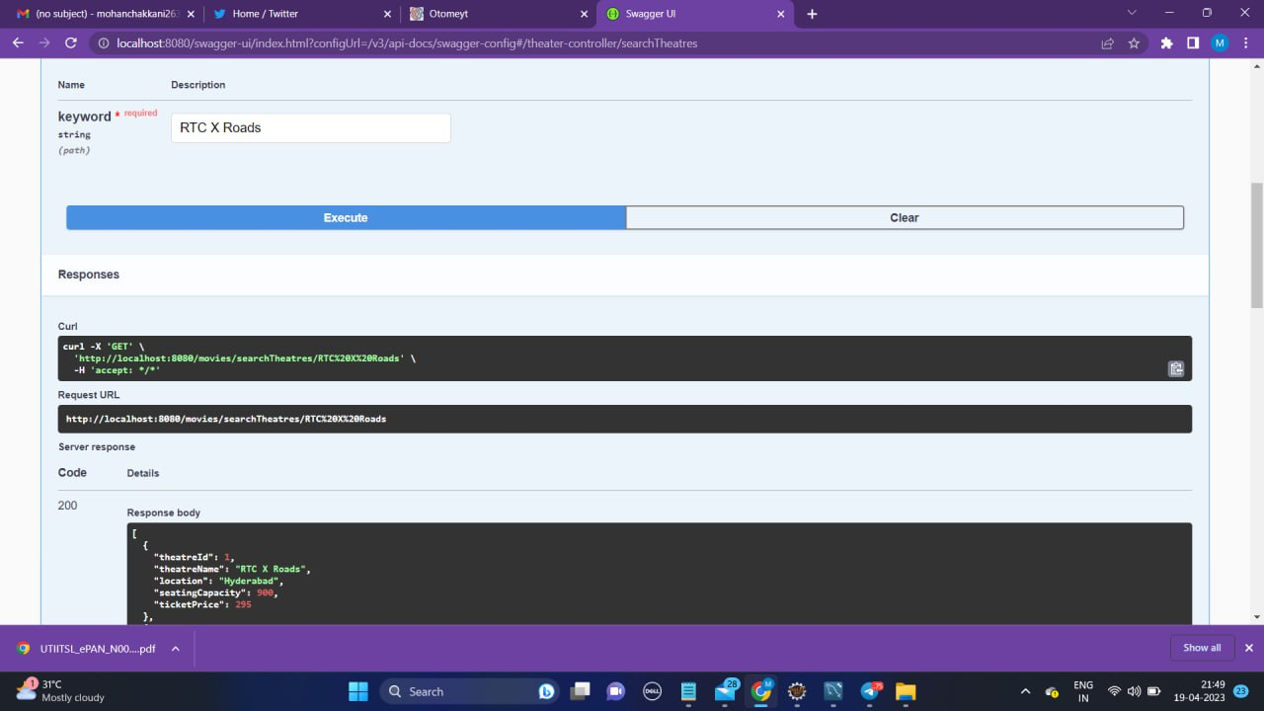

Slide 17
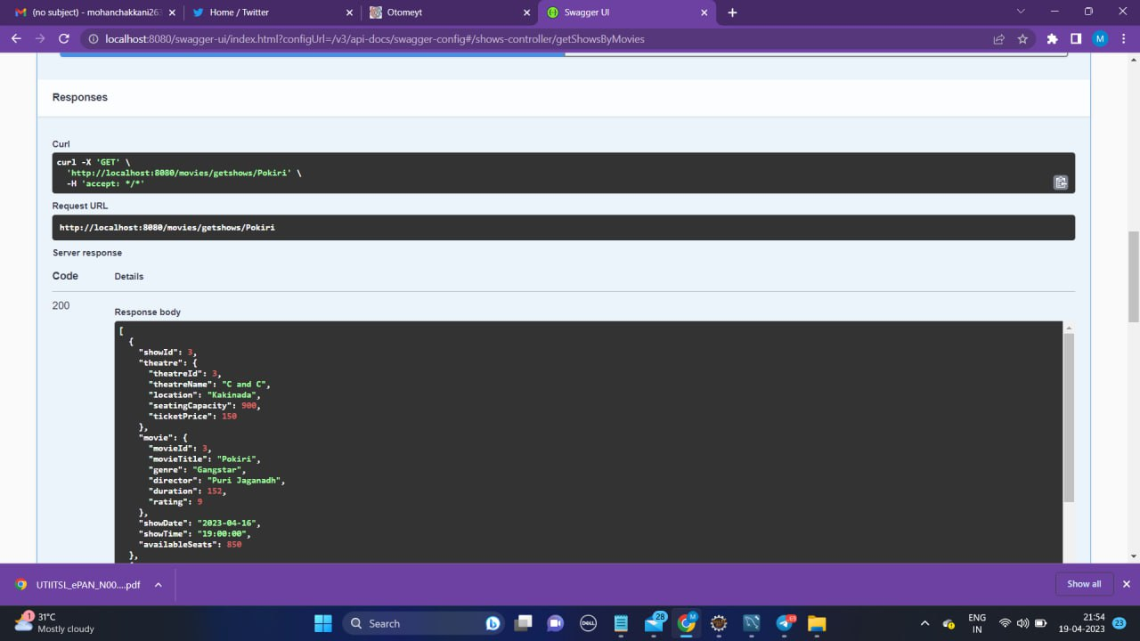

Slide 18
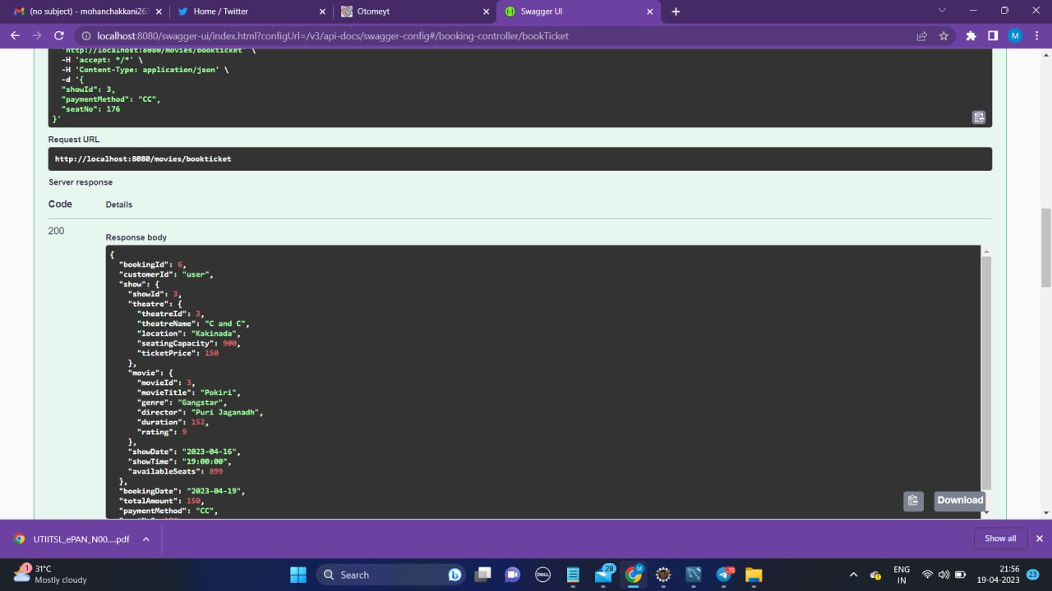

Slide 19
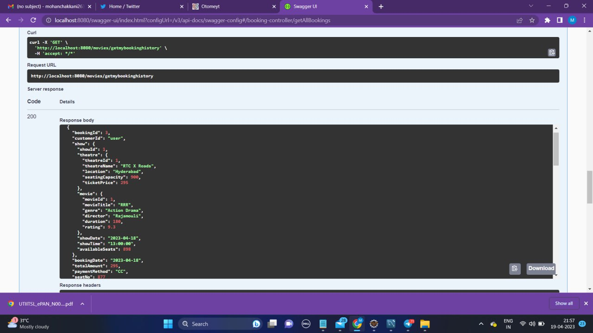

Slide 20
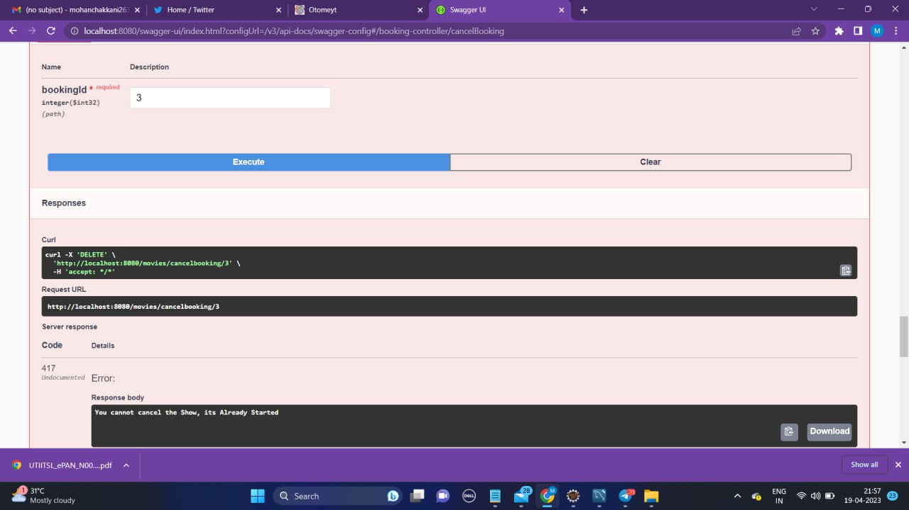

Slide 21
Conclusion
The Movie Ticket Booking Application is an essential requirement for moviegoers to book their movie tickets easily and efficiently.

