Slide 1
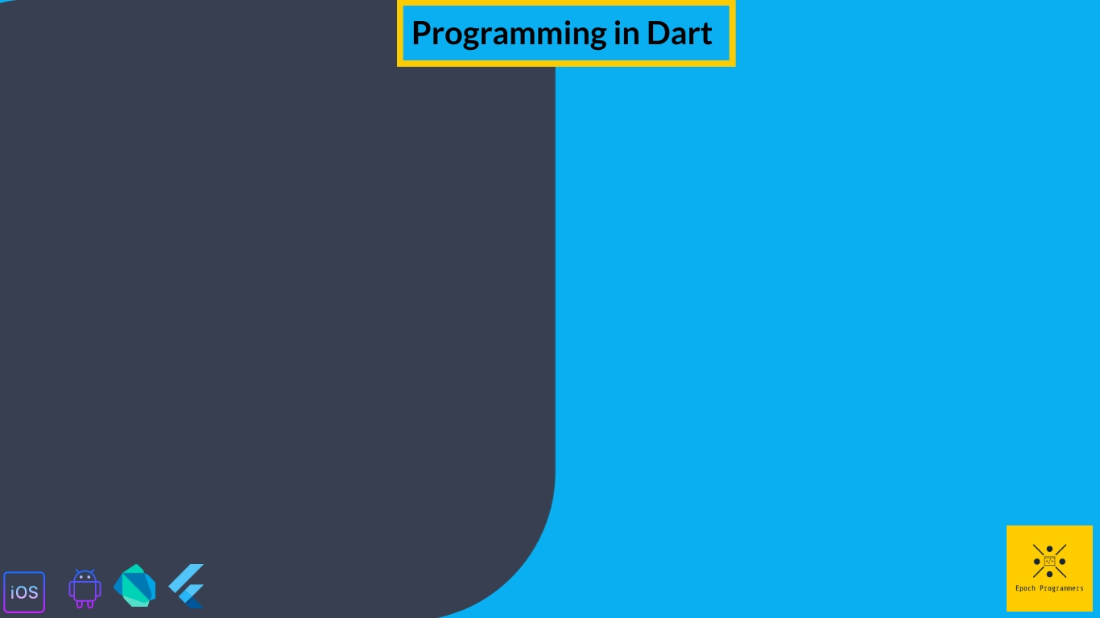
Control Flow Statements

Slide 2
What are we going to learn in this video?
IF and Else Statements
IF and Else Ladder Formats
Conditional Expressions
Switch Case Statements

Slide 3
IF and Else Statements
In IF and ELSE statements IF can be followed by an optional else block. The code inside the IF block is executed if the expression inside if is right else code inside else block is executed.
Syntax:
If(Boolean_expression){
//statement(s) to execute if Boolean_expression is correct
} else{
//statement(s) to execute if Boolean_expression is incorrect
}

Slide 4
IF and Else Ladder Formats
IF and Else Ladder Format is a conditional statement similar to If and Else but here, we check multiple conditions.
Syntax:
If(Boolean_expression 1){
//statement(s) to execute if Boolean_expression 1 is correct
} else if(Boolean_expression 2){
//statement(s) to execute if Boolean_expression 2 is incorrect
} else if(Boolean_expression 3){
//statement(s) to execute if Boolean_expression 3 is incorrect
} else if(Boolean_expression 4){
//statement(s) to execute if Boolean_expression 4 is incorrect
} else{
//statement(s) to execute if Boolean_expression is incorrect
}

Slide 5
Conditional Expressions
Conditional Expressions are short hand for If ElSE statements. They are usually used instead of IF ELSE with single statements inside. There are three formation of conditional statement in dart.
Syntax 1: Condition ? Exp1 : Exp2
Here if the condition is true then Exp1 is executed else Exp2 is executed.
Syntax 3: Exp1 ?? =Exp2
Here if Exp1 is not null then Value from Exp1 is used Else value from Exp2 will be assigned to Exp1.
Syntax 2: Exp1 ?? Exp2
Here if Exp1 is not null then Value from Exp1 is returned Else value from Exp2 is returned

Slide 6
Switch Case Statements
Switch Case Statements are the alternatives to the else if ladder statements. It allows a variable to be tested for the list of values. Whenever the expression value matches with the case value, the body inside that case is executed.
Syntax:
Switch(expression){
case one:
{//statements}
break;
case two:
{//statements}
break;
default:
{//statements}
break;
}

