Slide 1


VENUE RESERVATION PLATFORM
Project Members:
Hisha Maharjan (161714)
Krishiyana Bhakta (161718)
Rabina Pradhan (161727)
20th March 2020
1

Slide 2
OUTLINE OF PRESENTATION
Background and Introduction
Problem definition
Objectives
Significance
Scope & Limitation
Methodology
Technical Description
Project task & Schedules
Expected outcome

Slide 3
BACKGROUND AND INTRODUCTION
Venue Reservation Platform is related to the complete systematic arrangement of all activities related to booking of the venue based on budget specified within the nearest location.
This application provides a suitable platform for both the user & service handlers by providing all the information required by the customer to book a venue in one single platform.
Picture and detail information of the venue is provided for the benefit of the customers.

Slide 4
PROBLEM DEFINITION
People get tired from searching appropriate banquets or hall according to their requirement but with this project they don’t have to travel from one place to another.
Time availability of the customers and the owners may be different which cause the time consumption issues as well.
The records are difficult to store in manual system, uneconomical & time consuming but this platform makes it easier to store records.

Slide 5
OBJECTIVE
To make the workload simple for customers to book a venue for an event they need to search for it without visiting actual place.
To provide Single platform to get and set all the information about the available venues.

Slide 6
SIGNIFICANCE
It works 24*7 regardless which day of the week it is hence it increases the number of venue booking.
Hassle free management of booking as the clients don’t have to travel from one place to another for booking.
Easy promotion of the venue sites where the customers can choose the venue according to their requirements.

Slide 7
SCOPE & LIMITATIONS
The scope of this project are:
Online viewing of reservation information.
Email verification code.
Vendor login (B2B).
The limitations of this project are:
Customers can reserve only single venue at a time.
It will be available in mobile platform only.
Can only show location of certain range.

Slide 8
METHODOLOGY
We have planned to work on following methodologies for the application of knowledge, skills, tools, and techniques to a broad range of activities in order to meet the requirements of our project
Software Development Life Cycle: Increment Model
This model combines linear sequential model with the iterative prototype model. New functionalities are added as each increment is developed. The phases of the linear sequential model are: Analysis, Design, Coding and Testing.

Slide 9
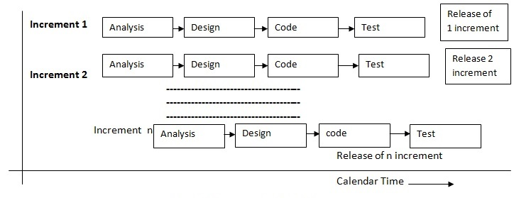
METHODOLOGY
Figure 1:Incremental model

Slide 10
METHODOLOGY
Analysis All the necessary requirements are collected and we analyze whether the proposed project is feasible or not
Design In this phase, the requirement specification from the first phase are studied and the system design is prepared. We design our system using different diagram such as use-case, sequence diagram, ER diagram.
Coding In this phase, coding is done according to the design and a working system is developed by the end of this process. We use flutter for frontend and Python, Django, PostgreSQL for backend
After the software is developed, it is tested and the necessary feedbacks are collected from the users
a. Deployment of system
b. Maintenance

Slide 11
TECHNICAL DESCRIPTION
Technologies to be used:
Python and Django for backend development
Postgresql for database
Flutter for frontend development
Tools to be used:
Edraw, draw.io For designing diagrams
Android studio Android development platform
Microsoft Word For documentation
GitLab Control versioning and managing teamwork

Slide 12
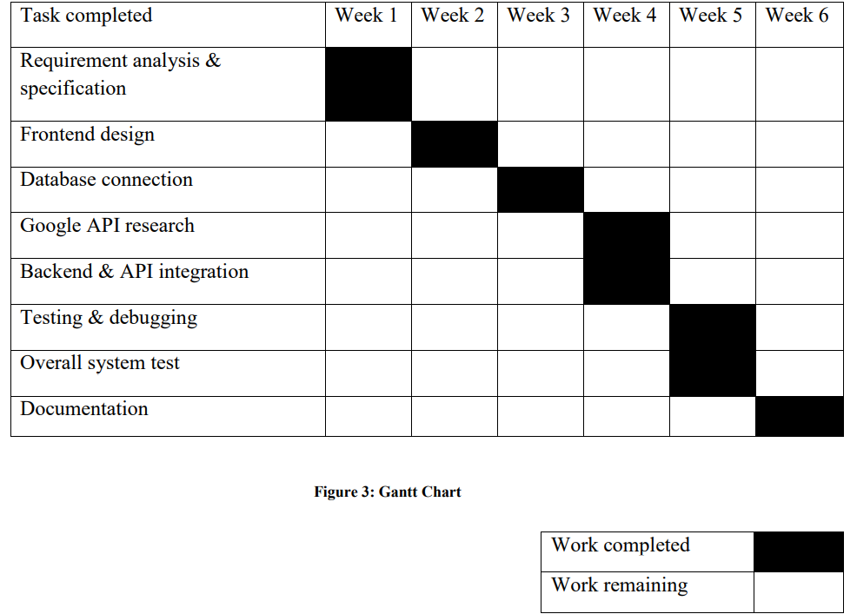
PROJECT TASK & SCHEDULES
The project tasks involve, requirement analysis, front end development, google API research, backend and API integration, testing and debugging , overall system test and final documentation

Slide 13
EXPECTED OUTCOME
Our project at its final phase will able to provide customer with a platform from where they can easily reserve venue under their budget within their nearest location. In this application the customer need not go anywhere he/she can just get all information about venues in a single click.

Slide 14
THANK YOU

