Slide 1


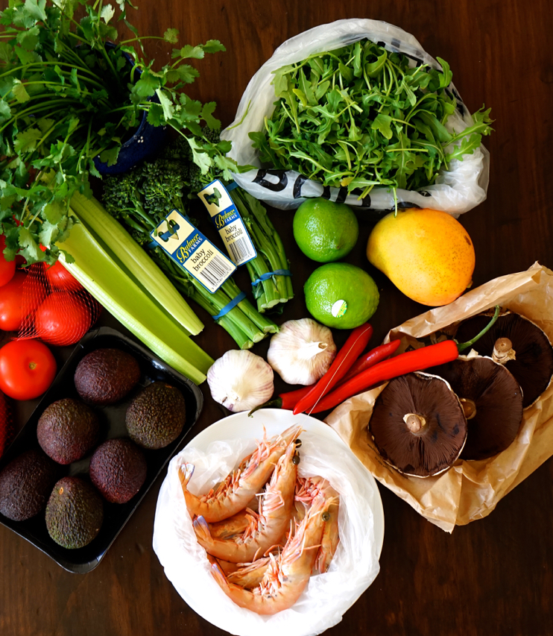
Swasthya-Pala:
An Expert Meal Planning Agent with Forward Chaining for Diabetics Specific to Nepal​
Participants:
Jitendra Bhatta, 161747
Ghanshyam Joshi, 161613
Mohan Kumar Dhakal, 161657
1
1

Slide 2
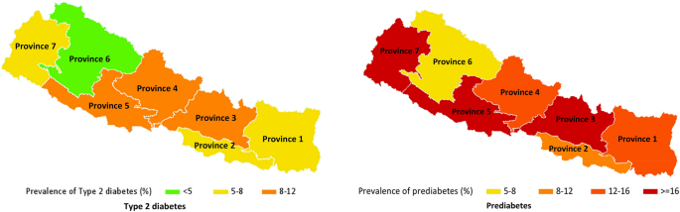
Introduction
Affects 15% people of age more than 20 years
19% of people of more than 40 years of age
Predicted to reach around 1,238,000 by 2030 in Nepal.

Slide 3
Objective
Custom meal plan for diabetics considering nutritional need.
Diabetics track their blood sugar level and warn them when caution needs to be taken.​
Predict probable blood sugar without using glucometer.
Notification System to family members

Slide 4
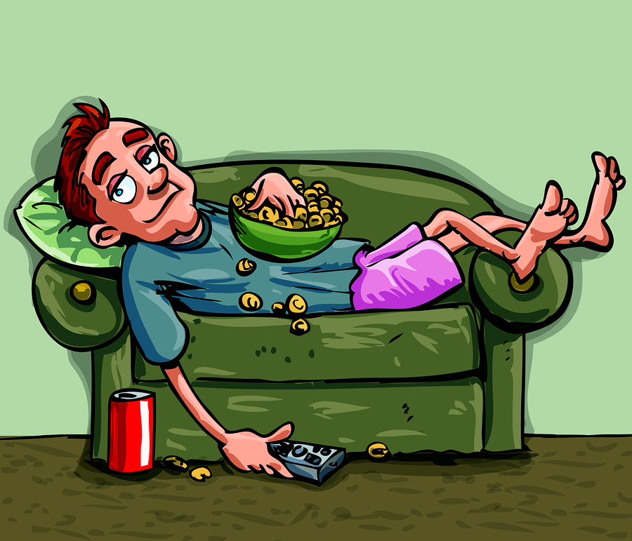
Problem Statement
Unhealthy eating habits
Unmanaged and Busy life
Lack of Food related knowledge

Slide 5
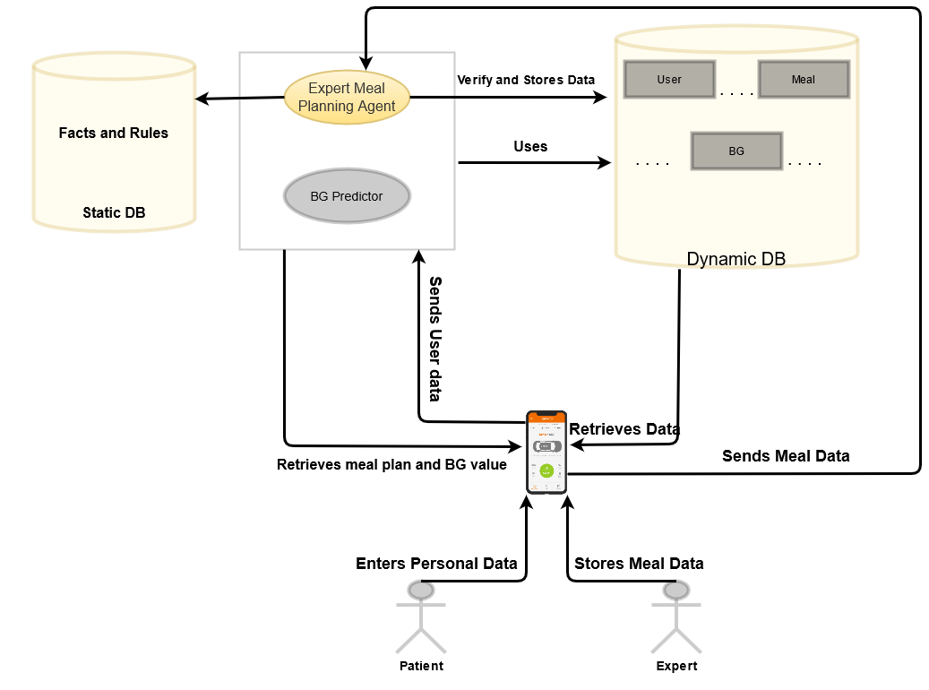
System Architecture

Slide 6
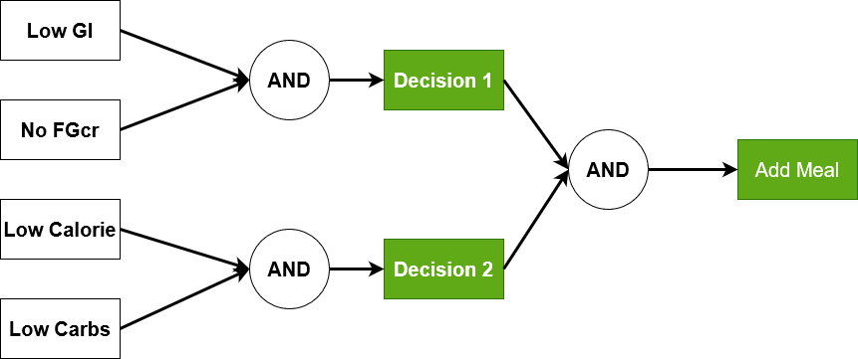
Expert Planning Agent
Fig. Forward Chaining

Slide 7
Scope
Major focus on Type-2 diabetes
Meal recommendation is based on Nepalese Cuisine
Deals with balance macro nutrients
Works on android platform

Slide 8
Limitation
No insulin tracking mechanism.
Meal which will be recommended by the app is not expert certified.
Lack of certified datasets.
Does not deal with micronutrients

Slide 9







Tools and Technology to be used

Slide 10
PROJECT TIME AND TASK SCHEDULE
Tasks | Projected Duration(Days)
Research, Planning and Documentation | 15
Database Schema Design | 2
Data collection, refinement, Facts and Rule Building | 10
Expert System Building, Server-side coding, Regression model preparation | 20
Documentation and testing | 3
Application Coding | 10
Documentation | 4
 | 64 days

Slide 11
Roles and Responsibility
Work | Name
Flutter/Expert System Implementation | Mohan Kumar Dhakal
Machine learning/Knowledge acquisition and Representation | Ghanshyam Joshi
Middleware Server Implementation/ Documentation | Jitendra Bhatta

Slide 12
Drools
It is a business rule management system with a forward and backward chaining inference-based rules engine, more correctly known as a production rule system.

Slide 13
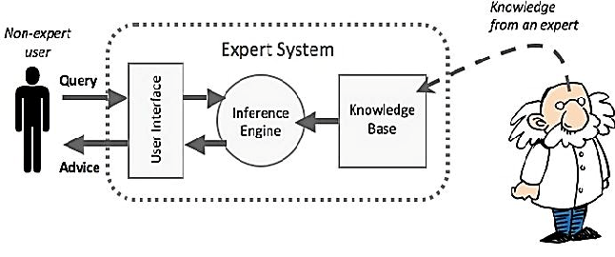
Expert System Implementation

Slide 14
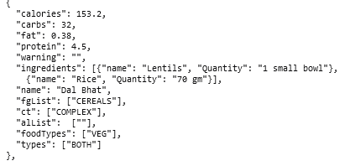
Result And Discussion
Fact Example

Slide 15
Rule Example
rule "Dinner Choosen based on calorie and carb"
agenda-group "dinner-plan"
when
pf:Profile()
bf:Meal(carbs<=pf.getCarb(),calorie<=pf.getCalorie())
then
bf.referenceCountD=bf.referenceCountD + 1;
update(bf);
end

Slide 16

Future Extension
Exercise
Lifestyle Recommendation
Insulin tracking mechanism

Slide 17

Any Questions?

