Slide 1
Minor Project Final Defense on
Nutritional Information extraction using Mask-RCNN deep learning model with food images

Slide 2
Project Members
BE.Software
Mohan Kumar Dhakal, 161756
Sumit Paudel,161752
Keshav Kunwar,161749`
Jitendra Bhatta,161747

Slide 3
Facts
According to WHO almost 20% of deaths worldwide are attributable to an unhealthy diet. 39% of adults aged 18 years and over were overweight in 2016, and 13% were obese.

Slide 4
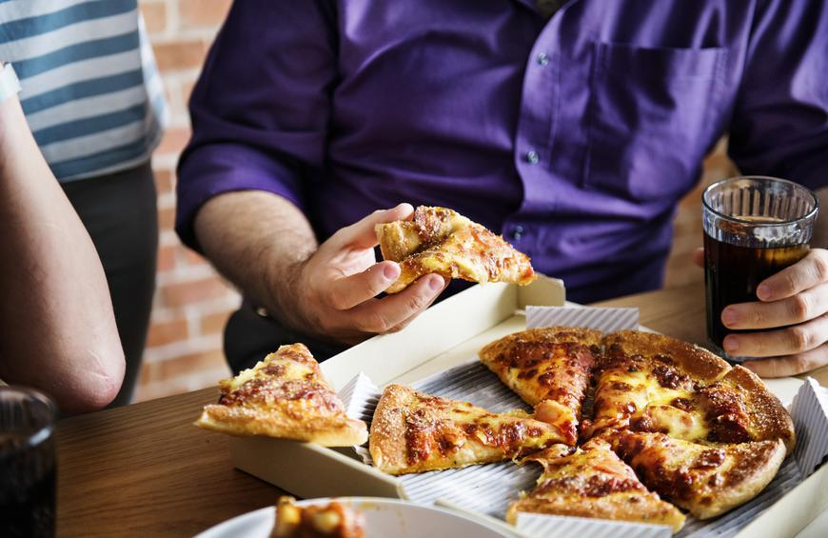
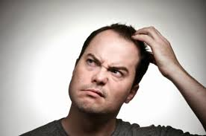
What’s the problem?
I will take care of my nutritional intake.
Forgot what I ate and no idea about nutrition and stuff???

Slide 5
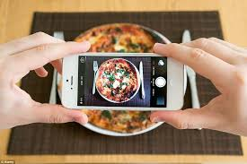
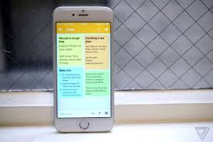
Why not being smart?
Take Image
Edit,Save and review the Nutritional value predicted by app.

Slide 6
What does our project do ?
Provide critical nutritional information about the food consumed based on the image provided.
Allow customization of nutritional value and for wrong prediction in case happened.
Provide periodic nutrition report about the food consumed .

Slide 7
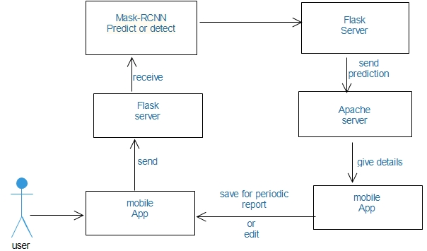
Behind the scenes??

Slide 8
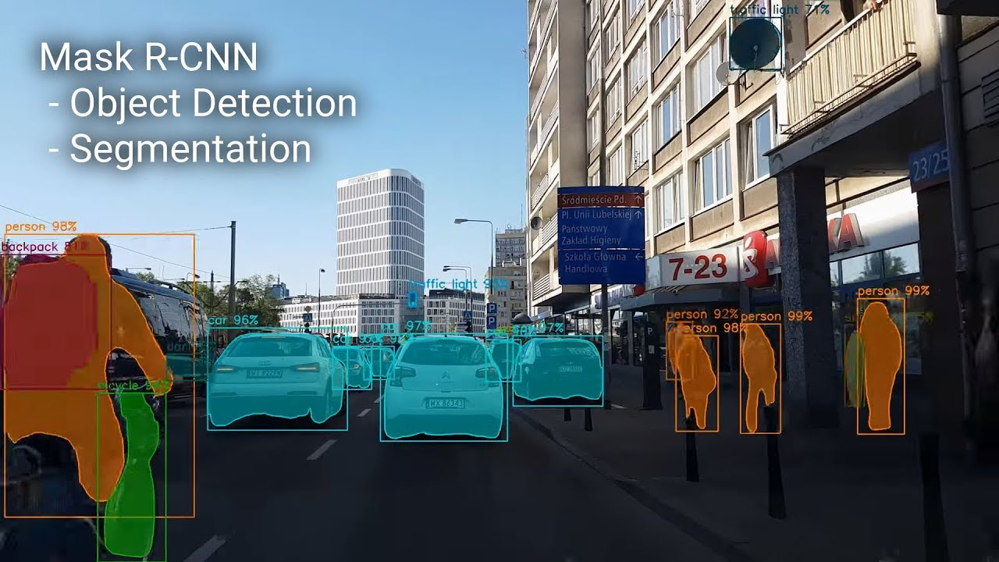
How we process image and predict?

Slide 9
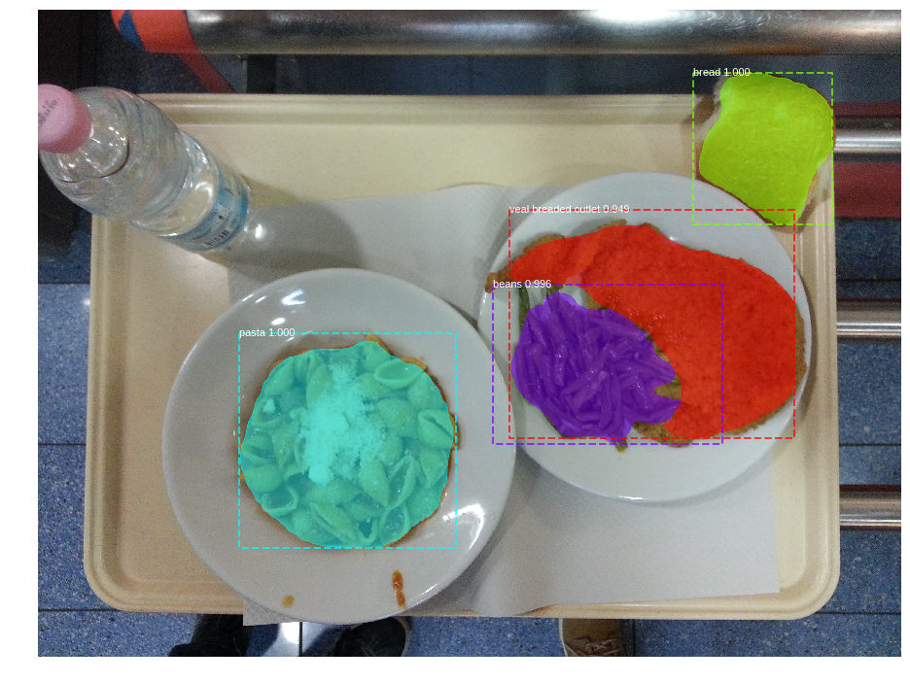
How masking happens?

Slide 10
Data Collection and cleanup
Image Stack (320)
Train Data(256)
Test Data(64)

Slide 11
How do we get prediction result?
The neural network being used by our application is trained on the desktop, and will run for every image sent by the mobile application for the detection in the server .
MySQL database server will provide additional macro information about the food predicted which is hosted on the server.

Slide 12
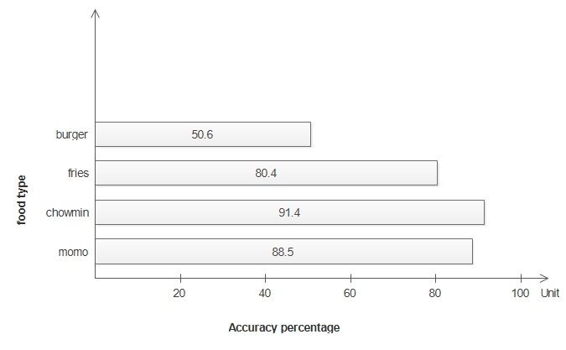
Prediction Accuracy with 60 images

Slide 13
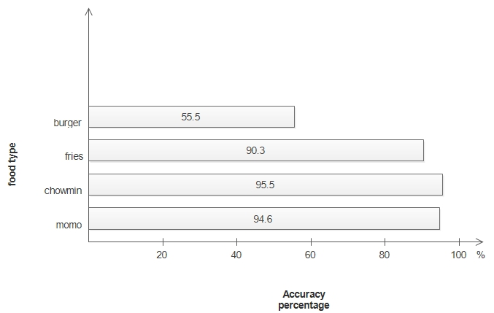
Prediction Accuracy with 80 image each

Slide 14
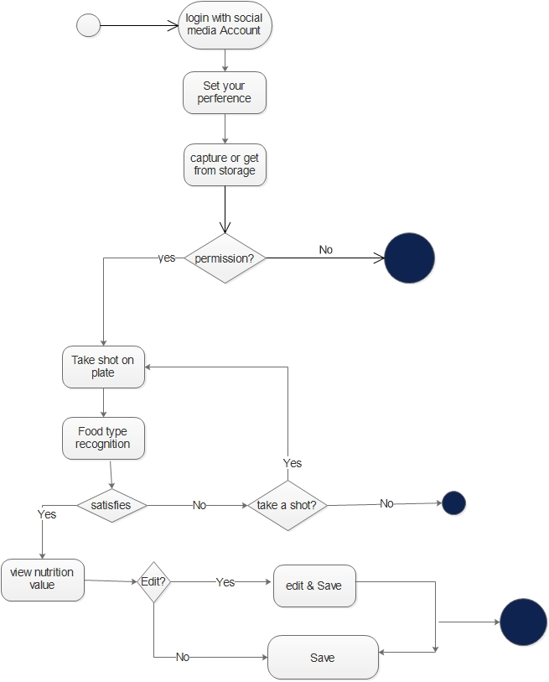
Activity Diagram

Slide 15
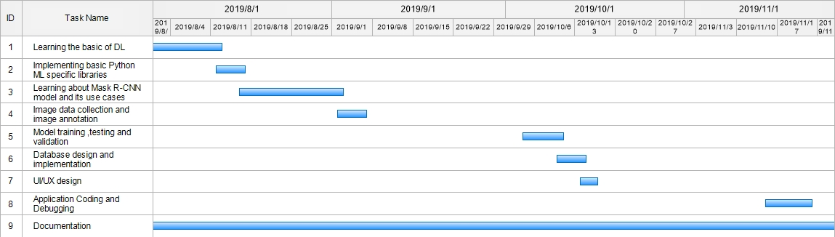
Gantt Chart

Slide 16
Tools and Technology we used
Java( Core)
Android Studio,Vscode and PyCharm.
SQlite,MySQL
Adobe XD.
Python and Flask
PHP

Slide 17
Future Extension
More food will be added in the stack.
Extension of datasets for increasing accuracy.
AI based recommendation system on how to organize the diet based on preference.
Health related blogging for engaging user experience.

Slide 18
DEMO

