Slide 1


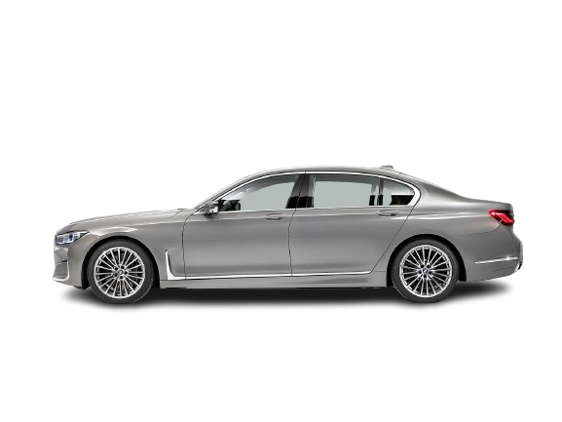
CONTROL THEORY & RADAR SENSOR FOR ADAS

Slide 2


#
#
#
#
#

Slide 3
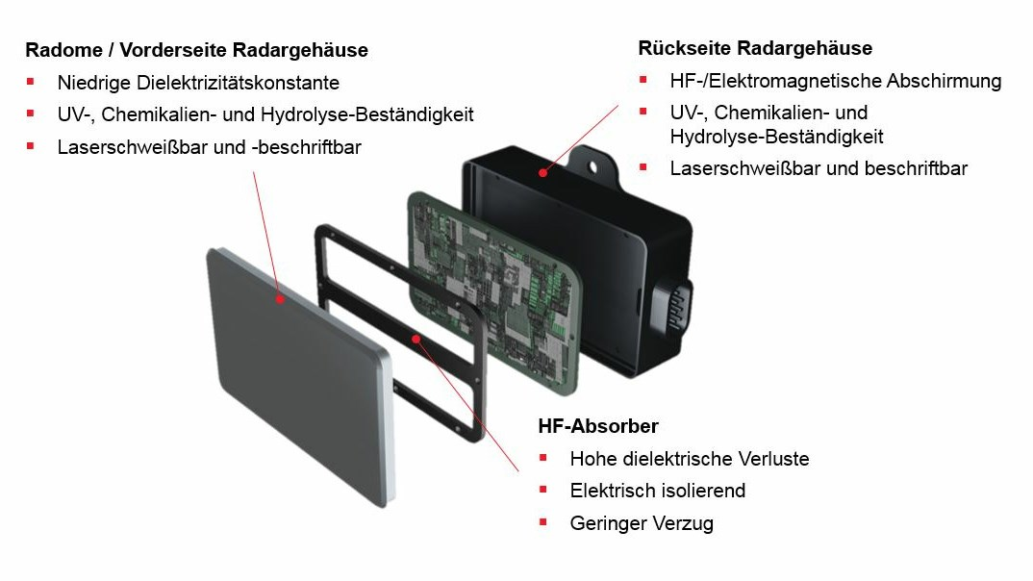
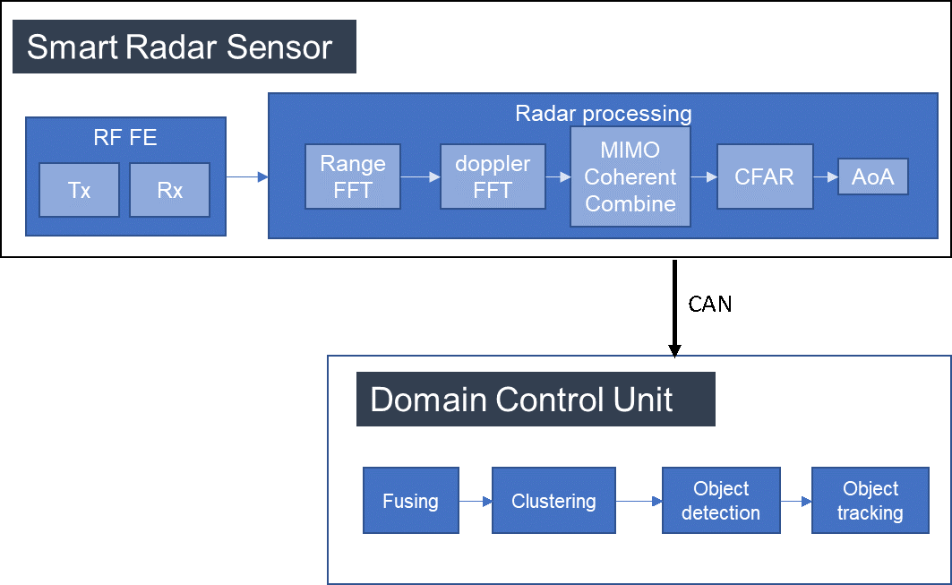
# RADAR SENSOR

Slide 4
#

Slide 5
5

Slide 6
#
6

Slide 7
#

Slide 8
# MULTICLASSIFICATION OF FOOD TYPES

Slide 9
Danke! THANK YOU! धन्यवाद!
9

