Slide 2
What is CAN bus?
CAN is a simple protocol used in manufacturing and in the automobile industry.
- What is protocol
“A communication protocol is a set of rules for exchanging information over a network.”
CAN became the standard protocol in U.S. since 1996
Every Simple system in vehicle follow CAN

Slide 3
How does CAN bus transfer data
CAN runs on two wires: CAN high(CANH) and CAN low (CANL). In idle mode, both wires are 2.5V。 Differential wire bus
When transmitting data. The wires either add or subtract 1V (3.5V or 1.5V).
The two lines generate 2.5 V differential voltage.(?)
Differential signaling is fault tolerant to noise.(?)
Sensors and ECUs use transceivers to check and ensure both signals are triggered.

Slide 4
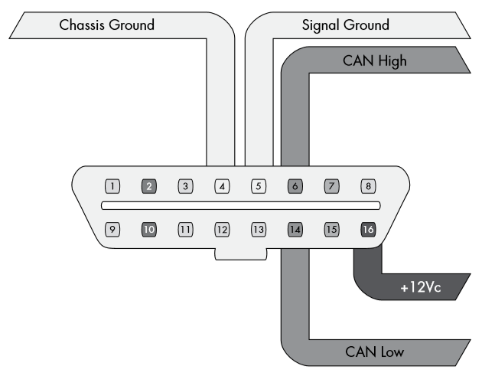
OBD-II connector
Communicates with the vehicle’s internal network.
Pins 6 and 14 are for standard high-speed CAN lines.
Other pins are used for mid-speed.

Slide 5
CAN Bus Packet Layout
Standard Packets
Extended Packets
Similar to Standard Packets but have larger space to hold IDs.

Slide 6
Standard Packets
Arbitration ID: identify which device is going to communicate with
Identifier extension (IDE): always 0 for standard CAN
Data length code(DLC): size of data (0-8)
Data: up to 8 bytes. Some systems force 8 bytes.
Any controllers on the same network see every packet.
The packet don’t carry information about which controller (or attacker) sent what. (?)

Slide 7
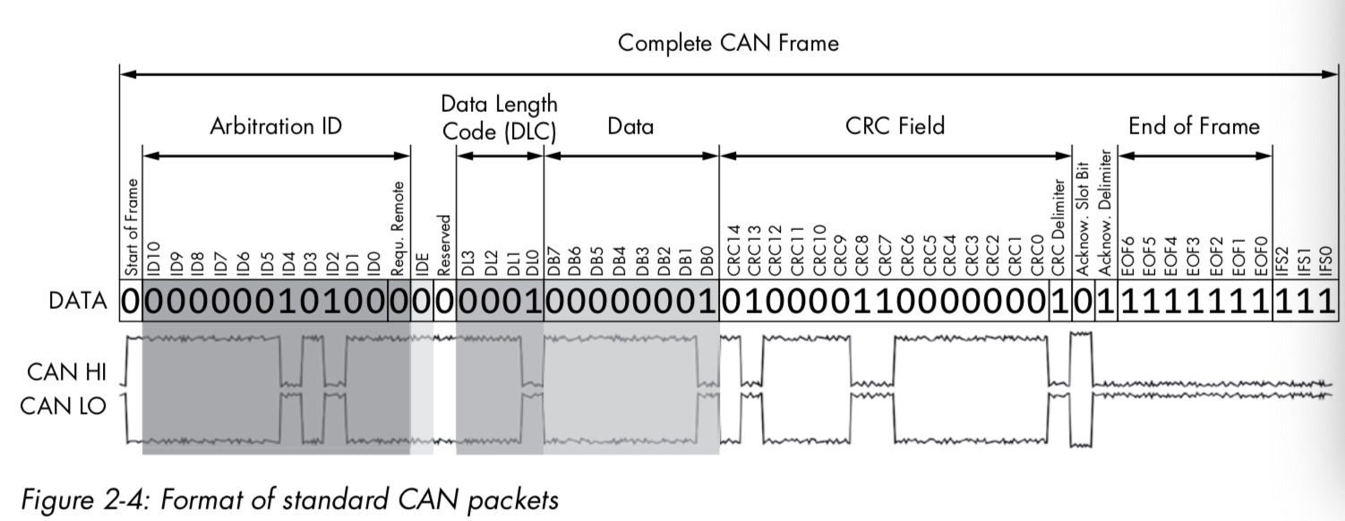

Slide 8
Extended Packets
Can be chained together to create longer IDs.
Designed to fit inside standard CAN formatting to maintain backward compatibility.
Replace remote transmission request (RTR) with substitute remote request (SRR) and set to 1.
Set IDE to 1
Have a 18-bit identifier as the extend of the first standard 11-bit identifier.

Slide 9
An abstract view of the controllers
Every ‘node’ has a filter to determine whether to receive the data or not.
filter
Message

Slide 10
The working principle of CAN Bus
When one node sending out a message, all nodes on the CAN Bus will listen to the message.
Every node would assume the messages are in standard form or in extend form.
If the message can not be decoded, the Bus will report the error.

Slide 11
CAN BUS
If node A send the message, both B and C will receive that message. And the filter in the two nodes would decide to decode the message or ignore the message.
A
B
C

Slide 12
The priority in CAN Bus
If two nodes begin the transmission at the same time. The node with higher priority will get access to the CAN Bus.
The attribute ID reflects the priority, lower attribute ID has higher priority.

Slide 13
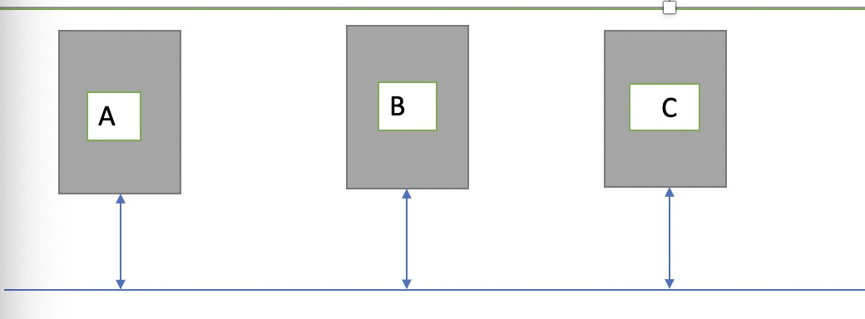
If node A and B send message at the same time and A’s message has higher priority. A will first send the message.

