Slide 1
RAG(Retrieval-Augmented Generation)

Slide 2

Components of RAG
Retriever
The retriever fetches relevant documents or data from an external knowledge base or database (e.g., a Chroma DB or vector database).
Example: For a chatbot about movies, the retriever might pull plot details or actor information from a movie database.
Generator
The generator is typically a language model (e.g., GPT, BERT) that uses the retrieved documents as context to generate coherent, relevant responses.
Example: Using retrieved information about a movie, the generator might create a detailed summary of its storyline.
Knowledge Base/Source
This is the external data repository where information is stored, such as a vector database, SQL database, or plain text documents.
Example: A library's catalog or Wikipedia articles stored as embeddings.
Query Processor
The query processor refines user inputs and matches them with the relevant data.
Example: Translating a user query, "Tell me about AI," into a specific search, like "Artificial Intelligence overview from trusted sources."

Slide 3
Standard RAG:
Convert the data into embeddings, Store them in vector Database, Retrieves the relevant data from the knowledge base based on the user prompt and generates the response without additional validations or enhancements.
Use Case: General-purpose Q&A systems, customer support bots.
Data(Structured & Unstructured)
Chunking and embeddings
Retriever
LLM(Generator)
Response
Vector-Database
Query

Slide 4
Corrective RAG:
Corrective RAG identifies potential errors in the initial responses and corrects them using additional retrievals or models. Example: An academic assistant ensuring sources cited are accurate.
Use Case: Medical systems, legal advisors
Vector-Database
Validate(Corrective Mechanism)
Data(Structured & Unstructured)
Chunking and embeddings
Retriever
yes
LLM(Generator)
no
Query
Response

Slide 5
Speculative RAG:
This RAG specializes in handling unique or niche datasets, catering to highly specific domains. It ensures retrieval from domain-specific repositories and uses tailored generation methods.
Use Case: Technical Documents.
Targeted Retrieval: Fact-Checking Specific Claims
Speculative Generation: Draft Writing
Revision: Refining the Draft
Prompt

Slide 6
Fusion RAG: Combines multiple sources of retrieved information (structured and unstructured) to generate a cohesive response. It fuses data from diverse sources for a comprehensive output.
Weighted query Results
Retriever
Query Result 1
Fusion Result
Query
Retriever
Query Result 2
Response
retriever
Query result 3

Slide 7
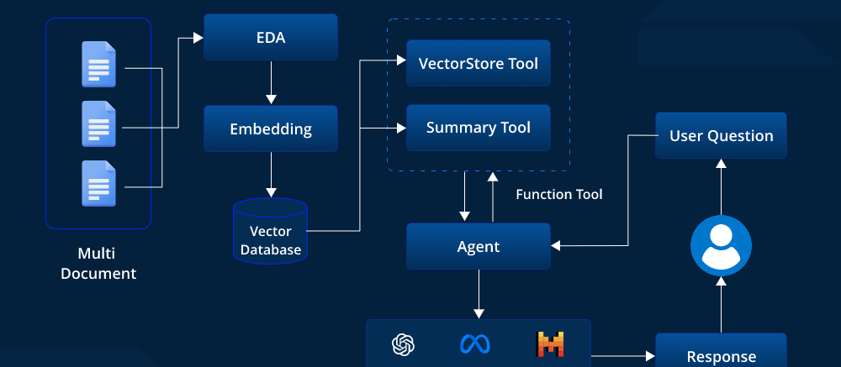
Agentic RAG:
An advanced RAG system that integrates decision-making capabilities. It operates with agents that can initiate tasks, interact with multiple tools, and self-improve based on feedback loops.
Delegates tasks to external agents for responses.
Use Case: complex task handling, project management.

