Slide 1
Dandelion or Not? A deep learning model
Revathi, Francis, Ophelia, Mohan

Slide 2
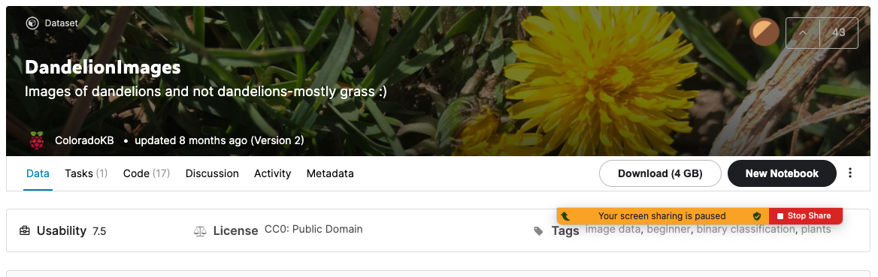
Project Goal
Develop a deep learning model to predict if an image contains dandelion
Data obtained from Kaggle
1200+ images of dandelions and other
Stored in AWS S3

Slide 3
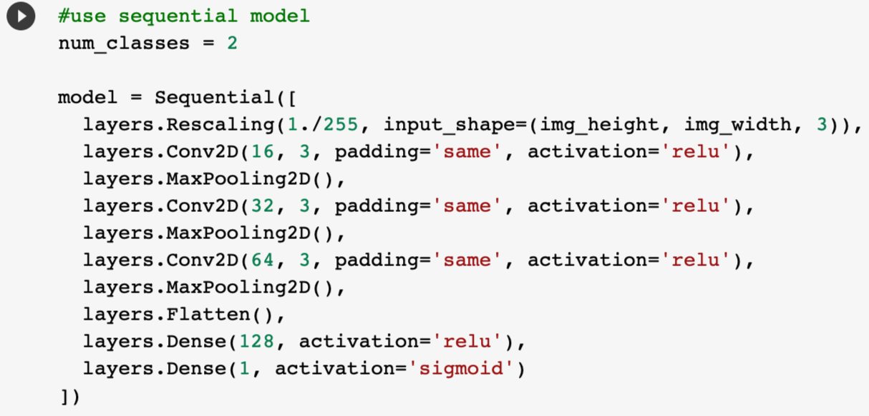
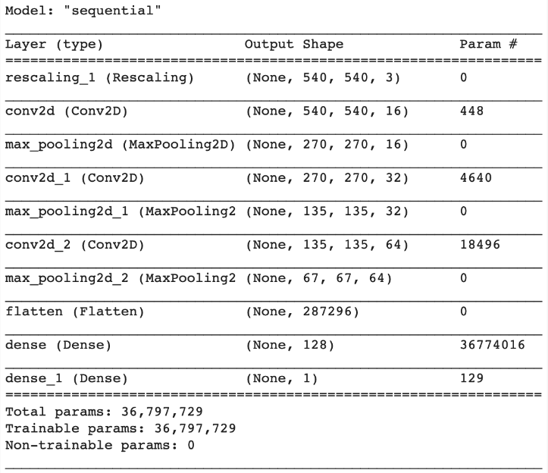
Classification Model
Neural Network Model with 3 convolutional blocks
Image scaling (540 ✕ 540)
ReLu and Sigmoid activation
Tried 6 model variants
Number of layers
Epochs (chose 7)
Dropout, Augmentation

Slide 4
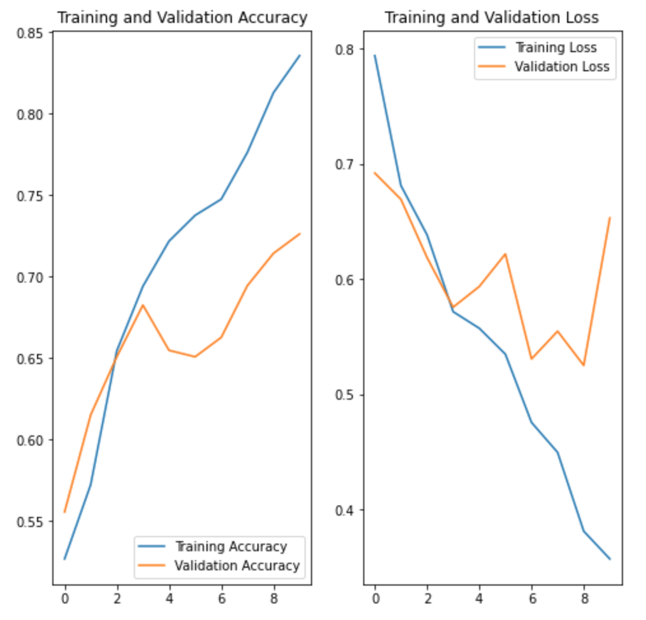
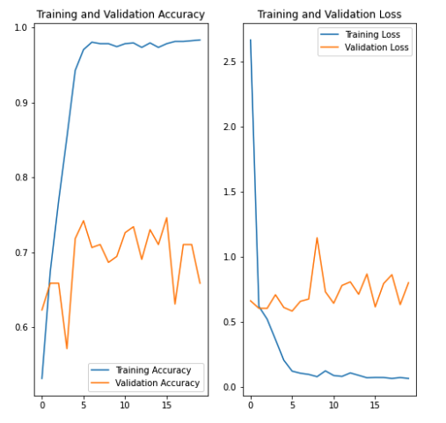
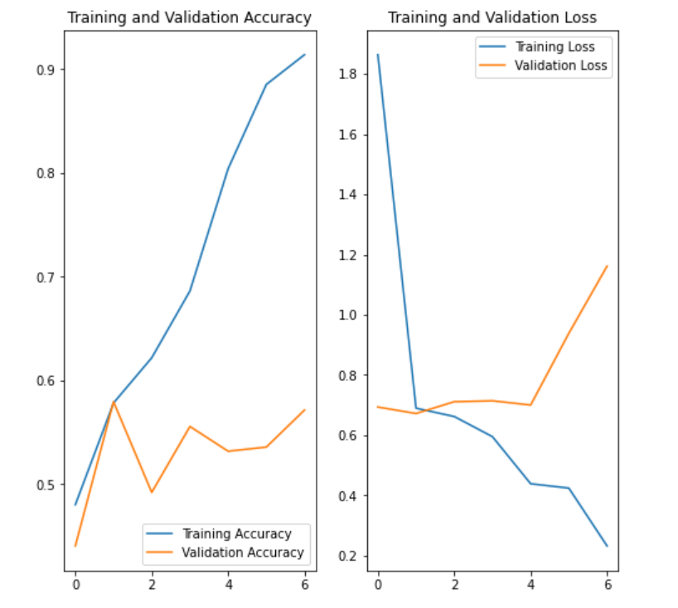
Model Accuracy
img size 180 ✕ 180
10 epochs
img size 720 ✕ 720
15 epochs
img size 540 ✕ 540
7 epochs

Slide 5
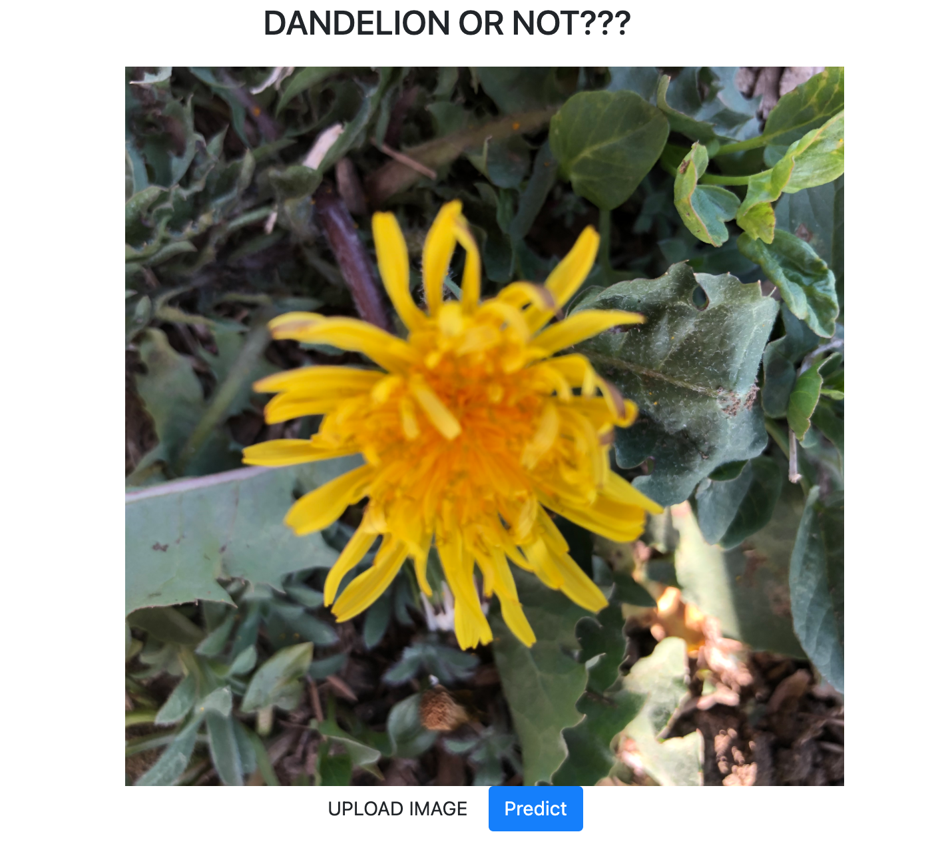
Demo of app

Slide 6

Conclusions
AWS → Google Colab → Generated .h5 model → Flask → index/predict html (bootstrap, css)
Overtraining was observed with epochs greater than 8
Unable to increase model accuracy over 75%. Finetuning probability helped in better prediction
Data set affected the results of the model. No dandelions in the training data set
Model could be improved with better training dataset

