Slide 1
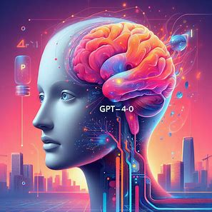
GPT-4o
Mohan Ramadoss

Slide 2

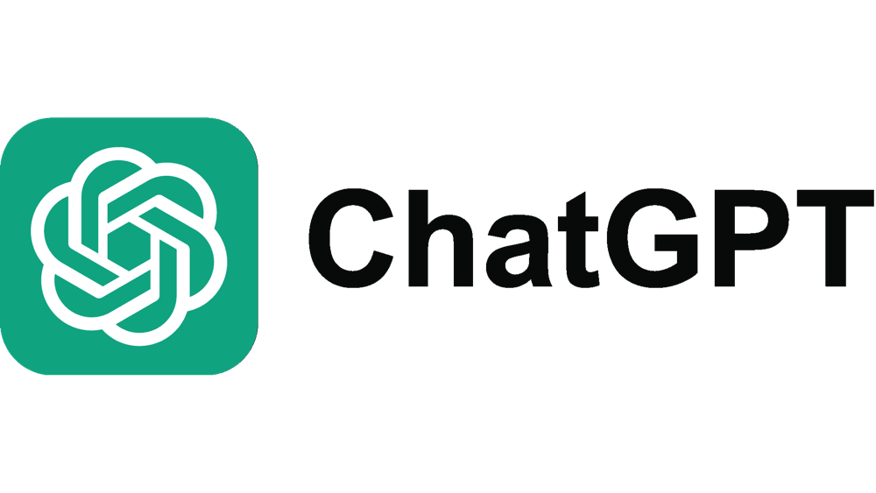



LLMs (Large Language Models)
A large language model is a model trained on a large amount of text data that is capable of understanding human text and/or generating human-like text

Slide 3
GPT
GPT stands for Generative Pre-trained Transformer. It refers to a series of large language models developed by OpenAI that use transformer-based neural network architectures.

Slide 4

Generative AI
A generative model is one that can create new content based on data it's been trained on
Image generation
Video generation
Music generation
Text generation

Slide 5
Quick refresher on the various GPT models
GPT-1: introduced in 2018, GPT-1 was one of the first natural language processing models and was limited to basic tasks.
GPT-2: the second GPT model was released around eight months later and was significantly more powerful, showing great improvements in NLP models.
GPT-3: finally moving closer to what GPT models were created to be, GPT-3 was able to produce human-like responses and understand context.
ChatGPT (GPT-3.5): this chatbot, released to the world in late 2021, revolutionized how everyday people interact with artificial intelligence, bringing NLP to be included in people’s day-to-day lives.
GPT-4: the next iteration of GPT, GPT-4, was even better, with improved accuracy, conversational skills, and safety parameters.
GPT-4o: the newest GPT model, was released to the public on a limited basis in May 2024 and boasts improved text generation, context understanding, and overall abilities.

Slide 6
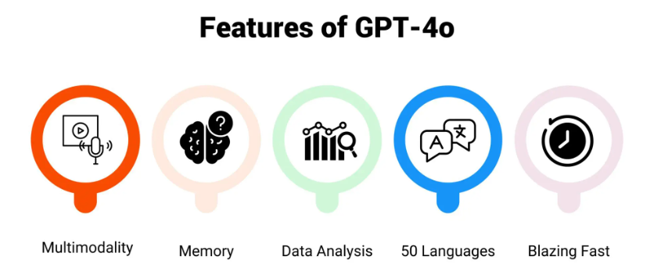
What is GPT-4o?
GPT-4o is OpenAI’s latest LLM. The 'o' in GPT-4o stands for "omni"—represents a significant advancement in AI. Omniscient (knowing everything) & Omnipotent (having unlimited power)
Unlike GPT-4, which only handles text.
GPT-4o is a multimodal model that processes and generates text, audio, and visual data.
Free for Everyone though free users will have capacity Limits
Speaks in 50 different languages and multiple tone
2 x faster
50 % cheaper
5 x higher rate limits compared to GPT-4 Turbo
Rumors claim that GPT-4 has 1.76 trillion parameters (GPT4 is 8 x 220B params = 1.7T params)

Slide 7
With Use Cases That Will Melt Your Brain
It can act as a tutor
It can act as a real time translator
It can act as a coding assistant
It can act as a fair host
Can help blind and low vision individuals

Slide 8

New Features of GPT-4o
Enhanced Artificial Intelligence:
Provides better creativity, reasoning, problem-solving, and knowledge.
Handles greater context (more than 25,000 words).
Data Analysis:
Upload data to receive insights, patterns, trends, and create charts/tables.
Supports 512MB per file and up to 10 files in a conversation.
Image and Voice Capabilities:
Understands and generates responses based on images and voice inputs.
Can solve math problems from images or suggest recipes from fridge contents.
Allows voice conversations for a more interactive experience.
File Uploads:
Analyze, transform, and extract information from uploaded files.
Identify tone, style, and provide summaries or feedback.
Longer Memory:
Retains guidelines and preferences across conversations, improving user experience.

Slide 9
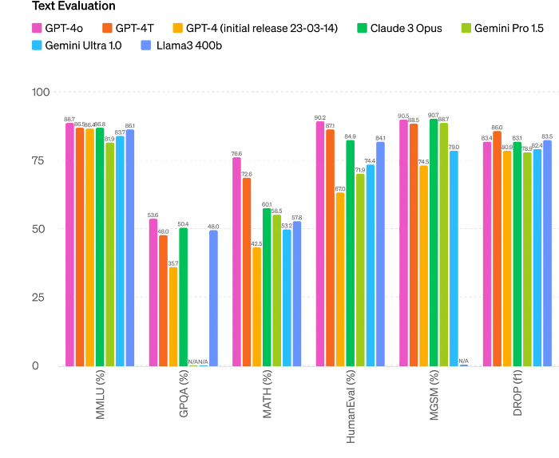
GPT-4o has surpassed other AI models
Text Evaluation
The image shared by OpenAI clearly shows that GPT-4o outperforms other models, particularly in areas such as Math and HumanEval — attributes highly valued by users for enabling smoother and more human-like conversations

Slide 10
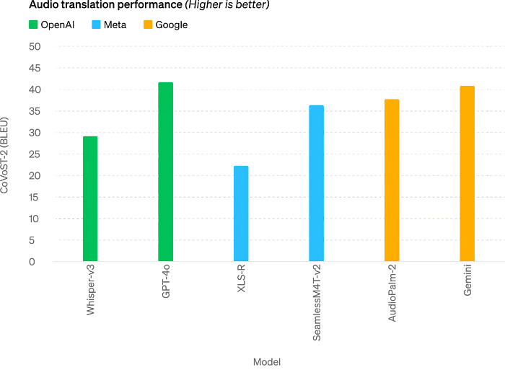
Audio translation performance
The enhanced capabilities of GPT-4o, coupled with its Text Evaluation feature, provide an opportunity to connect with more people, recognizing that language often serves as a barrier beyond just communication.
The chart clearly illustrates that GPT-4o has outperformed other AI systems, such as Gemini and Whisper-v3.

Slide 11
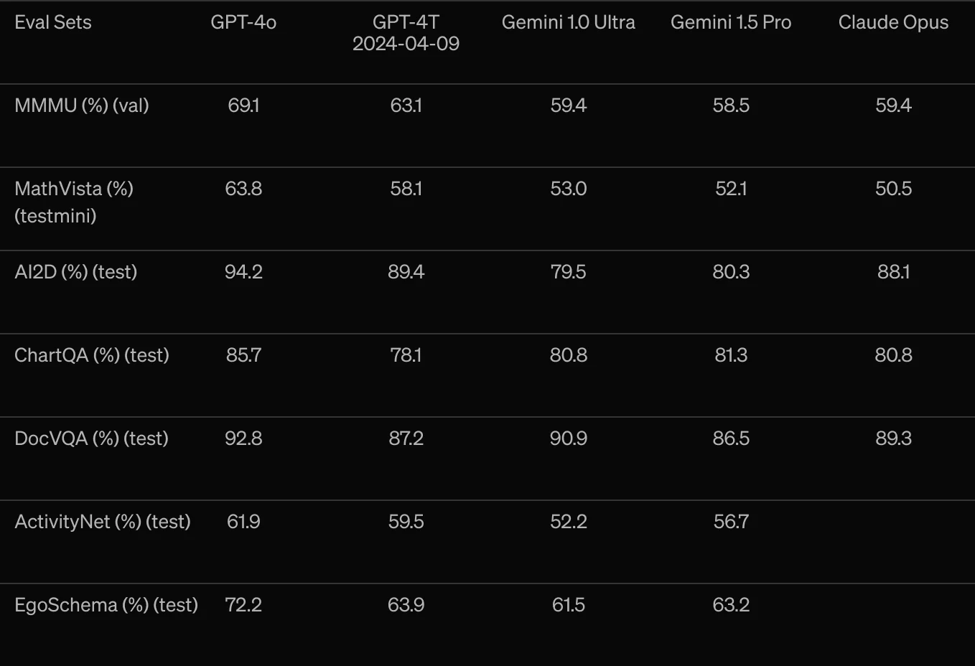
Vision understanding evals
GPT-4o’s state-of-the-art performance in visual perception benchmarks through 0-shot evaluations, including advanced reasoning in MMMU, MathVista, and ChartQA, underscores its significant capabilities in understanding and reasoning across multi-modal information. Its proficiency in 0-shot Chain-of-Thought reasoning further highlights its robustness and adaptability in diverse visual tasks.

Slide 12
GPT-4o Use Cases
Modality | Use Cases | Description
Text | Text Generation, Text Summarization, Data Analysis & Coding | Content creation, concise summaries, code explanations, and coding assistance.
Audio | Audio Transcription, Real-Time Translation, Audio Generation | Convert audio to text, translate in real-time, create virtual assistants or language learning.
Vision | Image Captioning, Image Analysis & Logic, Accessibility for Visually Impaired | Describe images, analyze visual information, provide accessibility for visually impaired.
Multi | Multimodal Interactions, Roleplay Scenarios | Seamlessly combine modalities, create immersive experiences.

Slide 13
How ChatGPT Enhances Team Collaboration
Engineering | Marketing | Sales & Success | Finance & Accounting | IT | Operations | HR & Recruiting
Code reviews and debugging assistance. | Content creation and optimization. | Customer support and chatbots. | Financial data analysis and reporting. | Network monitoring and issue resolution. | Workflow automation and process optimization. | Candidate screening and interview scheduling.
Automated documentation generation. | Social media management and engagement. | Lead qualification and follow-ups. | Automated invoicing and expense tracking. | User support and helpdesk automation. | Inventory and supply chain management | Employee onboarding and training support.
Providing quick answers to technical questions. | Market research and trend analysis. | Personalized sales pitches and proposals. | Compliance and audit support. | Security threat detection and response. | Real-time performance monitoring and reporting. | Policy documentation and compliance tracking.

Slide 14
Future Potential - GPT5
Parameter size GPT -5 will be twice
Human like AI assistance
Human like reasoning abilities
Multimodality - Video processing emerges as a natural progression for GPT-5.
Better accuracy
Increased context windows
Cost-effective use of the OpenAI API
From Chatbot to Agent.

Slide 15
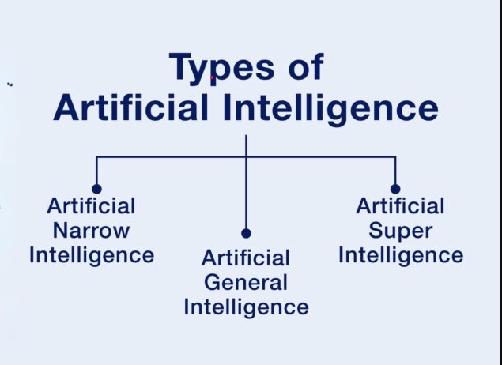
Artificial General Intelligence (AGI)
Artificial general intelligence (AGI) is a type of artificial intelligence (AI) that matches or surpasses human capabilities across a wide range of cognitive tasks.
Regarding whether modern large language models (LLMs) such as GPT-4 are early, incomplete forms of AGI

Slide 16
Future AI Generation details
AI – 2G
Generative AI – 4G
Artificial General Intelligence - 5G
Artificial Super Intelligence - 6G - End 2030
2032 Entire AI will be replaced by Organized Intelligence Most Emerging Multi intelligence

Slide 17
Conclusion
GPT-4o is user-friendly and intelligent
Enhances communication and task management
Encouragement to explore GPT-4o's capabilities

