Slide 1

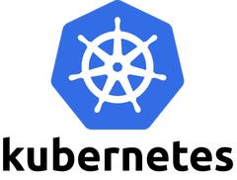
Introduction
Kubernetes is a powerful open-source system, initially developed by Google, for managing containerized applications in a clustered environment. It aims to provide better ways of managing related, distributed components and services across varied infrastructure.
we'll discuss some of Kubernetes' basic concepts. We will talk about the architecture of the system, the problems it solves, and the model that it uses to handle containerized deployments and scaling.
By Mohan Ramadoss

Slide 2
What is Kubernetes?
Kubernetes, at its basic level, is a system for running and coordinating containerized applications across a cluster of machines. It is a platform designed to completely manage the life cycle of containerized applications and services using methods that provide predictability, scalability, and high availability.
Kubernetes is a platform for hosting docker containers In a clustered environment with multiple docker hosts, Providing grouping, load balancing,auto-healing ,and scaling
As a Kubernetes user, you can define how your applications should run and the ways they should be able to interact with other applications or the outside world. You can scale your services up or down, perform graceful rolling updates, and switch traffic between different versions of your applications to test features or rollback problematic deployments. Kubernetes provides interfaces and composable platform primitives that allow you to define and manage your applications with high degrees of flexibility, power, and reliability.

Slide 3
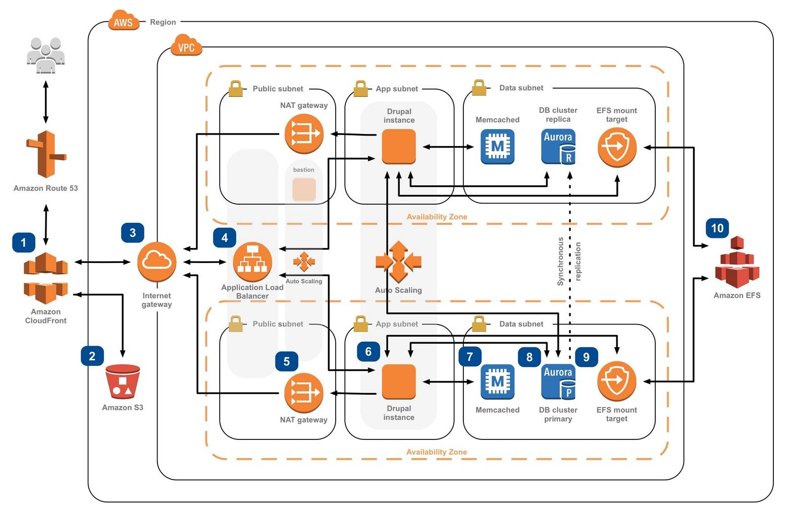
What we know:
Very popular
Based on containers
Questions:
Why are containers great?
Why are they not enough?
But complex.

Slide 4
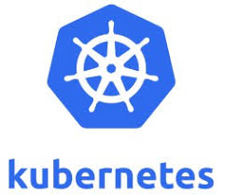
Kubernetes’ strength is abstraction paired with powerful, automated, infrastructure and app management.
Automation of many difficult tasks for ops & API access.
An even playing field to devs, regardless of cloud.
With abstracted principles.

Slide 5
Key Feature
Automatic binpacking
Horizontal Pod Autoscaling(HPA)
Automated rollouts and rollbacks
Storage orchestration
Self-healing
Service discovery and load balancing
Secret and configuration management
Batch execution

Slide 6
Automatic Schedule binpacking
CPU/Memory’s utilization can define on Pods (Smallest Unit of Kubernetes)
Schedule will select the node by ensure all resource is enough for running Pods as required If reach memory limit Current Pods will be terminate (Kill)
If restart flag was set. Kubenetes will try to restart Pods on other node
If reach cpu limit • Schedule will not kill Pods and waiting for it back to normal state
Check available node resource by command: kubectl describe node

Slide 7
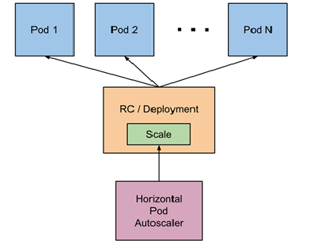
Horizon Pods Autoscaling (hpa)
The Horizontal Pod Autoscaler automatically scales the number of pods in a replication controller, deployment or replica set based on observed CPU utilization
(or, with custom metrics support, on some other application-provided metrics).

Slide 8
Storage Orchestrator
Support several storage type:
Local Storage • Network Storage (NFS, iScsi, Gluster, Ceph, Cinder, Flocker)
Cloud Storage (AWS, GCE, AzueDisk etc)

Slide 9
Self-healing
Replication Controller (RC) will maintain unit of Pods as design (not to much (kill) and not to few (create)
Full-fill Pods on every failure case with automatic by system

Slide 10
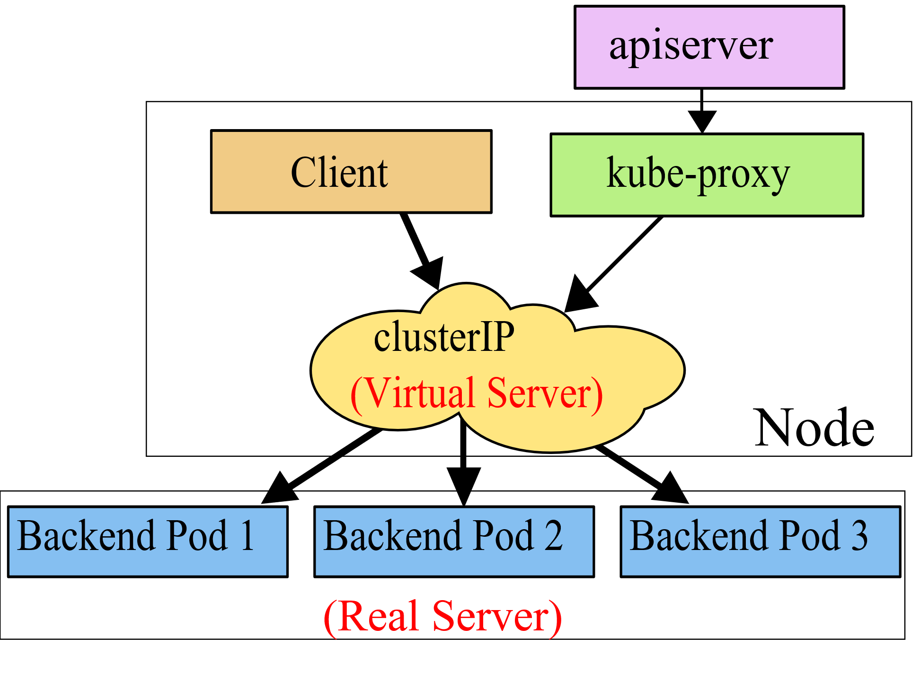
Service Discovery and Load Balancing
Service will act like “connector” for client need to connect with Pods o Discovery will use for service to look “Pods” by environment variable or dns service
Support load balancing between multiple Pods (replica)

Slide 11
Secret and Configuration Management
Kubernetes can keep confidential data (such as username/password) for running application on encrypt format.
Can reference on Pods instead plan text configuration.

Slide 12
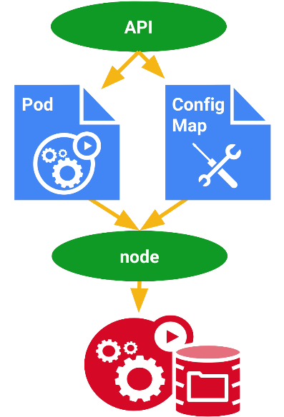
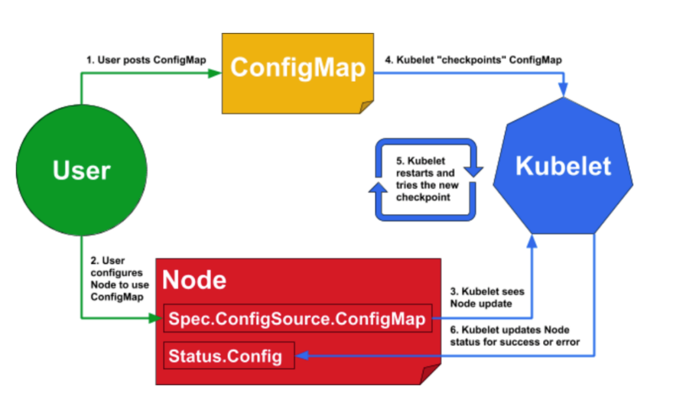
Secret and Configuration Management
Sometime we have a many configuration that need to specify on each application, But it should be change every time need.
Idea is create configuration file (ConfigMap) for define all configuration that reference on Pods instead

Slide 13
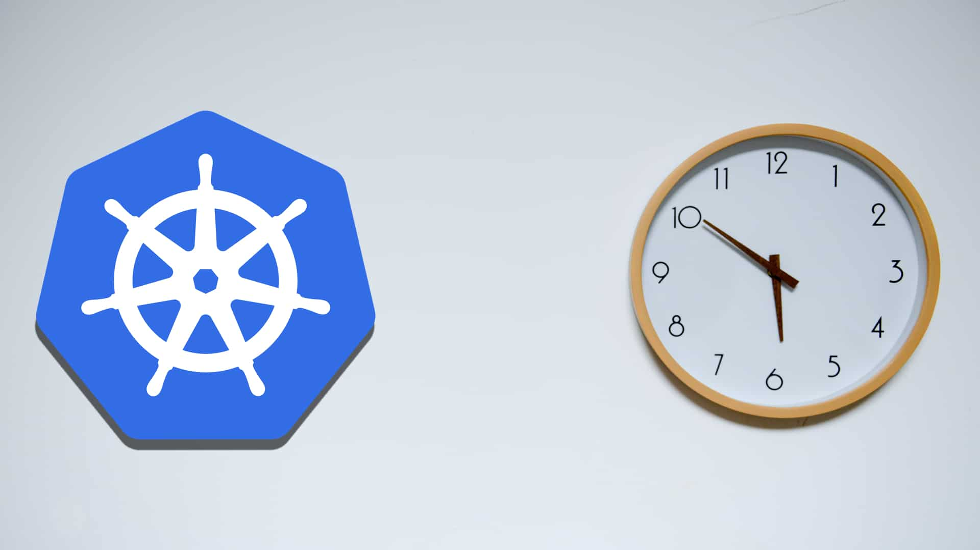
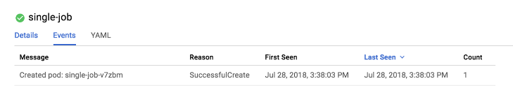
Batch Execution
A job will response some kind of batch execute by create special Pods (Terminate when batch complete)
Normally kubernetes will use job for maintain many background process for cluster system such as Replication Controller (RC) will submit job for start new Pods when existing is fail or delete. o Type of Job
Non-parallel jobs
Parallel jobs with fix-completion
Parallel jobs with work queue

