Slide 1
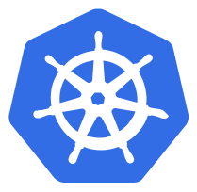
Scaling
If your application is stateless you can horizontally scale it
  Stateless = your applicate doesn't have a state, it doesn't write any local file / keeps local session.
  All traditional database ( MySQL, Postgres) are stateful, they have database files that can't be split over multiple session.
Most Web Application can be made stateless:
  Session Management needs to be done outside the container ( MemCache, Redis etc)
  Any files that need to be saved can't be saved locally on the container

Slide 2
Scaling
Our example app is stateless, if the same app would run multiple times, it doesn't change state.
Later in this course I'll explain how to use volumes to still run stateful apps
  Those stateful apps can't horizontally scale, but you can run them in single container & vertically scale ( allocate more CPU/ Memory/ Disk )

Slide 3
Scaling
Scaling in Kubernetes can be done using the Replication Controller
The Replication Controller will ensure a specified number of pod replicas will run at all times
A Pods created with Replication Controller will automatically be replaced if they fail, get deleted, or are terminated.
Using the Replication Controller is also recommended if you just want to make sure 1 pod is always running, even after reboot.
  You can then run a replication controller with just 1 replica
  This makes sure that the pod is always running.

Slide 4
Demo Placeholder
Scaling

Slide 5


