Slide 1
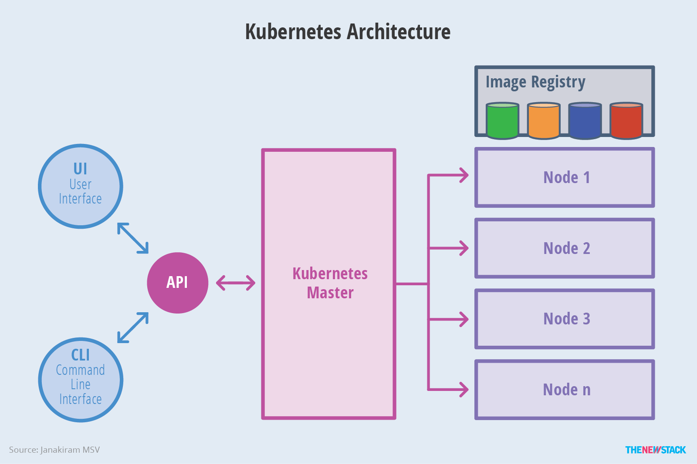
Kubernetes Architecture

Slide 2
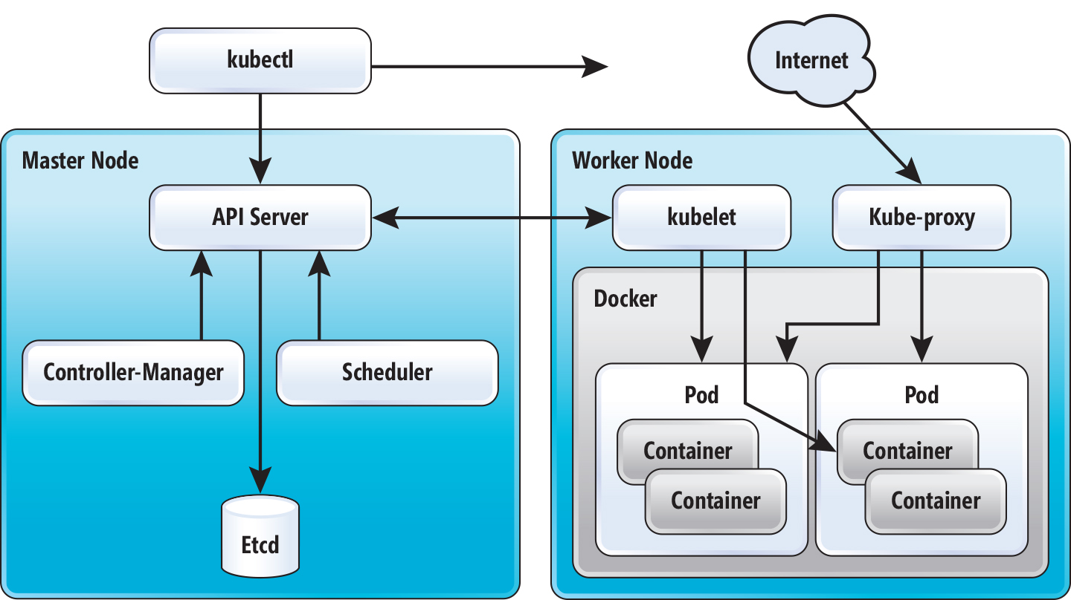
Kubernetes Architecture

Slide 3
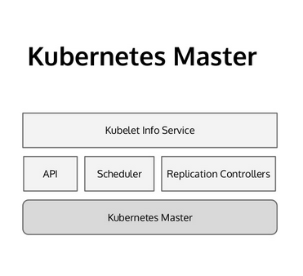
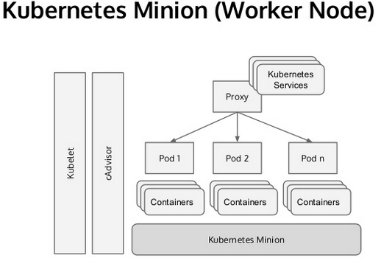
Kubernetes architecture diagram

Slide 4
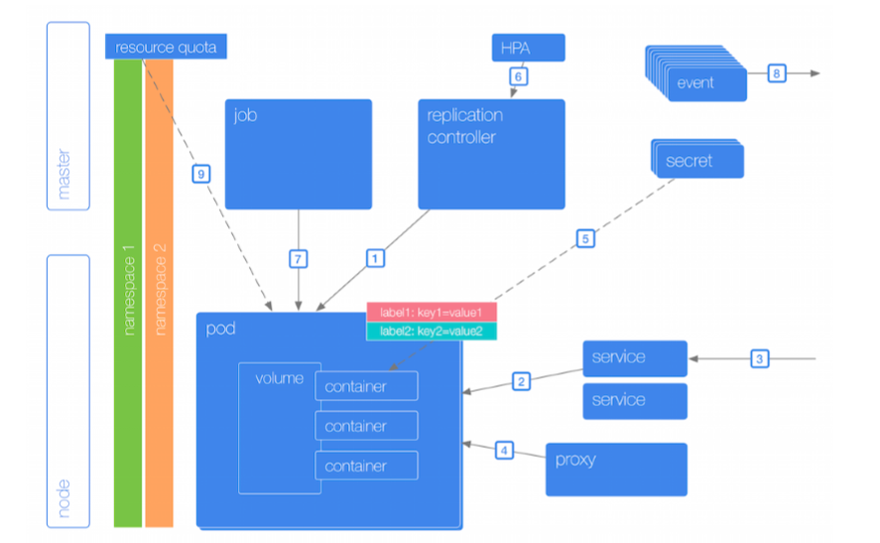
Kubernetes architecture diagram

Slide 5
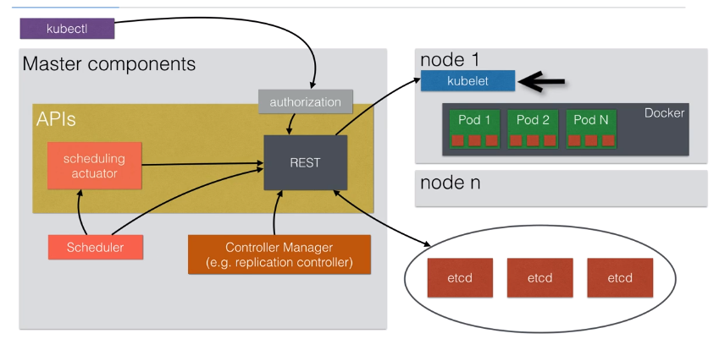
Architecture Overview

Slide 6
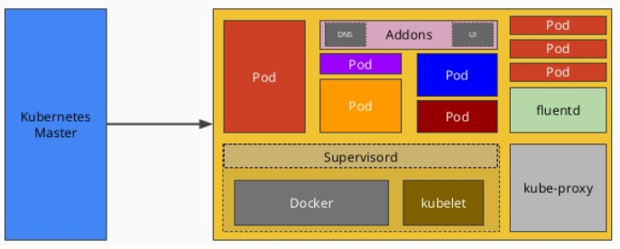
The Worker Nodes
The number of worker nodes depends on the size of the cluster. It can be one but its not uncommon to have Kubernetes cluster with over 2000 nodes. the size depends on your budget and use case. each worker node runs the following services.
Kubelet: Is a service that receives orders from the master and a container runtime (e.g Docker) which it interfaces to manage container instances.
Kube-proxy: The proxy (kube-proxy) provides simple network proxy and load balancing capability. kube-proxy enables services to be exposed with a stable network address and name.
Docker: Docker is the container engine responsible for creating the pods on each slave node. To run the containers it has to download the images from a docker registry.

Slide 7
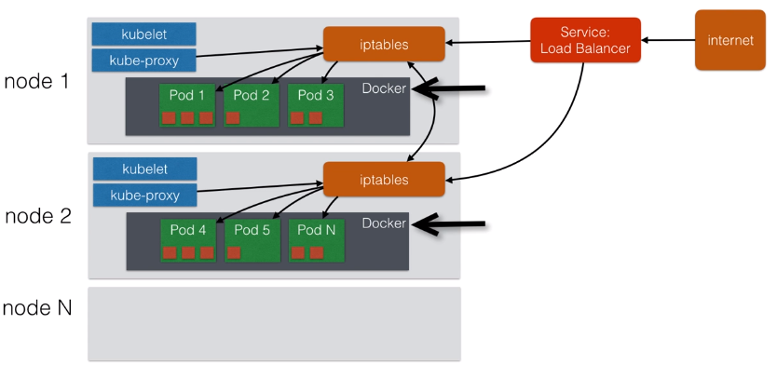
Architecture overview

Slide 8


