Slide 1

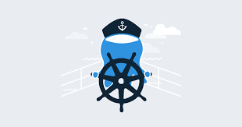
Minikube setups
Kubernetes should really be able to run anywhere
But, there are more integration for certain cloud providers, like AWS & GCE
Things like Volumes and External Load Balancers work only with supported Cloud Providers
I will first use minikube to quickly spin up a local single machine with a Kubernetes cluster
I’ll then show you how to spin up a multi-node cluster
Later : AWS using Kops***

Slide 2
Kubernetes setups
Doing the lab yourself is possible ( and highly recommended ):
You can use AWS Free tier account for the same.
Using your local machine
https://github.com/kubernetes/minikube

Slide 3
Minikube setups
It works on Windows, Linux and MacOS
You will need Virtualization Software installed to run Minikube:
VirtualBox is freeware
You can download minikube from https://github.com/kubernetes/minikube
To launch your cluster you just need to enter ( in a shell / powershell);
.\minikube.exe start --vm-driver="virtualbox"

Slide 4
Kubernetes setup with 3 Node cluster
CENTOS 7.5 = 6 GB Memory - 4 CPU on Each machine
Master = 192.168.1.70
Node1 = 192.168.1.72
Node2 = 192.168.1.73
Node3 = 192.168.1.74

Slide 5
Kubernetes setup Steps
https://github.com/MohanRamadoss/kubernetes/tree/master/LAB

Slide 6
DEMO

Slide 7


