Slide 1

YAML
YAML, which stands for Yet Another Markup Language, or YAML Ain’t Markup Language (depending who you ask) is a human-readable text-based format for specifying configuration-type information. For example, in this article, we’ll pick apart the YAML
maps, which are groups of name-value pairs
lists, which are individual items
maps of maps
maps of lists
lists of lists
lists of maps

Slide 2
First app
Let’s run our newly built application on the new Kubernetes cluster
Before we can launch a container based on the image, we need to create a pod definition
A pod describe an application running on kubernetes
A pod can contain one or more tightly coupled containers, that make up app
Those apps can easily communicate with each other using their local port numbers
Our app only has one container

Slide 3
Demo Placeholder
Running first app on kubernetes

Slide 4
Demo
CREATING POD WITH LABELS USING YAML
a simple manifest that creates 2 containers.

Slide 5
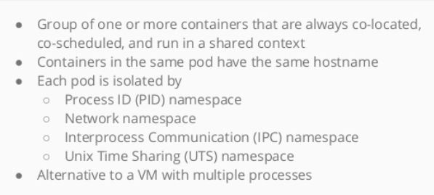
Pods

Slide 6
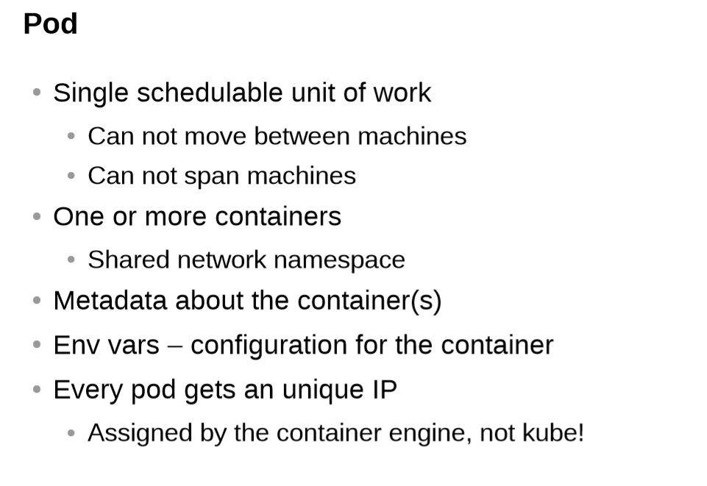

Slide 7
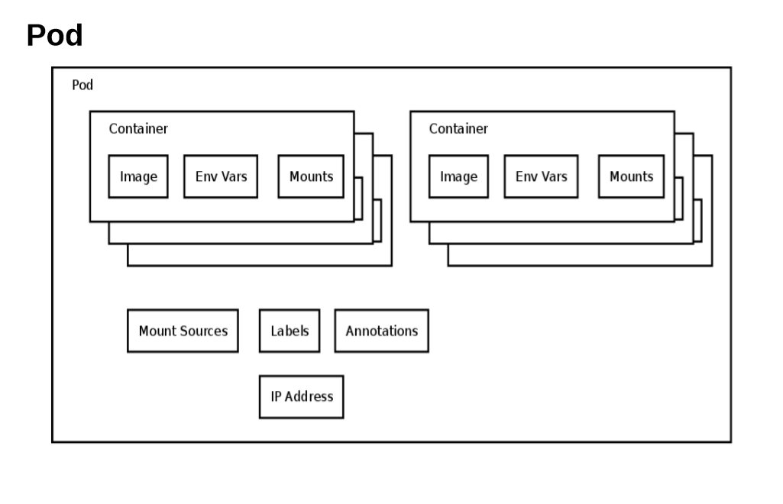

Slide 8
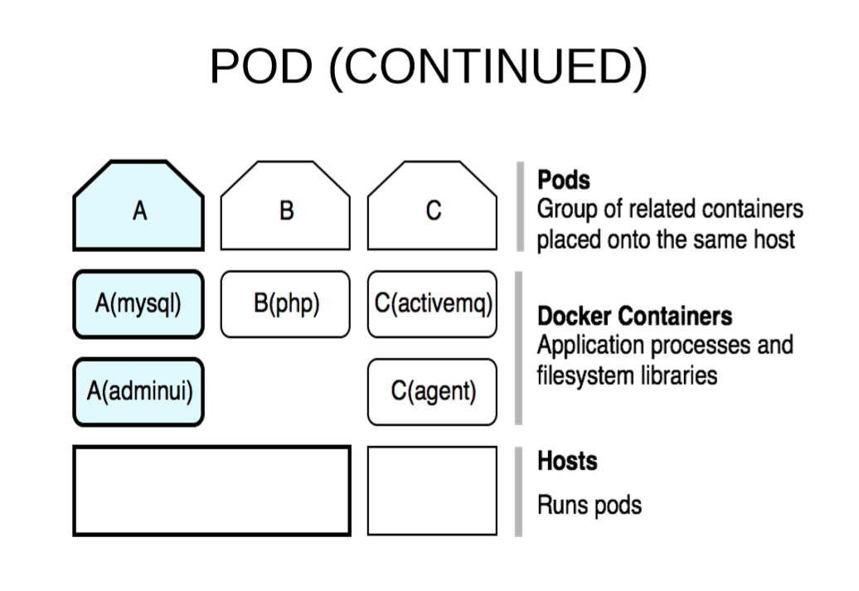

Slide 9
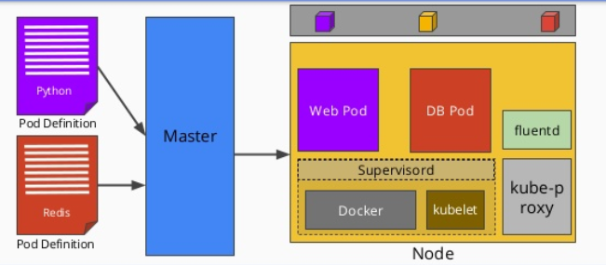
Deploying pod

Slide 10
Demo Pods
How to create a pods

Slide 11
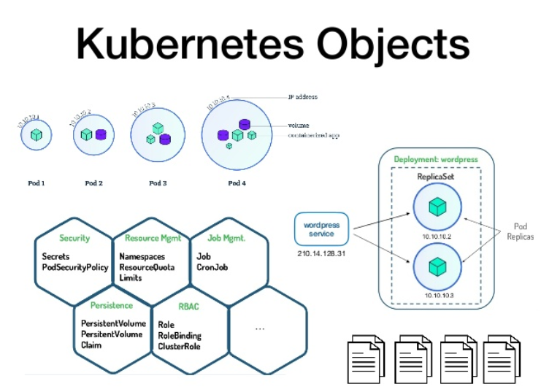

Slide 12


