Slide 1
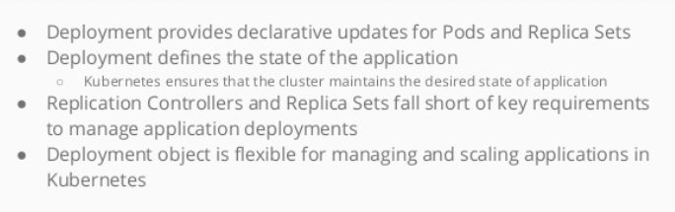
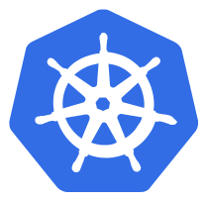
What are deployments

Slide 2
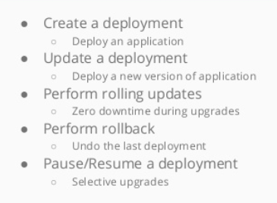
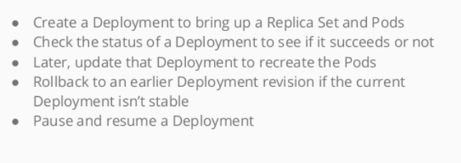
Why to use deployment

Slide 3
Deployment
A Deployment declaration in Kubernetes allows you to do app deployments and updates
When using the deployment object, you define the state of your application
Kubernetes will then make sure the cluster matches your desired state
Just using the replication-controller or replication set might be cumbersome to deploy apps
The Deployment Object is easier to use and gives you more possibilities

Slide 4
Deployment
With a deployment object you can:
Create a deployment ( e.g. deploying an app )
Update a deployment ( e.g. deploying an new version )
Do rolling updates ( Zero downtime deployment)
Roll Back to previous version
Pause/Resume a deployment ( e.g. to roll-out to only certain percentage )

Slide 5
Useful Commands
Command | Description
kubectl get deployment | Get info on current deployments
kubectl get rs | Get info about the replica sets
kubectl get pods --show-labels | Get info about the labels attached to those pods
kubectl rollout status deployment/helloworld-deployment | Get deployment status
kubectl set image deployment/helloworld-deployment k8s-demo=k8s-demo:2 | Run k8s-demo with image label version
kubectl edit deployment/helloworld-deployment | Edit the deployment Object
kubectl rollout history deployment/helloworld-deployment | Get the rollout history
kubectl rollout undo deployment/helloworld-deployment | Rollback to pervious version
kubectl rollout undo deployment/helloworld-deployment --to-revision=n | Rollback to any pervious version

Slide 6
Demo Placeholder
A deployment

Slide 7


