Slide 1
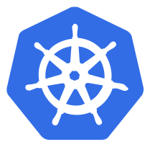
Secrets
Secrets provides a way in kubernetes to distribute credentials, Keys, passwords or "secret" data to the pods
Kubernetes itself uses this Secrets mechanism to provide the credentials to access the internal API
You can also use the same mechanism to provide secret to your application
Secrets is one way to provide secret, native to Kubernetes
There are still other ways your container can get the its secrets if you don't want to use Secrets ( e.g using an external vault services in your app)

Slide 2
Secrets
Secrets can be used in the following ways:
Use Secrets as environment variables
Use secrets as a file in a pod
This setup uses volumes to be mounted in a container
In this volume you have files
Can be used for instance for dotenv files or you app can just read this file

Slide 3
Secrets
To generate secrets using files:
A Secret can also be an SSH Key or an SSL certificate

Slide 4
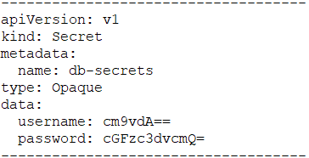


Secrets
To generate secret using yaml definitions:
secrets-db-secret.yml
After creating the yml file, you can use kubectl create:

Slide 5
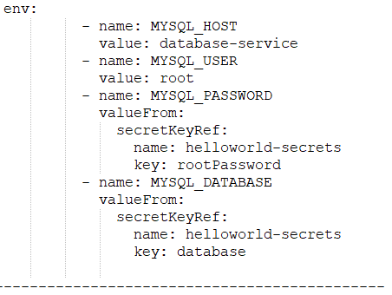
Using Secrets
You can create a pod that expose the secret as environment variables:

Slide 6
Demo Placeholder
Performing Secrets

Slide 7


