Slide 1
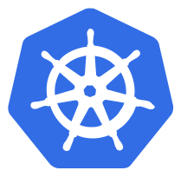
ConfigMap
Configuration parameters that are not secret, cab be put in a Config Map
The input is again key-value pairs
The ConfigMap key-value pairs can then be read by the app using:
Environment Variables
Container command line arguments in the Pod Configuration
Using Volumes

Slide 2
ConfigMap
A ConfigMap can also contain full configuration files
e.g. an webserver config file
This file can then be mounted using volumes where the application expects it config file
This way you can “inject” configuration settings into containers without changing the container itself

Slide 3
ConfigMap
To generate configmap using files:

Slide 4
Using ConfigMap
You can create a pod that exposes the ConfigMap using a volume
YMAL

Slide 5
Using ConfigMap
You can create a pod that exposes the ConfigMap as environment variables
YMAL

Slide 6
Demo Placeholder
Config Map

Slide 7


