Slide 1

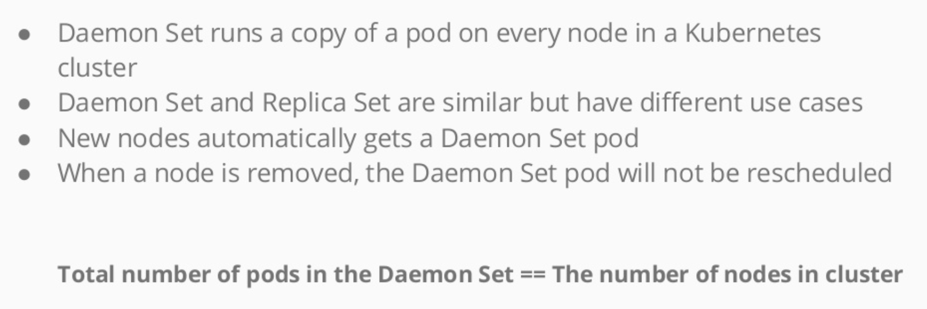
Daemonsets

Slide 2
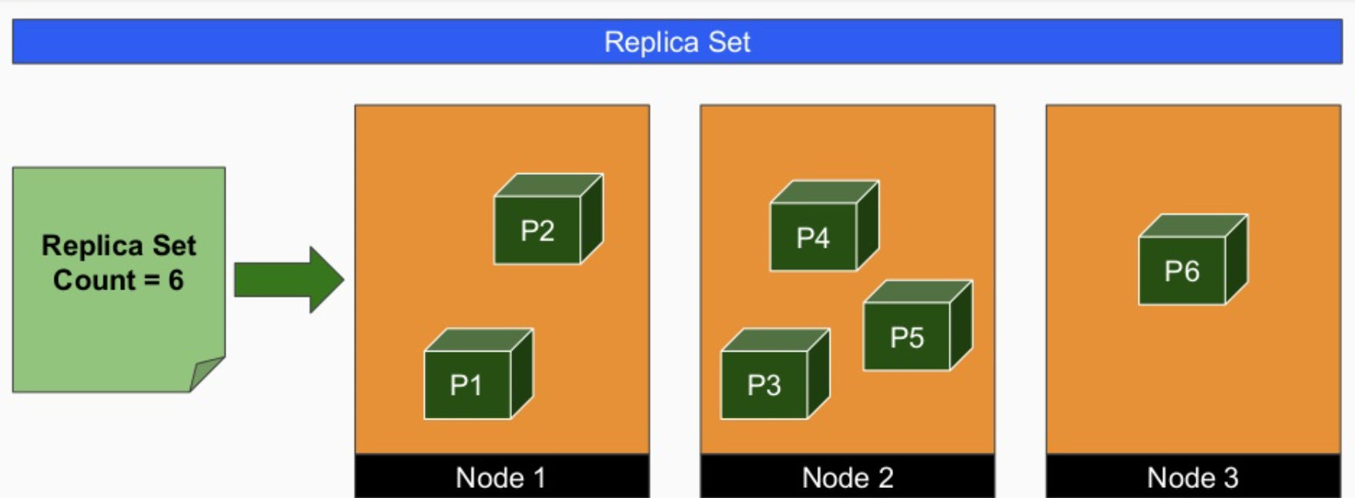
Daemonsets

Slide 3
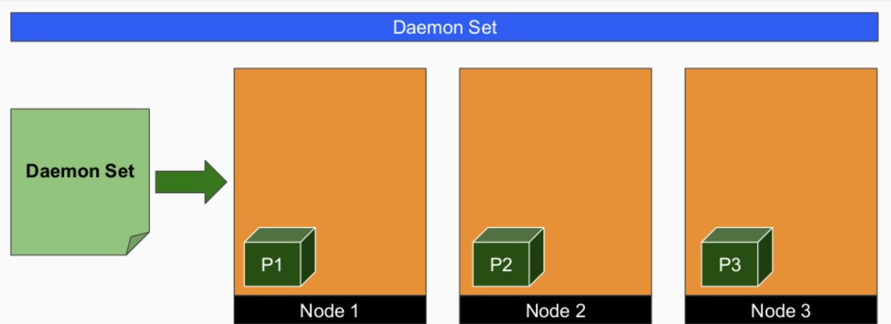
Daemonsets

Slide 4

Daemonsets

Slide 5


