Slide 1
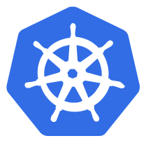
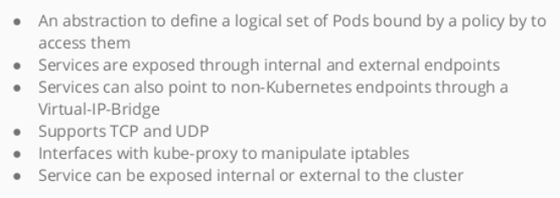
Services

Slide 2
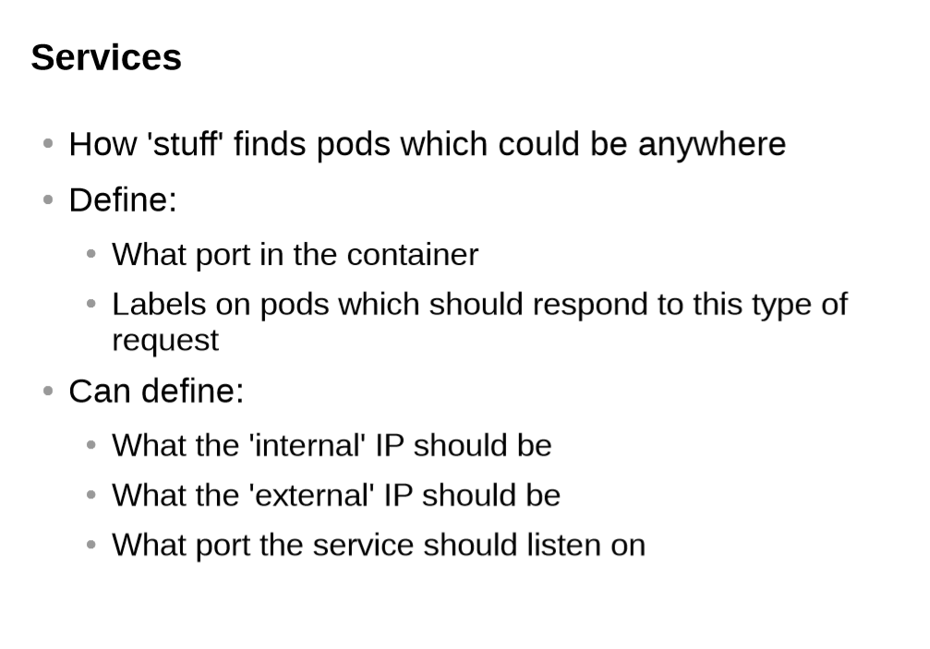

Slide 3
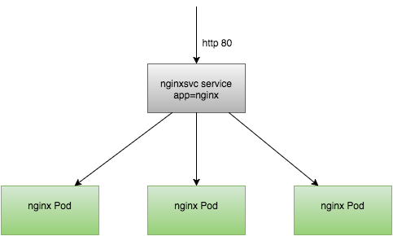
Services

Slide 4
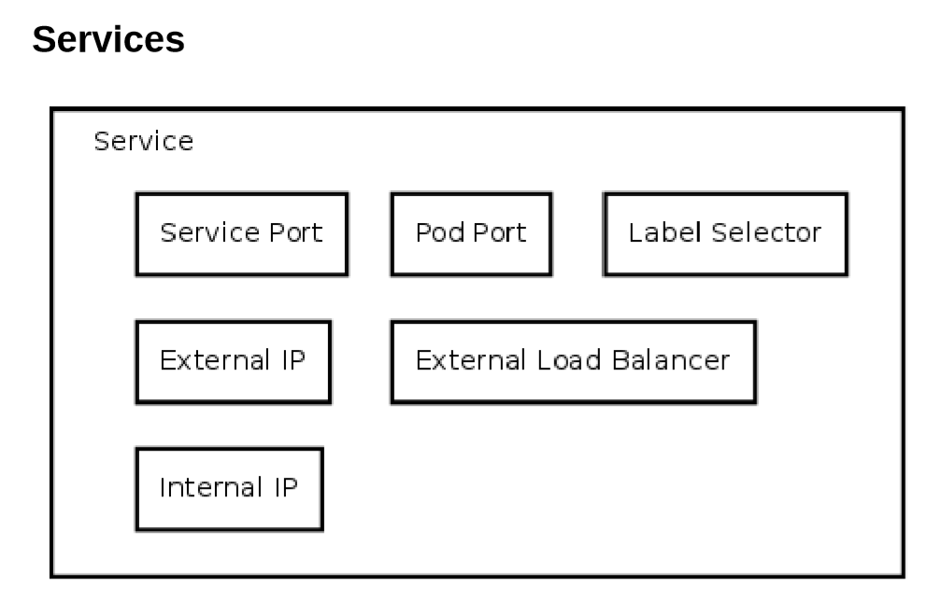

Slide 5
Services
Pods are very dynamic, they come and go on the kubernetes cluster
When using a replication-controller, pods are terminated and created during scaling operations
When using Deployments, when updating the image version, pods are terminated and new pods take the place of older pods
That's why pods should never be accessed directly, but always through a Service
A Service is logical bridge between the "mortal" pods and other services or end-users

Slide 6
Services
When using the "kubectl expose" command earlier, you created a new service for your pod, so it could be accessed externally
Create a service will create an endpoints for your pod(s)
A ClusterIP: a virtual IP address only reachable from within the cluster. ( this is default )
A Nodeport: a port that is the same on each node that is also reachable externally
A LoadBalancer: a LoadBalancer created by the cloud provider that will route the external traffic to every node on the NodePort ( ELB on AWS )

Slide 7
Services
The option just shown only allow you to create virtual IPs or Ports
There is also a possibilities to use DNS Name
ExternalName can provide a DNS name for the service
e.g for service discovery using DNS
This only works when the DNS add-on is enabled

Slide 8
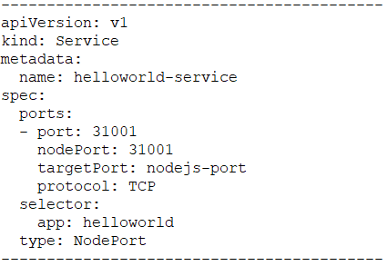
Services
This is an example of a Service definition ( also created using kubectl expose):
Note: By default service can run only between port 30000 - 32767, but you could change this behavior by adding the --service-node-port-range= argument to the kube-apiserver ( in the init scripts )

Slide 9
Demo Placeholder
A new service

Slide 10
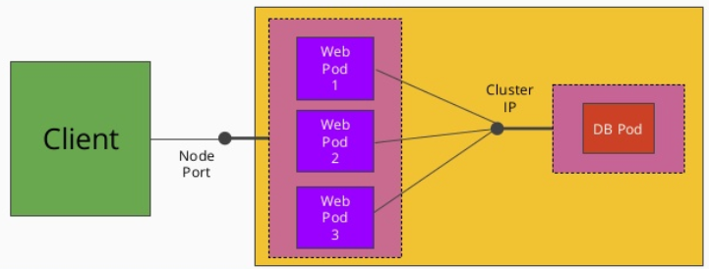
Exposing Services

Slide 11


