Slide 1
PRICE PREDICTION OF USED CARS

Slide 2
introduction
The objective of this project is to develop a machine learning model for predicting used car prices using the Craigslist Cars dataset. The dataset, obtained from Kaggle, contains valuable information about various car attributes The goal is to leverage this dataset to create a predictive model that can estimate the price of used cars based on these features. The project involves a series of steps, including data exploration, cleaning, and preprocessing, followed by the implementation of a machine learning mode The results will be visualized and analyzed to assess the model's accuracy and effectiveness in predicting used car prices. This project aims to provide insights into the factors influencing used car prices and demonstrate the application of machine learning techniques in the automotive domain.

Slide 3
DATASET OVERVIEW
Understanding the Data: Craigslist is the world's largest collection of used vehicles for sale. This data is scraped every few months, it contains most all relevant information that Craigslist provides on car sales including columns like price, condition, manufacturer, latitude/longitude, and 18 other categories. Understanding and predicting these prices can be invaluable for both buyers and sellers. Our dataset comprises 427880 observations and 26 characteristics i.e.in terms of rows and column.
In the following sections, we will delve into the details of the dataset, the steps taken for data preprocessing, the implementation of the machine learning model, and a comprehensive analysis of the results obtained.

Slide 4
EXPLORATORY DATA ANALYSIS
We perform EDA to predict the price of used cars by considering different parameters like fuel type, drive type, Manufacturer, condition, etc.
To take a closer look at the data Our dataset comprises 427880 observations and 12 characteristics. i.e., Total Rows: [426880]. Total Columns: [26]. It is good practice to know the columns and their corresponding data types along with finding whether they contain null values or not. Data has float and integer values. After that we have found the missing values is several columns of our dataset.

Slide 5
DATA CLEANING and preprocessing
Ensuring Data Quality: This process involves dealing with inconsistencies, missing values in the data to ensure its quality and accuracy. There are several common techniques used in data cleaning: Handling Missing Values: There are several methods to deal with missing values So, in our dataset we have converted all missing values as ‘unknown’. Handling Duplicate Values: The total number of duplicated rows in the dataset is 53043. By eliminating duplicate values, we will get new shape of data.
Categorical Data Cleaning: This report aims to analyze the distribution of car manufacturers within the used cars dataset. and the focus of this analysis is on the 'manufacturer' column.

Slide 6
DATA CLEANING and preprocessing
Numerical data cleaning refers to the process of transforming raw numerical data into a clean, organized, and structured format suitable for machine learning algorithms. This process typically involves the following steps: Data Verification, Data Integration, Data Conversion, Outlier Detection and Removal, Missing Value Handling, Data Validation:

Slide 7
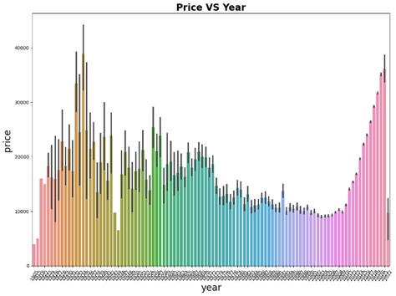
Feature Engineering
The feature engineering process and a visualization created from the updated dataset Feature engineering includes transforming the 'odometer' and 'year' columns to integer types and visualizing the relationship between 'price' and 'year.' From figure 2 Price vs. Year: A bar plot illustrates the relationship between 'price' and 'year.' The plot reveals how the 'price' of cars varies across different 'year' values. The bar plot shows that, in general, newer cars tend to have higher prices

Slide 8
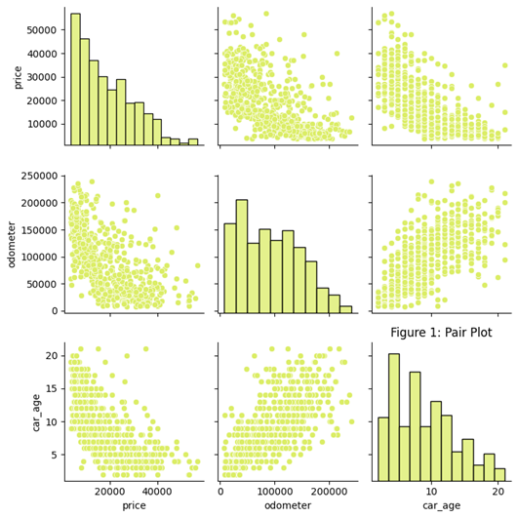
DATA VISUALIZATION
The data visualization process using a pair plot generated from a sample of the updated dataset . The pair plot provides a visual overview of relationships between pairs of variables. The dataset was down sampled to 600 random entries.

Slide 9
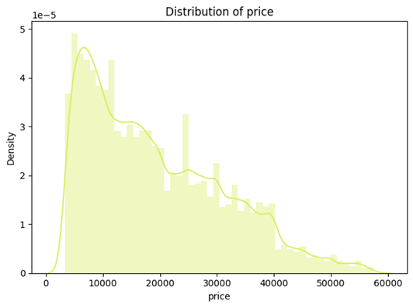
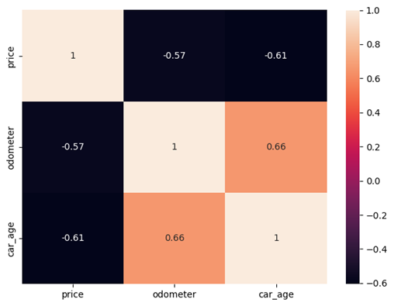
DATA VISUALIZATION
The heatmap provides insights into the degree and direction of linear relationships between pairs of numerical variables.
A distribution plot was generated to visualize the distribution of 'price' values in the dataset. The distribution plot provides insights

Slide 10
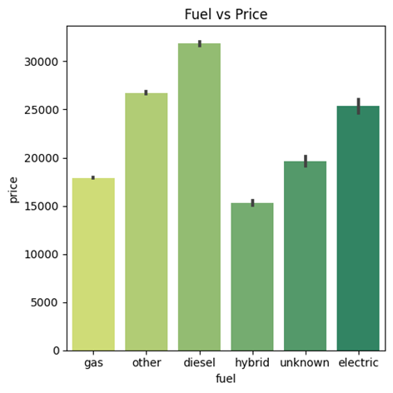
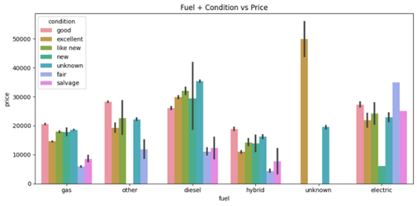
DATA VISUALIZATION
A bar plot was generated to illustrate the average 'price' for each 'fuel' type in the dataset. The bar plot provides insights into how the average 'price' varies across different 'fuel' types.
The below plot reveals variations in average prices based on different combinations of 'fuel' types and 'condition' states. The interaction between 'fuel' type and 'condition' state is considered, providing a more nuanced view of price variations.

Slide 11
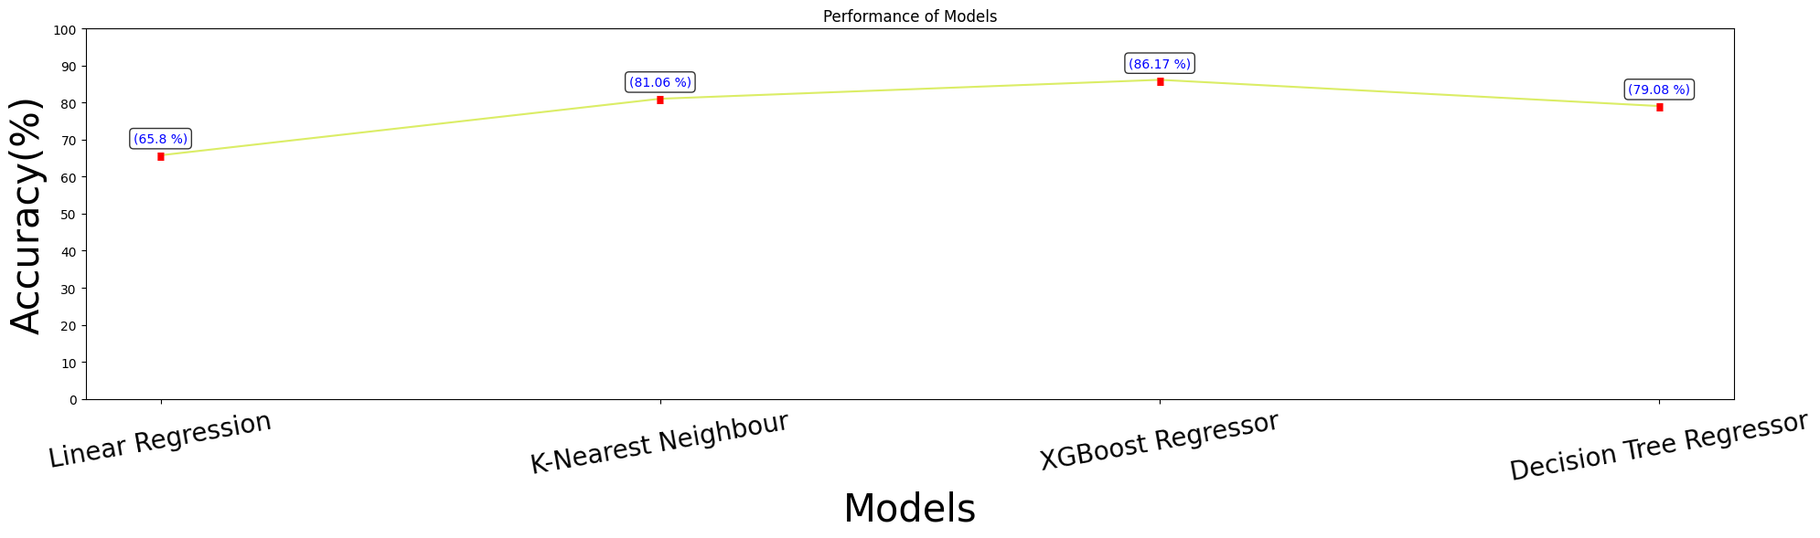
Model Training and Evaluation
The performance of various regression models on predicting car prices using the transformed dataset The models considered include Linear Regression, K-Nearest Neighbors (KNN), XGBoost Regressor, and Decision Tree Regressor.

Slide 12
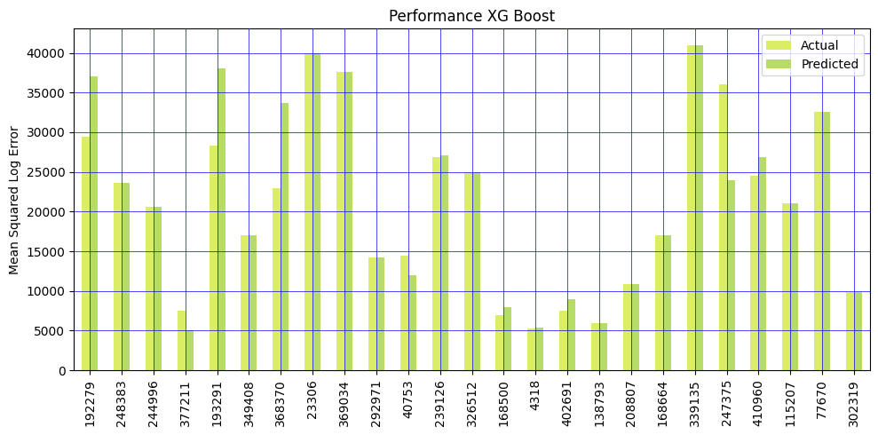
FINAL MODEL ANALYSIS
The bar chart below provides a visual representation of the model’s predictions compared to the actual prices for 25 randomly selected samples from the testing set:

Slide 13
CONCLUSION
In conclusion, the project successfully addressed the prediction of used car prices through a systematic approach. This project embarked on predicting used car prices through a systematic and thorough data analysis, preprocessing, and machine learning approach. The XGBoost Regressor emerged as the standout model, showcasing exceptional performance in predicting prices

Slide 14
THANK YOU

