Slide 1
SWITCHED CAPACITOR VOLTAGE BOOST CONVERTER FOR HYBRID ELECTRIC VEHICLE DRIVES Under the Guidance
APPALA NAIDU K
(Asst. Professor)
Presented by
18EE019
Regd. No. | Name | No. of meetings with Guide | Total No. of meetings | Individual contribution
18L31A02A8 | V SAI VAMSI | 26 | 30 | Problem Identify Literature Survey
18L31A02C9 | P PURNA VIKAS | 24 | 30 | Simulation and Literature and survey
19L35A0201 | J VENKATA KISHORE | 27 | 30 | Paper writing and Literature and survey
18L31A02H4 | B MOHAN SAI | 25 | 30 | Literature survey, Simulation and presentation

Slide 2
INTRODUCTION
By 2042, around 93% (290 million) of all vehicles will be electric and internal combustion-based automakers will have a Kodak moment.
The prospective evolution of EV technology is categorized into three 1.Battery chemistry 2. Autonomous driving 3. Power electronic units. The power conversion units is the drivetrain is the critical one.[1] The refinement of the drivetrain upshot in decrease in size, better battery usage.
Most of the EV’s utilize two level VSI with or without boost stage due to its liability[2]
Generally, for commercial traction drives two configurations are used
1.Battery directly powering a two level inverter
2.Battery connect to inverter with DC-DC boost stage
First configuration offers less stress on inverter but the batteries are expensive with large number of cells placed in series. This leads in slow charge. This is used in more range of EV(75-100 KWh) [3] [4]
Second configuration is used in HEV with a battery energy ratings range of (50-95 KWh)

Slide 3
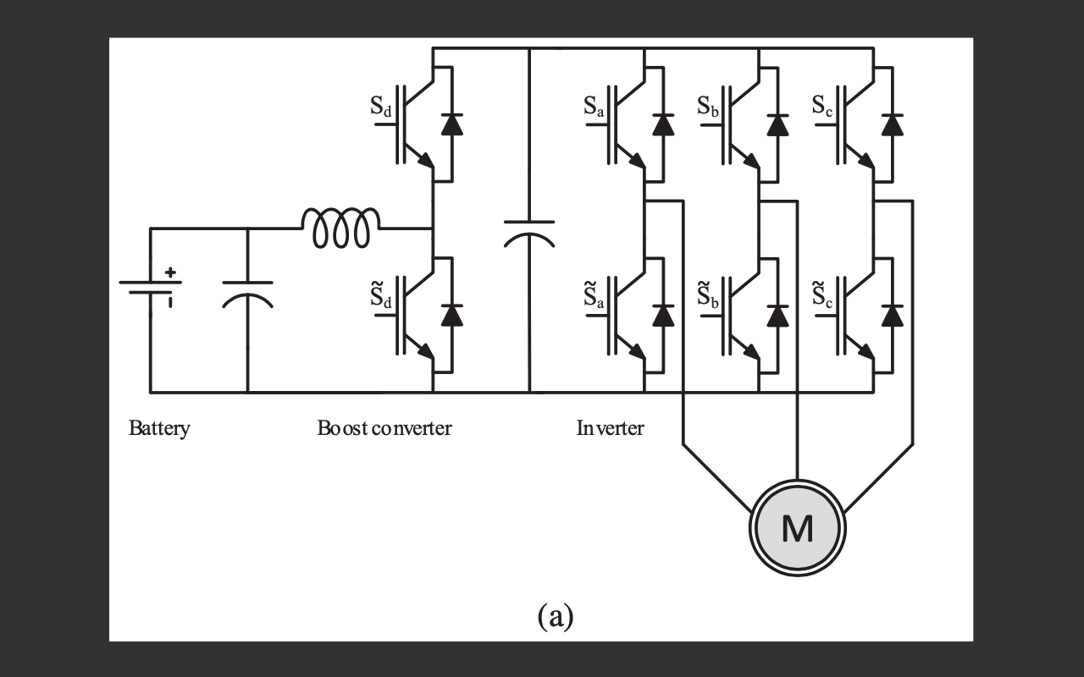
Fig1. conventional inverter converter topology [1]
Its drawbacks are inductor is heavy and costly. The copper and core losses increase proportionally with size of inductor.

Slide 4
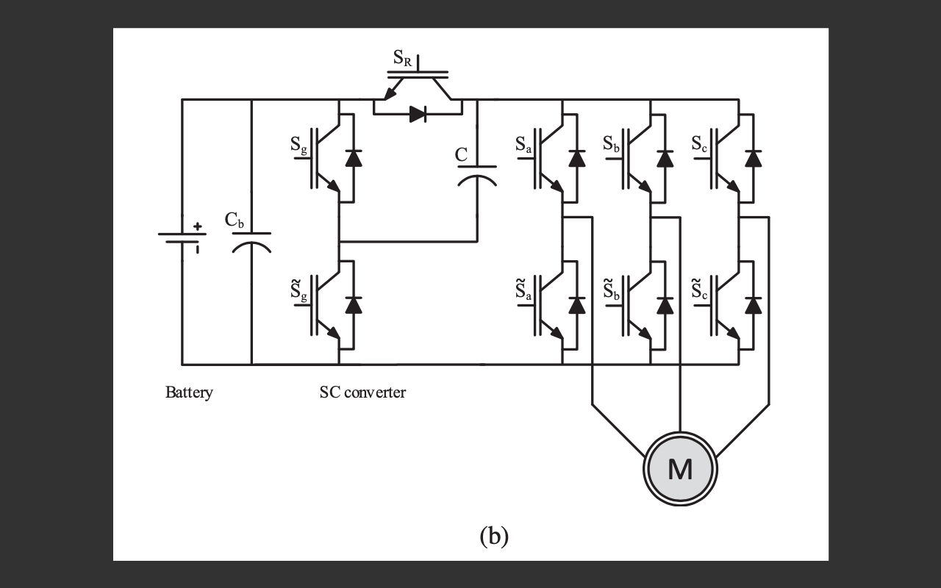
Fig2. switched-capacitor power converter[1]
The above circuit shows the SC circuit employed with inverter to form unified circuit.
The SC circuit is used to create multileveled DC link voltage
It is different from conventional one by not having reverse blocking diode at load or large filter capacitor

Slide 5
LITERATURE SURVEY
Ref. No. | Year | Author | Title | Inference
[1] | 2019 | Janabi, A., & Wang, B. | Switched-capacitor voltage boost converter for electric and hybrid electric vehicle drives. | A new switched-capacitor power converter (SC) for implementing dc-ac and ac-dc power conversion is proposed.
[2] | 2014 | Song, Y., & Wang, B. | Evaluation methodology and control strategies for improving reliability of HEV power electronic system. | the failure rates of semiconductor devices are strongly correlated to the driving behaviors. Thermal stresses have a significant influence on the reliability of devices. the variable dc-link voltage control and a hybrid discontinuous modulation scheme are presented

Slide 6
LITERATURE SURVEY
Ref. No. | Year | Author | Title | Inference
[3] | 2012 | W. Qian, H. Cha, F. Z. Peng and L. M. Tolbert | DCDC Converter for Plug-in Hybrid Electric Vehicles | A four-level flying-capacitor dc-dc converter is explored that can overcome these drawbacks by dramatically reducing the inductance requirement. A special case of the four-level converter, the 3X dc-dc converter, operates at three discrete output/input voltage ratios, thus further reducing the inductance requirement to a minimal value (~0).
[4] | 2012 | J. O. Estima and A. J. Marques Cardoso | Efficiency Analysis of Drive Train Topologies Applied to Electric/Hybrid Vehicles | The second topology, the battery is connected to a bidirectional dc–dc converter, which supplies the inverter and a variable-voltage control technique applied to this which allows for the improvement of the drive overall performance.

Slide 7
OBJECTIVES
To overcome the limitations of traditional drivetrain this project proposes Switched Capacitor voltage boost converter and its control methods.
It employs a SC circuit with inverter to form a unified circuit.
The SC circuit is used to create a multileveled DC-link voltage.
The proposed SC circuit differs from conventional one by not having reverse blocking diode or large capacitor filter.
The regulation of output current and voltage is realized by unified control of both the inverter and the SC stages

Slide 8
METHODOLOGY
The reliability prediction of hybrid electric vehicles (HEVs) is of paramount importance for planning, design, control, and operation management of vehicles, since it can provide an objective criterion for comparative evaluation of various configurations and topologies and can be used as an effective tool to improve the design and control of the overall system.
This project presents a mission-profile-dependent simulation model based on MATLAB for quantitatively assessing the reliability of the electric drivetrain of HEVs. This model takes into consideration the variable driving scenarios, dormant mode, electrical stresses, and thermal stresses. Therefore, more reliable and accurate prediction of system reliability has been achieved.
The methodology is explained in detail, and the results of reliability assessment based on a series HEV are presented. Based on reliability analysis, two control strategies are proposed to increase the mean time to failure of HEV powertrains: 1) variable dc-link voltage control.
These novel control schemes reduce the power losses and thermal stresses of power converters, and consequently, enhance system reliability. Numerical simulation results verify the benefits of two proposed control strategies in terms of power losses and reliability

Slide 9
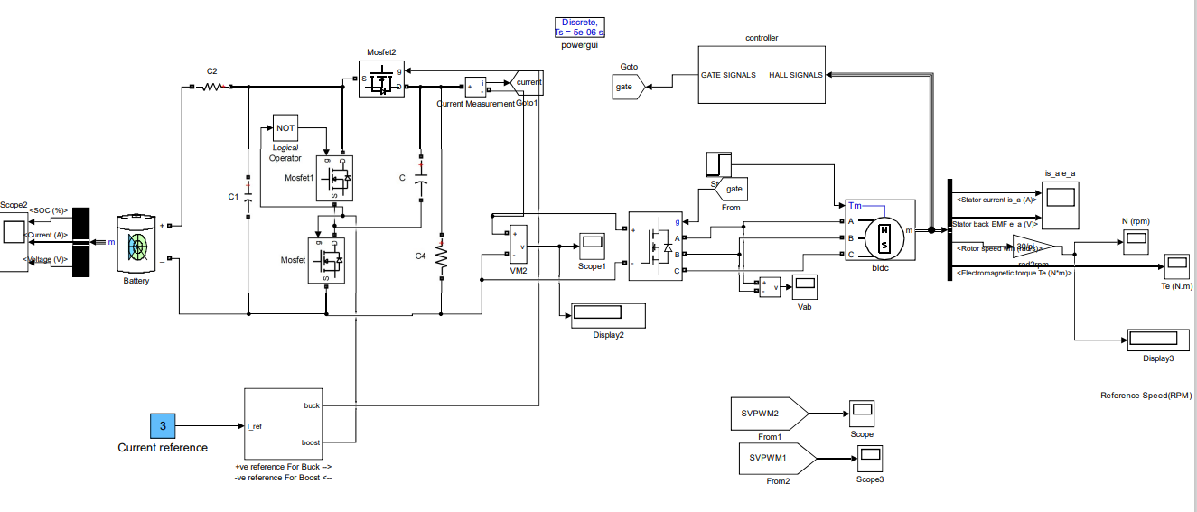
SIMULATION CIRCUIT

Slide 10
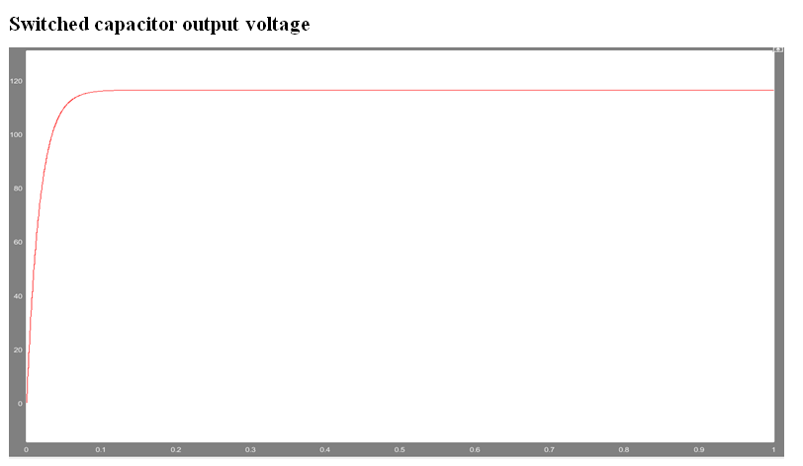
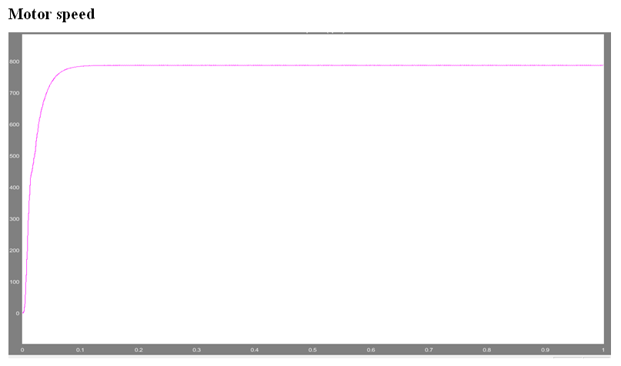
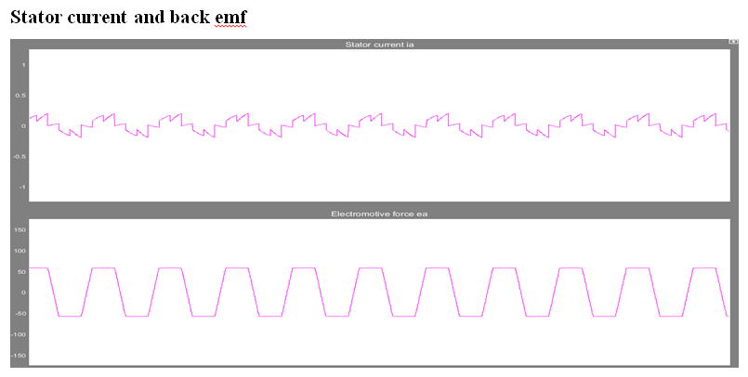
SIMULATION OUTPUT WAVE FORMS

Slide 11
CONCLUSION
This project has presented a new switched-capacitor power converter (SC) for implementing dc-ac and ac-dc power conversion. The SC converter employs a switched-capacitor circuit augmented with the main converter circuit to the power source, thus providing unique features that cannot be attained by the traditional VSI or boost VSI.
One of these unique features is doubling the area of the linear modulation region. The SC converter eliminates the need for the cumbersome and costly inductor to boost the voltage. Instead, it relies on only the capacitors to achieve voltage boost, which allows higher power density. The formulation of the maximum voltage drop across the capacitor and the minimum charging current are analytically derived.
The analytical results provide a clear insight into the design elements that affect the behavior of the charging current, thus allowing the operation at higher power.

Slide 12
FUTURE SCOPE
The SC converter can boost or buck voltage, minimize component count, increase power density, and reduce cost This paper proposes a control method for a low cost GC micro-inverter with MPPT used in photovoltaic applications. A macro-model is proposed in order to test the proposed system and improve simulation times.
In this way different MPPT algorithms can be developed and easily compared. Also, the macro-model speeds-the tuning of the voltage loop and the design of the input filters used for maximum power point tracking. The AM and the circuit used for inverter simulations are validated experimental results.

Slide 13
REFERENCES
[1] Janabi, A., & Wang, B. (2019). Switched-capacitor voltage boost converter for electric and hybrid electric vehicle drives. IEEE Transactions on Power Electronics, 35(6), 5615-5624.
[2] Y. Song and B. Wang, “Evaluation Methodology and Control Strategies for Improving Reliability of HEV Power Electronic System,” in IEEE Transactions on Vehicular Technology, vol. 63, no. 8, pp. 3661-3676, Oct. 2014
[3] W. Qian, H. Cha, F. Z. Peng and L. M. Tolbert, “55-kW Variable 3X DCDC Converter for Plug-in Hybrid Electric Vehicles,” in IEEE Transactions on Power Electronics, vol. 27, no. 4, pp. 1668-1678, April 2012

Slide 14
THANK YOU

