Slide 1
Bootstrap Images
Bootstrap supports for images. There are three classes in Bootstrap that can be used to apply some simple style to the images.
The following classes add style to the images:
Classes | Uses
.img-rounded | It adds border-radius to give the image rounded corners.
.img-circle | It makes the entire image round by adding border-radius.
.img-thumbnail | It adds a bit of padding and a gray border.

Slide 2
Bootstrap Image-rounded Example
The class .img-rounded is used to add rounded corners to an image.
Example:
<!DOCTYPE html>
<html lang="en">
<head>
<title>Bootstrap image</title>
<link rel="stylesheet" href="https://maxcdn.bootstrapcdn.com/bootstrap/3.3.6/css/bootstrap.min.css">
</head>
<body>
<div class="container">
<h2>Rounded Corners</h2>
<img src="abc.jpg" class="img-rounded" alt="abc" width="300" height="250">
</div>
<script src="https://ajax.googleapis.com/ajax/libs/jquery/1.12.0/jquery.min.js"></script>
<script src="https://maxcdn.bootstrapcdn.com/bootstrap/3.3.6/js/bootstrap.min.js"></script>
</body>
</html>

Slide 3

Output:-

Slide 4
Bootstrap Image-circle Example
The class .img-circle is used to shape the image to a circle
Example:
<!DOCTYPE html>
<html lang="en">
<head>
<title>Bootstrap image</title>
<link rel="stylesheet" href="https://maxcdn.bootstrapcdn.com/bootstrap/3.3.6/css/bootstrap.min.css">
</head>
<body>
<div class="container">
<h2>Circle</h2>
<img src="good-morning.jpg" class="img-circle" alt="abc" width="300" height="250">
</div>
<script src="https://ajax.googleapis.com/ajax/libs/jquery/1.12.0/jquery.min.js"></script>
<script src="https://maxcdn.bootstrapcdn.com/bootstrap/3.3.6/js/bootstrap.min.js"></script>
</body>
</html>

Slide 5

Output:-

Slide 6
Bootstrap Thumbnail Image Example
The class .img-thumbnail is used to shape an image to a thumbnail
Example:
<!DOCTYPE html>
<html lang="en">
<head>
<title>Bootstrap image</title>
<link rel="stylesheet" href="https://maxcdn.bootstrapcdn.com/bootstrap/3.3.6/css/bootstrap.min.css">
</head>
<body>
<div class="container">
<h2>Thumbnail</h2>
<img src="abc.jpg" class="img-thumbnail" alt="abc" width="300" height="250">
</div>
<script src="https://ajax.googleapis.com/ajax/libs/jquery/1.12.0/jquery.min.js"></script>
<script src="https://maxcdn.bootstrapcdn.com/bootstrap/3.3.6/js/bootstrap.min.js"></script>
</body>
</html>

Slide 7

Output:-

Slide 8
Advancement in Bootstrap
jQuery was dropped
Bootstrap 5 is using Vanilla JavaScript
Internet Explorer support is removed
Responsive Font Size support is added
Bootstrap 5 has got RTL support for other languages that are from right to left.

Slide 9
SVG Icons library added
Faster and lighter
Highly customizable via Utilities API & extended colors
Improved & enhanced grid system

Slide 10
INTRODUCING BOOT STRAP GRID SYSTEM

Slide 11
BOOT STRAP | GRID SYSTEM:
Grid:
The Bootstrap grid system is a fundamental feature for creating responsive layouts. It uses rows and columns to divide webpages into sections and arrange content in a grid-like structure. Columns automatically adjust their width based on screen size, making the layout responsive and adaptable to different devices.
The Bootstrap Grid System allows up to 12 columns across the page. You can use all 12 columns individually or you can groups the columns together to create wider columns.

Slide 12
GRID OPTIONS: BREAKPOINTS IN GRID SYSTEM
Bootstrap’s grid system can adapt across all six default breakpoints, and any breakpoints you customize. The six default grid tiers are as follows:
Extra small | <576px | Phones
Small | ≥576px | Tablets
Medium | ≥768px | Desktops
Large | ≥992px | Large desktops
Extra large | ≥1200px
Extra extra large | ≥1400px

Slide 13
HERE ARE THE KEY COMPONENTS AND CONCEPTS OF THE GRID SYSTEM IN BOOTSTRAP:
Containers:
Grid layouts in Bootstrap should always be placed within a container. Containers provide a fixed width container for your content and automatically center it on the page. Bootstrap offers two types of containers: .container for responsive layouts and .container-fluid for full-width layouts.

Slide 14
Rows:
Inside the container, you define rows to create horizontal groups of columns. Rows ensure proper alignment and padding. To create a row, use the .row class.

Slide 15
Columns:
Columns are the building blocks of the grid system. They exist within rows and define the content's width. You can create columns of different widths by specifying how many columns (out of 12) they should span. Bootstrap provides predefined classes from .col-1 to .col-12, allowing you to create columns of various widths.

Slide 16
Column Nesting:
You can nest columns inside other columns to create more complex layouts. By nesting columns, you can divide a column's space into smaller sections. For example, you can have a row with two columns, and one of those columns can contain another row with multiple nested columns.

Slide 17
Responsiveness:
Bootstrap's grid system is responsive by default, meaning it automatically adapts to different screen sizes. You can define different column widths for different screen sizes using responsive classes. For example, you can use .col-sm-6 to make a column occupy half the width on small screens, and .col-lg-4 to make it occupy one-third of the width on large screens.

Slide 18
Offset and Ordering:
Bootstrap also provides classes for offsetting columns and changing their order. You can use .offset-* classes to create empty space before a column, and .order-* classes to change the order of columns.
By utilizing these components and classes, you can create complex and responsive layouts in Bootstrap's grid system. It provides a flexible and consistent way to arrange content and make your web pages adapt to different screen sizes.

Slide 19
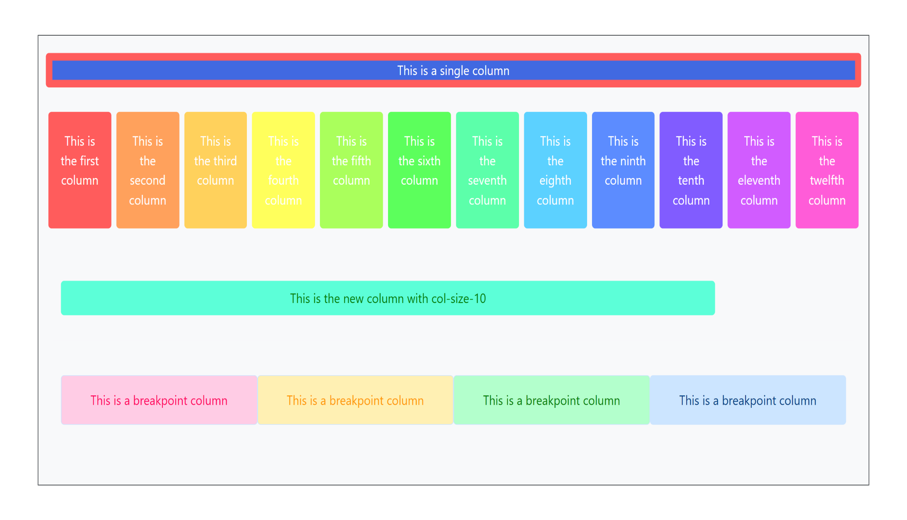
Original web page

Slide 20
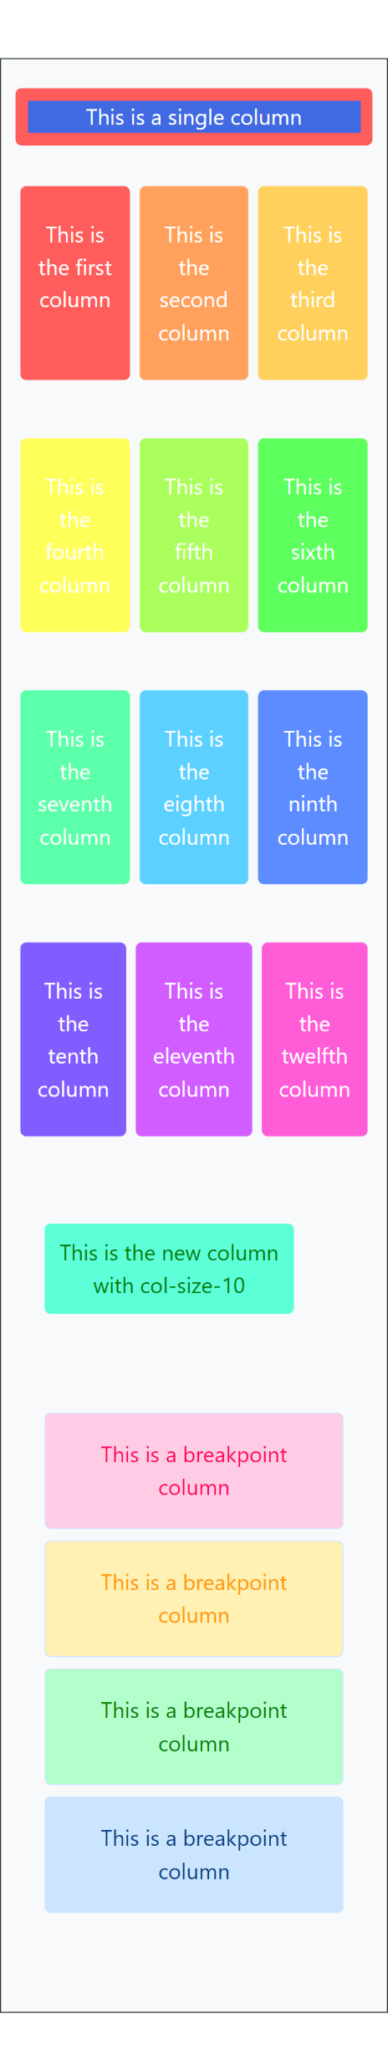
Mobile view : 320px

Slide 21
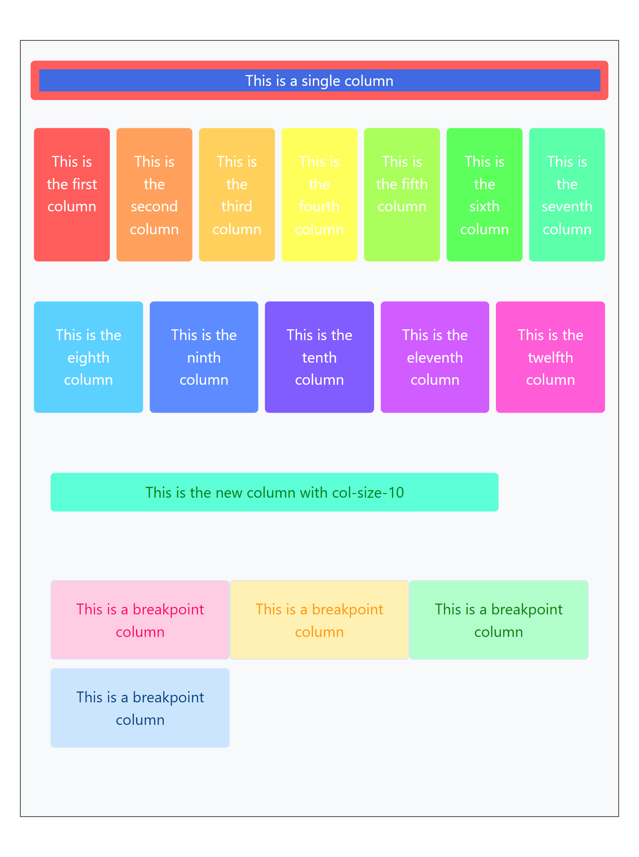
Tablet : 768px

Slide 22
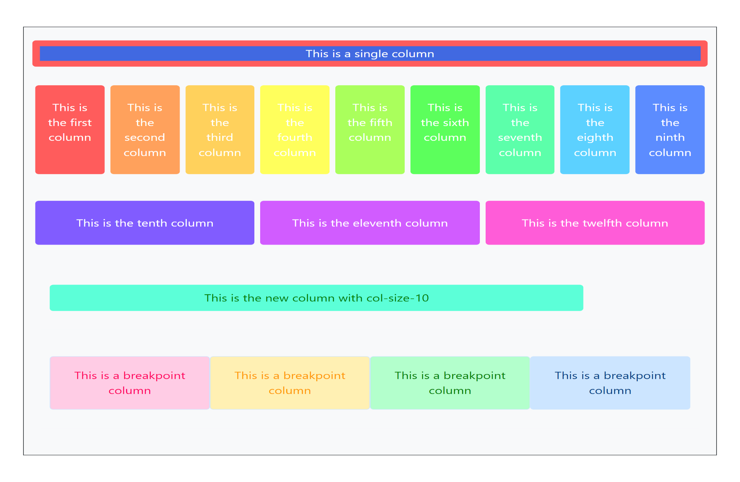
Laptop : 1024px

Slide 23
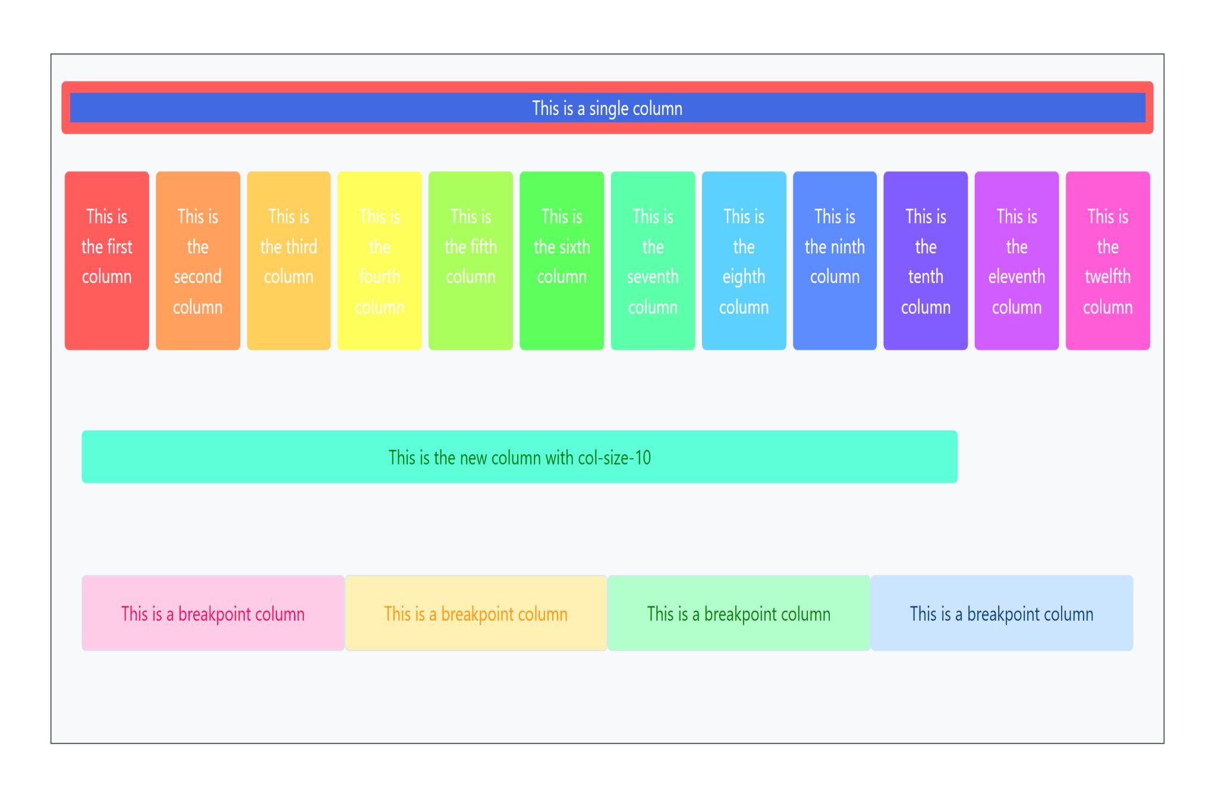
Laptop : 1440px

