Slide 1
Final
Mohan Wang

Slide 2
Outline
1. Data processing and analysis
2. Plot on Data
3. Linear regression Model
4. LR model analysis

Slide 3
Data processing and analysis
3.1 – 3.1 group for every year
Drop NA data, calculate day average value (standard is base on day average value)

Slide 4
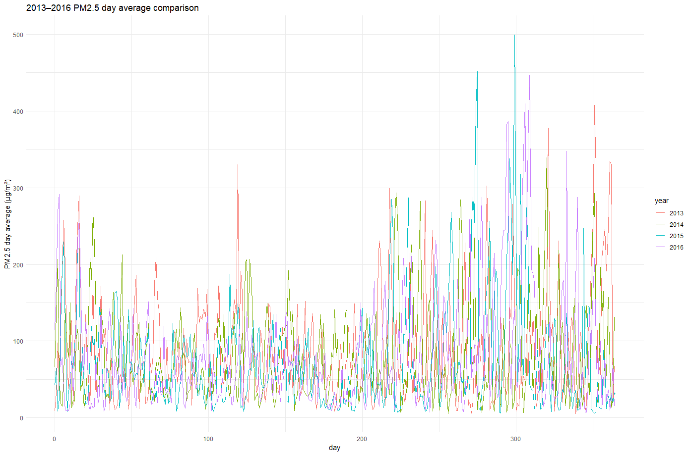
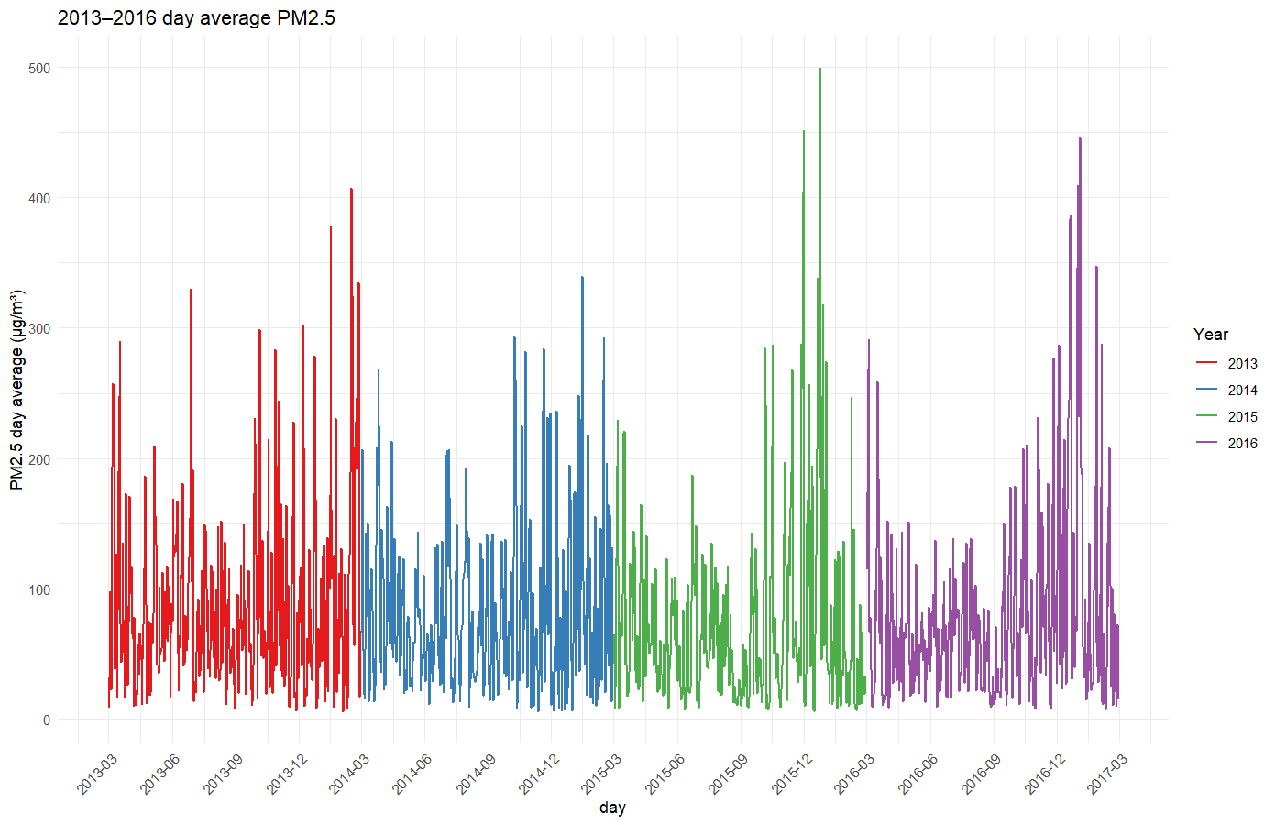

Slide 5
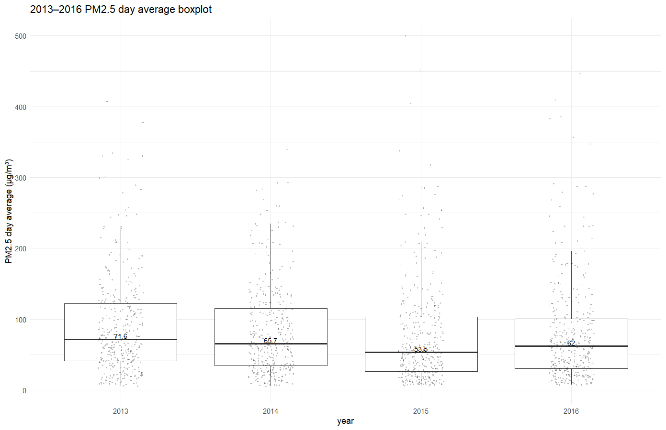
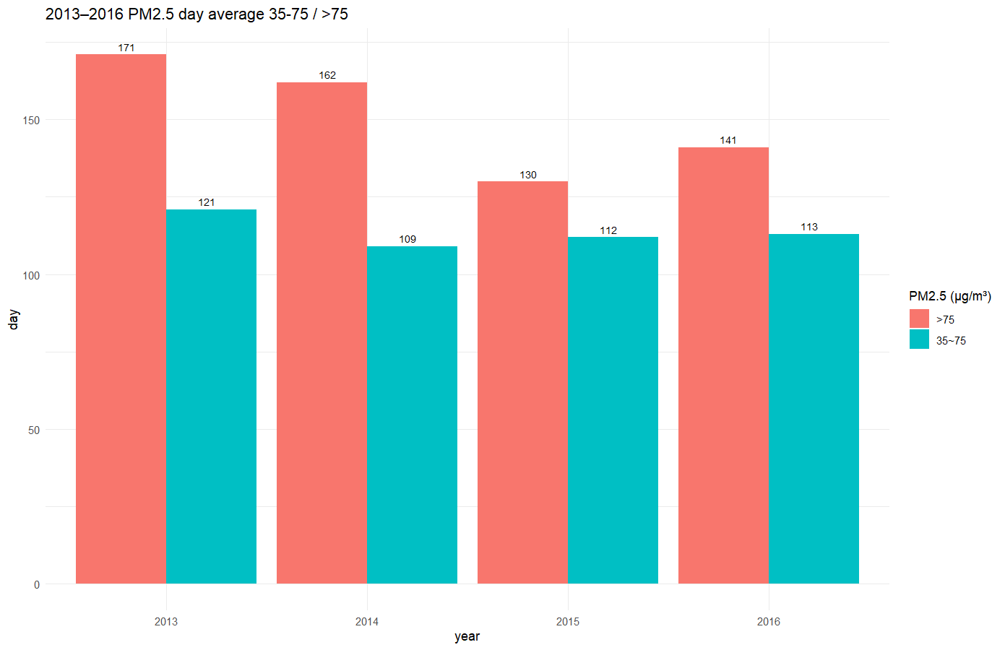

Slide 6
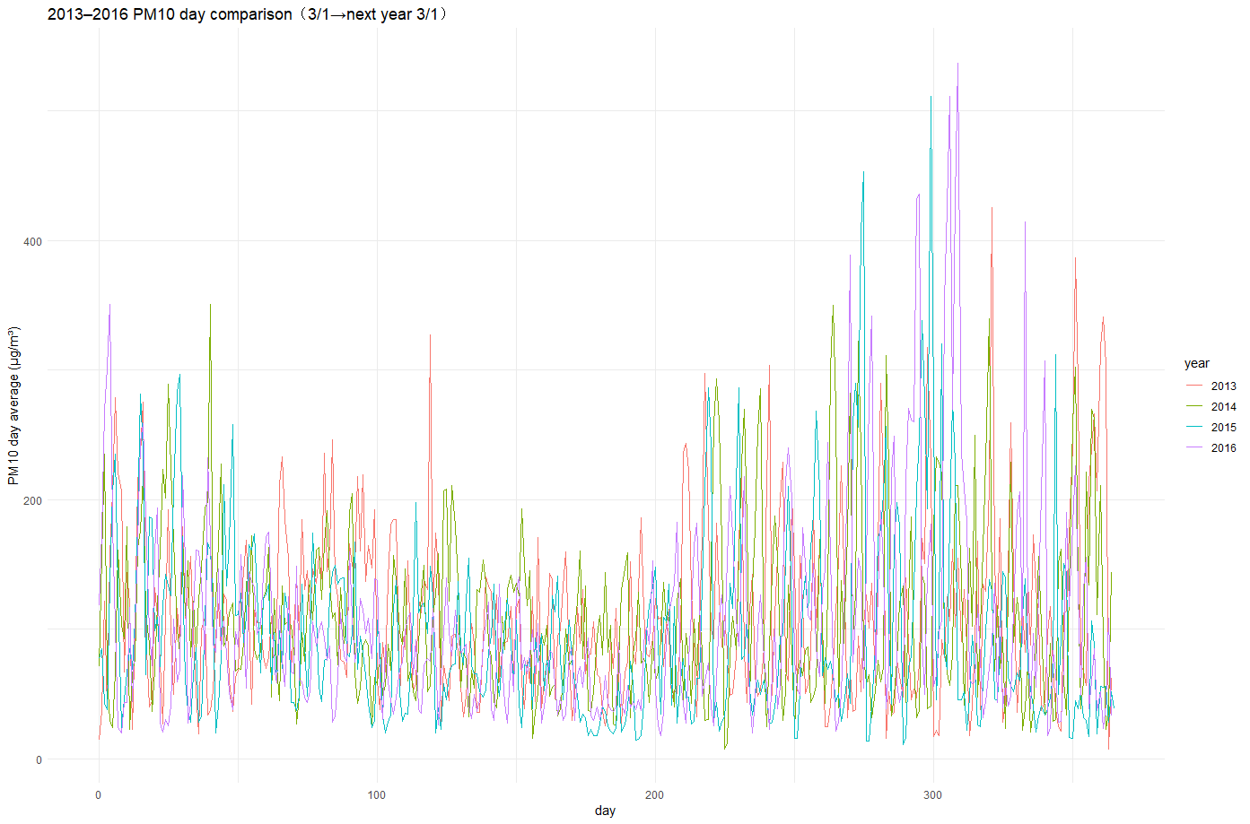
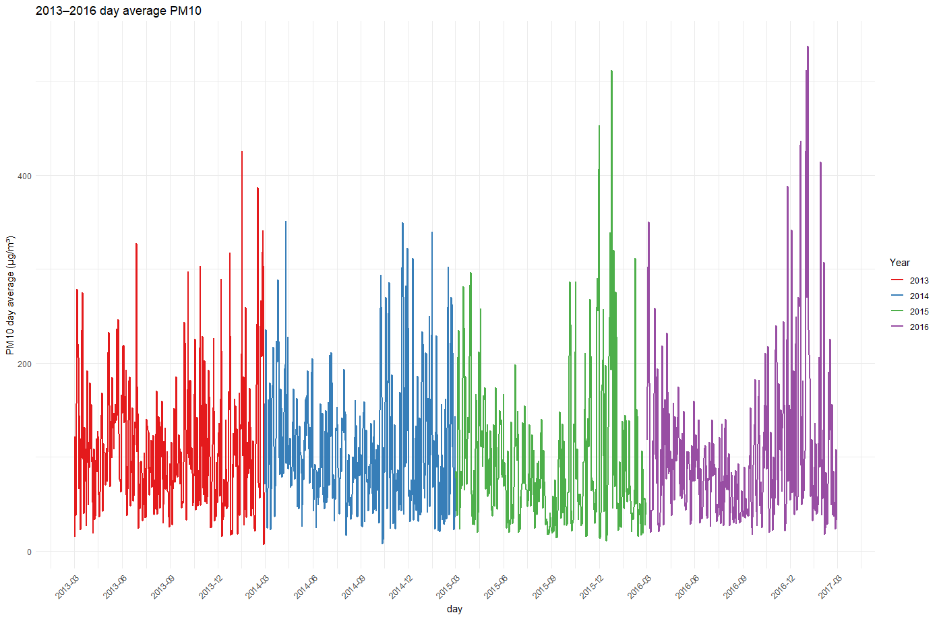

Slide 7
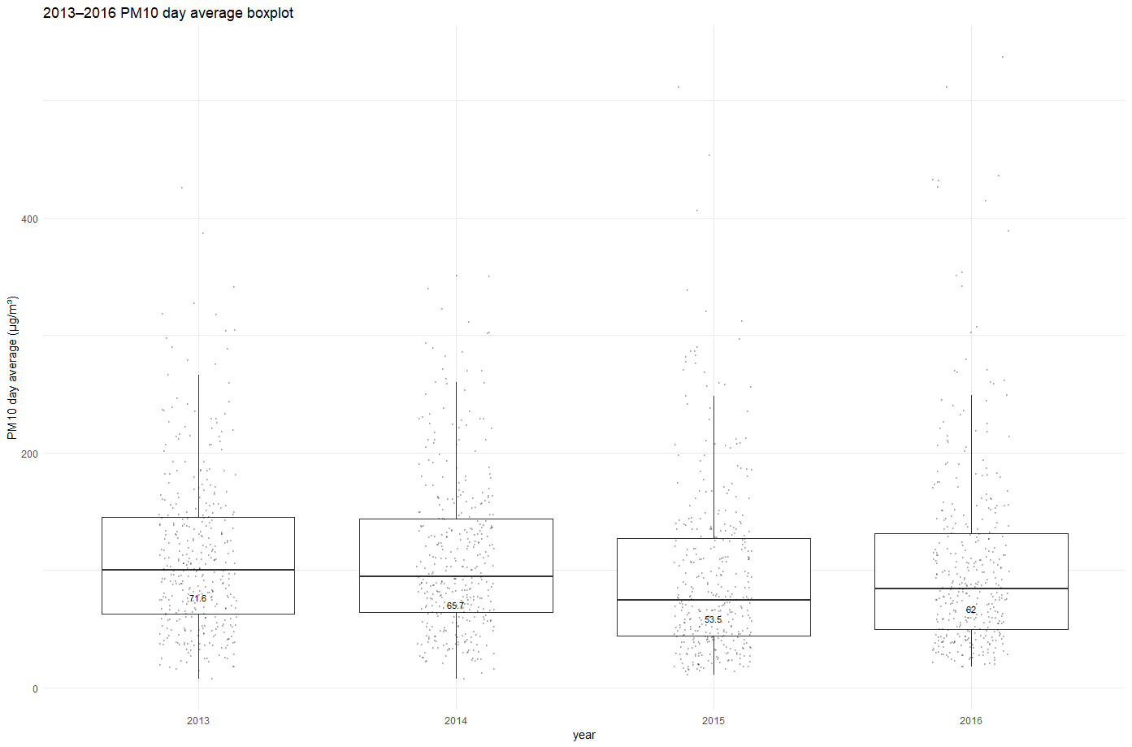
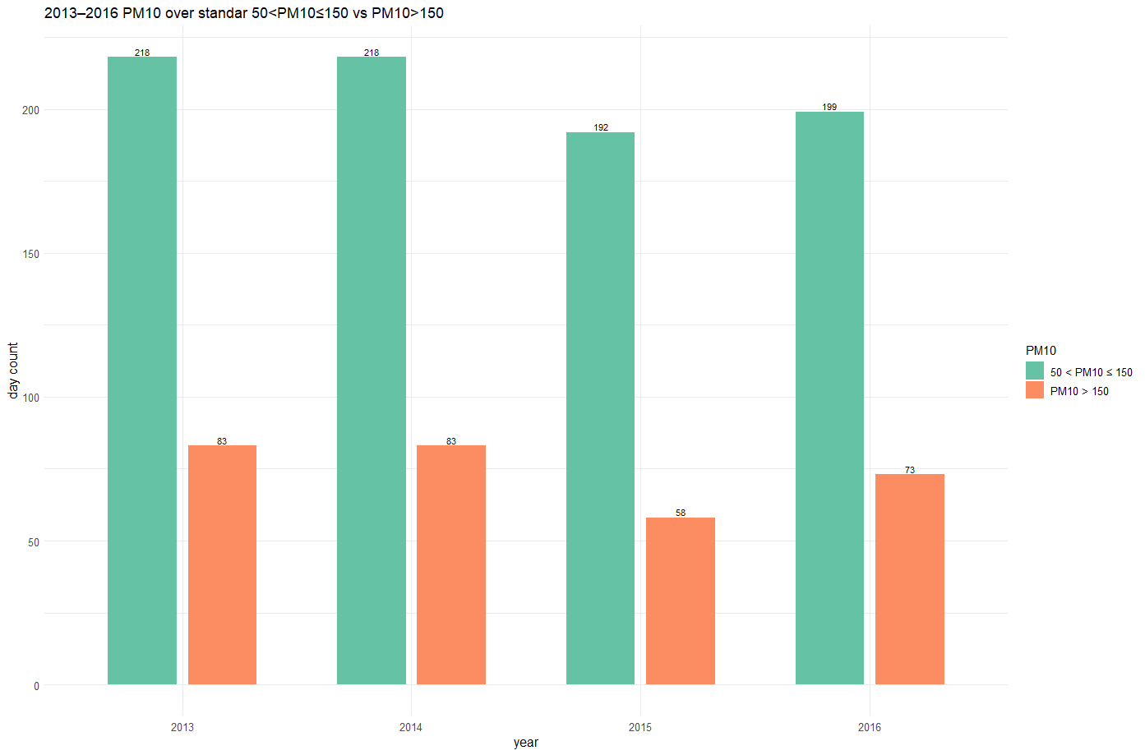

Slide 8
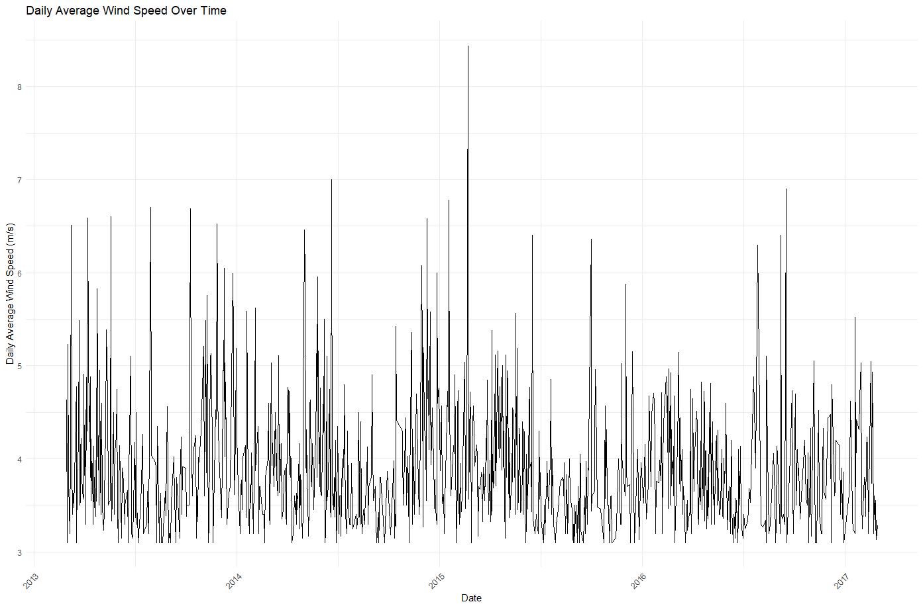
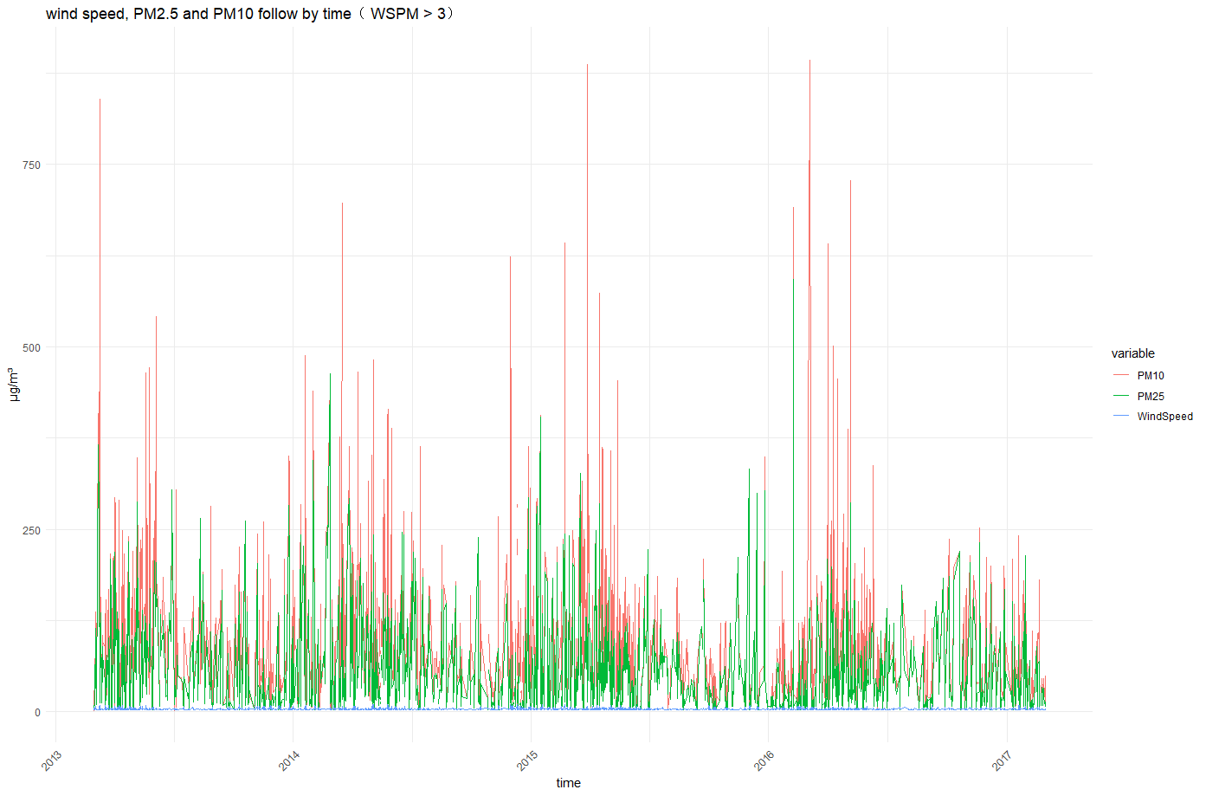

Slide 9
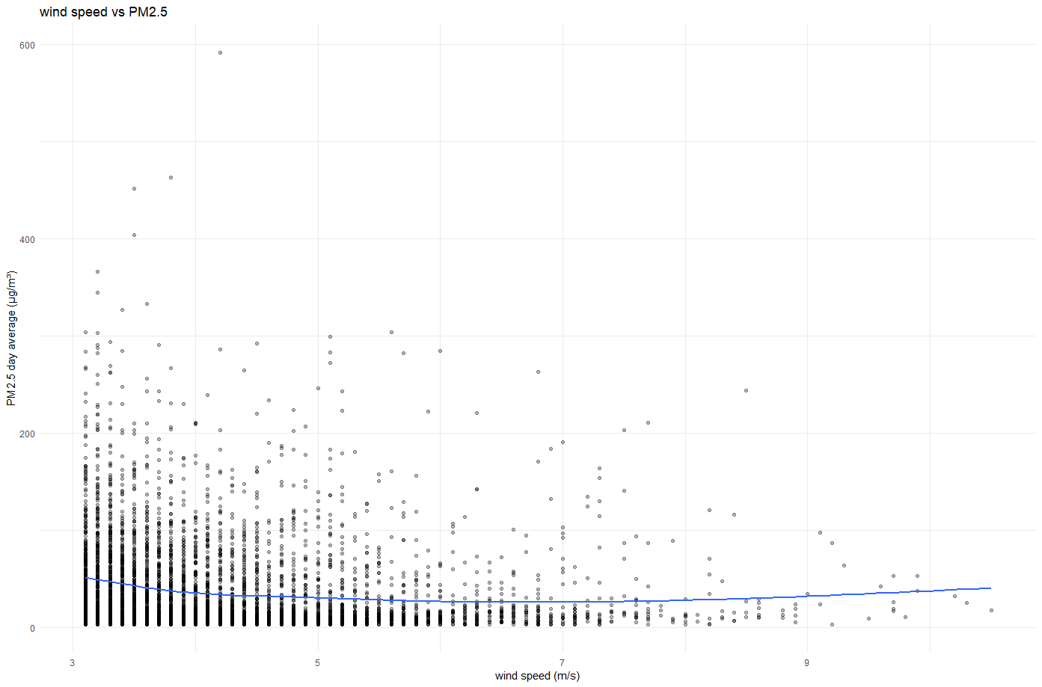
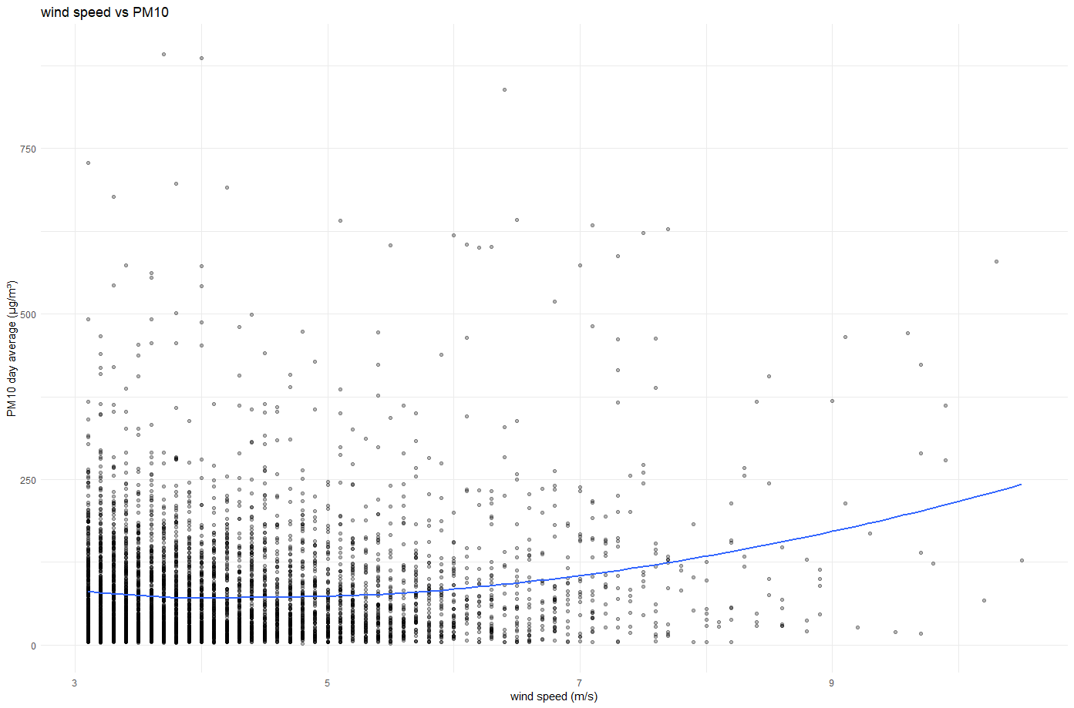

Slide 10
Linear regression Model
Model for time
Model with all element
Model on RAIN and Wind Direction(with comparison)

Slide 11
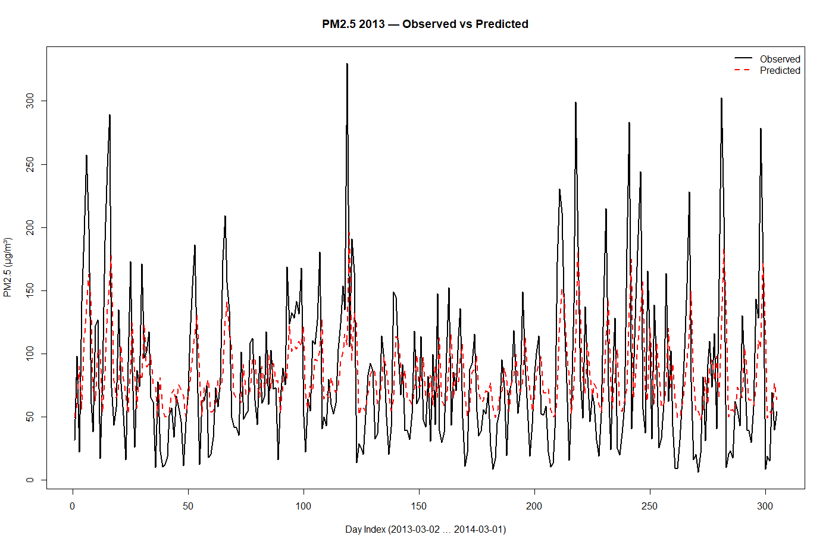
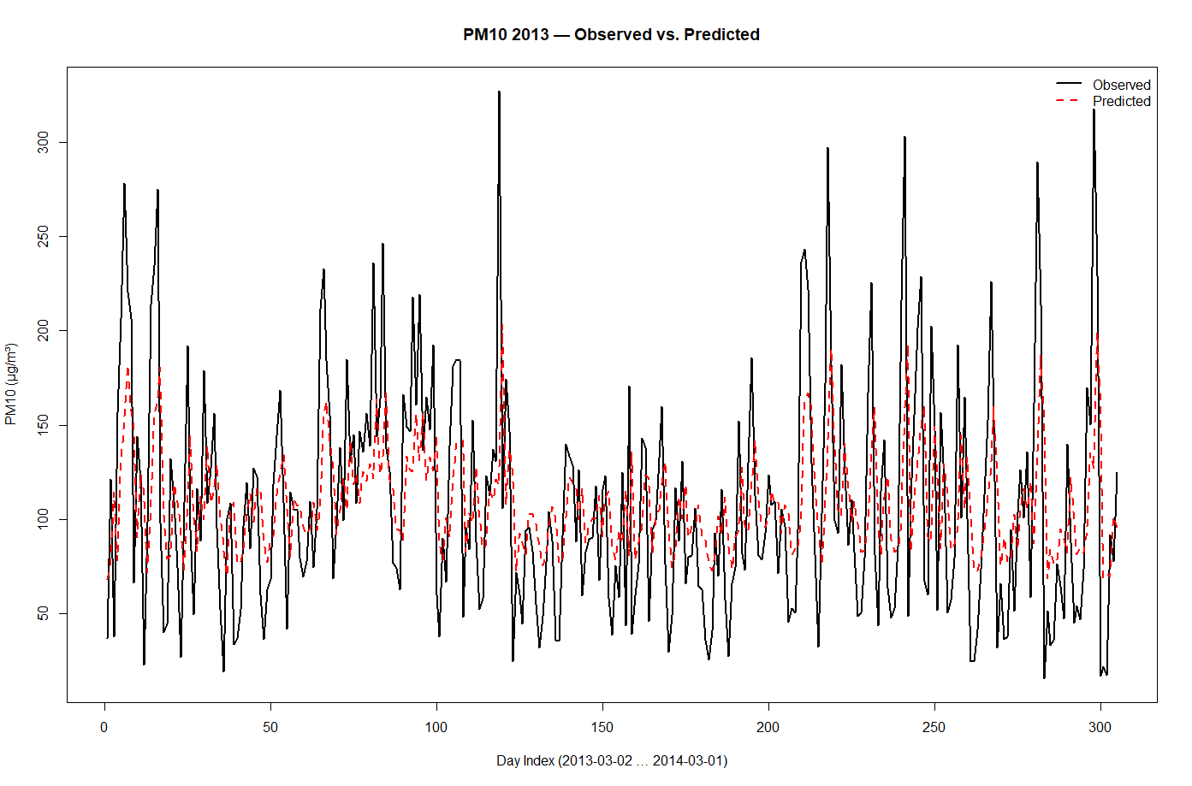
Time prediction LR model
Use yesterday’s value to predict tomorrow’s value

Slide 12
PM2.5
54.91
PM10
 |  | intercept
Estimate | 0.45688 | 45.41623
std. Error | 0.05097 | 5.25892
P value | 2e-16 | 3.38e-16
 |  | intercepte
Estimate | 0.43275 | 61.75245
std. Error | 0.05155 | 6.40405
P value | 1.81e-15 | < 2e-16
R-squared=54.91
R-squared=54.14
P < 0.01

Slide 13
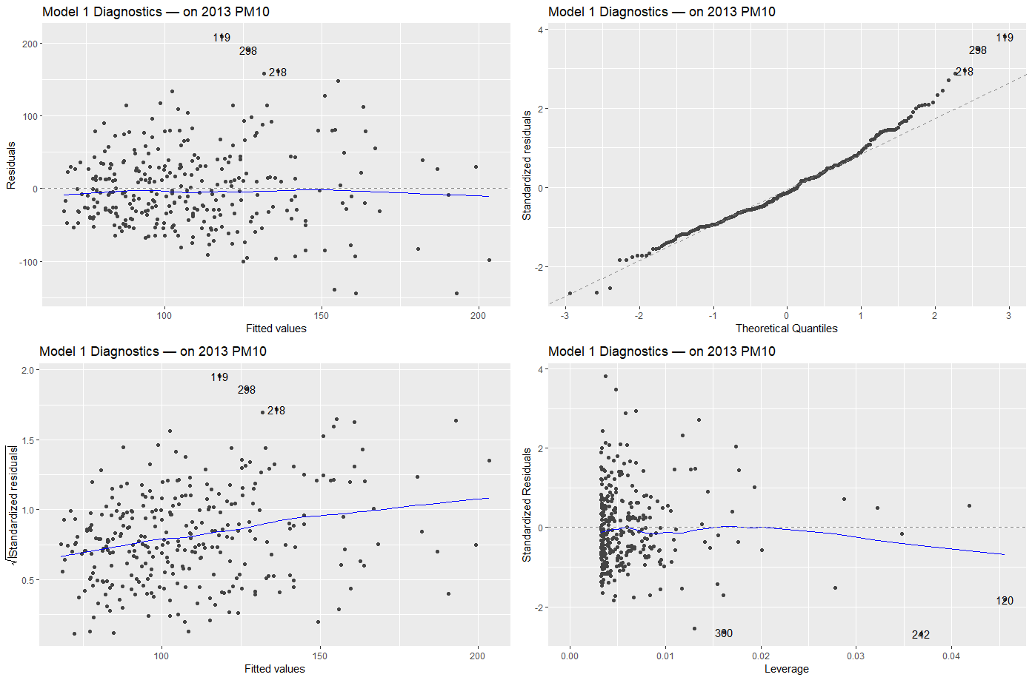
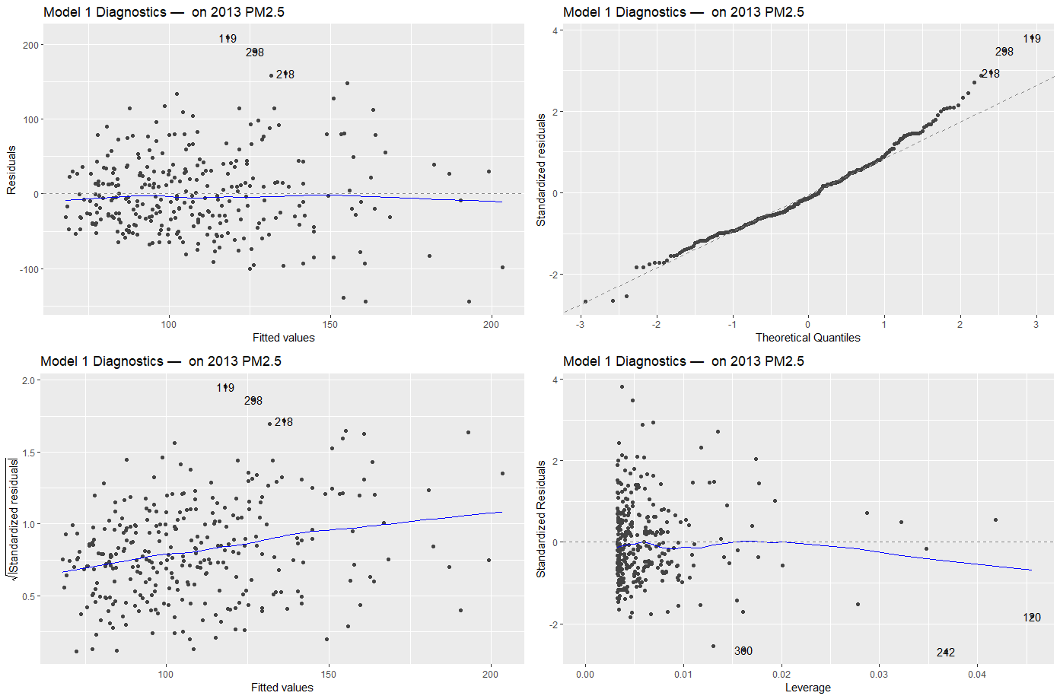

Slide 14
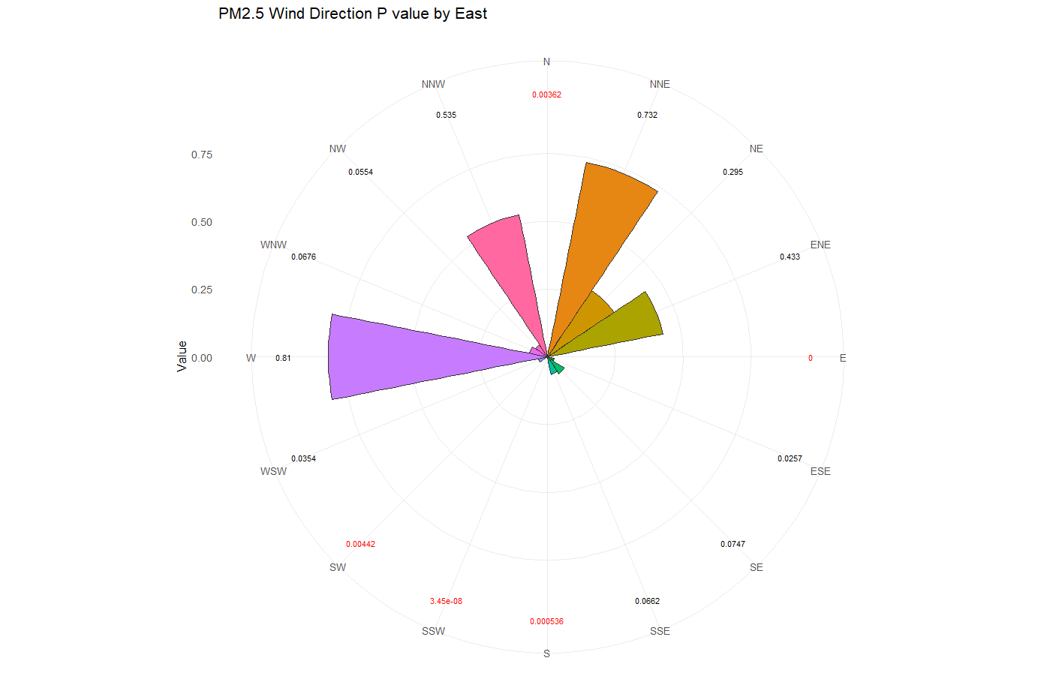
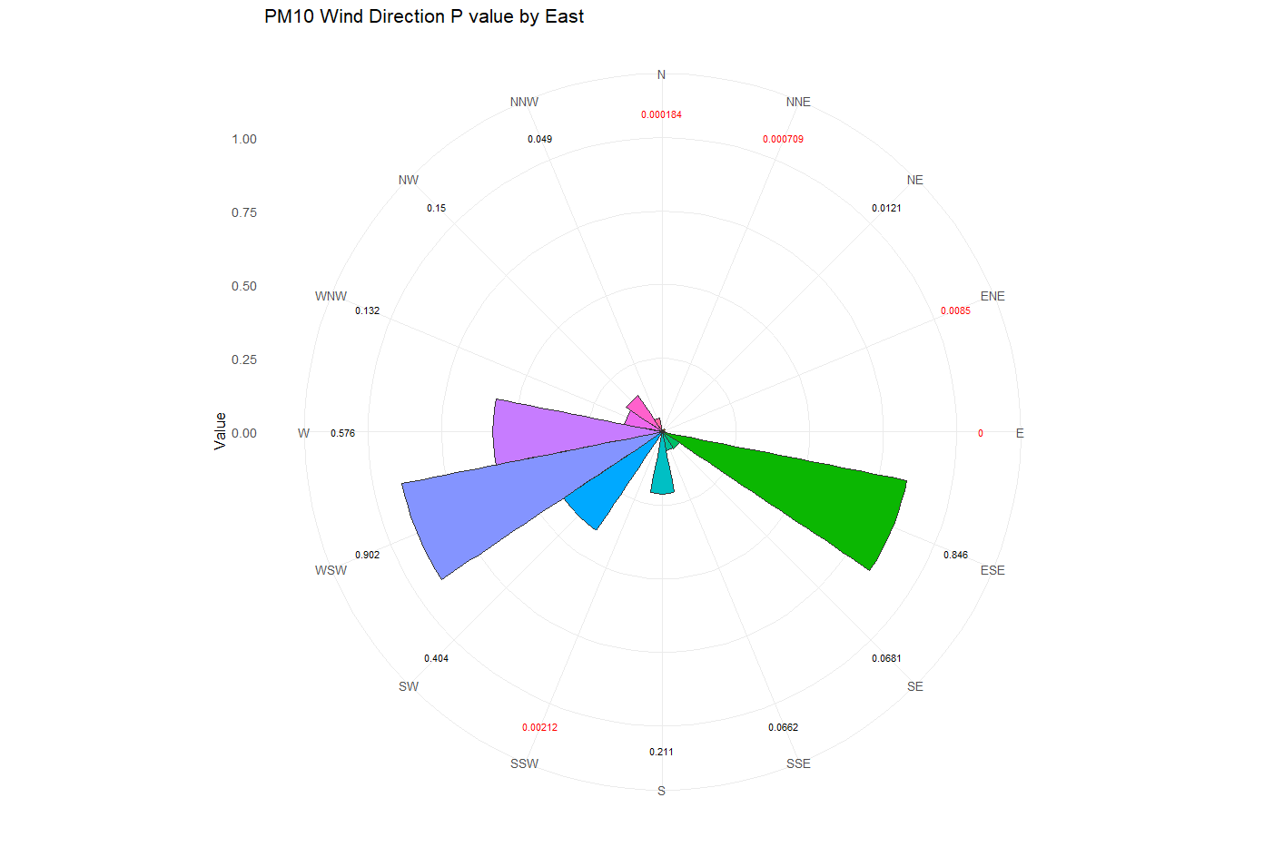
Model with all element – Wind Direction

Slide 15
Model on Temperature and Rain
TEMP |  | RAIN |  | intercept
Estimate | -0.95274 | Estimate | -2.66454 | 95.7408
std. Error | 0.04262 | std. Error | 0.60502 | 0.6801
P value | < 2e-16 | P value | 1.07e-05 | <2e-16
R-squared = 79.02

