Slide 1
Moseq Progress Report
Mohan Yang

Slide 2
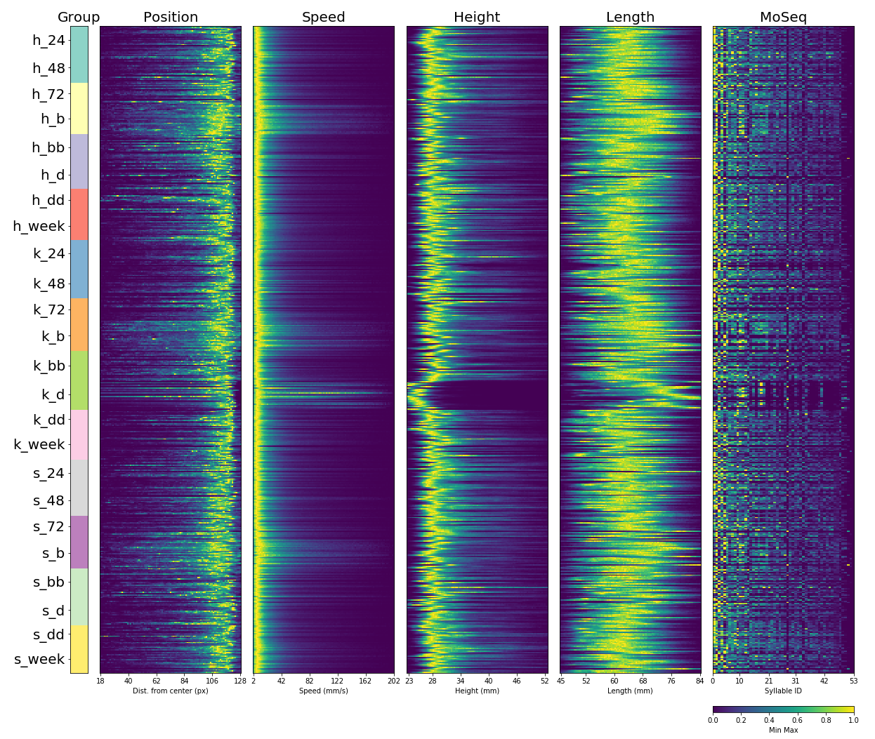
Steve’s Ketamine
Data Summary
Total of 519 Recorded Sessions (Approximate 6TB of data in total)
24 different treatment groups
The figure on the right shows the Behavioral Summary (Fingerprints)

Slide 3
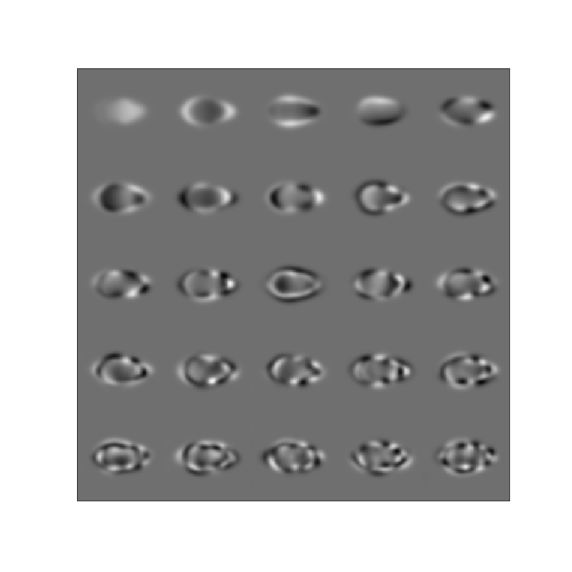
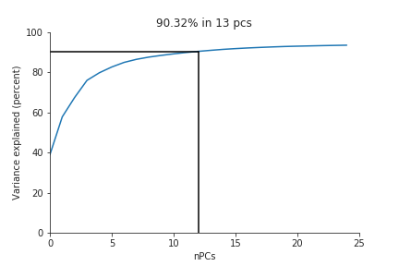
Fitting PCA
13 Principal Components in Steve’s recorded data will explain 90% of the variation.
In the AR-HMM model fitting, I have tuned the parameters of number of PCs to 13 in order to reach 90% explained variation.

Slide 4
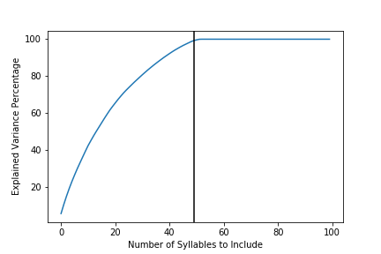
Maximum Syllable setting
Instead of the previous 100 maximum states (syllables), I set the parameter of maximum states to 60 for the AR-HMM model.
After the model is trained, it turns out that 49 syllables are enough to explain 99% of the variation for all frames
It took 7 hours to train the model

Slide 5
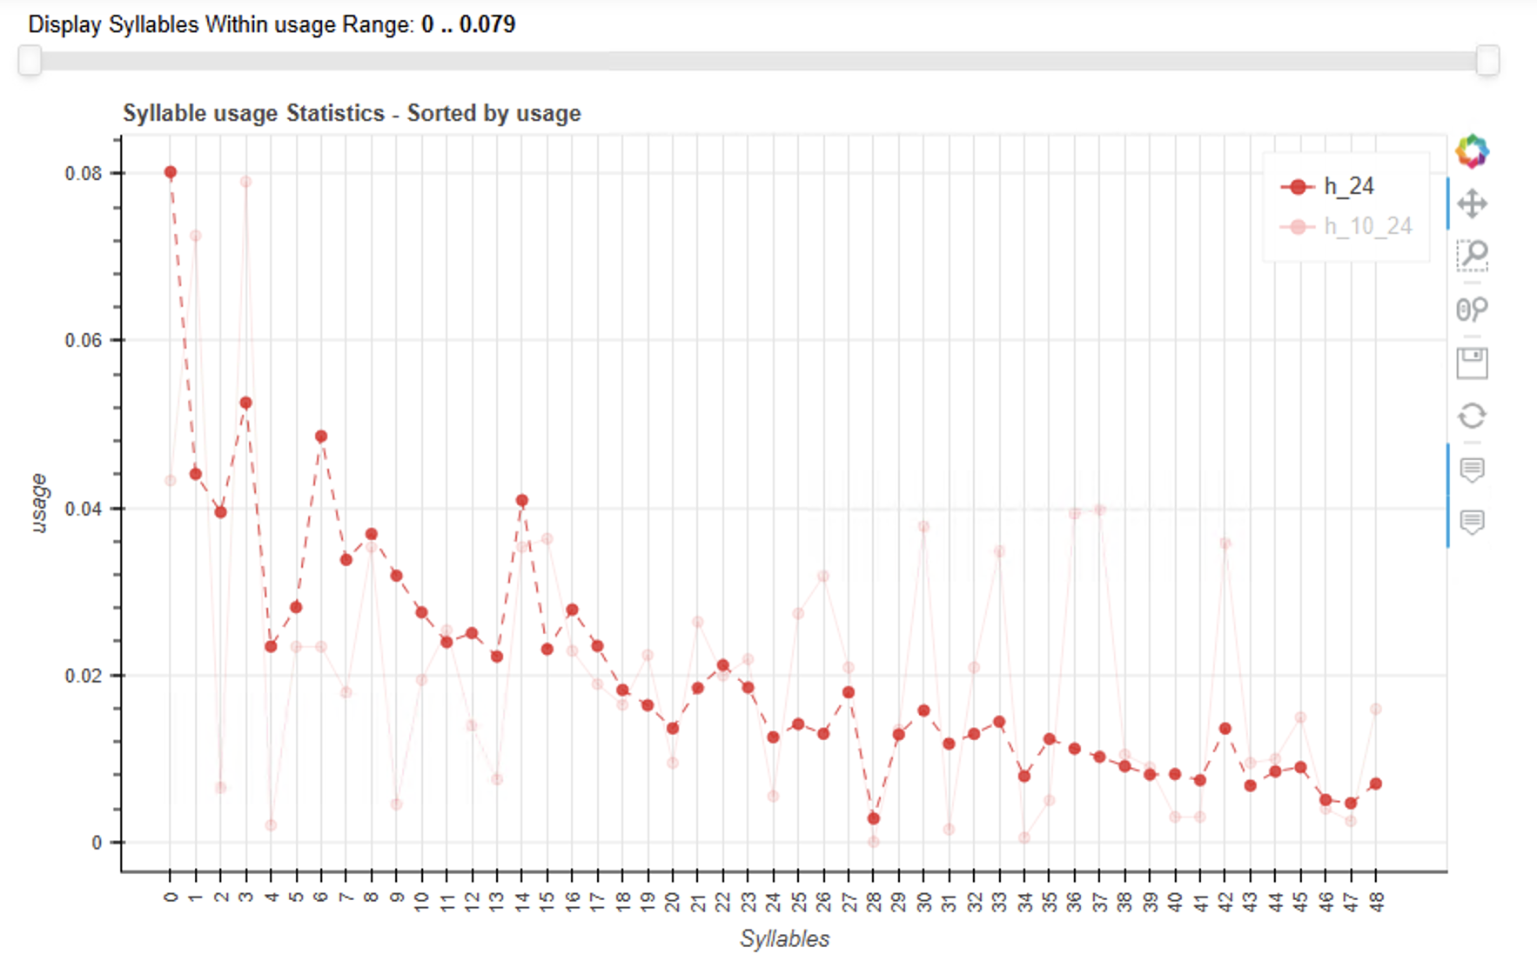
Syllable Usage
Due to the large dataset, the syllable statistic in moseq pipeline takes a long time to compute and visualize.
Currently facing trouble with the interactive widgets provided in moseq not responding.
Can use the raw data stats_df.scv to calculate this plot ourselves.

Slide 6
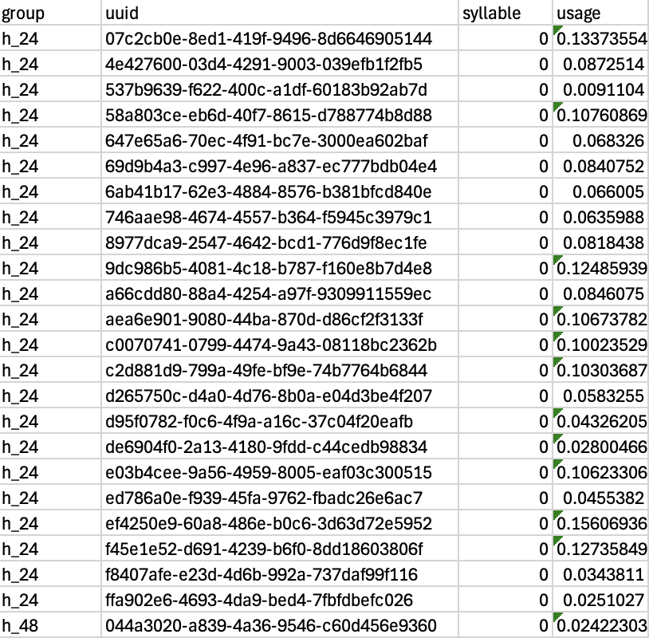
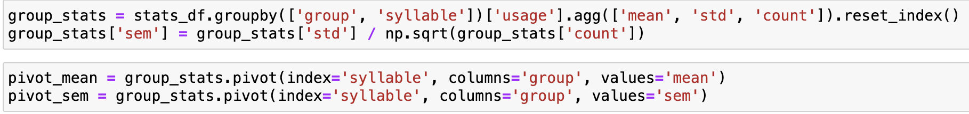
Calculate Syllable Usage manually from stats_df
Each row represents a recorded session
Eg: The first row represents the first session recorded for h_24 group, and it’s usage on syllable 0 is 13%
We can group by the “syllable” and “group” columns to obtain the mean and standard deviation of the usage for each syllable per treatment group.

Slide 7
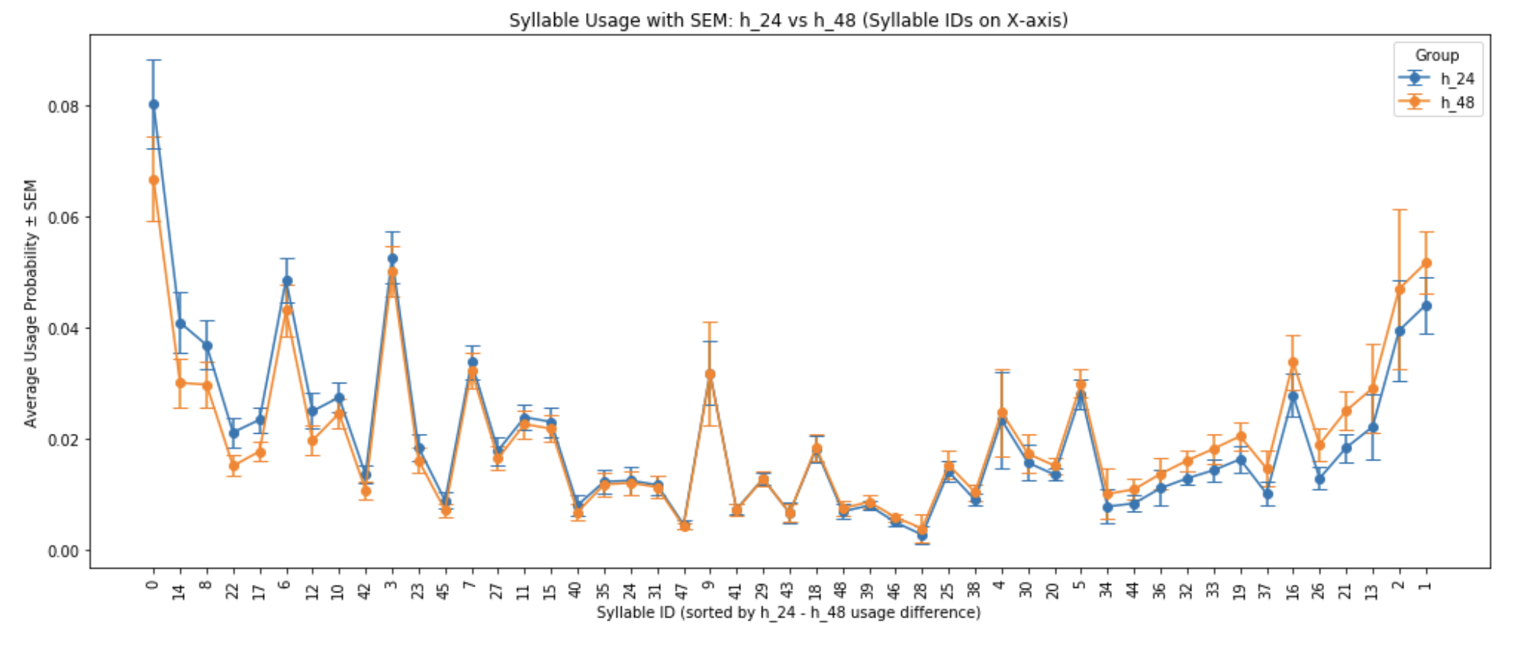
Reproduced similar syllable usage visualization
Using pandas and matplotlib, I have reproduced this plot from stats_df
By using the standard error of the syllable usage, we can also conduct hypothesis testing
Question: What are the groups of interest to compare with? I can reconstruct this plot with different groups.

Slide 8
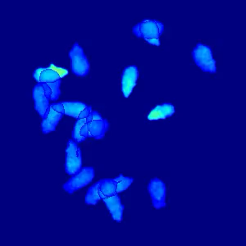
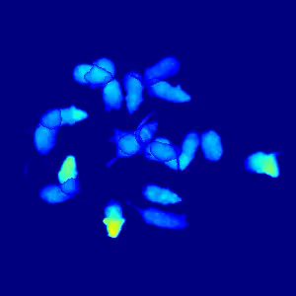
Further Work
Manually interpret each syllable (49 in total) from crowd movie
Syllable 0 (rest?):
Syllable 1:

