Slide 1
08/07 Update

Slide 2
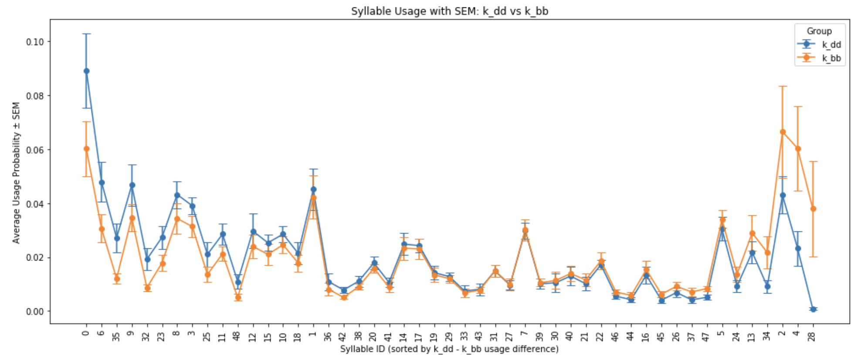
Syllable Usage
2 Hour after injection (k_dd) vs Baseline (k_bb)

Slide 3
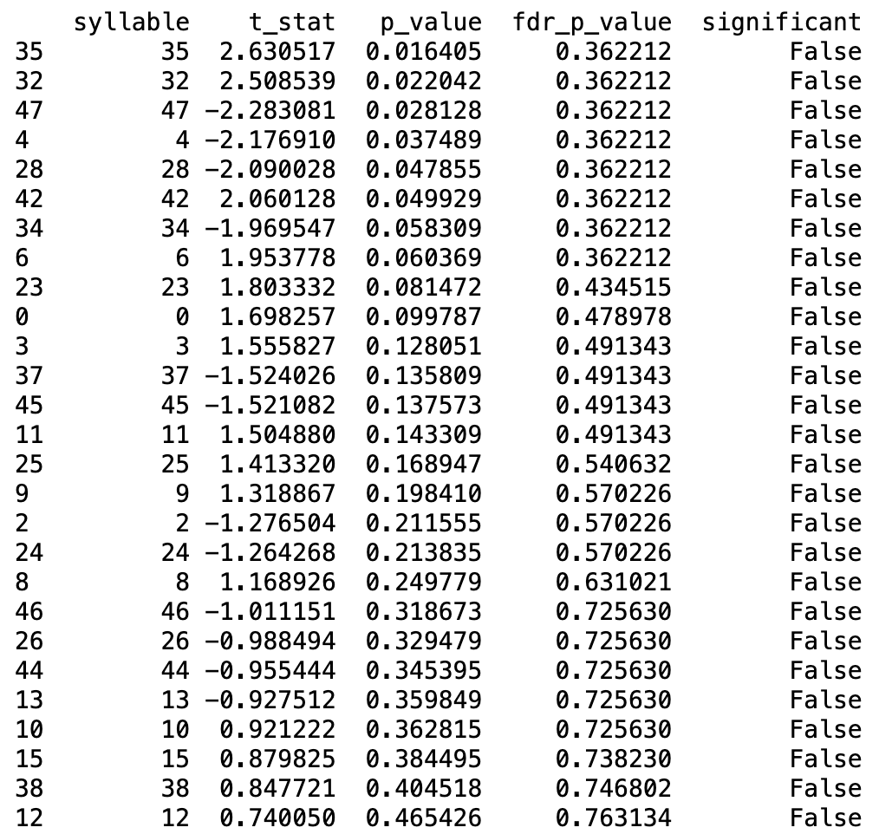
Syllable t-test with FDR adjusted p-value
Syllable test between k_dd group and k_bb group, which is the ketamine injection group after 2 hours compared with the baseline group.
The p-value for syllable 35, 32, 47, 4, 28
42 is less than 0.05. However, the FDR p-values are all non-significant.
I used Benjamini-Hochberg’s method for the FDR

Slide 4
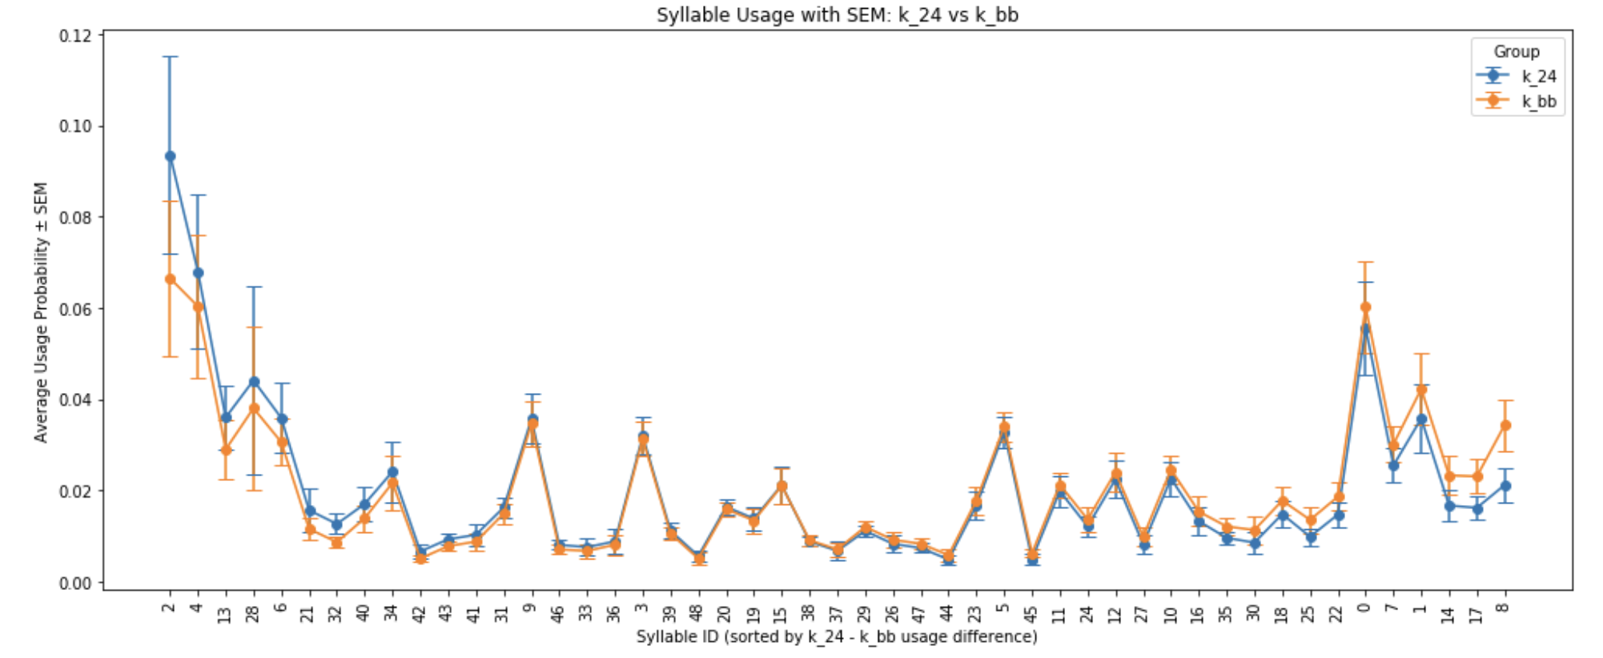
Syllable Usage
24 Hour after injection (k_24) vs Baseline (k_bb)

Slide 5
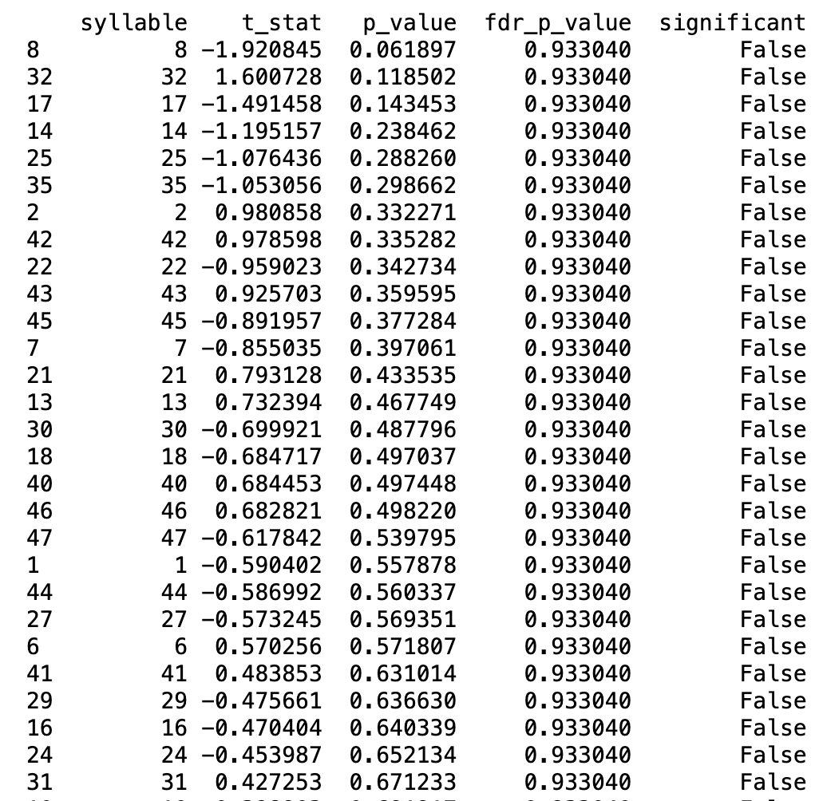
Syllable t-test with FDR adjusted p-value
Syllable test between k_24 group and k_bb group, which is the ketamine injection group after 24 hours compared with the baseline group.
None of the syllable has significant usage difference.

Slide 6
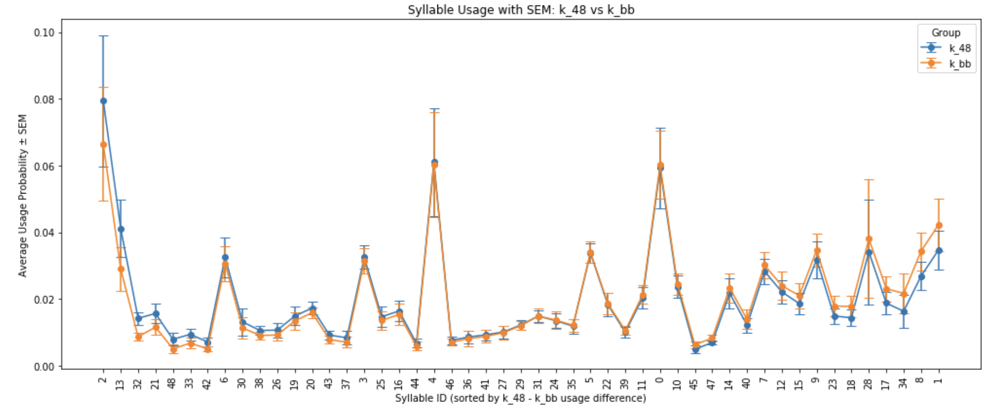
Syllable Usage
48 Hour after injection (k_48) vs Baseline (k_bb)

Slide 7
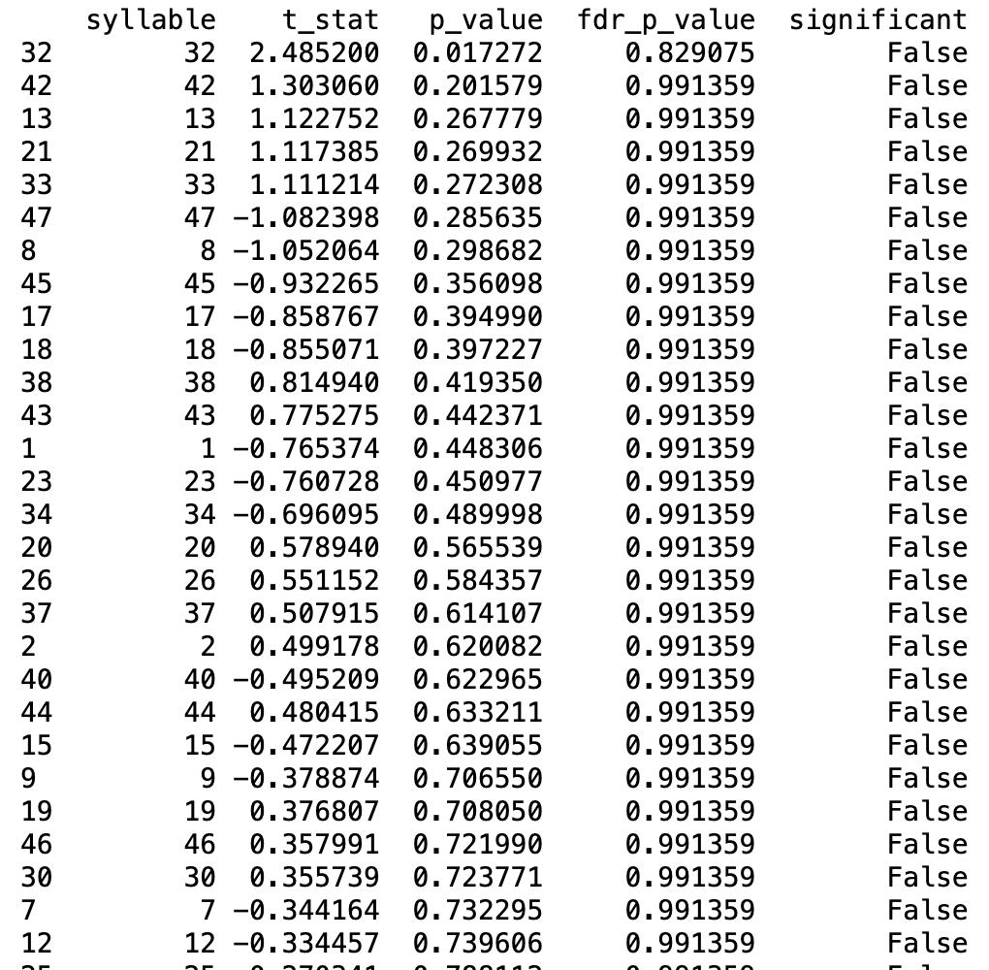
Syllable t-test with FDR adjusted p-value
Syllable test between k_48 group and k_bb group, which is the ketamine injection group after 48 hours compared with the baseline group.
Syllable 32 has a p-value less than 0.05, but FDR p-value is non-significant.

Slide 8
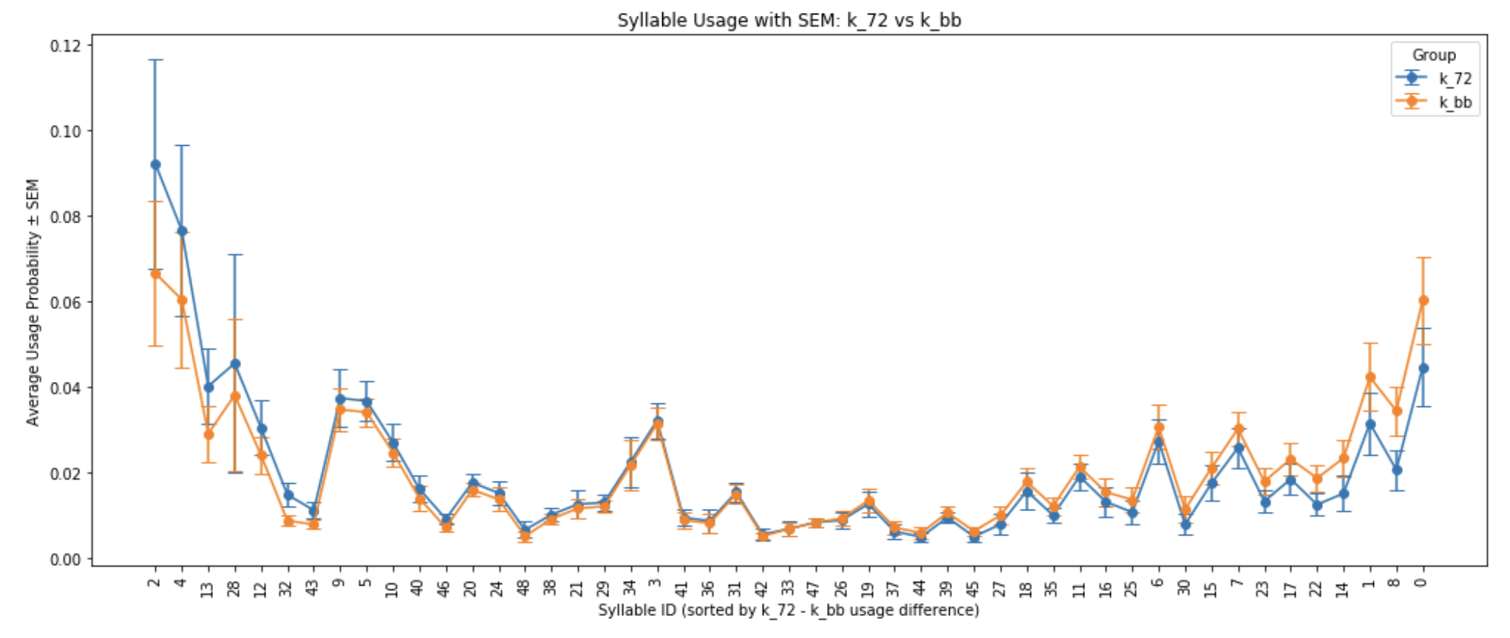
Syllable Usage
72 Hour after injection (k_72) vs Baseline (k_bb)

Slide 9
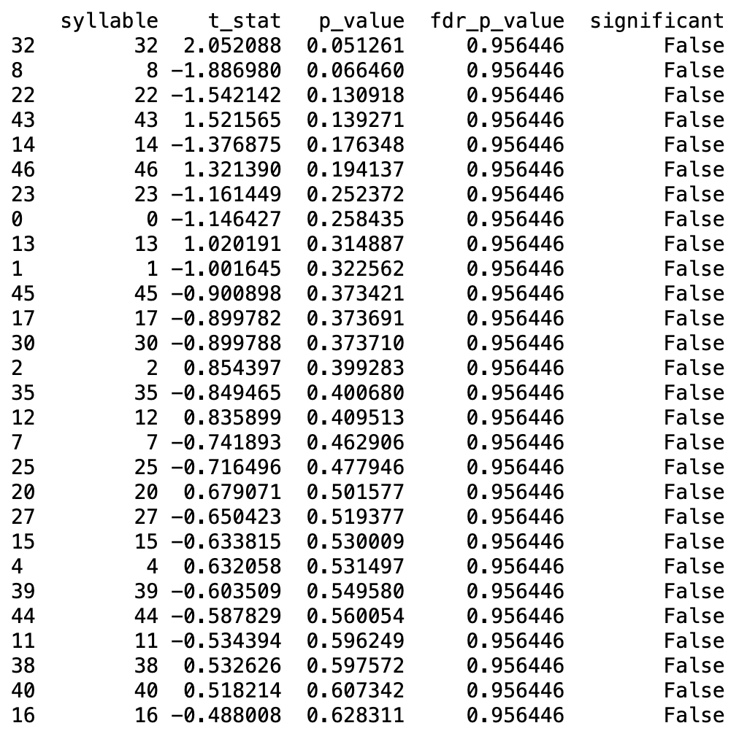
Syllable t-test with FDR adjusted p-value
Syllable test between k_72 group and k_bb group, which is the ketamine injection group after 72 hours compared with the baseline group.
None of the syllable has significant usage difference.

Slide 10
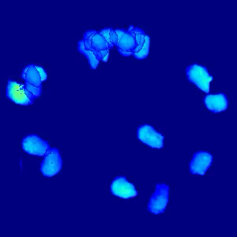
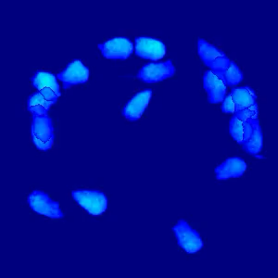
Syllable 32 Syllable 35

Slide 11
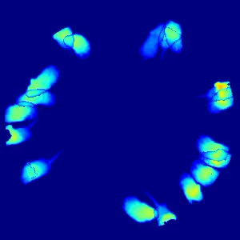
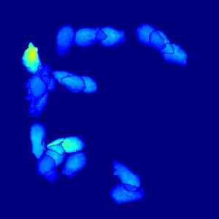
Syllable 47 Syllable 4

Slide 12
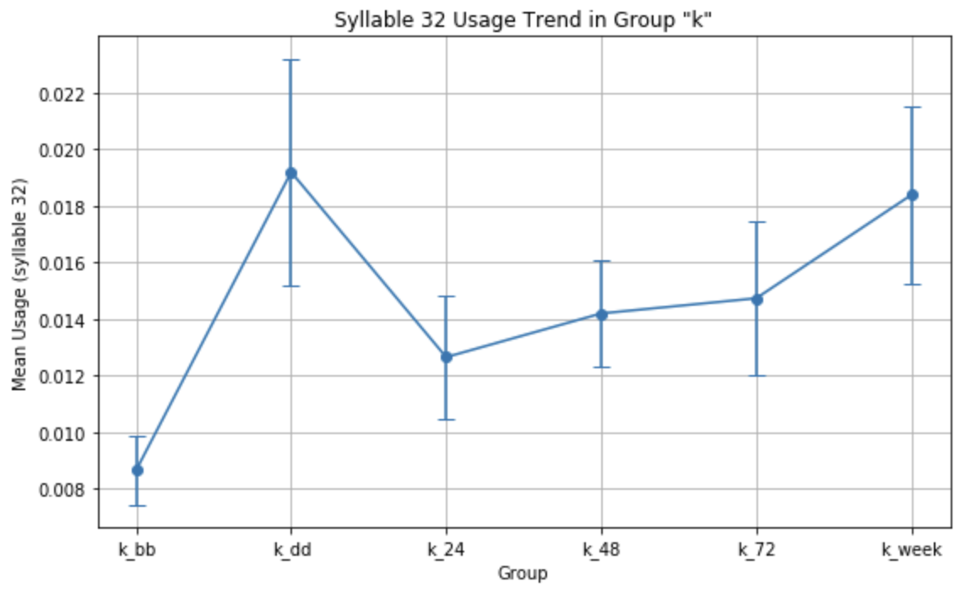
Syllable 32 trend in the ketamine group (Grooming)

Slide 13
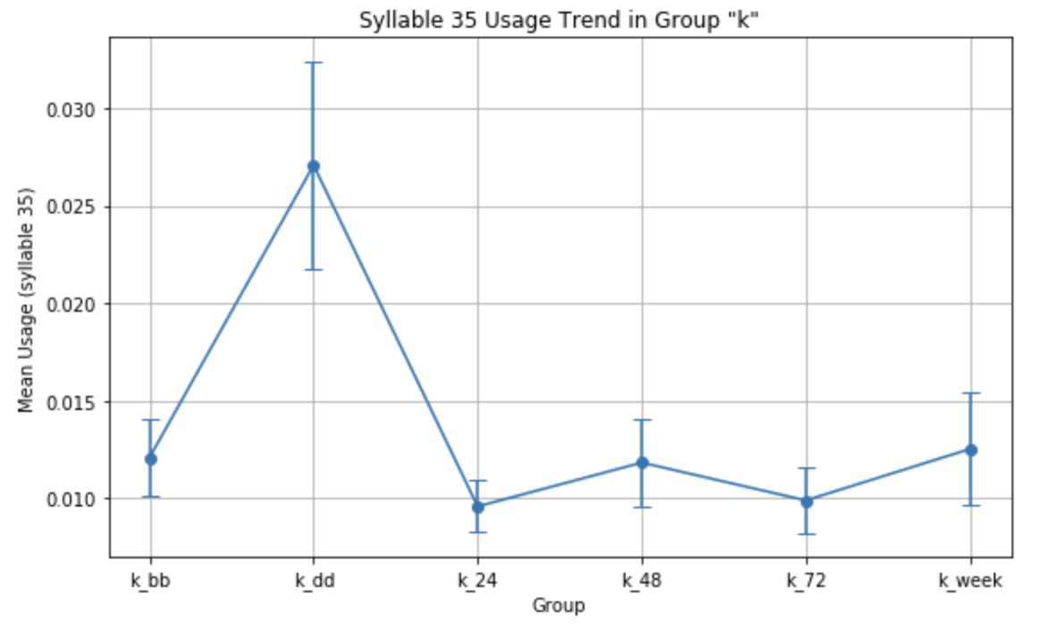
Syllable 35 trend in the ketamine group

Slide 14
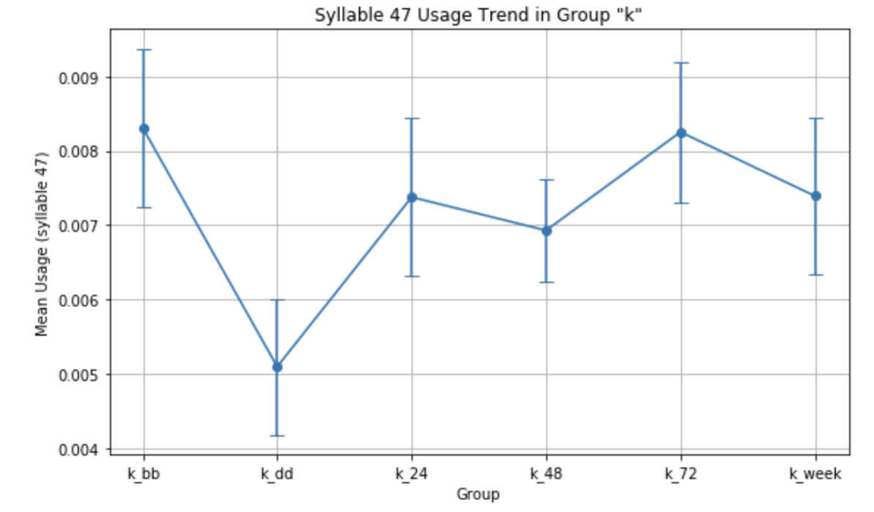
Syllable 47 trend in the ketamine group
(rearing)

Slide 15
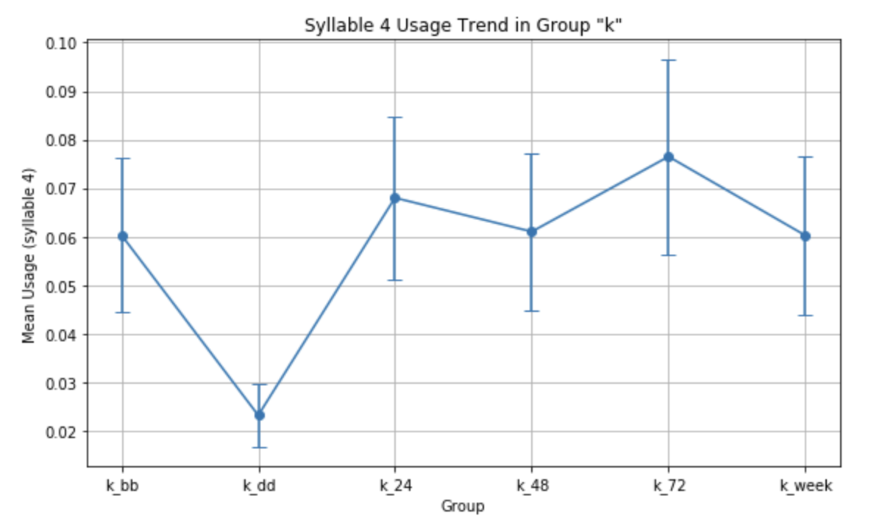
Syllable 4 trend in the ketamine group

