Slide 1
08/07 Update

Slide 2
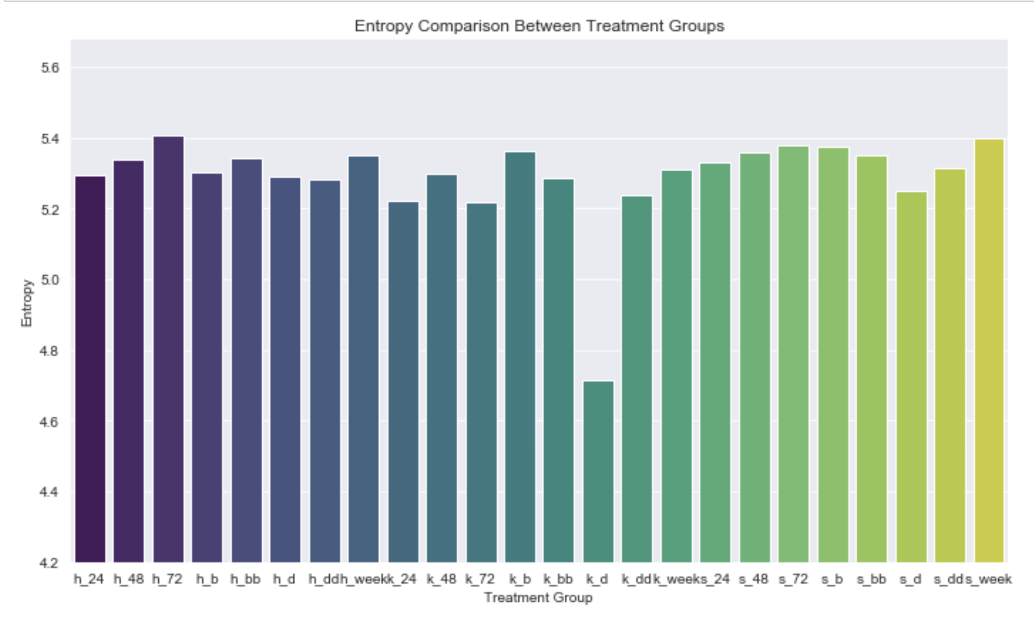
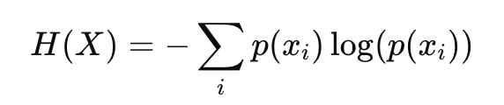
Entropy of syllable usage between groups
Low entropy in the context of syllable usage within a treatment group means that the distribution of syllable usage is highly concentrated or predictable.
In other words, there is a few dominant that make up most of the usage, while the other syllables contribute very little.

Slide 3
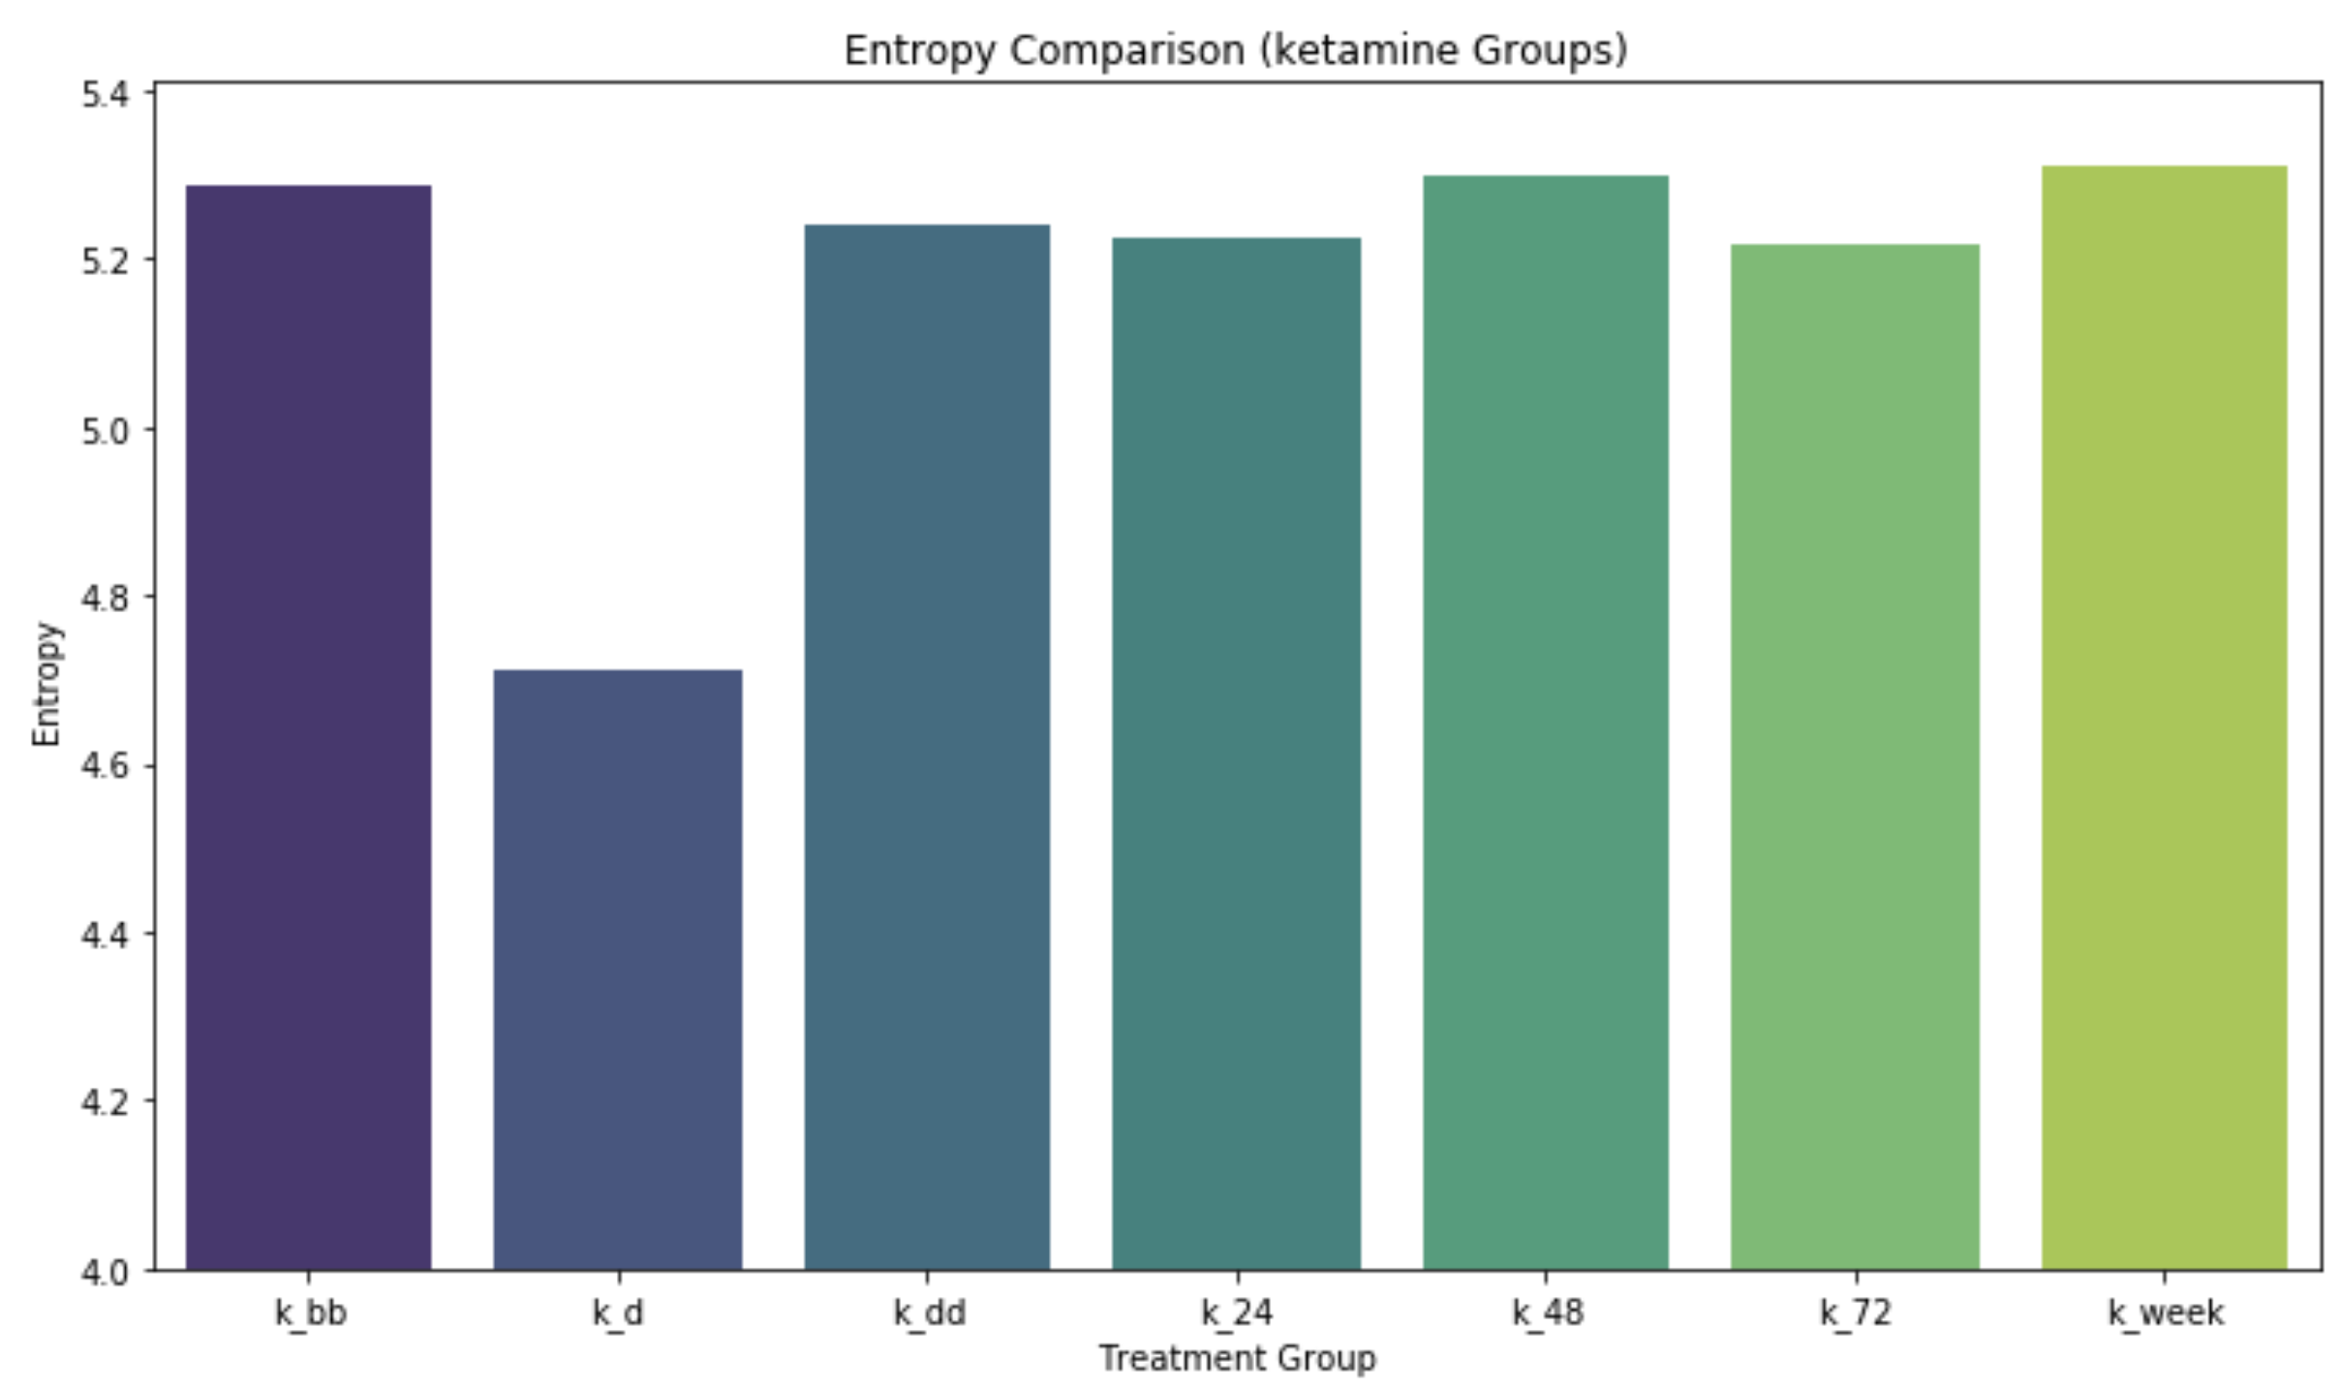
Entropy of syllable usage in ketamine group

Slide 4
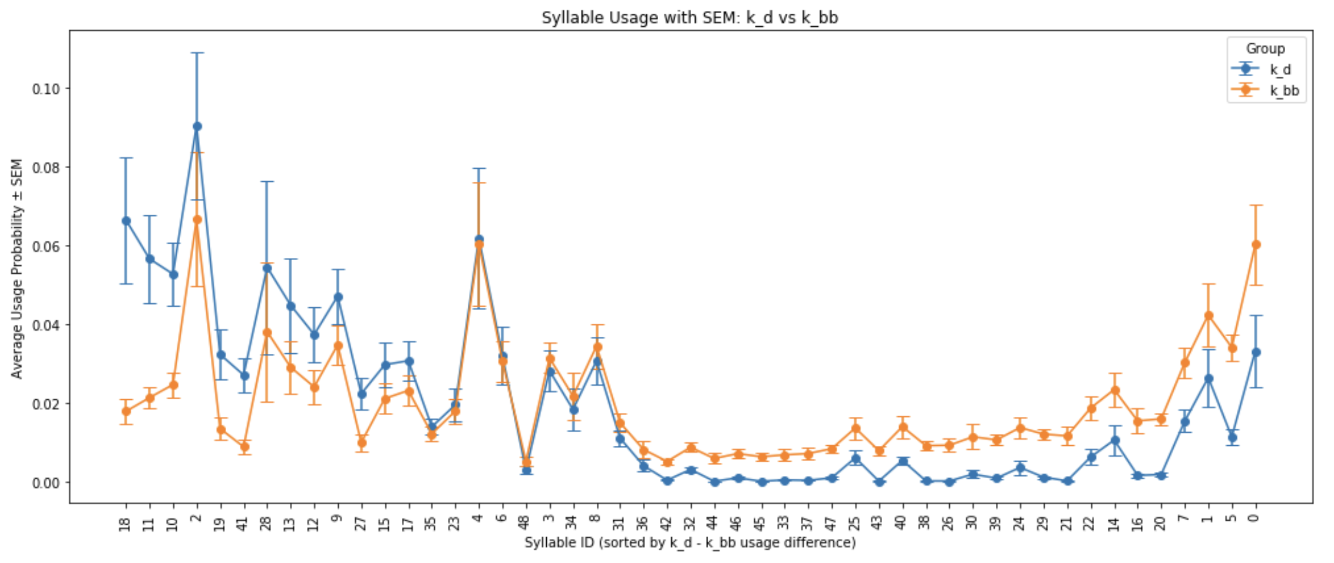
Syllable Usage
10 min after injection (k_d) vs Baseline (k_bb)

Slide 5
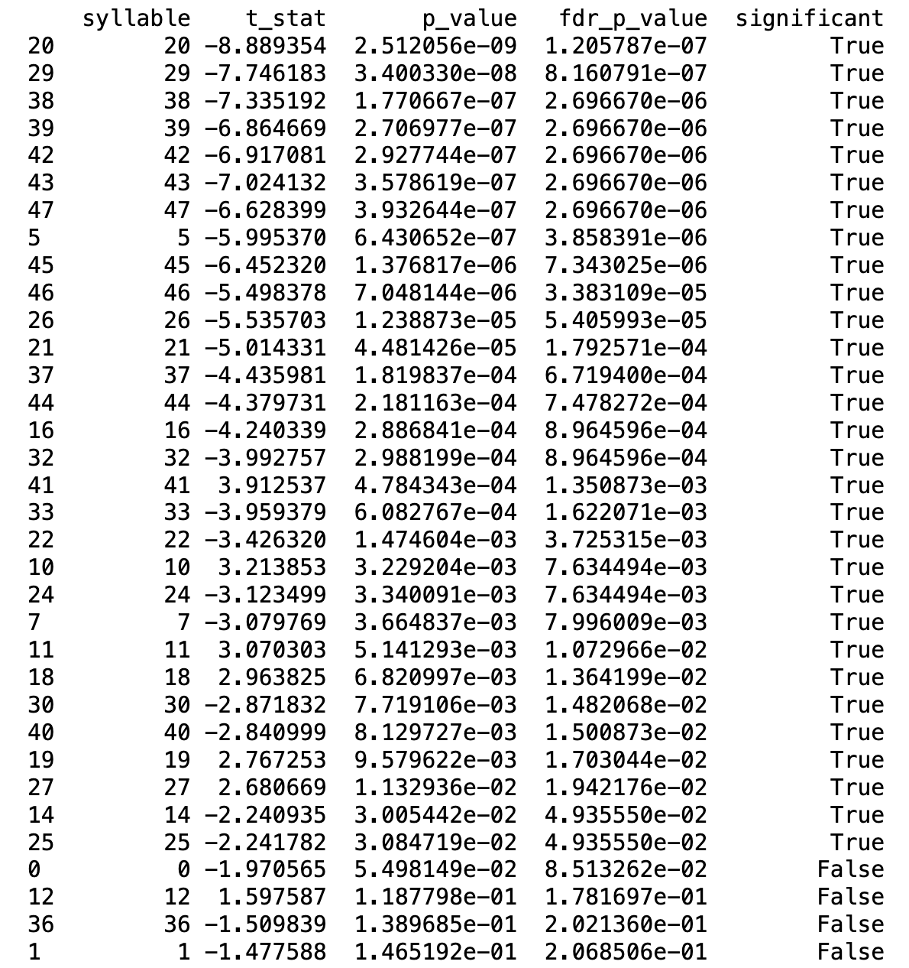
Syllable t-test with FDR adjusted p-value
Syllable test between k_d group and k_bb group, which is the ketamine injection group after 10 min compared with the baseline group.
Benjamini-Hochberg’s method is used for the FDR.
30/49 syllables show significant difference between these two groups after the FDR adjustment.

Slide 6
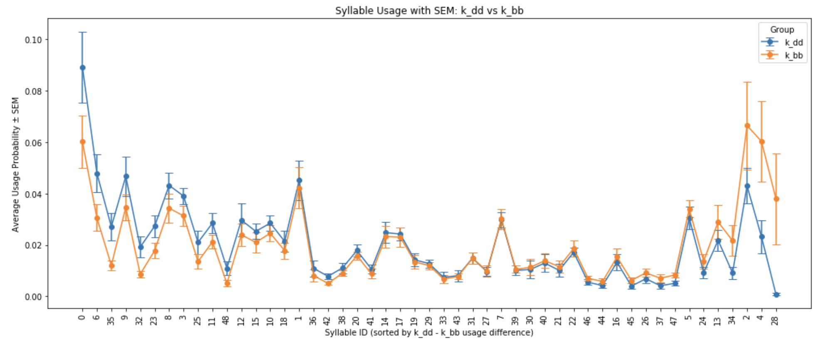
Syllable Usage
2 Hour after injection (k_dd) vs Baseline (k_bb)

Slide 7
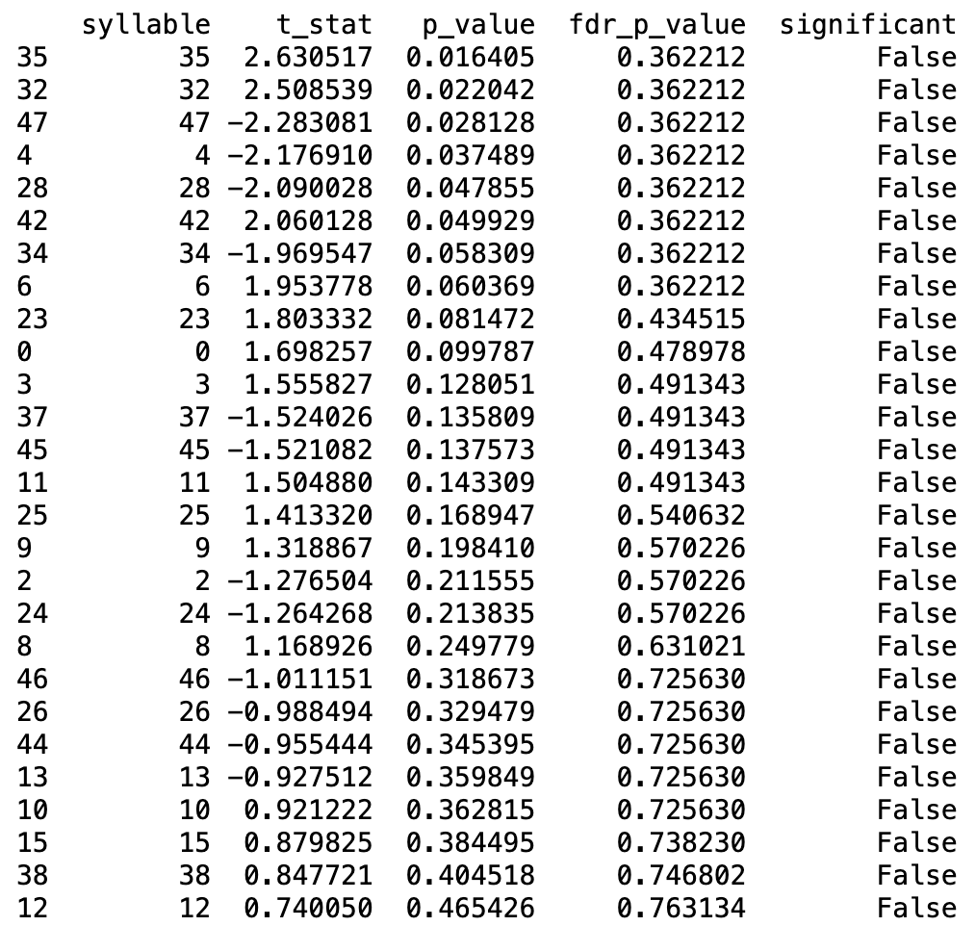
Syllable t-test with FDR adjusted p-value
Syllable test between k_dd group and k_bb group, which is the ketamine injection group after 2 hours compared with the baseline group.
The p-value for syllable 35, 32, 47, 4, 28
42 is less than 0.05. However, the FDR p-values are all non-significant.
I used Benjamini-Hochberg’s method for the FDR

Slide 8
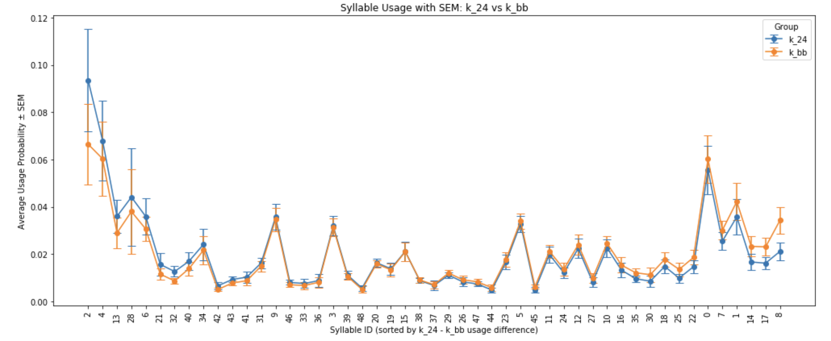
Syllable Usage
24 Hour after injection (k_24) vs Baseline (k_bb)

Slide 9
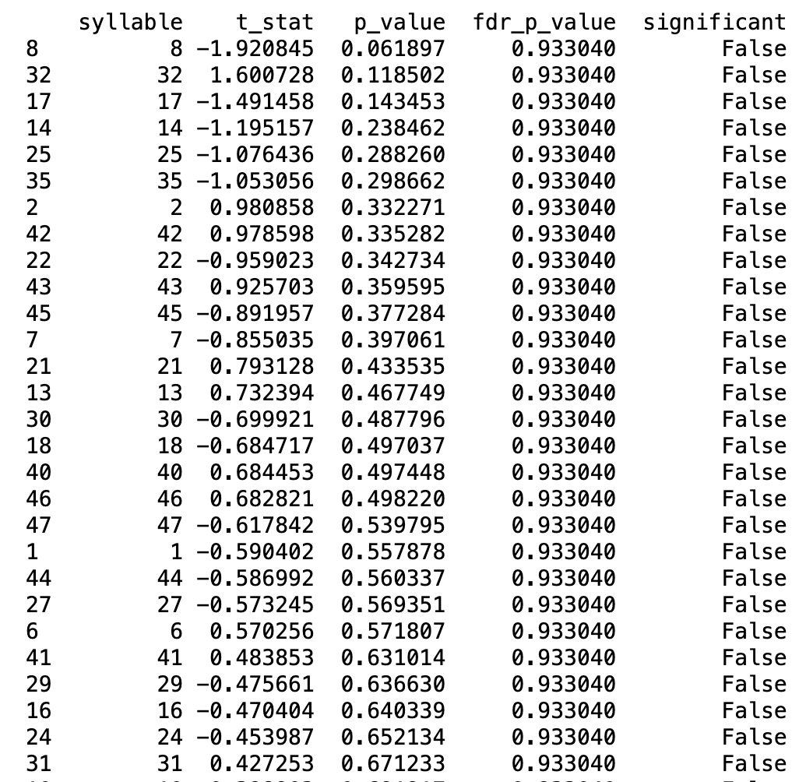
Syllable t-test with FDR adjusted p-value
Syllable test between k_24 group and k_bb group, which is the ketamine injection group after 24 hours compared with the baseline group.
None of the syllable has significant usage difference.

Slide 10
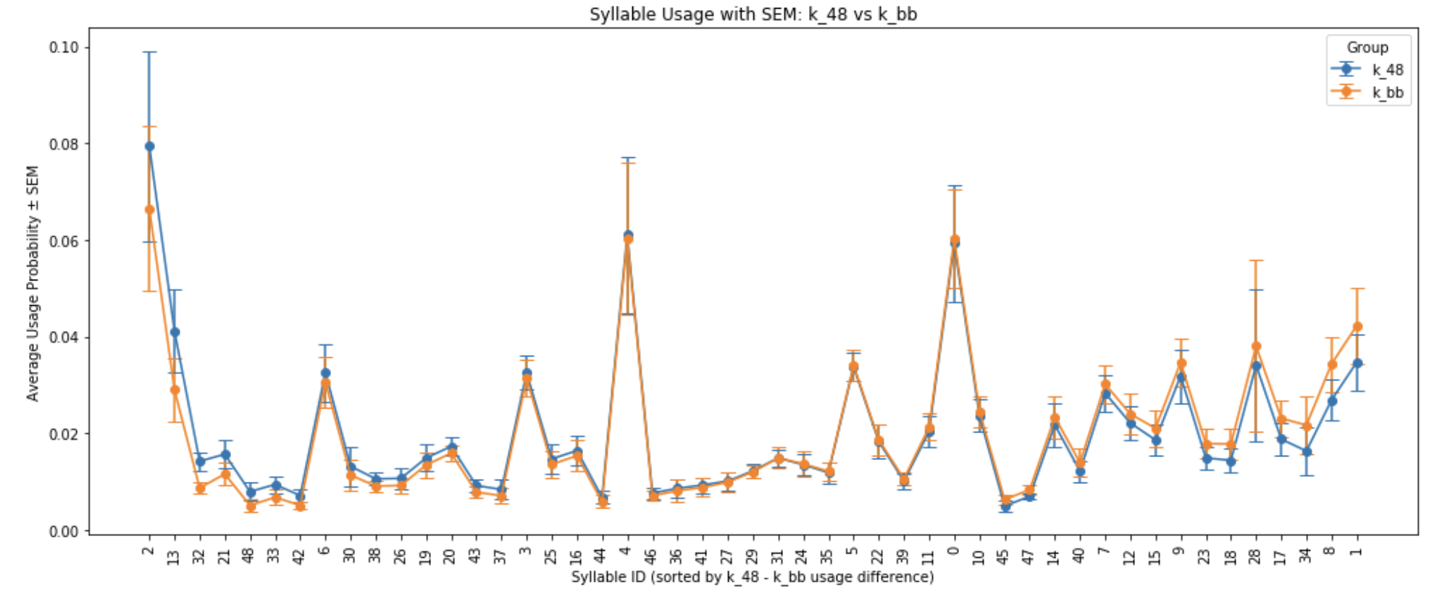
Syllable Usage
48 Hour after injection (k_48) vs Baseline (k_bb)

Slide 11
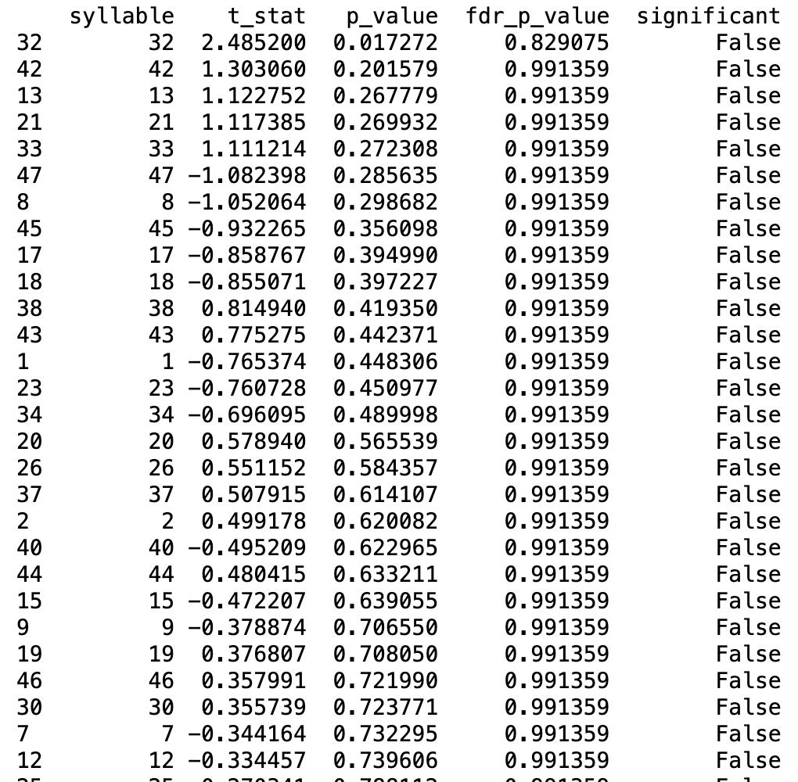
Syllable t-test with FDR adjusted p-value
Syllable test between k_48 group and k_bb group, which is the ketamine injection group after 48 hours compared with the baseline group.
Syllable 32 has a p-value less than 0.05, but FDR p-value is non-significant.

Slide 12
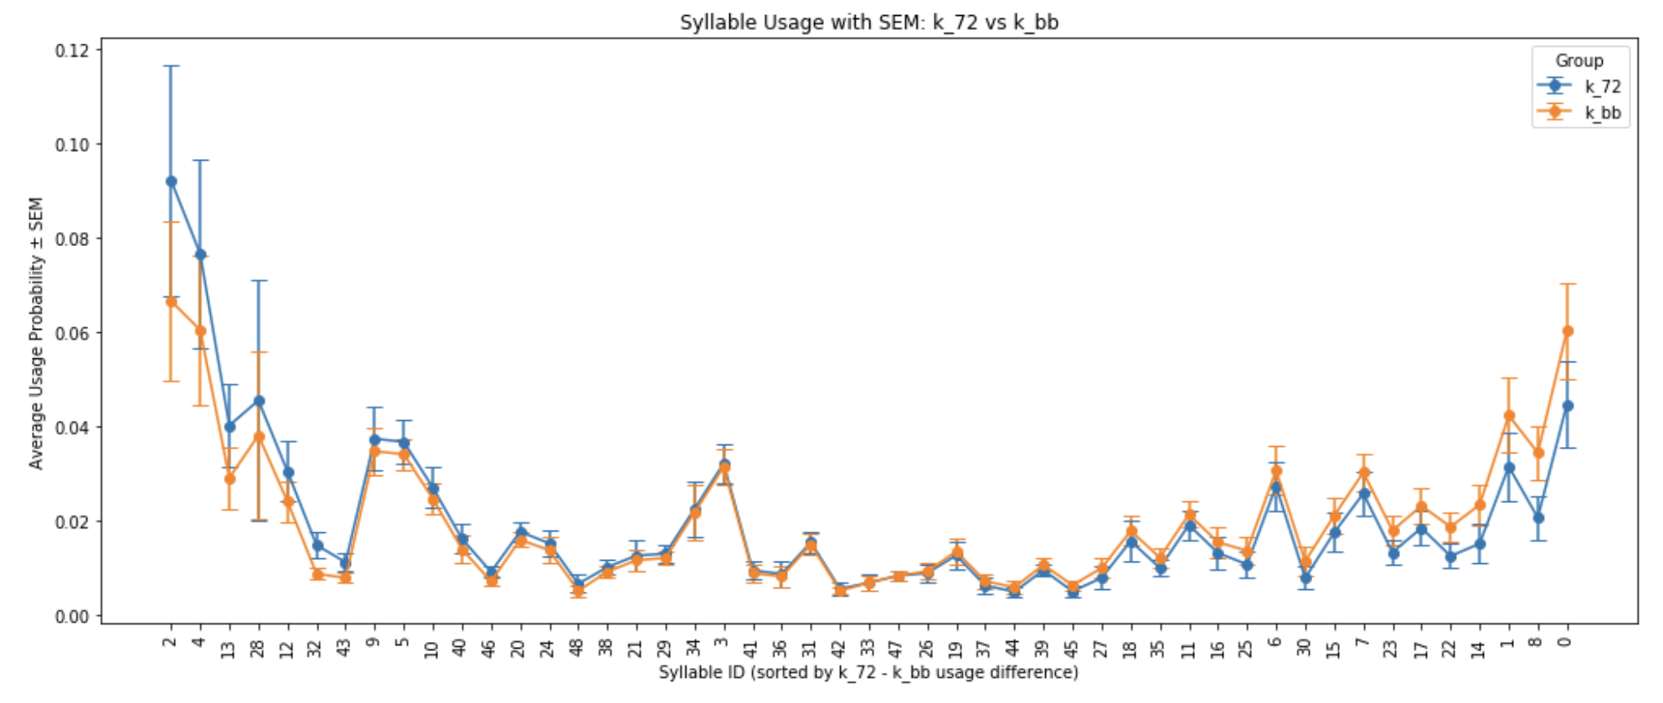
Syllable Usage
72 Hour after injection (k_72) vs Baseline (k_bb)

Slide 13
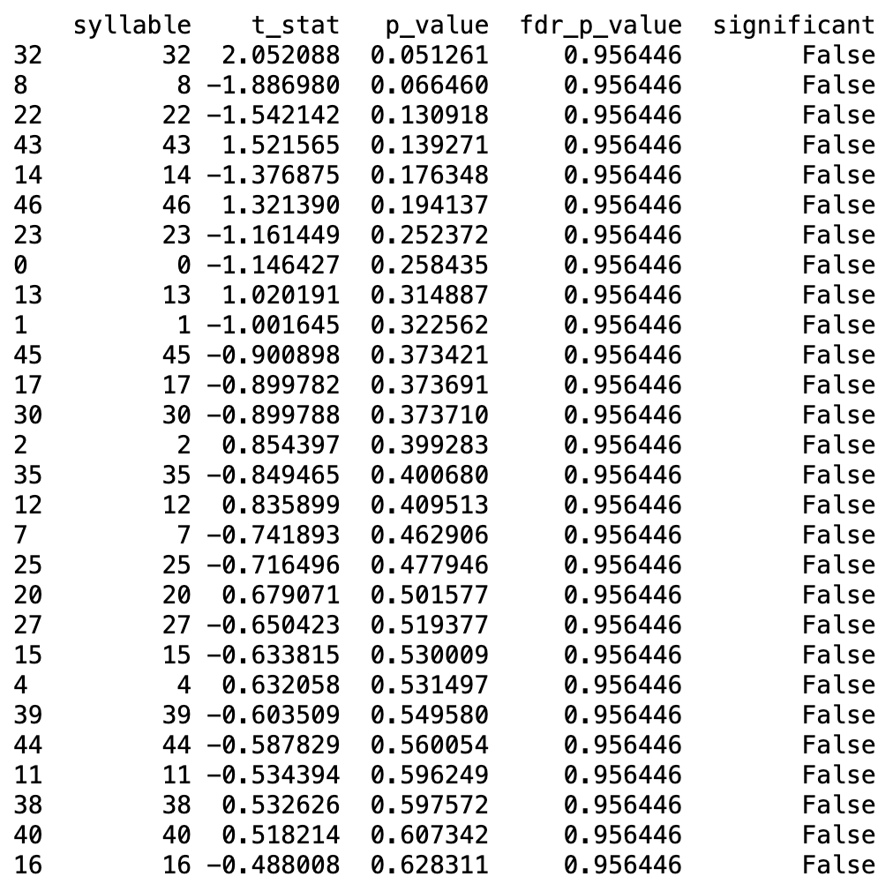
Syllable t-test with FDR adjusted p-value
Syllable test between k_72 group and k_bb group, which is the ketamine injection group after 72 hours compared with the baseline group.
None of the syllable has significant usage difference.

Slide 14
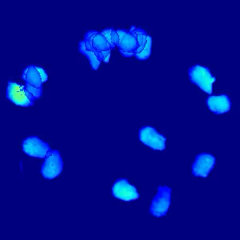
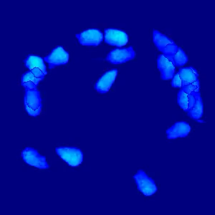
Syllable 32 Syllable 35

Slide 15
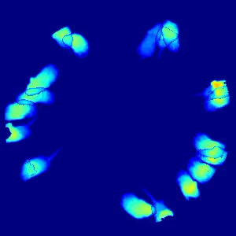
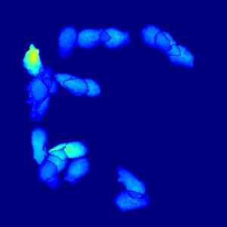
Syllable 47 Syllable 4

Slide 16
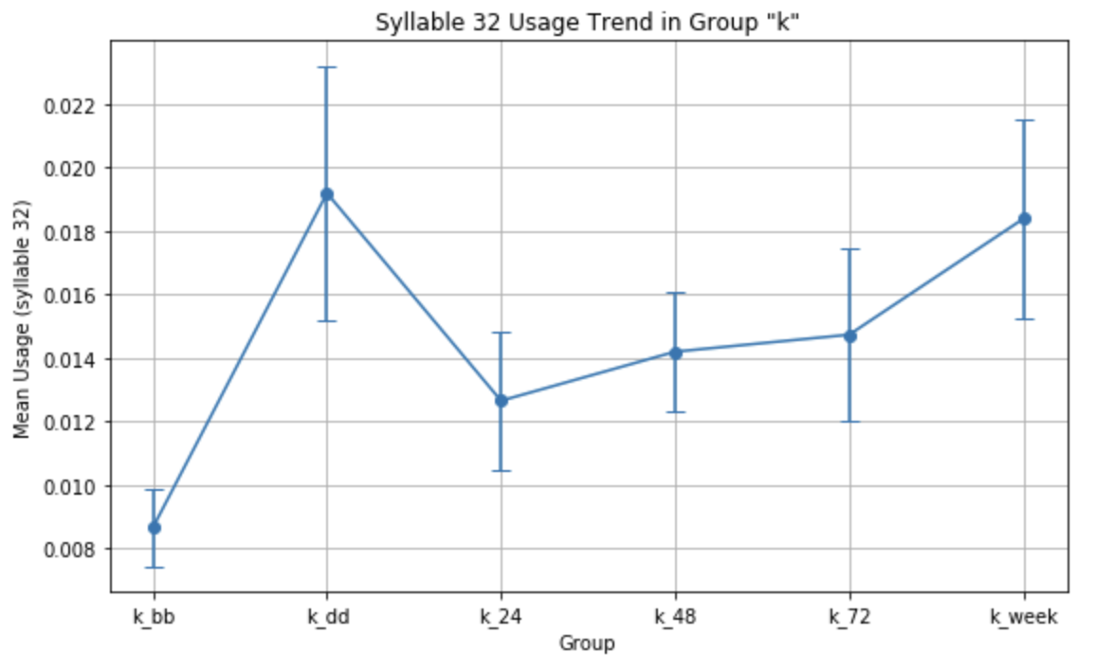
Syllable 32 trend in the ketamine group (Grooming)

Slide 17
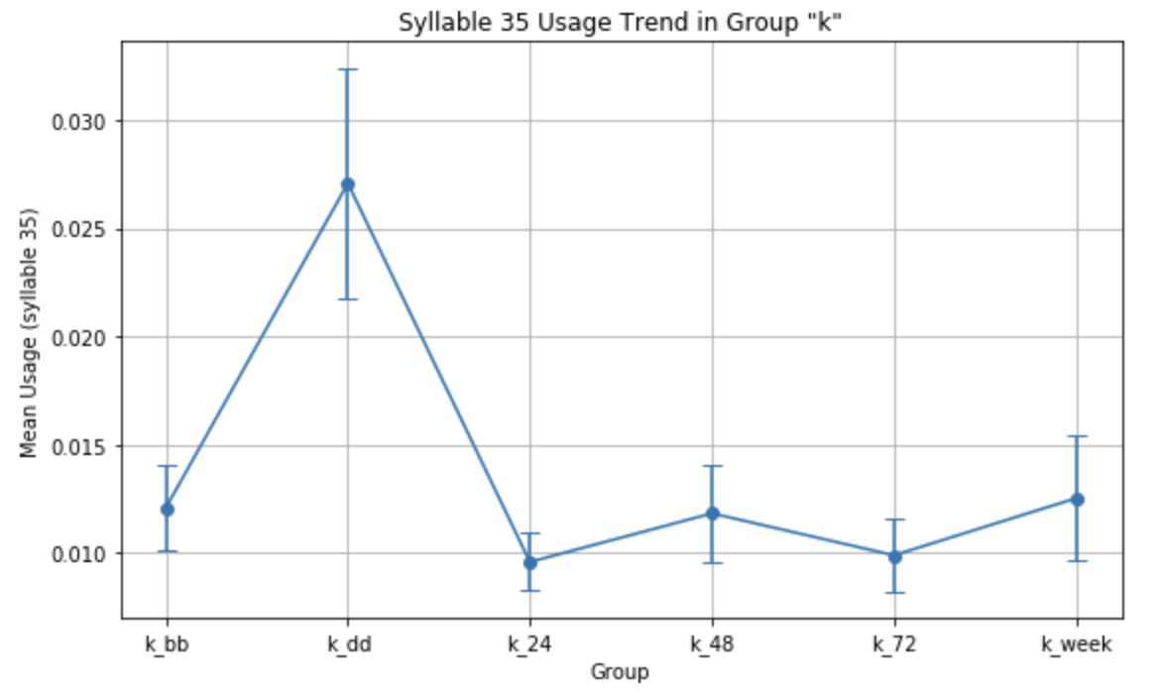
Syllable 35 trend in the ketamine group

Slide 18
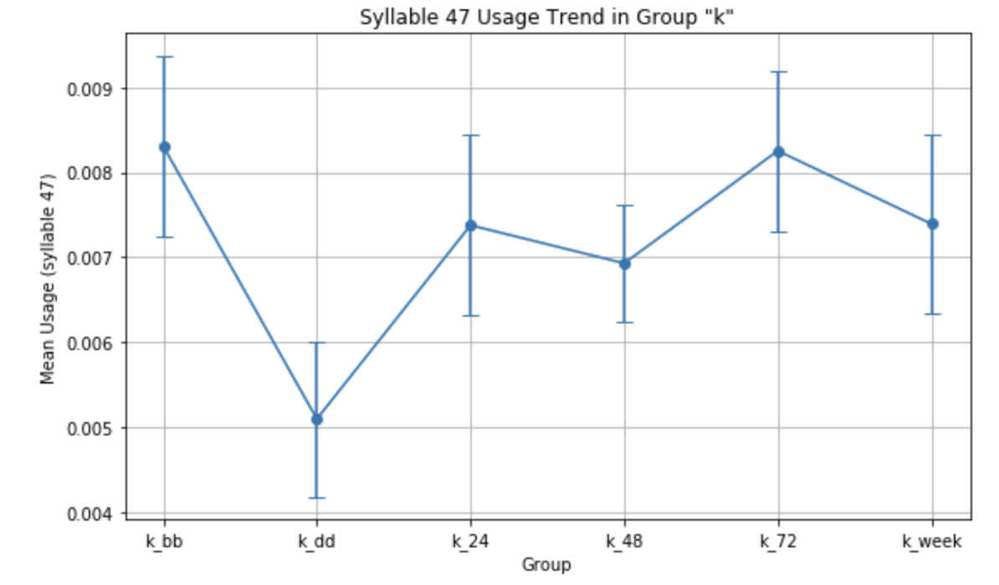
Syllable 47 trend in the ketamine group
(rearing)

Slide 19
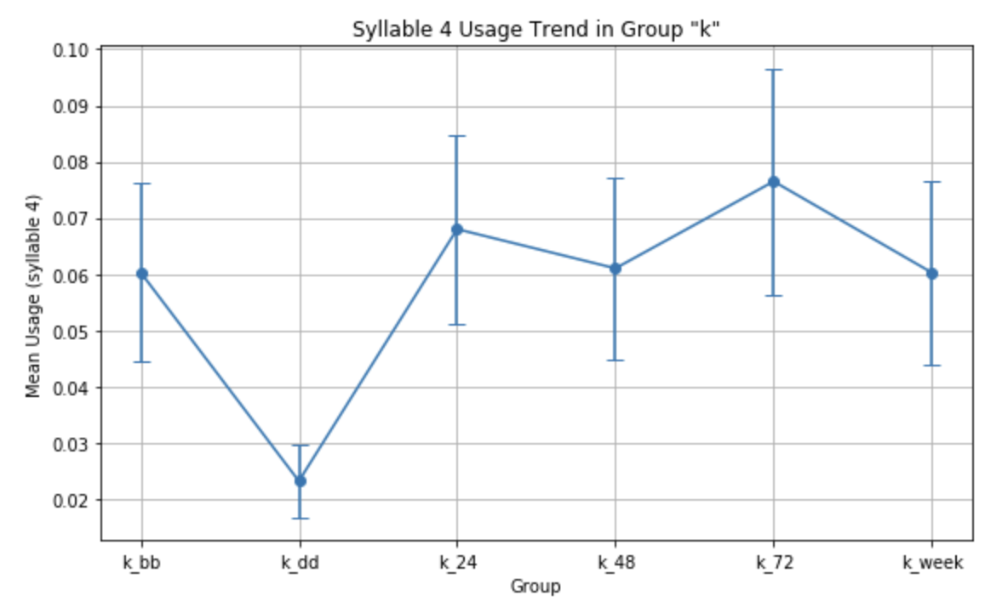
Syllable 4 trend in the ketamine group

Slide 20
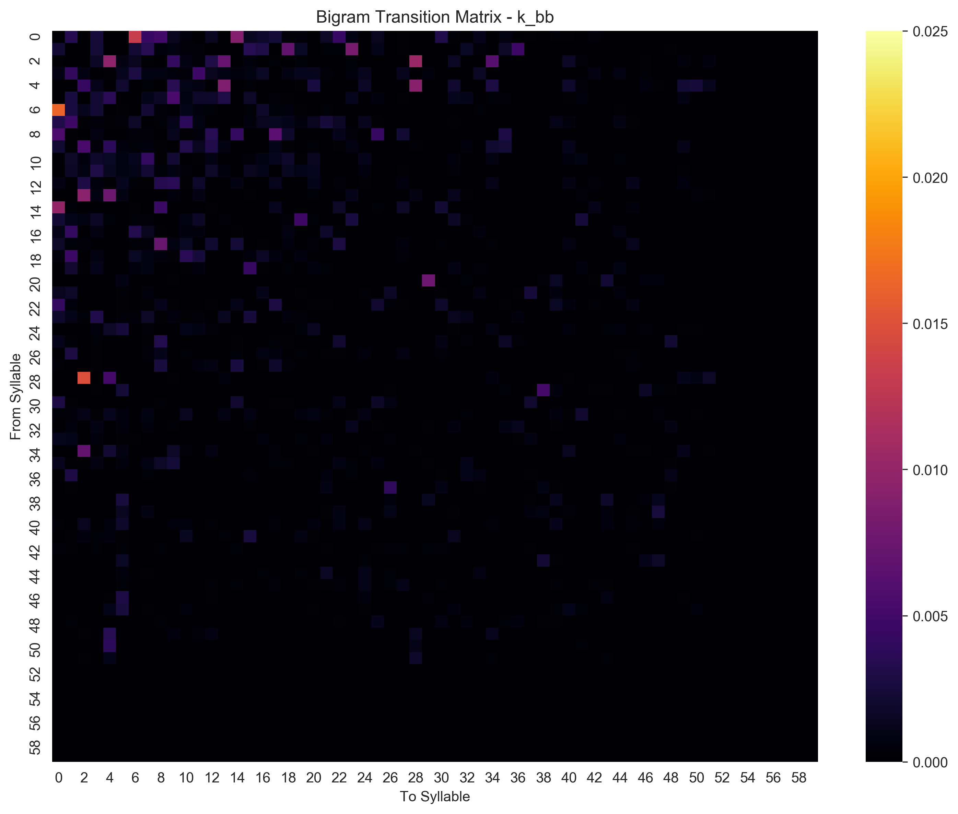
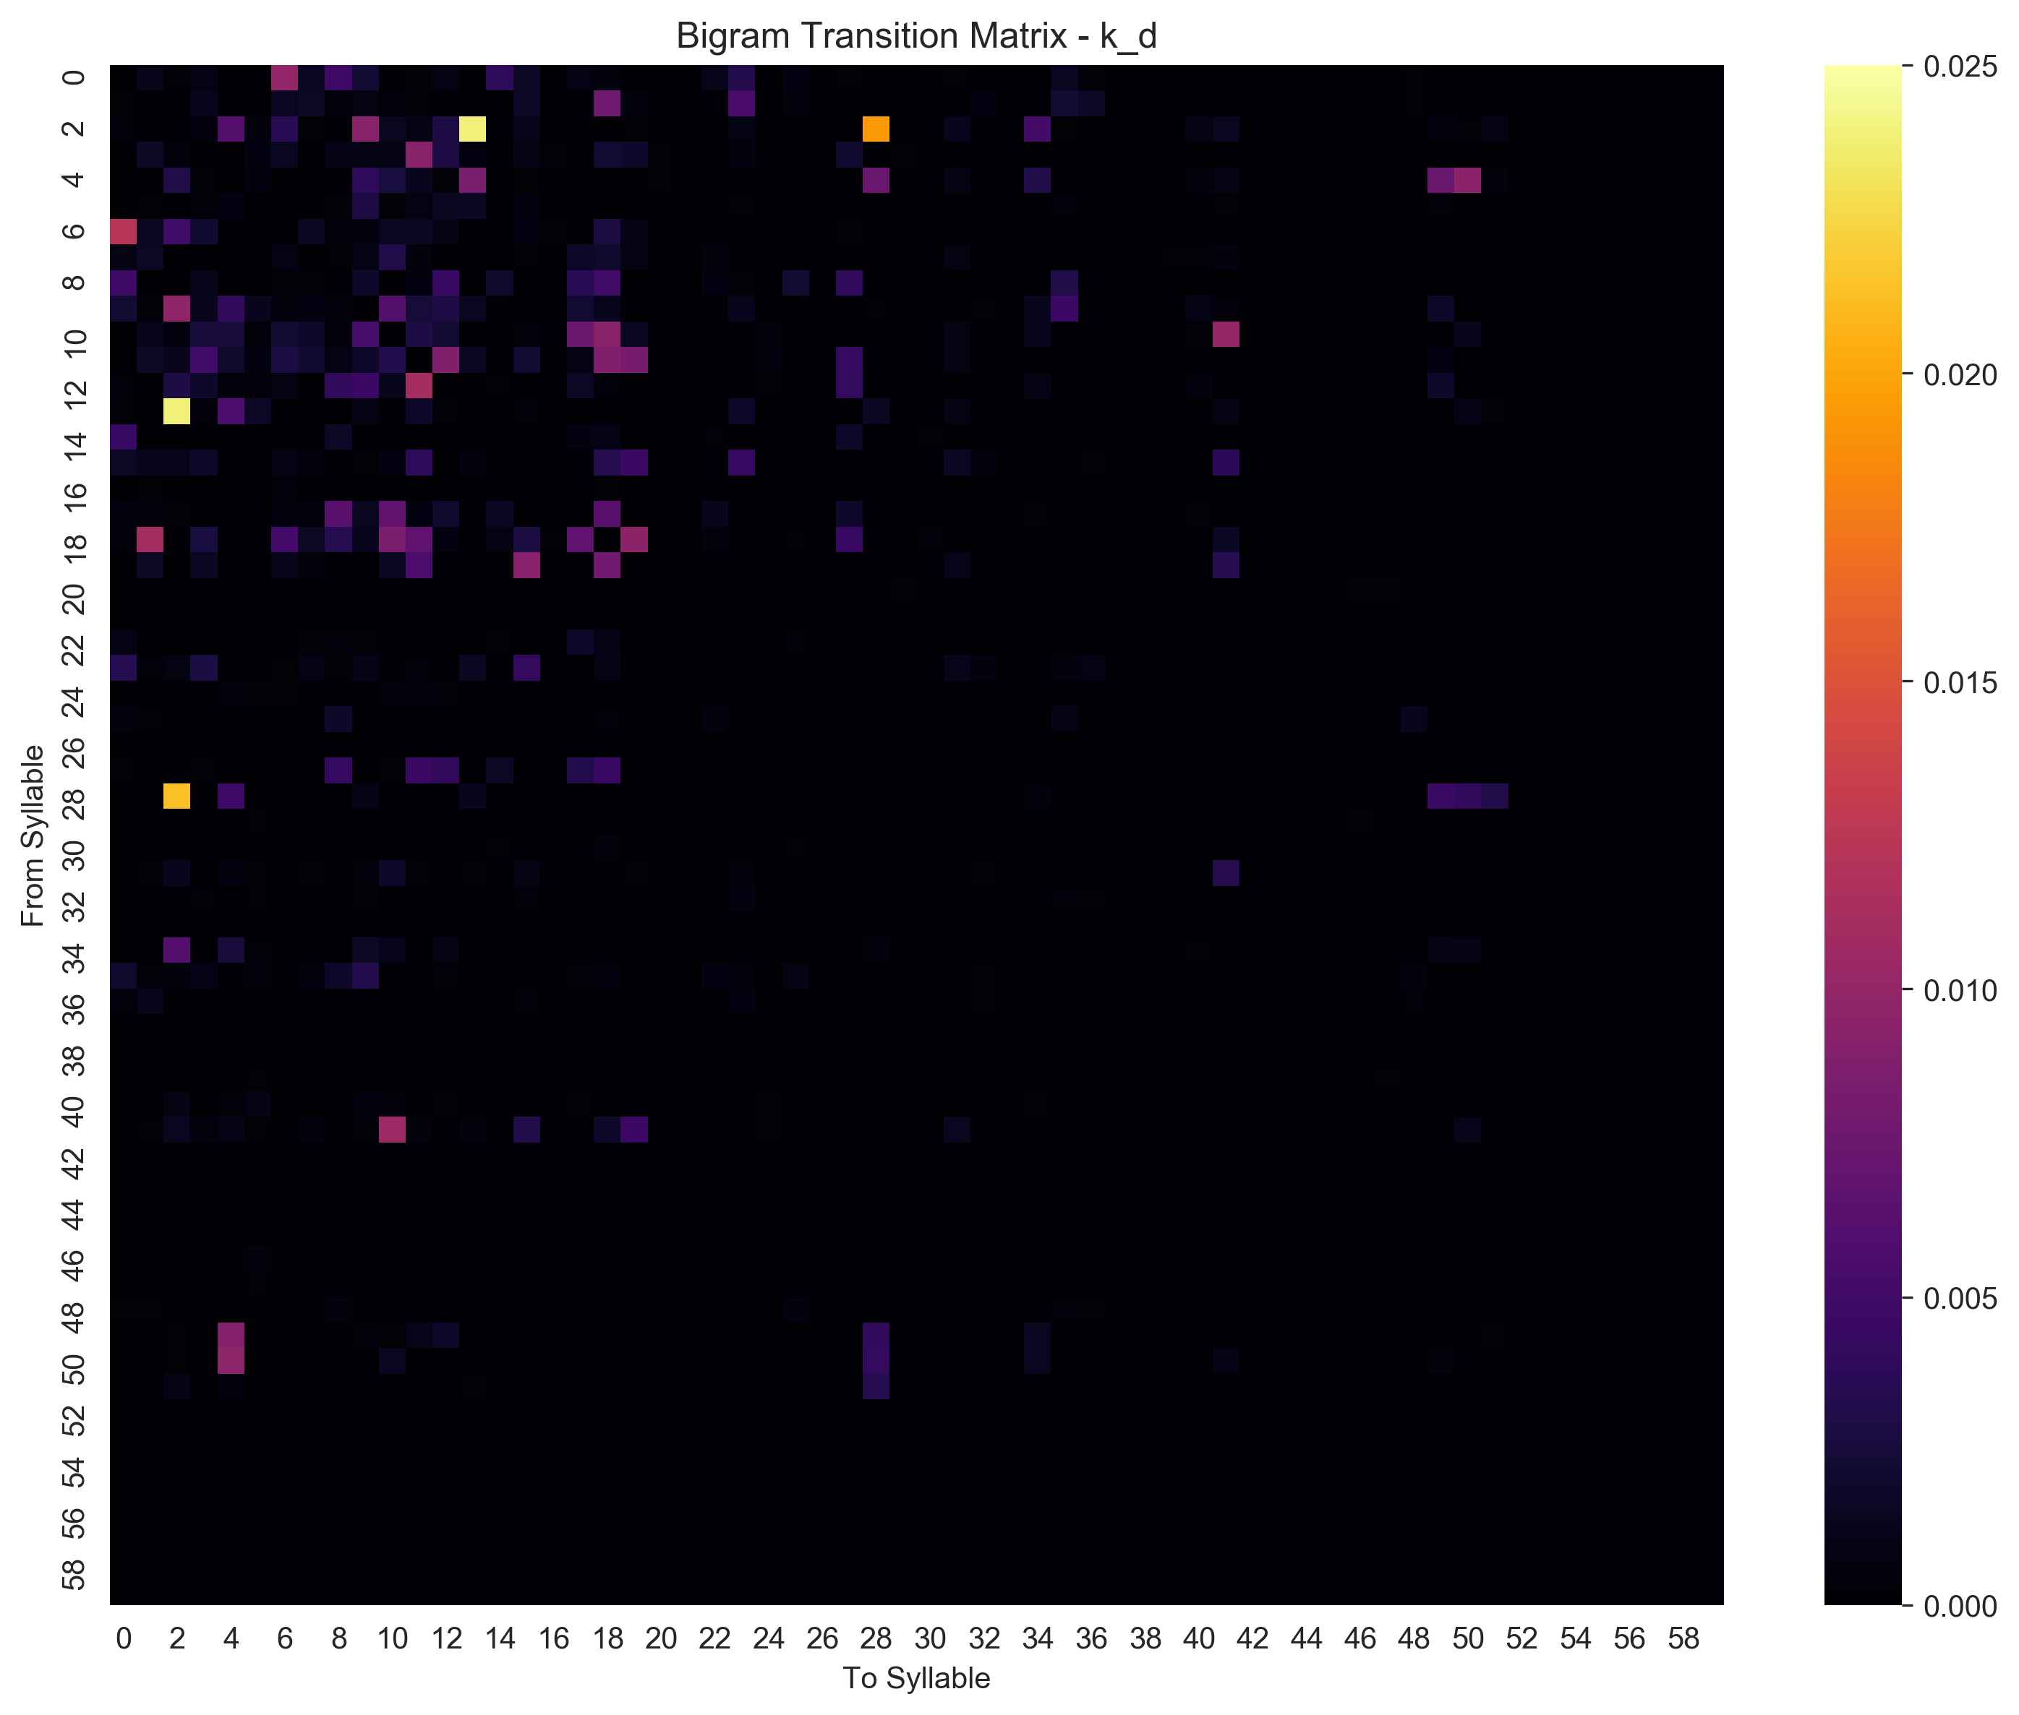
Transition Matrix

Slide 21


Transition Matrix

Slide 22


Transition Matrix

Slide 23
Currently trained 5 models with different hyperparameters
(kappa values, max-states) to choose the best model possible
moseq2-model learn-model /mnt/z/Lab/Mohan_public/Moseq_Ketamine_data/_pca/pca_scores.h5 /mnt/z/Lab/Mohan_public/Moseq_Ketamine_data/models/model-000-100000.p --npcs 13 --num-iter 100 -i /mnt/z/Lab/Mohan_public/Moseq_Ketamine_data/moseq2-index.yaml --robust --hold-out --nfolds 2 --max-states 25 --kappa 100000
moseq2-model learn-model /mnt/z/Lab/Mohan_public/Moseq_Ketamine_data/_pca/pca_scores.h5 /mnt/z/Lab/Mohan_public/Moseq_Ketamine_data/models/model-001-1000000.p --npcs 13 --num-iter 100 -i /mnt/z/Lab/Mohan_public/Moseq_Ketamine_data/moseq2-index.yaml --robust --hold-out --nfolds 2 --max-states 25 --kappa 1000000
moseq2-model learn-model /mnt/z/Lab/Mohan_public/Moseq_Ketamine_data/_pca/pca_scores.h5 /mnt/z/Lab/Mohan_public/Moseq_Ketamine_data/models/model-002-10000000.p --npcs 13 --num-iter 100 -i /mnt/z/Lab/Mohan_public/Moseq_Ketamine_data/moseq2-index.yaml --robust --hold-out --nfolds 2 --max-states 25 --kappa 10000000
moseq2-model learn-model /mnt/z/Lab/Mohan_public/Moseq_Ketamine_data/_pca/pca_scores.h5 /mnt/z/Lab/Mohan_public/Moseq_Ketamine_data/models/model-003-100000000.p --npcs 13 --num-iter 100 -i /mnt/z/Lab/Mohan_public/Moseq_Ketamine_data/moseq2-index.yaml --robust --hold-out --nfolds 2 --max-states 25 --kappa 100000000
moseq2-model learn-model /mnt/z/Lab/Mohan_public/Moseq_Ketamine_data/_pca/pca_scores.h5 /mnt/z/Lab/Mohan_public/Moseq_Ketamine_data/models/model-004-1000000000.p --npcs 13 --num-iter 100 -i /mnt/z/Lab/Mohan_public/Moseq_Ketamine_data/moseq2-index.yaml --robust --hold-out --nfolds 2 --max-states 25 --kappa 1000000000

Slide 24
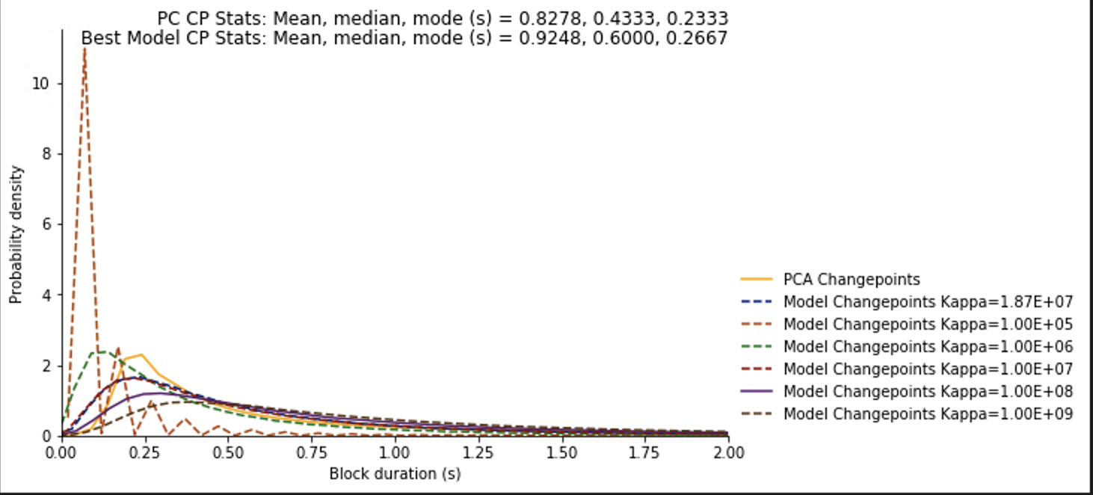
Purple model matched the PCA closely
(kappa = 1e+08 is the best)

Slide 25
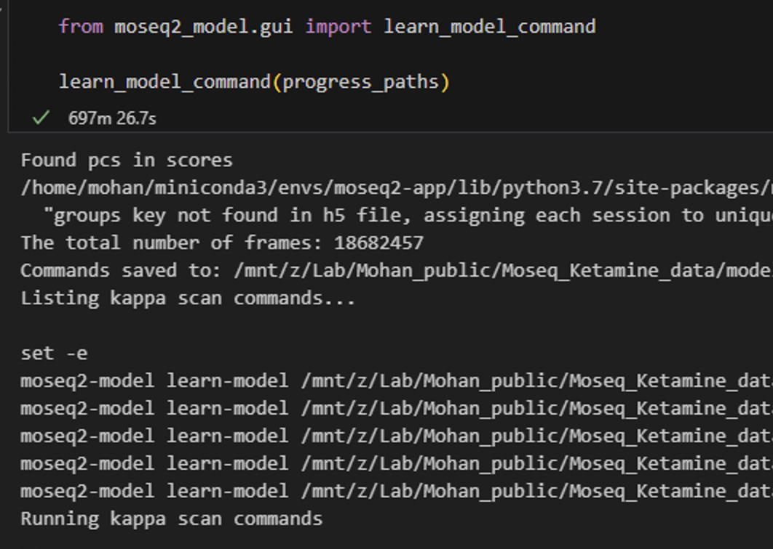
Training Time
5 models with each 100 iterations took 700 minutes.
Moseq recommends training the final model with 1000 iterations.
If 500 iterations took 700 minutes, 1000 iterations will take approximately 1400 minutes.
Currently training the model with kappa = 1e+08, max state = 25

