Slide 1
Moseq Progress Report
Mohan Yang

Slide 2
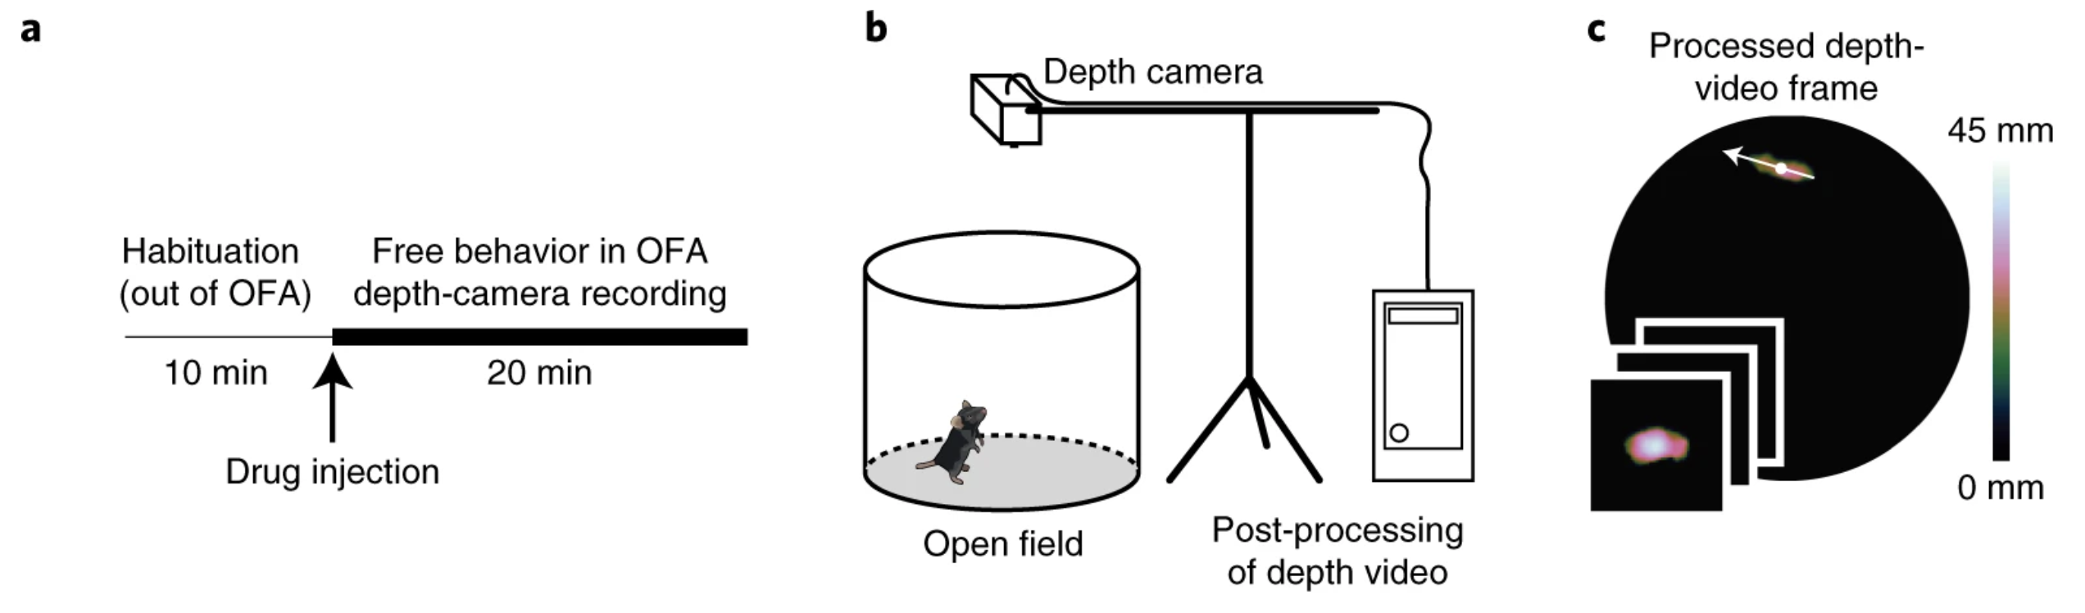
Background
Traditional identification of behavior:
  Behavioral modules (stereotyped units of behavior) were historically identified manually through human observation. This method is labor-intensive and subjective, lacking scalability and standardization.
Need for systematic analysis:
  Automated, scalable methods are necessary to reveal the structure and transitions of behavior
MoSeq's contribution:
  Motion sequencing (MoSeq) is a computational framework that automatically identifies behavioral modules in an unsupervised manner. It segments continuous mouse behavior into discrete, reusable modules (syllables) and models transitions between them.

Slide 3
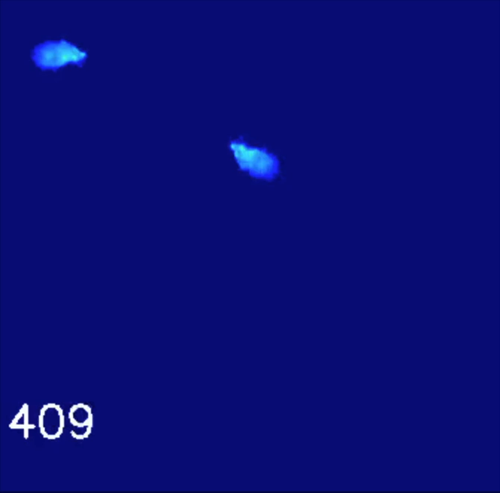
Extracted Video using Moseq
A Pre-trained Flip Classifier is used to guarantee that the mouse is always pointed to the right after cropping and rotationally aligning mice in the depth videos. (See the upleft corner)
Parameters such as floor depth range, mouse height, etc, can be adjusted to reach better extraction quality.

Slide 4
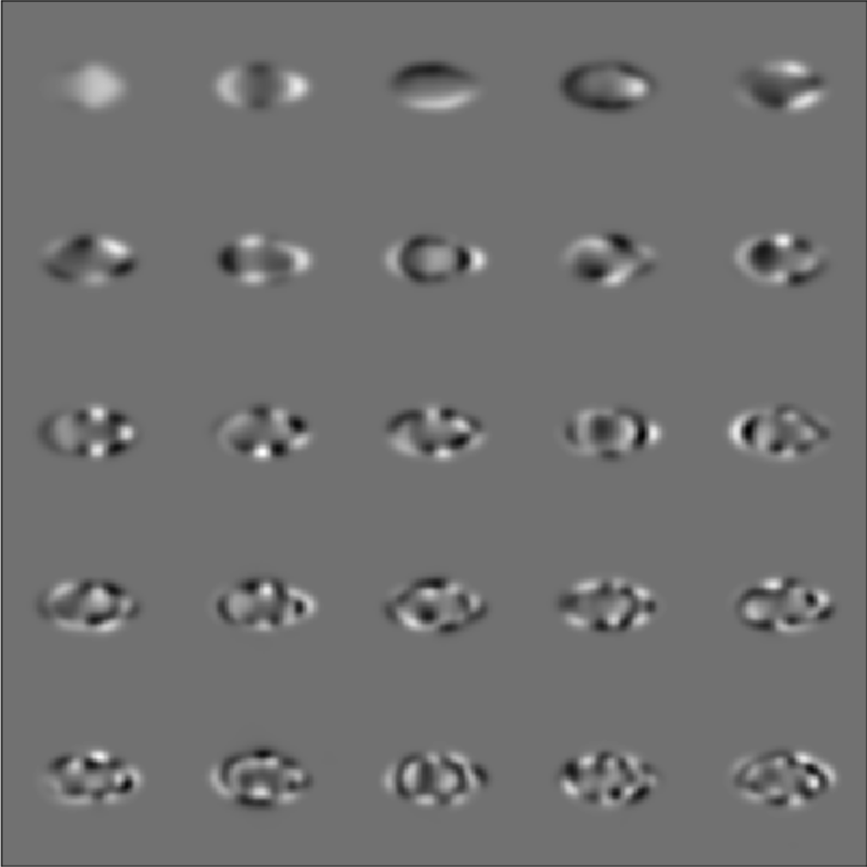
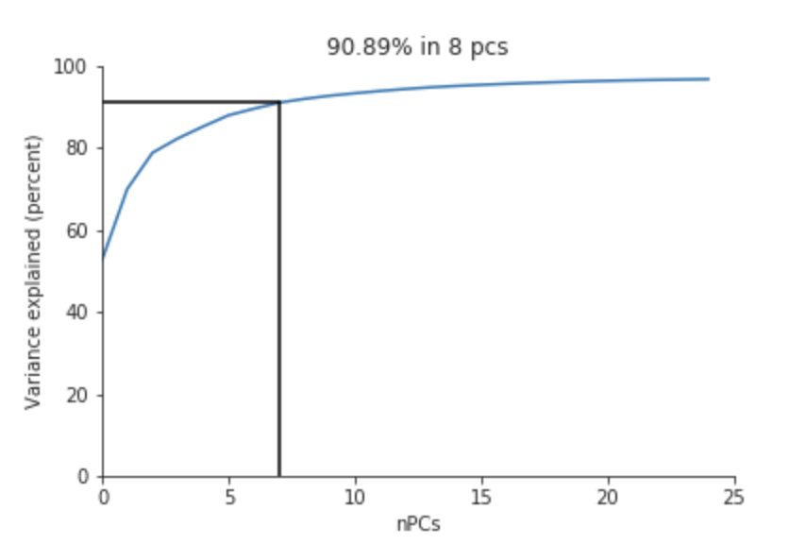
Fitting PCA
PCA is performed to learn a low-dimensional representation of mouse pose for each frame.
The top 10 principal components (default) are used to train the AR-HMM model.

Slide 5



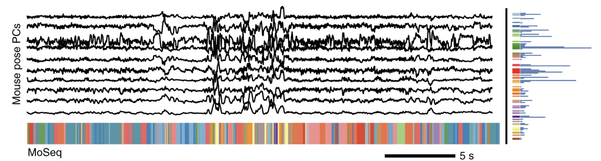
AR-HMM Model
Input: 3D pose data from depth camera over time:
Each frame (y) is assigned a hidden state
representing the discrete behavioral
syllable class at time t.
For each
, there exists a corresponding autoregressive parameter.
Each parameter A_{k} governs the autoregressive dynamics of the frame where z_{t} = k.

Slide 6
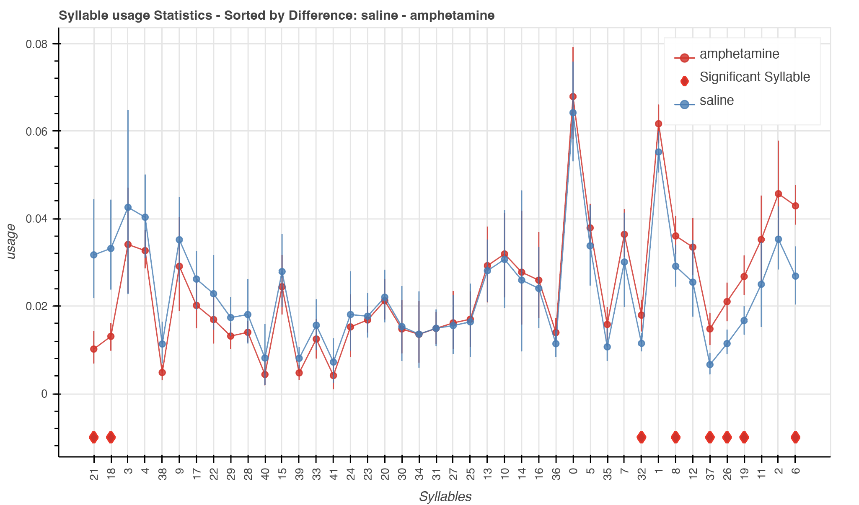
Syllable usage difference between groups
After modeling, we can obtain the syllable usage for each treatment group.
The usage of syllable 6 is much higher in amphetamine group comparing to saline group.
However what does syllable 6 represent?

Slide 7
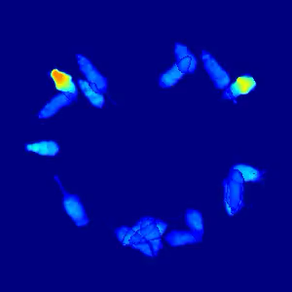
Interpretation of each syllable
Crowd movie for syllable 6 (stand up?):
If we train separate AR-HMM models for each group, the meaning of each syllable becomes arbitrary.
(e.g., syllable 1 in the saline group may not correspond to the same behavior as syllable 1 in the amphetamine group)
To ensure that syllables are comparable across groups, we must train a single, shared AR-HMM model on all groups jointly.
Then we can generate “crowd movies”, which aggregate video clips corresponding to the same syllable across all mice.

Slide 8
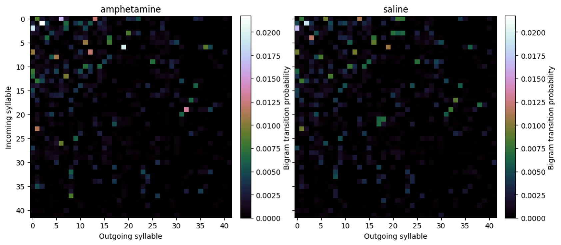
Transition Matrix between syllables

Slide 9
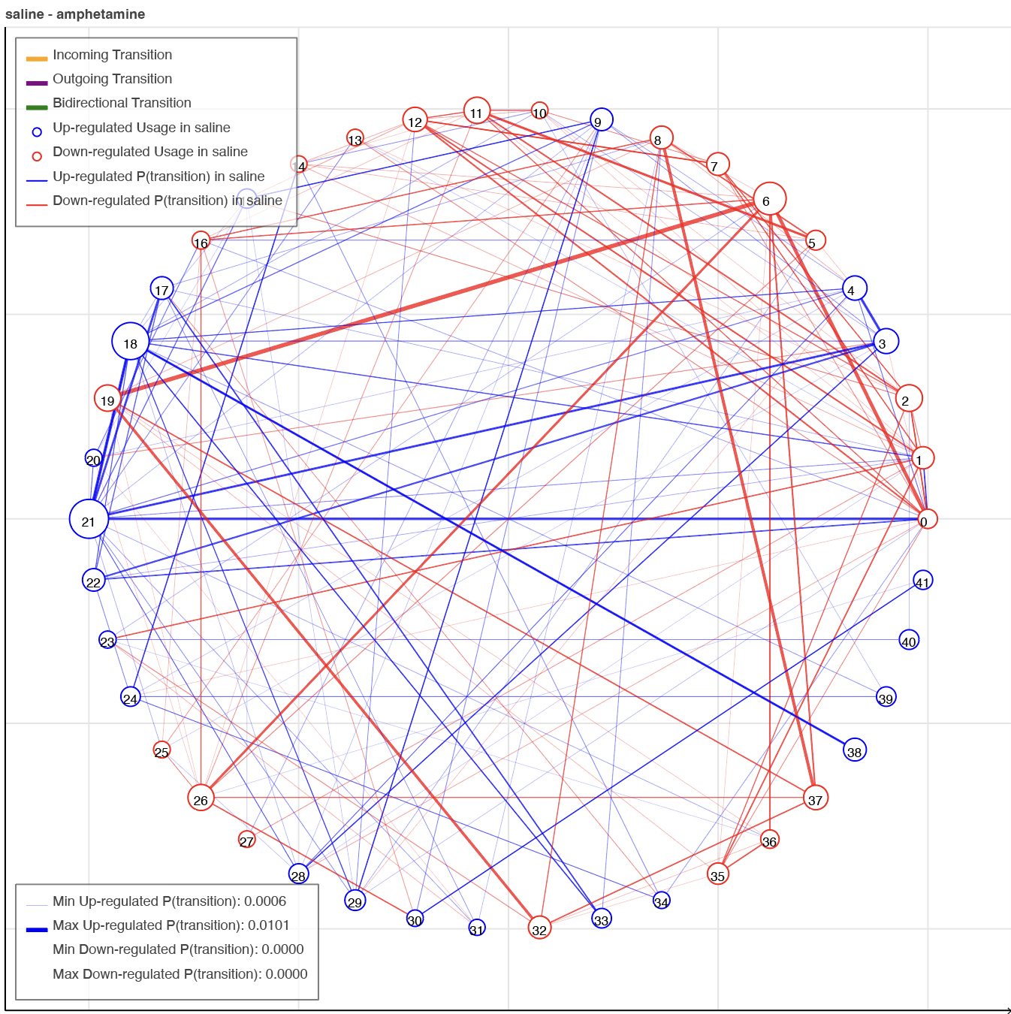

Slide 10
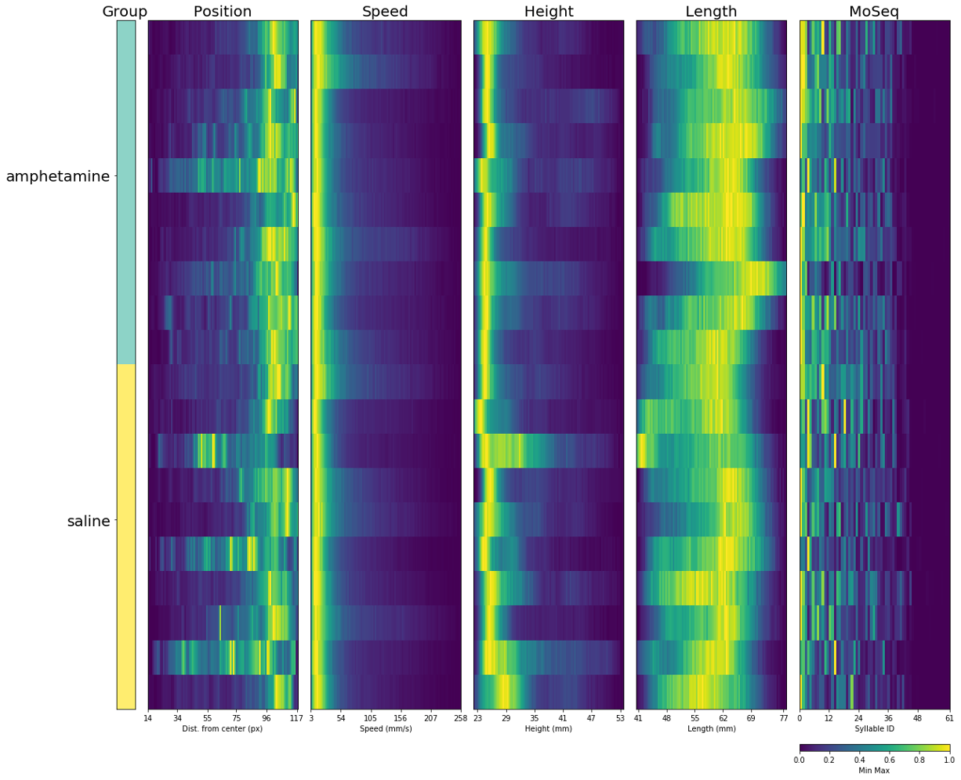
Fingerprint plot using Moseq
Fingerprint plots summarize behavior by showing distributions of MoSeq scalar values and MoSeq syllables.
Each row represents a session of recorded video.
It is useful for getting a sense of behavior across sessions, mice, and experimental groups, and can reveal general differences across experimental groups.

Slide 11
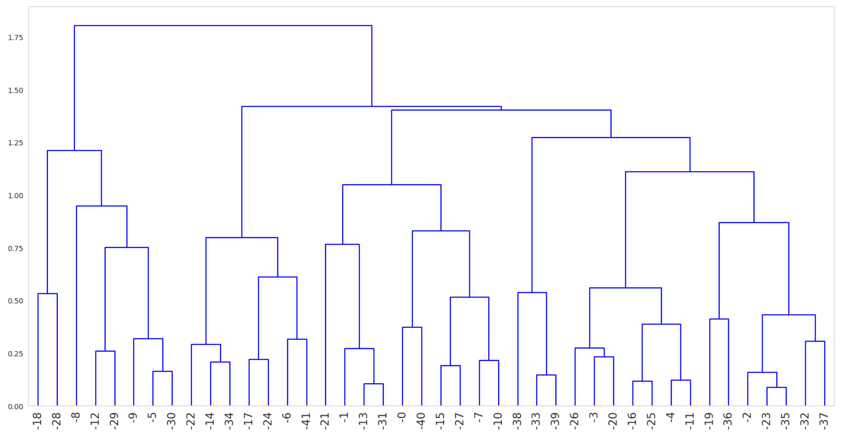
Syllable Dendrogram

