Slide 1
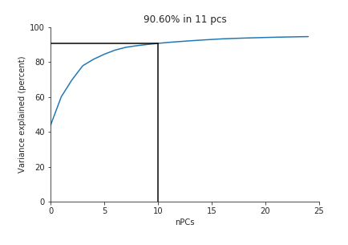
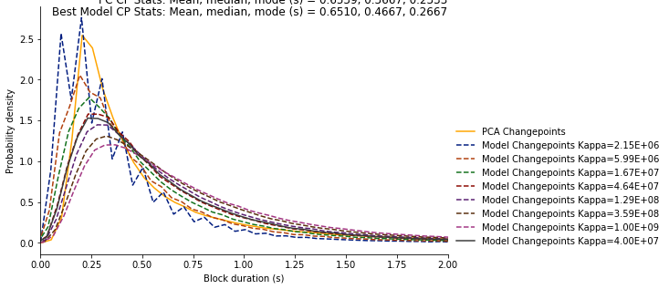
Tuning Hyperparameter
Chose Kappa = 4.00e+07 (closest to the PCA Changepoint - yellow line)
Used 11 pcs, maximum of 60 syllables

Slide 2
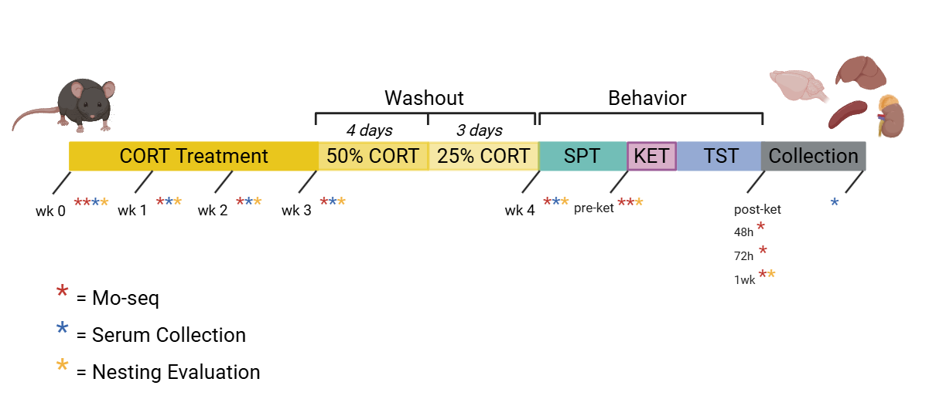
Timeline

Slide 3
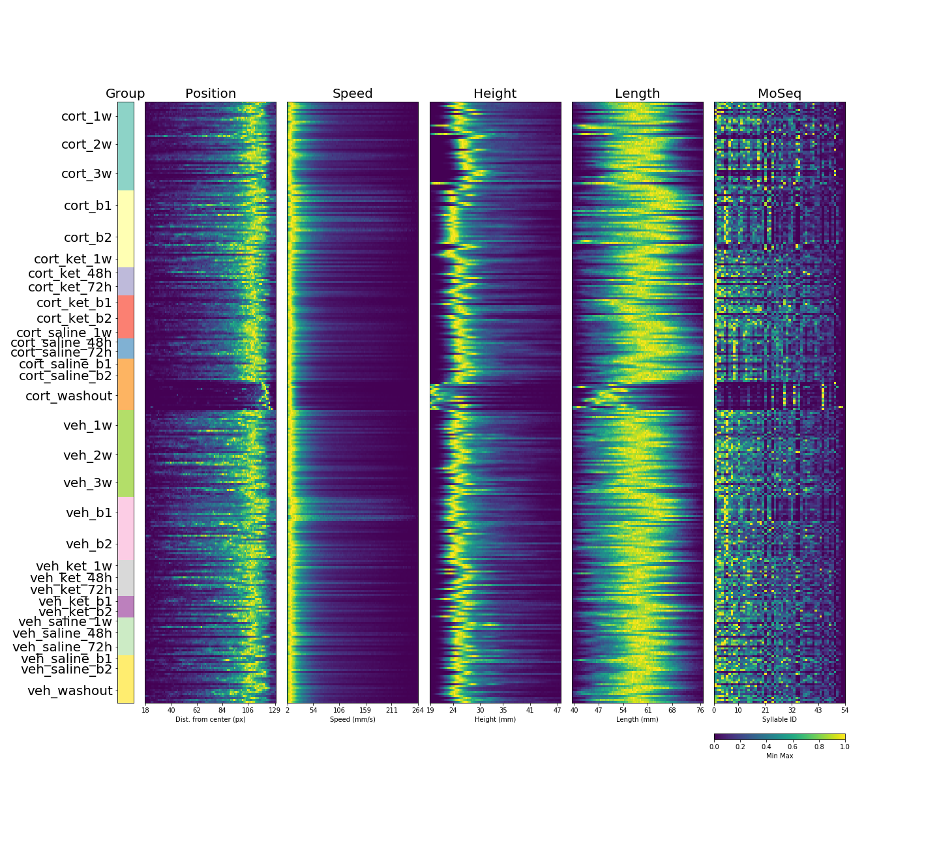

Slide 4
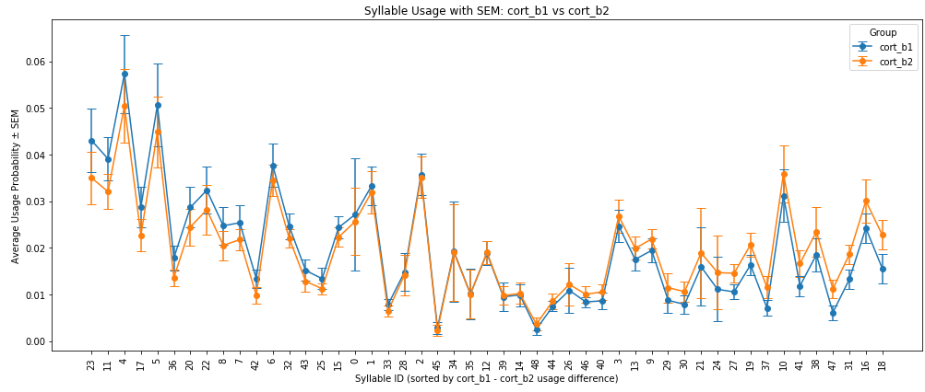
Cort baseline1 vs. Cort baseline2

Slide 5
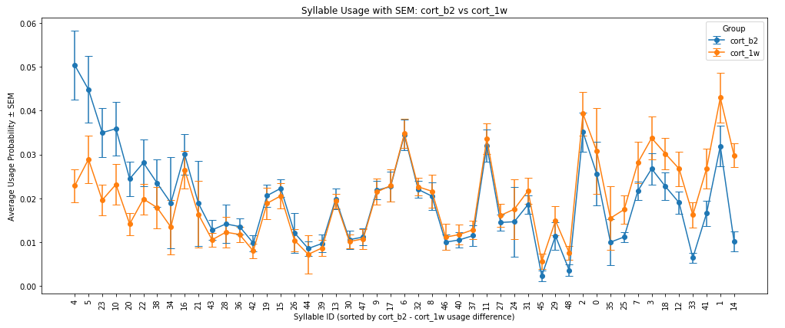
Cort baseline2 vs. Cort 1week

Slide 6
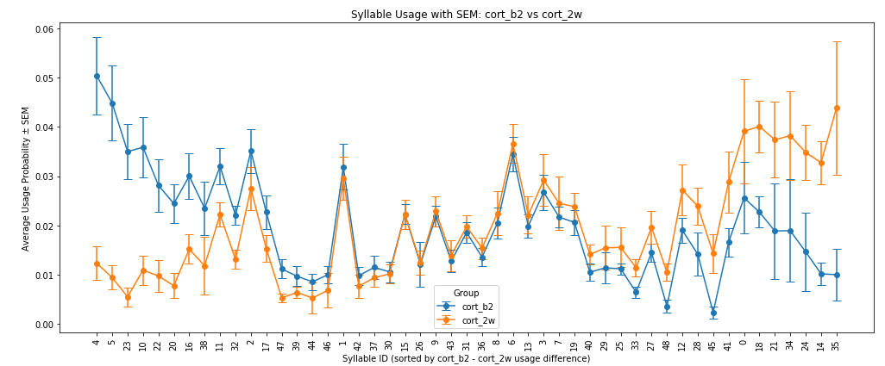
Cort baseline2 vs. Cort 2week

Slide 7
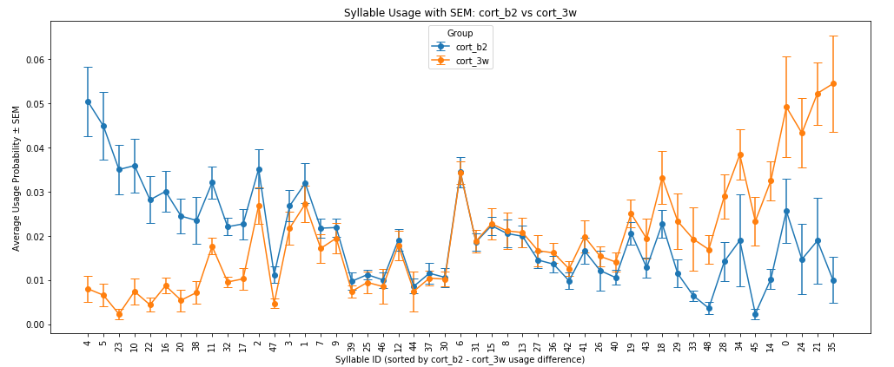
Cort baseline2 vs. Cort 3week

Slide 8
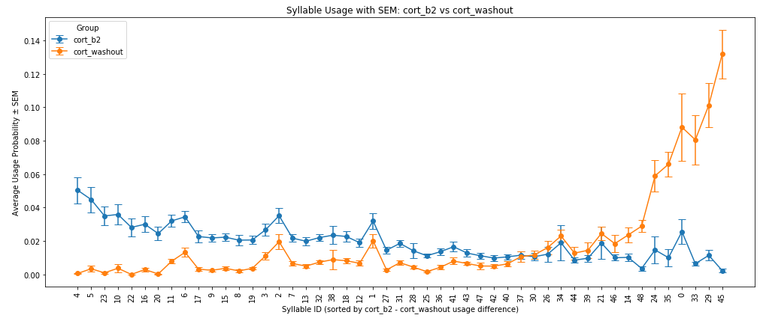
Cort baseline2 vs. Cort washout

Slide 9
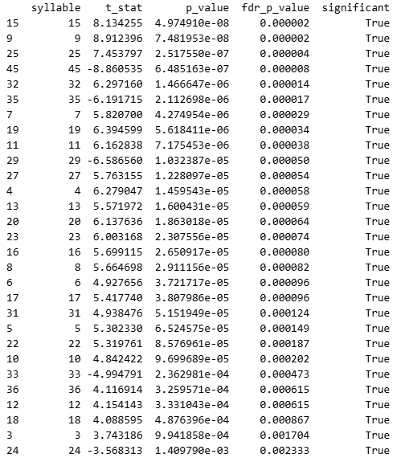
Cort basline2 vs Cort washout FDR test

Slide 10
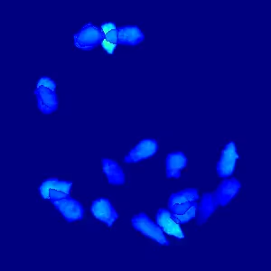
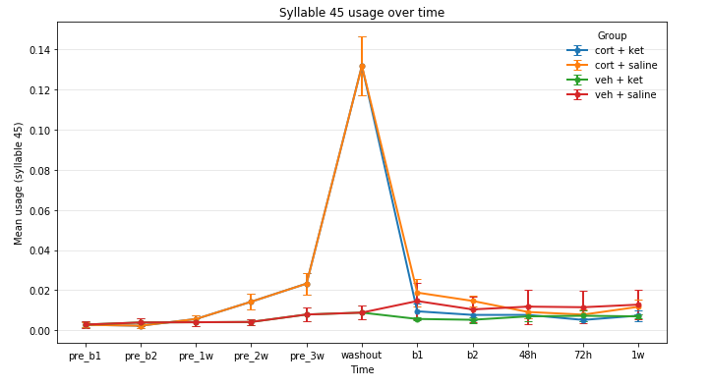
Syllable 45: Grooming

Slide 11
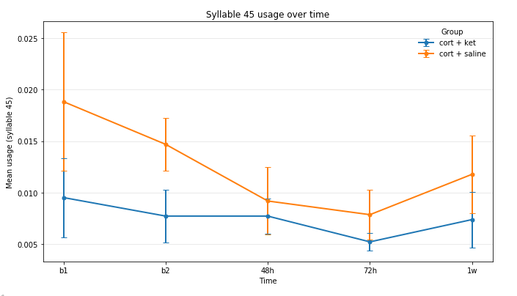
Syllable 45: Grooming (cort+saline vs. cort+ketamine)

Slide 12
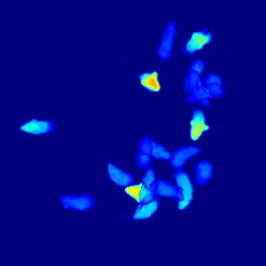
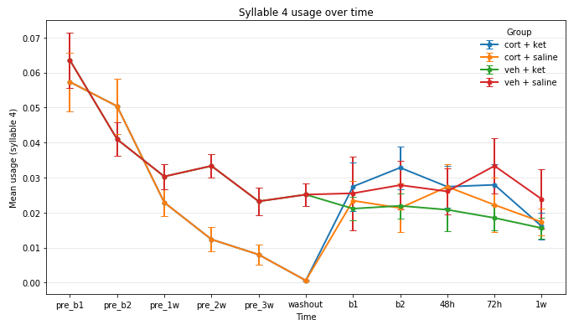
Syllable 4: Moving Forward

Slide 13
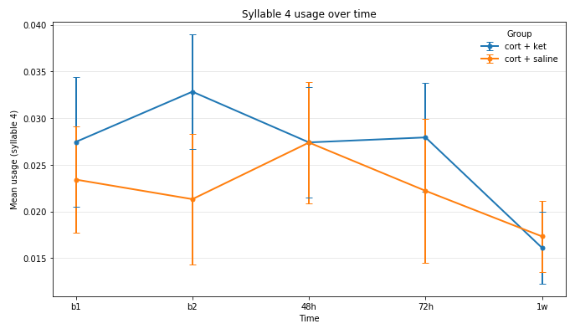
Syllable 4: Moving Forward
(cort+saline vs. cort+ketamine)

Slide 14
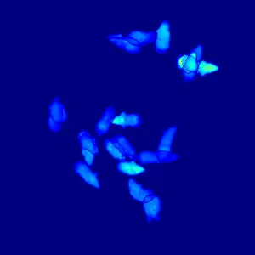
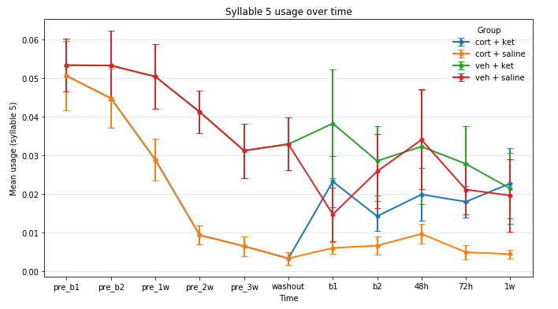
Syllable 5: turning head

Slide 15
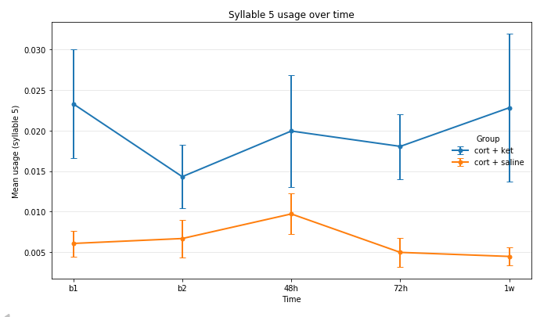
Syllable 5: turning head
(cort+saline vs. cort+ketamine)

Slide 16
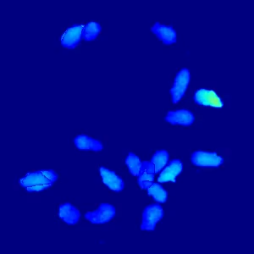
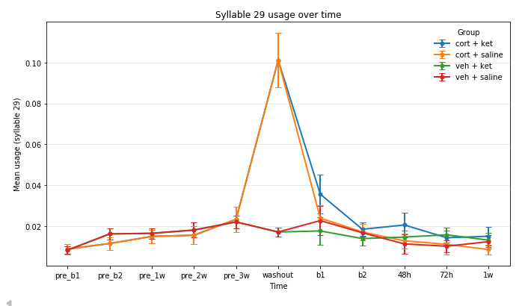
Syllable 29: staying still

Slide 17
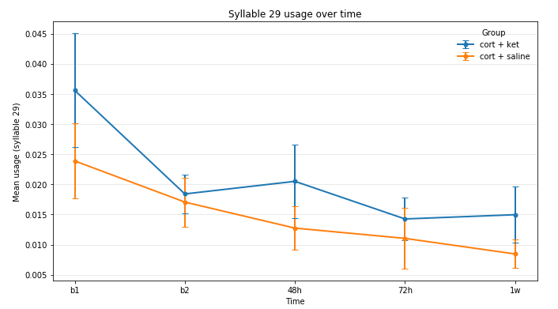
Syllable 29: staying still
(cort+saline vs. cort+ketamine)

Slide 18
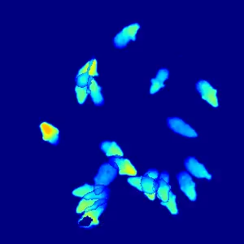
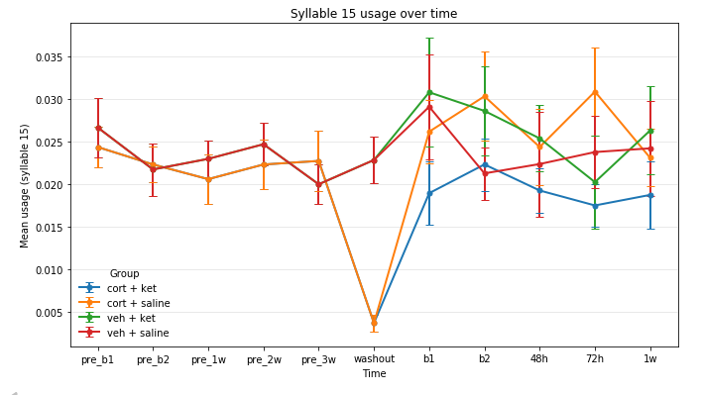
Syllable 15: Moving down from heads up

Slide 19
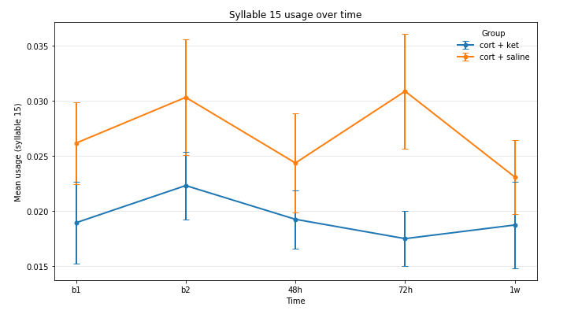
Syllable 15: Moving down from heads up
(cort+saline vs. cort+ketamine)

Slide 20
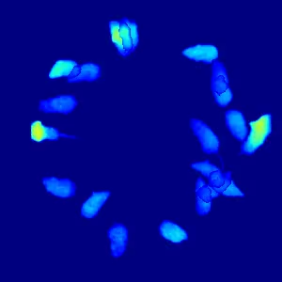
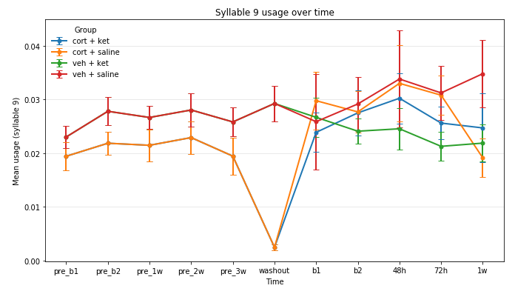
Syllable 9: Turning left

Slide 21
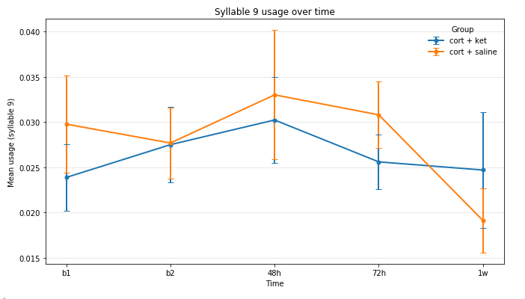
Syllable 9: Turning left
(cort+saline vs. cort+ketamine)

Slide 22
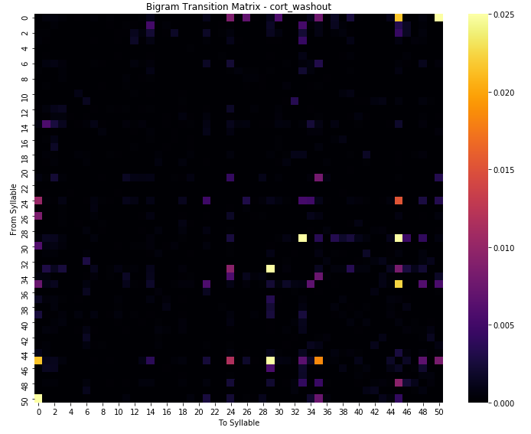
Transition Matrix – Cort washout
In the washout session, there syllable 33, 45(grooming) both have a high probability of transitioning to syllable 29 (staying still)

Slide 23
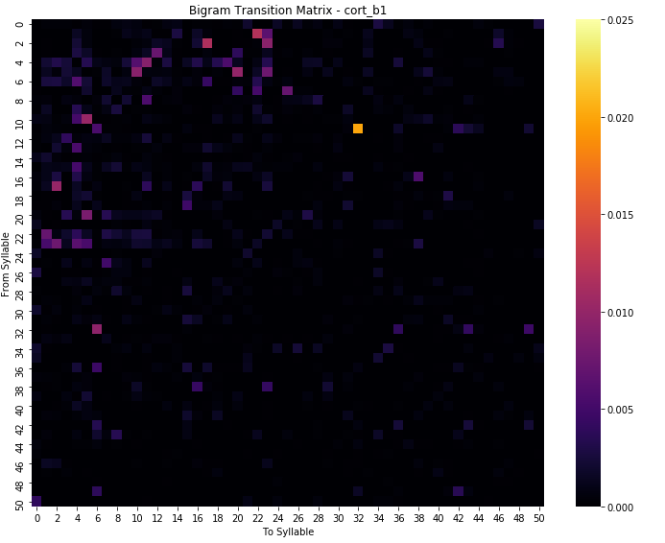


Slide 24

