Slide 1
Progress Update
Mohan Yang

Slide 2
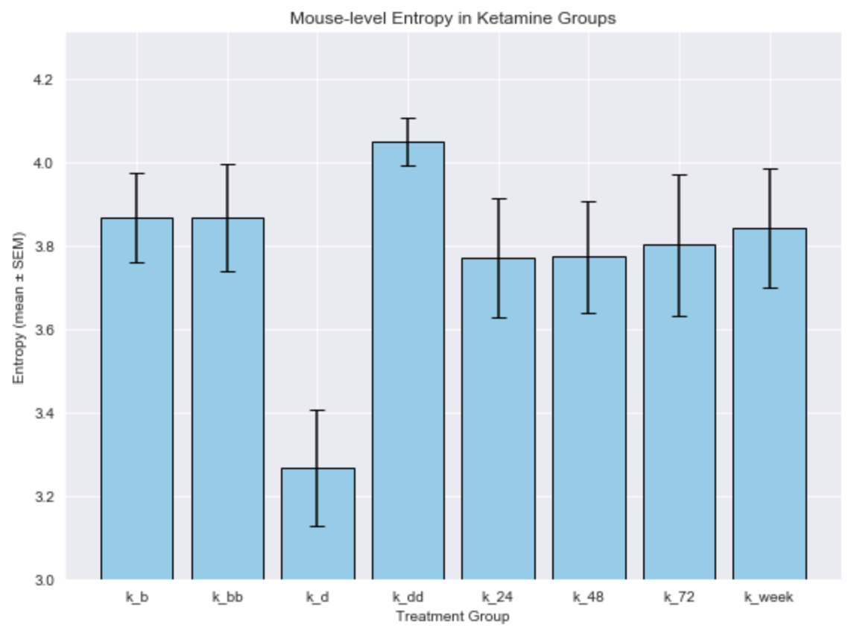
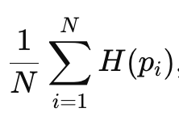
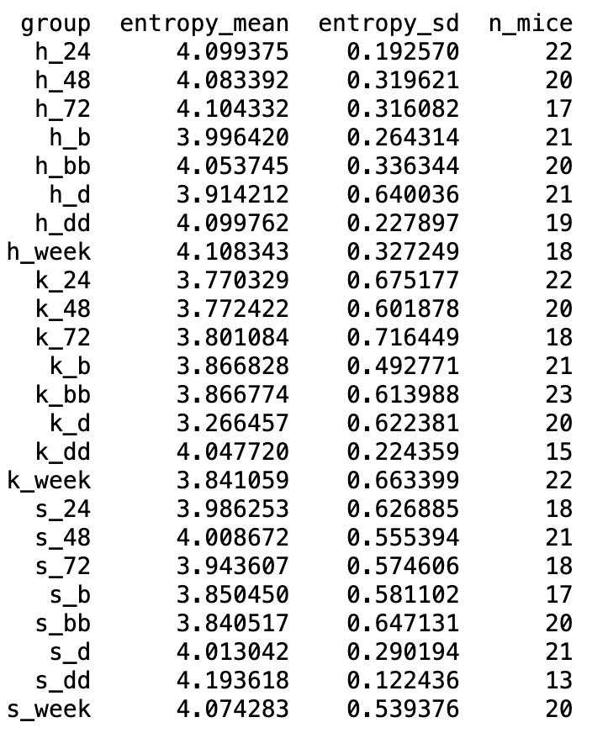

Entropy Calculated for each mouse, averaged for the same group
Welch’s t-test result:

Slide 3
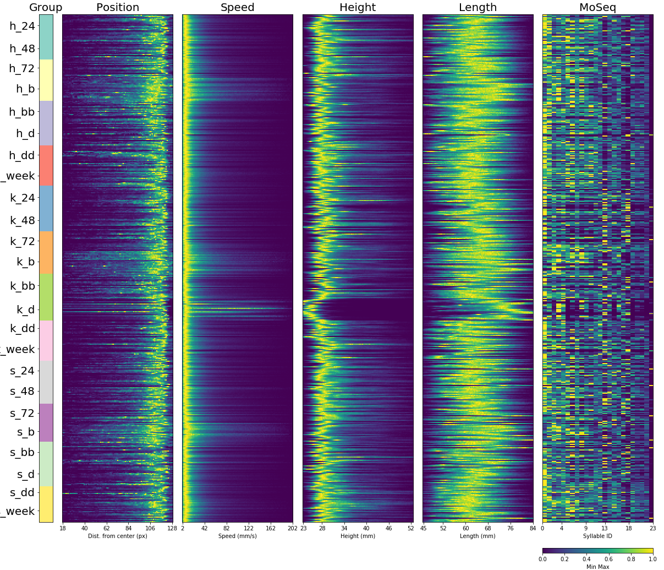
New model’s fingerprint plot:
(max_syllable = 25, kappa = 1e+8)

Slide 4
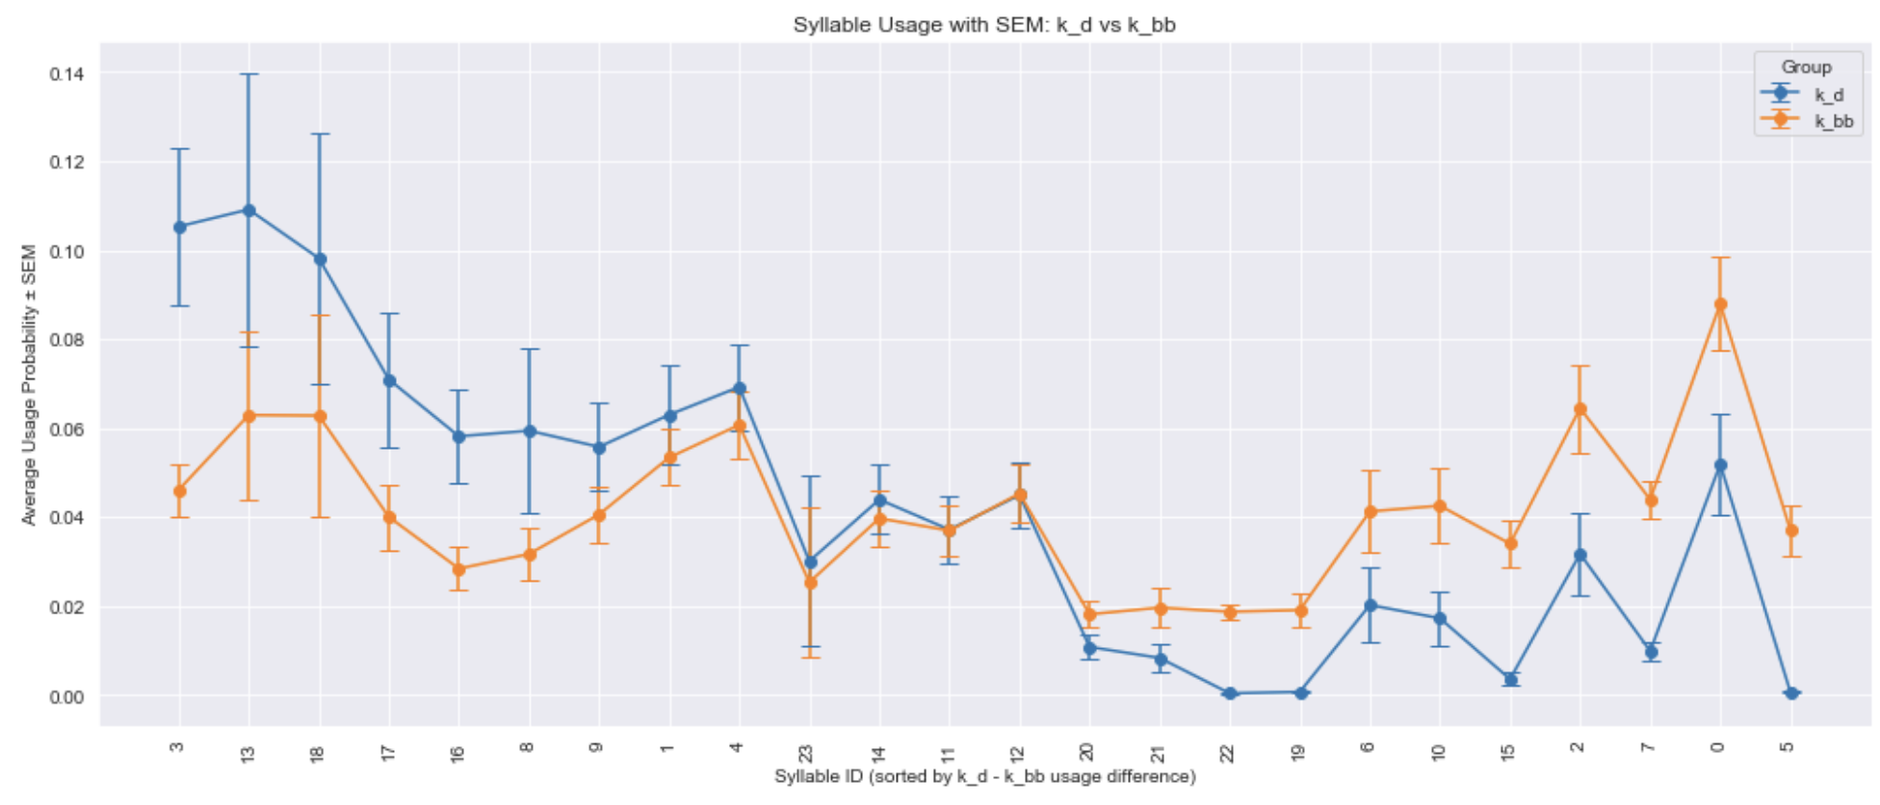
k_bb (before injection) vs. k_d (10 min after injection)

Slide 5
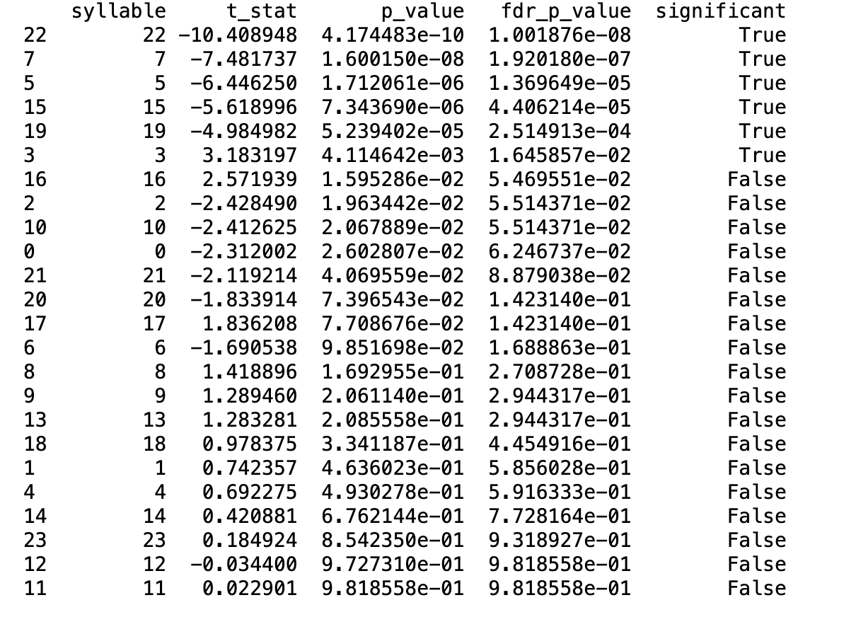
Syllable t-test with FDR adjusted p-value
t-stat is computed by k_d - k_bb

Slide 6
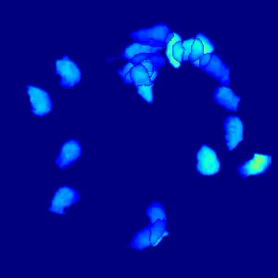
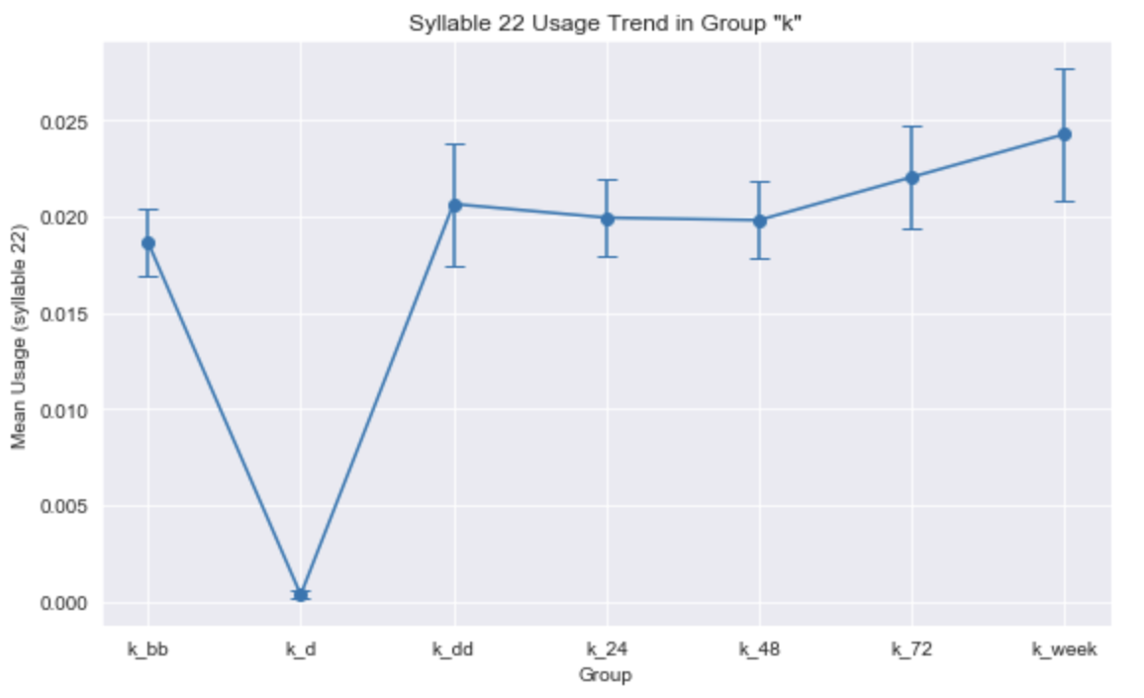
Syllable 22 (grooming)
Syllable usage shows grooming behavior is significantly more in k_bb (before injection group) comparing to the k_d (10 min after injection group).
k_dd (2 hour after injection) group has significantly more grooming comparing to k_d group

Slide 7
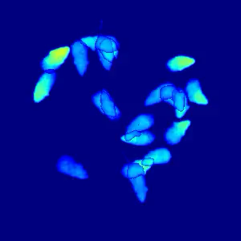
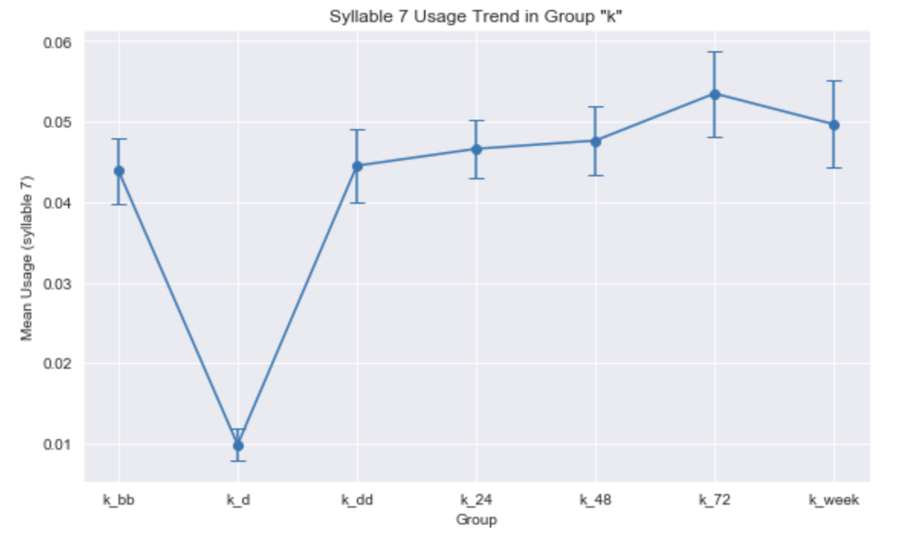
Syllable 7 (rearing)
Syllable usage shows rearing behavior is significantly more in k_bb (before injection group) comparing to the k_d (10 min after injection group).
k_dd (2 hour after injection) group has significantly more rearing comparing to k_d group

Slide 8
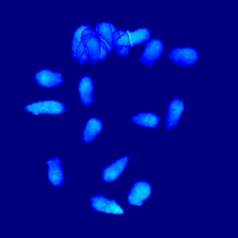
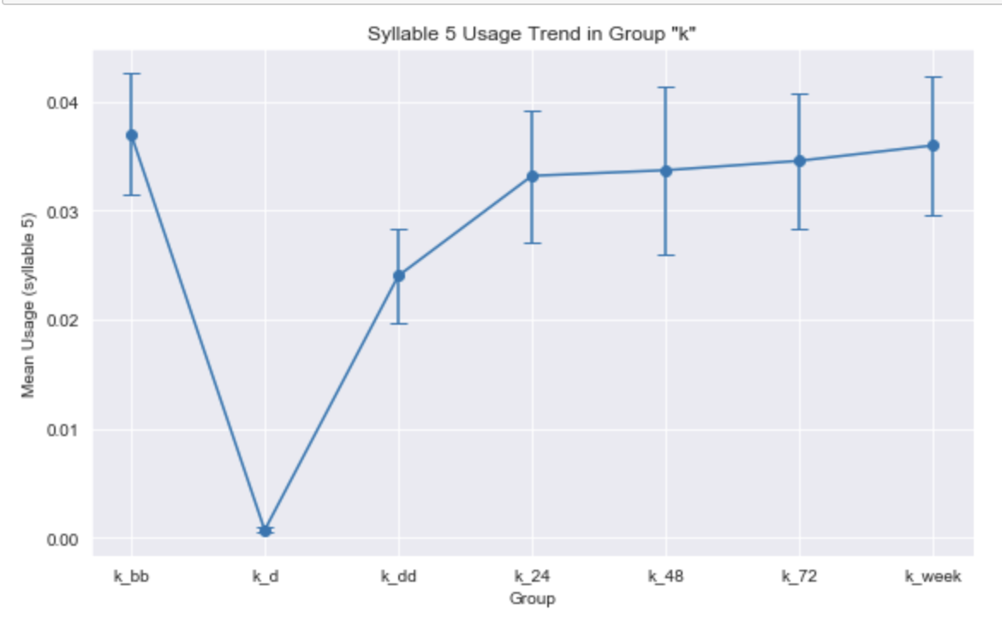
Syllable 5 (staying still)
Syllable usage shows staying still behavior is significantly more in k_bb (before injection group) comparing to the k_d (10 min after injection group).
k_dd (2 hour after injection) group has significantly more staying still behavior comparing to k_d group

Slide 9
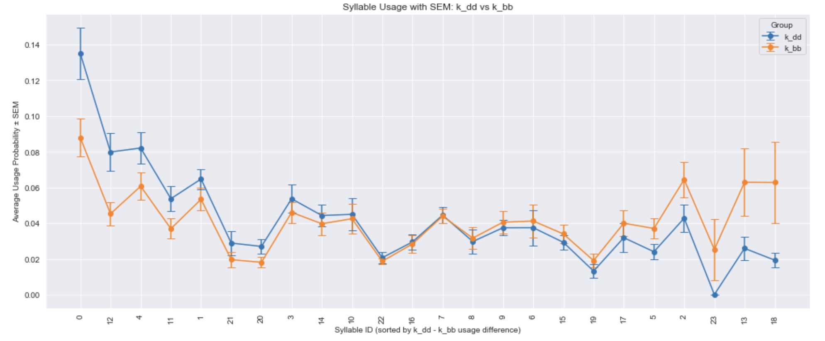
k_bb (before injection) vs. k_dd (2 hour after injection)

Slide 10
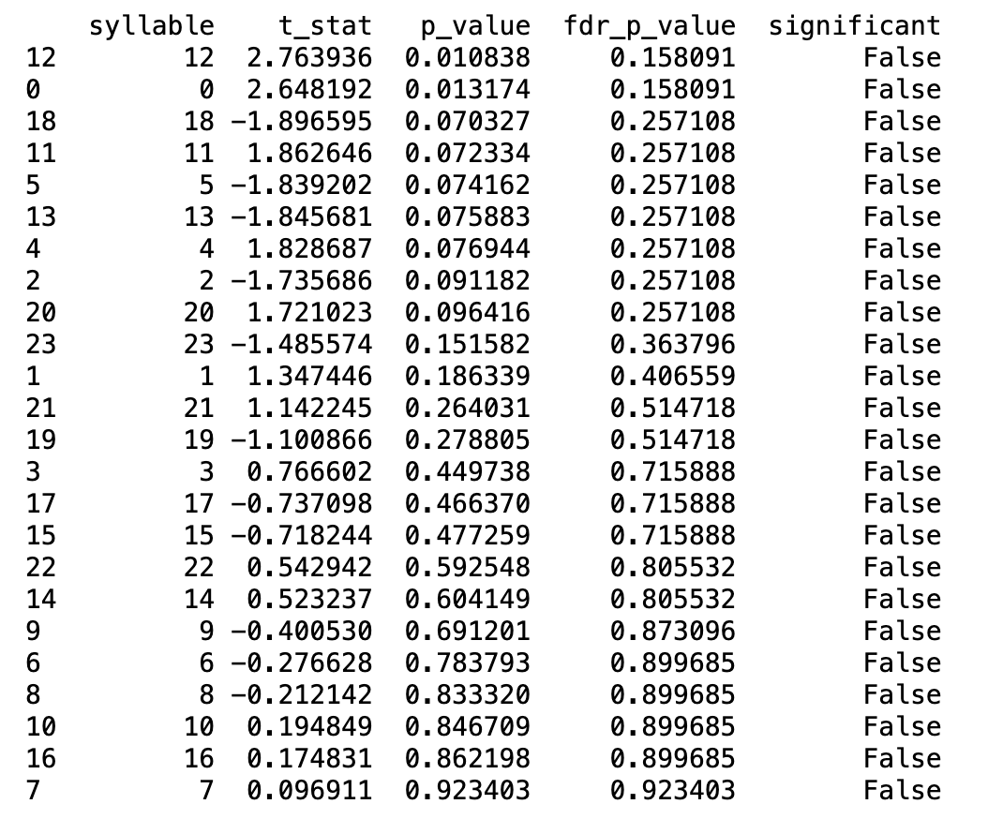
Syllable t-test with FDR adjusted p-value
t-stat is computed by k_dd - k_bb

Slide 11
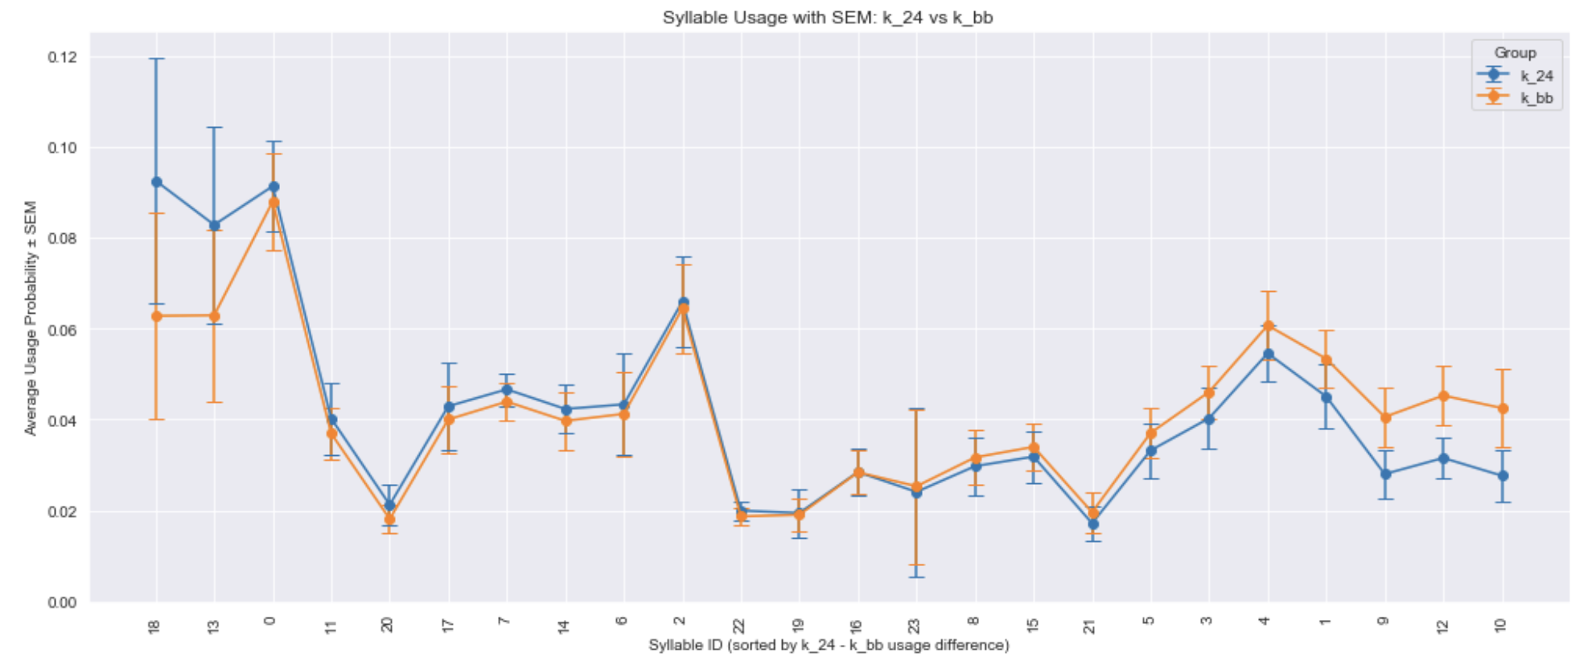
k_bb (before injection) vs. k_24 (24 hour after injection)

Slide 12
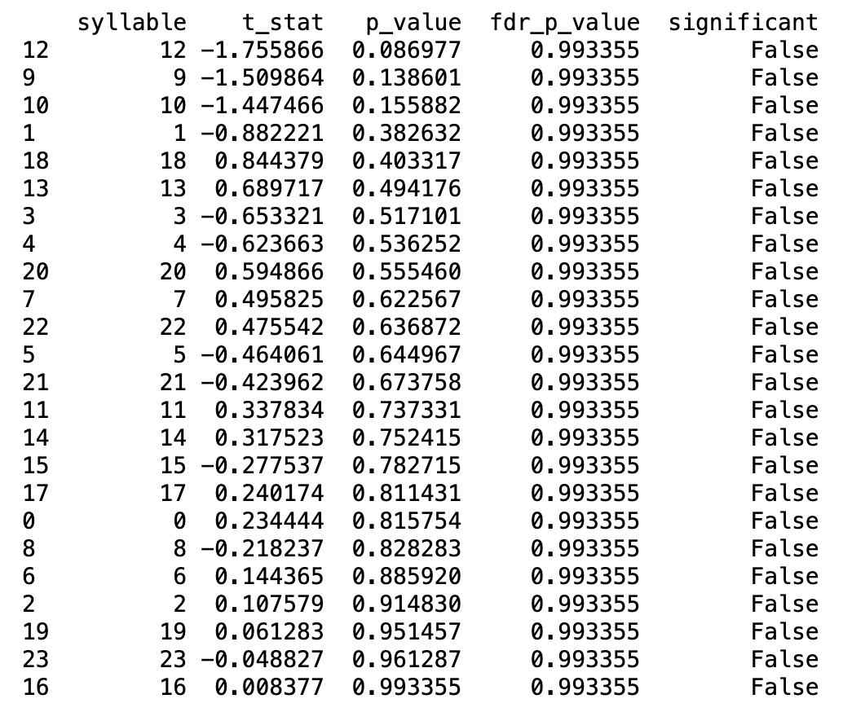
Syllable t-test with FDR adjusted p-value
t-stat is computed by k_24 - k_bb

Slide 13
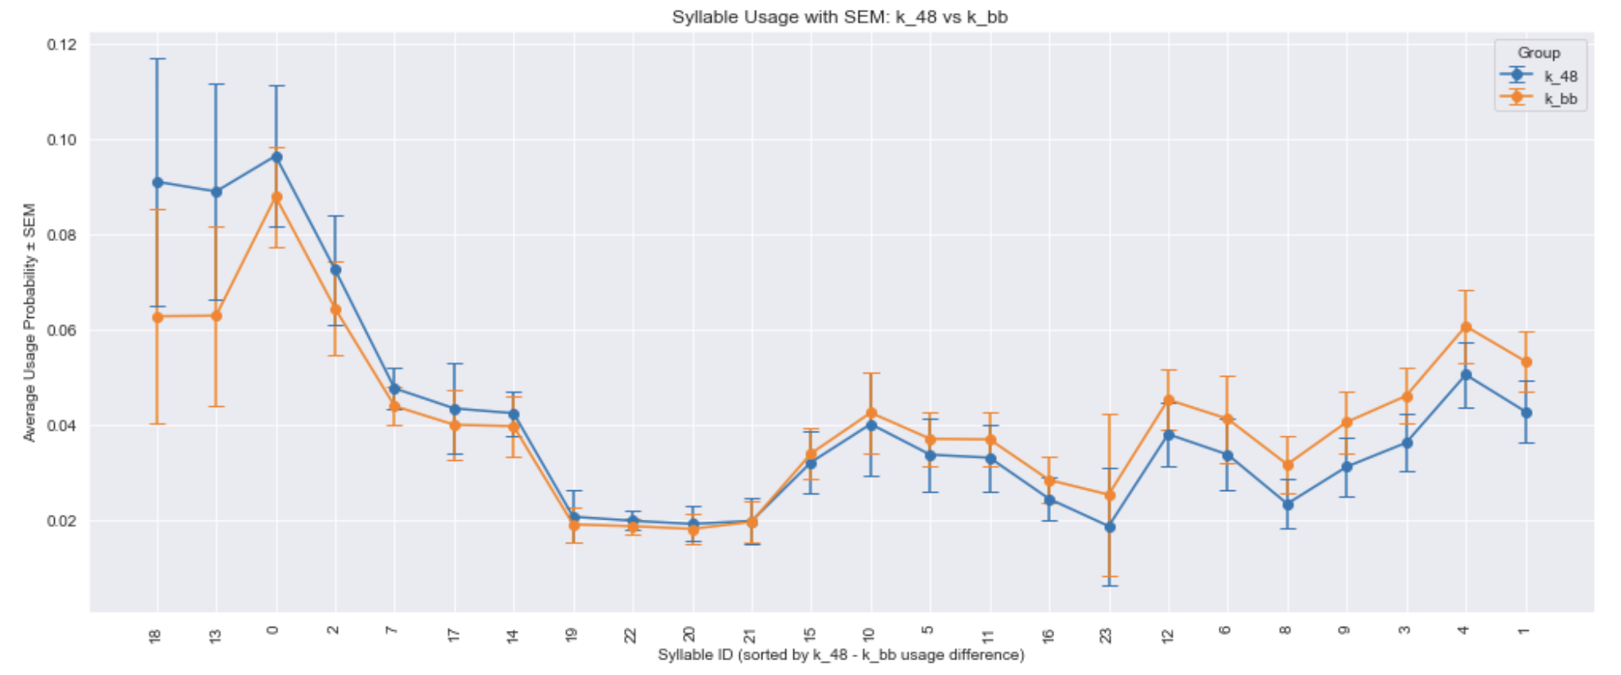
k_bb (before injection) vs. k_48 (48 hour after injection)

Slide 14
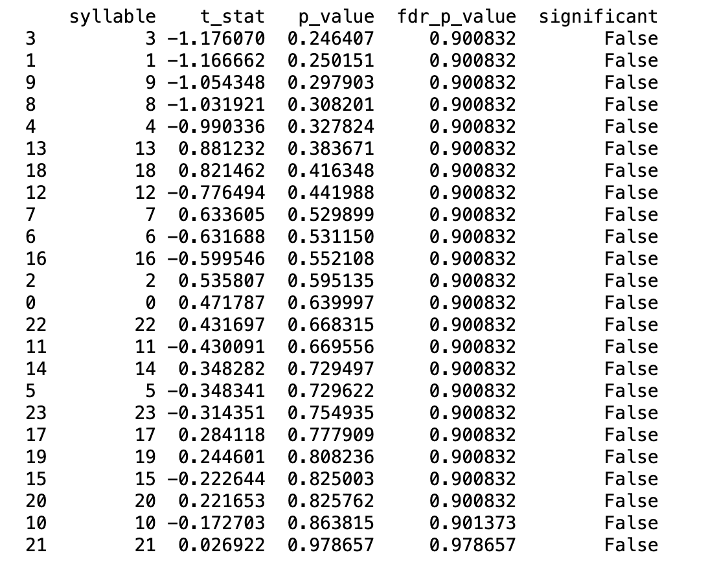
Syllable t-test with FDR adjusted p-value
t-stat is computed by k_48 - k_bb

Slide 15
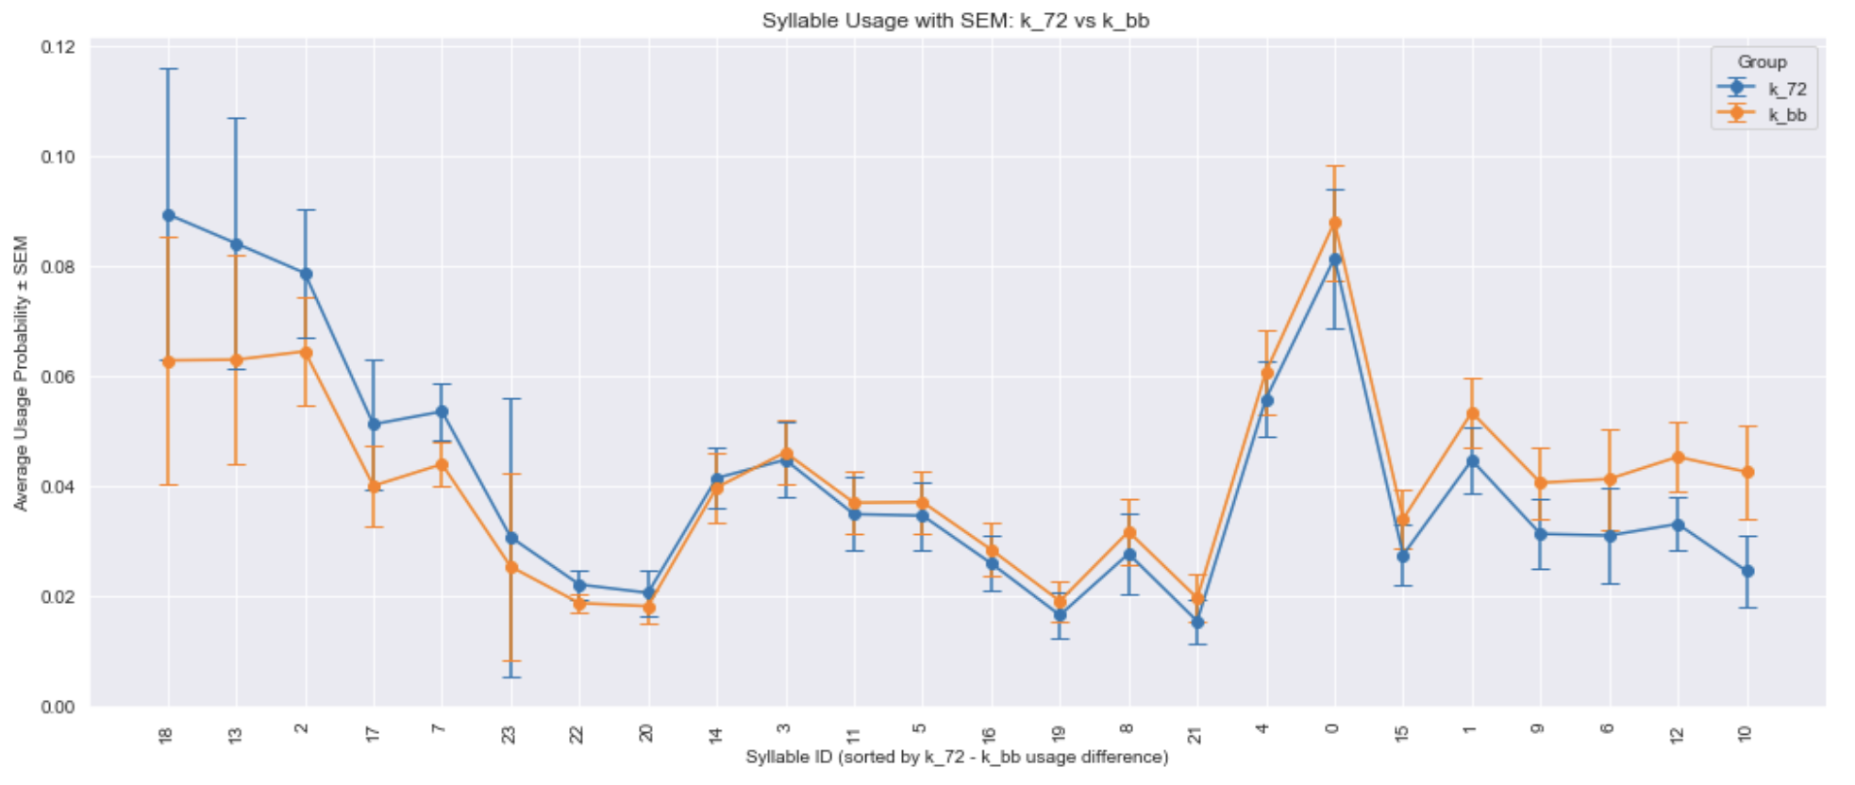
k_bb (before injection) vs. k_72 (72 hour after injection)

Slide 16
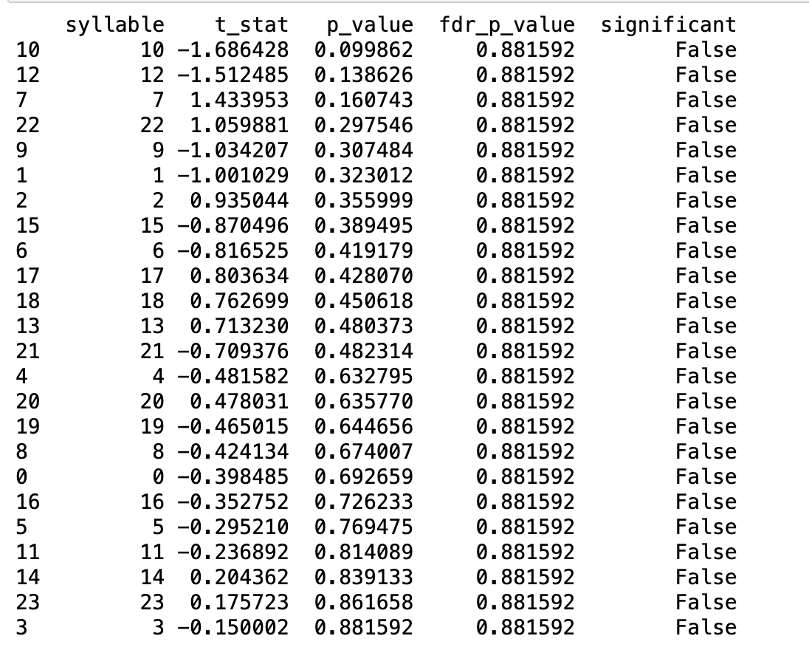
Syllable t-test with FDR adjusted p-value
t-stat is computed by k_72 - k_bb

