Slide 1
Encryption and Decryption of audio using Python
Mentor: nithya c kunala Rohit gupta (122004133)
Pingali mohana Vamsi(122004188)
Papadi haswanth (122004182)

Slide 2
Motivation
The rapid growth of digital data and its security raises the concern for developing more advanced techniques in cryptography.
There are many advanced encryption and decryption techniques for different multimedia like text and image in communication.
However, security measures for audio are least seen in any applications. This motivated us to do this project.

Slide 3
Objective
To design an encryption and decryption algorithm for audio.
To provide application security in audio communication.
To ensure confidentiality of audio files.

Slide 4
Literature Survey
In a paper “Audio water marking and partial encryption”, the author has applied the partial encryption to the audio and also audio water marking is implemented.
Partial encryption, also named selective encryption, is regarded as a suitable choice for multimedia content encryption because of the properties of time efficiency, format compliance, and network compliance.
Partial encryption provides particular properties that are different from the usual encryption schemes.

Slide 5
Literature Survey(Contd.)
In the paper “A novel audio encryption with Permutation- Substitution architecture” the author proposed a new cryptographic method is designed for audio files’ security.
The encryption algorithm is based on classic symmetric models using pseudo-random number generator composed with modified rotation equations.
The scheme of a new pseudo-random generator is presented and used as basis for chaotic bit-level permutations and substitutions applied to audio files structure for successful encryption.

Slide 6
Literature Survey(Contd.)
In the paper “Audio Encryption” it primarily centers on encryption strategies for sound information. This exhibits an examination and correlation of essential encoding norms and a writing overview encryption method that is utilized for encoding on sound information.
Audio Encryption can be done using certain encryption algorithms like AES (Advanced Encryption Standard), DES (Data Encryption Standard), Triple DES (3-Data Encryption Standard)
A replacement for DES was needed as its key size was too small. The increasing computing power and energy leads to vulnerability against exhaustive key search attack.

Slide 7
Literature Survey(Contd.)
In the paper “Encryption and decryption of audio signal based on RSA algorithm” the author applied the well-known RSA algorithm for audio signal encryption and decryption.
The results obtained demonstrated that the residual intelligibility in the encrypted audio signal is low while the quality of the recovered audio signal is maintaining good with a satisfying level.
It confirms the suitability, reliability, high security and effectiveness of the introduced scheme to be applied in practical applications like audio data encryption/decryption.

Slide 8
Introduction
Information security is designed to protect the confidentiality, integrity and availability of computer system and physical data from unauthorized access whether with malicious intent or not.
Confidentiality, integrity and availability are referred to as the CIA triad.
Confidentiality is to ensure the protection of data by preventing the unauthorised disclosure of information.

Slide 9
Methodology
The entire implementation of our project is done using Python.
The proposed idea of encryption and decryption process is based on symmetric key or private key cryptography.
The source audio file of any format is directly being encrypted into ciphered file which is then decrypted to reproduce the original audio.
The source audio can be either live or existing audio file.
The visualization of source audio and decrypted audio after sampling the original analog audio is done using MATLAB and matplotlib in Python.

Slide 10
Methodology(Contd.)
This project consists of audio file as an input where audio is live recorded using sounddevice and scipy.io modules.
A shared key is generated which is in URL-safe base64 encoded format.
This file is then passed into an encryption algorithm and then the encrypted file is provided as an output.
Now, to get the original file the encrypted file is then passed into the decryption algorithm and the original audio file comes as the output.

Slide 11
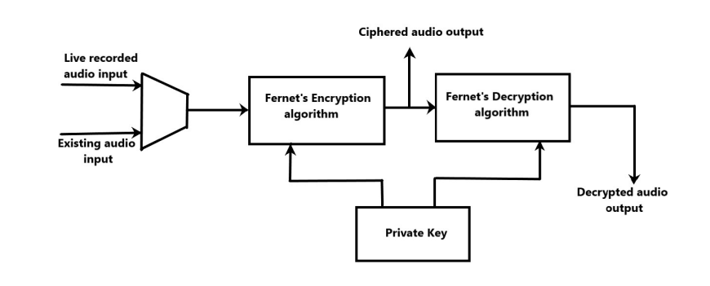
Block Diagram of audio encryption and decryption

Slide 12
Work Done
For taking audio as input we used sound device module and scipy.io module.
For the audio to be stored in a file format, it should be converted from analog to discrete form. The sampling process has to be done to achieve it.
The optimal sampling frequency is observed to be 44.1 KHz.
The duration to be recorded is given as a user input functionality.
The recorded audio is stored in a file.

Slide 13
Work Done(Contd.)
The shared key generated is URL-safe base64 encoded and is 32 bytes of size.
Then the recorded audio file is passed into the encryption algorithm and by using the above key, the algorithm encrypts the audio and store it in a file.
The encrypted file cannot be played as it is not in the audio format.
The plots of the both original audio inputs and decrypted outputs are shown using matplotlib module in Python.

Slide 14
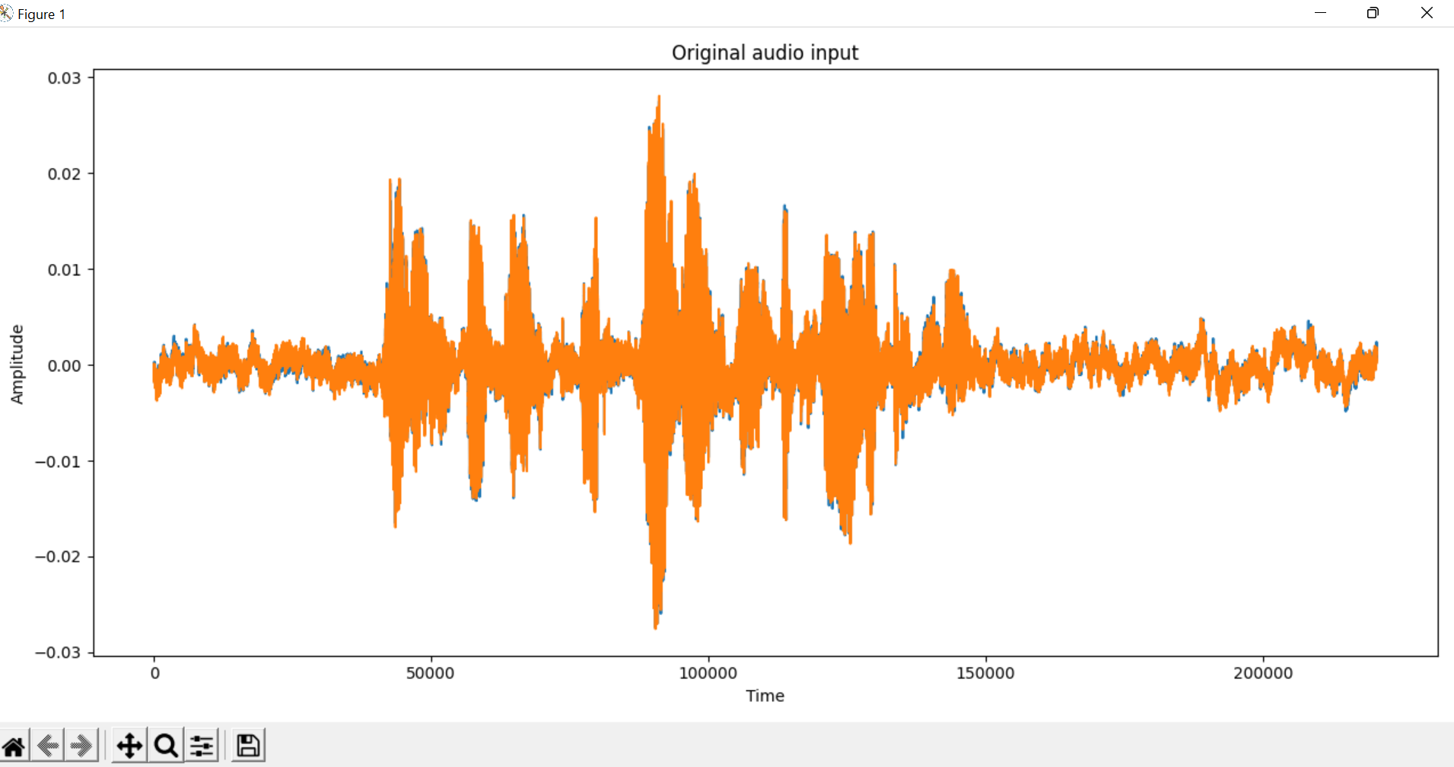
Fig. Plot of original audio input

Slide 15
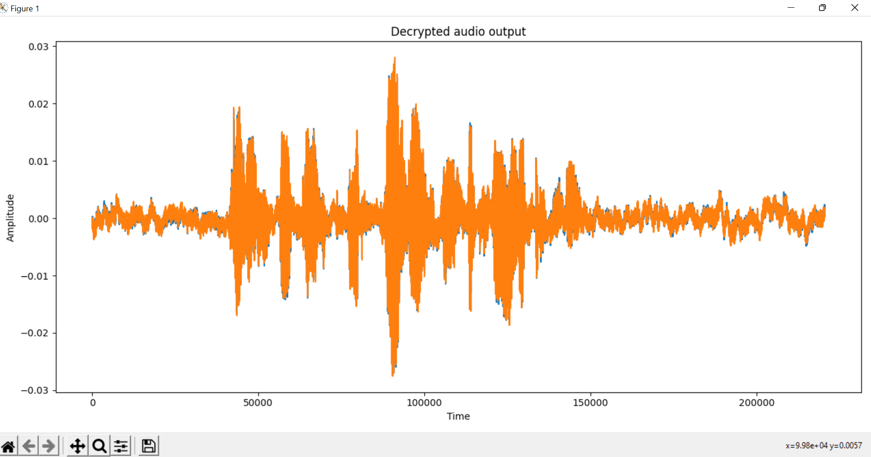
Fig. Plot of decrypted audio

Slide 16
Metrics
The metrics used to validate our project are Mean square error(MSE), Peak Signal to Noise Ratio(PSNR), Correlation.
All the metrics are observed using MATLAB.
The mean square error (MSE) between the original and decrypted audio signals is observed to be Zero.
The PSNR value between the original and decrypted audio signals is observed to be infinity.
The correlation value for both original and decrypted audio signals is observed to be same and the value is close to 1.

Slide 17
THANK YOU

