Slide 1
Employee Data Analysis using Excel
STUDENT NAME: Mohana. K
REGISTER NO: 122203891
DEPARTMENT: B.com corporate secretaryship
COLLEGE: Shri Shankarlal Sundharbai Shasun Jain College for women

Slide 2
PROJECT TITLE
Employee Salary Analysis using Excel

Slide 3


AGENDA
Problem Statement
Project Overview
End Users
Our Solution and Proposition
Dataset Description
Modelling Approach
Results and Discussion
Conclusion
3/21/2024 Annual Review

Slide 4

PROBLEM STATEMENT
This project is to know how much an individual employee is earning a salary in a month.

Slide 5

PROJECT OVERVIEW
Employee salary analysis involves examining and assessing the compensation structures within an organization. This analysis includes,
Performance and Rewards: Linking salary with performance metrics to ensure that compensation reflects employees contributions and achievements.
Equity and fairness: evaluating internal pay equity to ensure that employees in similar roles and similar experience and experience performance levels are paid fairly relative to each other.

Slide 6

WHO ARE THE END USERS?
CEO
MANAGER
EMPLOYEES
EMPLOYEES
MANAGER
TEAM LEADER

Slide 7

OUR SOLUTION AND ITS VALUE PROPOSITION
Conditional Formatting – to know the highest from 1,00,000
Pivot – summary
Bar chart- data visualization
Former painter- to highlight the fixed term

Slide 8
Dataset Description
Employee data set taken from the KAGGLE.
In dataset, out of 9 data I took only 2 features out of it.
Emp id:- Alpha and numeric
Name:- Text
Salary:- numeric

Slide 9

THE "WOW" IN OUR SOLUTION
To make your employee salary analysis solution truly stand out, focus on incorporating advanced analytics and to uncover deeper insights and predict future trends. Personalize dashboards to allow employees to visualize their salary data in a way that suits their needs, and integrate sentiment analysis to provide a qualitative perspective on employee engagement.
3/21/2024 Annual Review
9

Slide 10
MODELLING
Data collection:
The data has been collected through edunet dash board.
Feature collection:
The listed feature has been taken from analyses of data.
Data cleaning:
Conditional Formatting – to know the highest from 1,00,000
Pivot – summary
Bar chart- data visualization
10

Slide 11
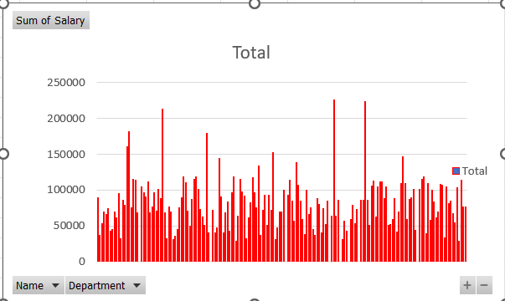
RESULTS
11

Slide 12
conclusion
The conclusion of an employee salary analysis typically summarizes key findings and provides actionable recommendations based on the data reviewed.
Competitive Positioning: Detail how the organization's salary levels compare to industry standards, competitors, or geographical norms. Highlight whether salaries are generally above, below, or at market rates.
Budget Implications: Provide an overview of how current salary structures align with the organization's financial capabilities and budget constraints. Mention any potential financial impacts of proposed changes.

