Slide 1
ITD 154: Final Project Presentation
Presented by:
Ramalingam Mohana Kalaiyarasan (19B599X)
Nanyang Polytechnic Specialist Diploma in Business & Big Data Analytics 180 Ang Mo Kio Ave 8, Singapore 569830

Slide 2
Business Objective
To find out the criteria for which type of customers will make late payment
Database: NYB.Data (Microsoft Access)

Slide 3
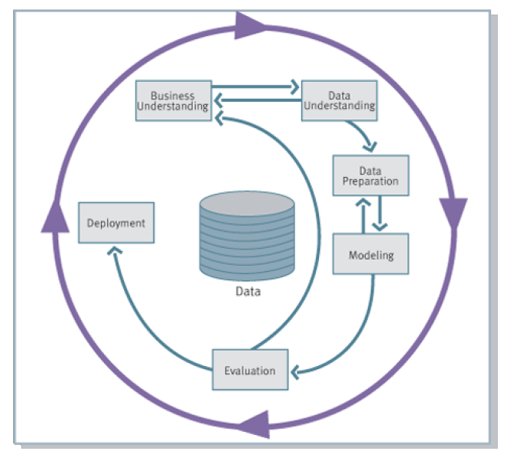
CROSS-Industry Standard Process for Data Mining (CRISP-DM)
Data Mining Objective: To Know What are the customer’s attributes (patterns & trends) show impact for late payment?
Milestone Review:
Data understanding
Data Cleansing

Slide 4
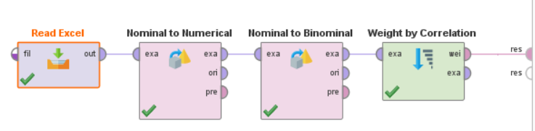
Correlation Weight Identification
Customized file with Attributes
Attribute | Weight
LoanStartDate | 0.616
LoanMaturityDate | 0.186
AnnualIncome | 0.168
MonthlyPaymentAmt | 0.148
PropertyPurchasePrice | 0.132
LoanPrincipalAmt | 0.127
Nationality | 0.111
SASNationality | 0.104
JobTitle | 0.051
MaritalStatus | 0.038
Gender | 0.027
EducationLevel | 0.022
Age | 0.016
NoOfDependents | 0.012
PropertyResidentialType | 0.008
LoanPeriod | 0.006
Selection of Attributes:
Based on data understanding the attributes are selected into a single file
Conclusion from Correlation:
LoanStartDate is the most relevant attribute followed by LoanMaturity, Annual Income in related to late payment.

Slide 5
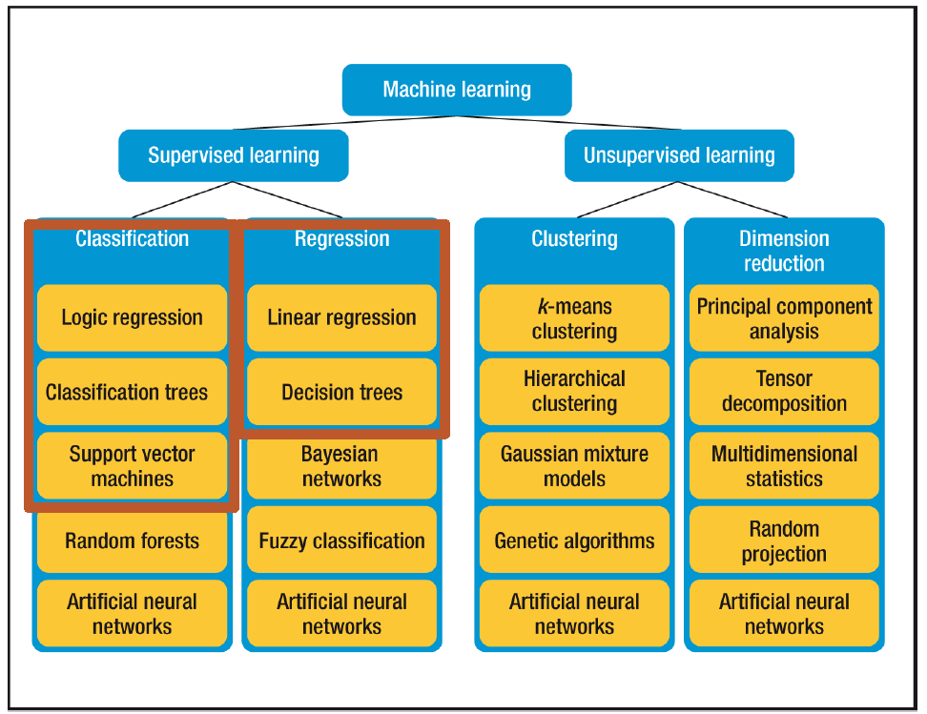
Model Selection
Model Selection for Supervised Learning:
Decision Tree
Support Vector Machines
Logic Regression
Selected Model: Logistic Regression
NYB bank data is mostly in polynominal, it is best suited to use the logic regression.

Slide 6
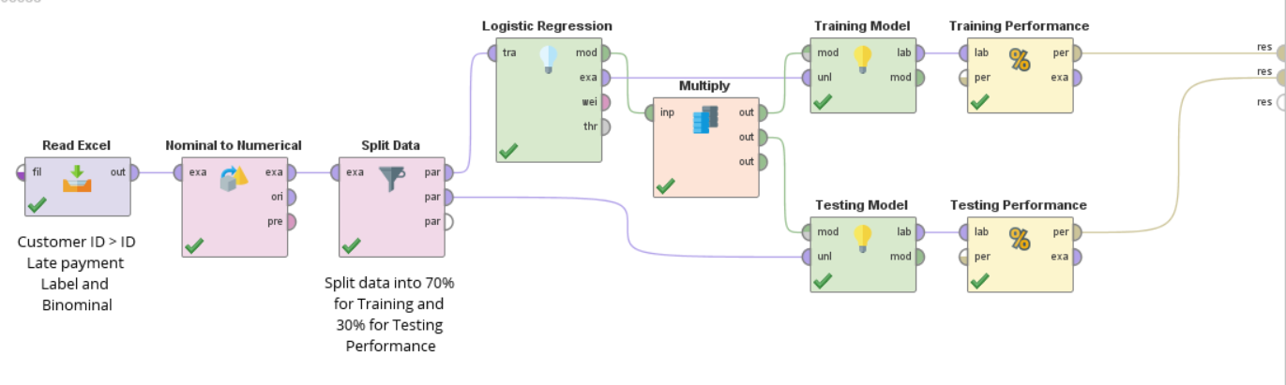
Logic Regression Model
Model Training and Testing:
Split the data 70% for Training the Logistic Regression and 30% for testing the efficiency of trained regression
Converted the fields data into Numerical to perform the logistic regression.

Slide 7
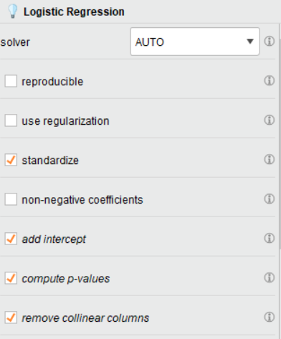
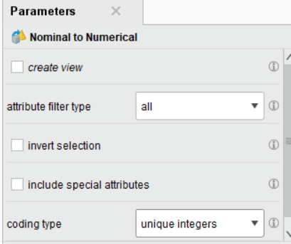
Logic Regression Model

Slide 8
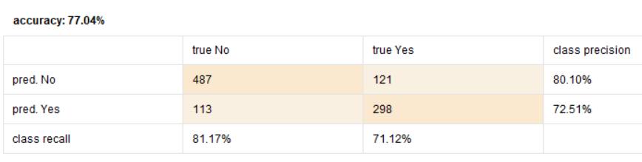
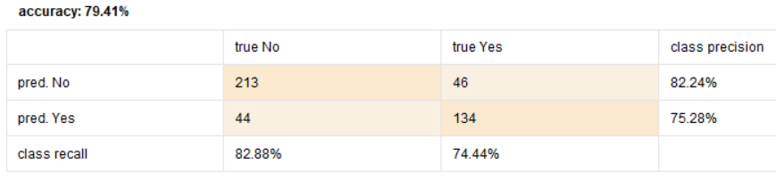
Logic Regression Model - Result
Late Payment:
Yes : Late Paid
No: No Late Paid
Reason for Highest Percentage True Negativity (Specificity, No Late Paid 80.1%) has more data compare to Late Paid (Yes, Sensitivity 72.15%)
No: Late Paid (857 data)
Yes: No Late paid (599 data)
Total Data: 1456
Training Performance:
Testing Performance:

Slide 9
Logic Regression Model – Outcome
Analysis Outcome:
With the Accuracy of Prediction for Trained and Testing performance will help the Bank employee to analyze the Loan Payment capacity in time with main attributes of Loan Starting Date, Loan Maturity Date, Annual Income and Monthly Payment amount, Property purchase price, Loan Amount and their Nationality.
Upon knowing their Loan Payment capacity, the bank employee can suggest the customer to go longer period of loan payment by reducing the Monthly payment amount.
Even one in four customer prediction will be analyzed wrongly based on the Regression model.

Slide 10
Logic Regression Model – Result Improvement
Improve the Accuracy of detection of Late Payer:
Balance the data to have equal data (Late Paid and No late paid) then the Training (79.83%) and testing prediction yield (77.78%) accuracies.
For this data, it is not necessary to have the balance data, 40% Late paid and 60% No Late paid.
Balancing the data didn’t help much in original accuracy of 77.04% (training), 79.41% (Testing).
Use Data Modelling Technique
Improve Data quality (Cleansing)

Slide 11
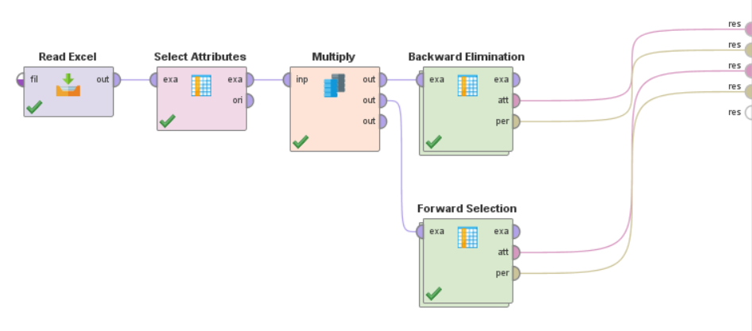
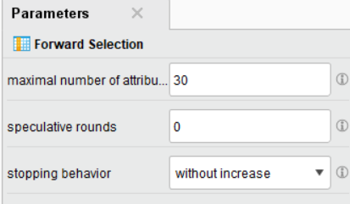
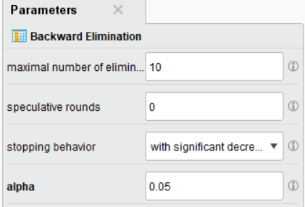
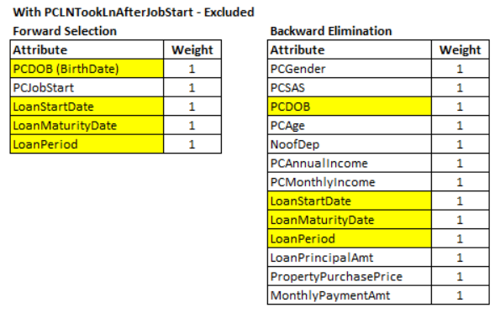
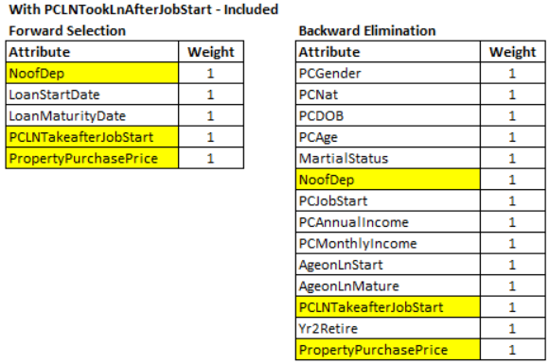
Feature Selection
Logic Regression Model – Result Improvement
Common Attributes Weight More in predicting Late Payer from Forward and Backward Elimination:
No.of Dependent
Loan Taken after Job Start (No. of Years in between Job start and Loan Taken)
Property Purchase Price

Slide 12
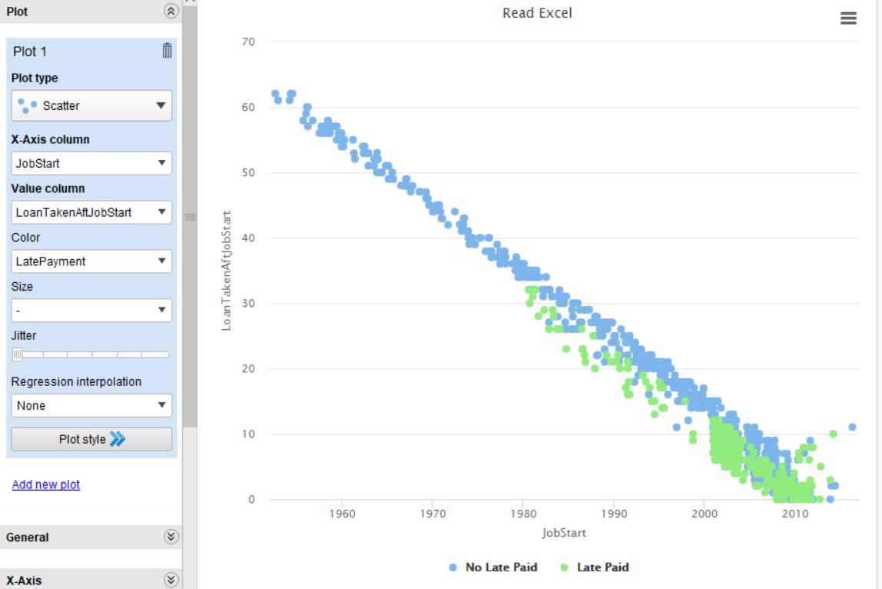
Feature Selection
Logic Regression Model – Result Improvement
Outcome of Feature Selection:
Attribute: Loan Taken after Job Start
Those who take housing loan after they started the Job, had more chances of Late Payment, compared to those who have worked more year and got housing loan.

Slide 13
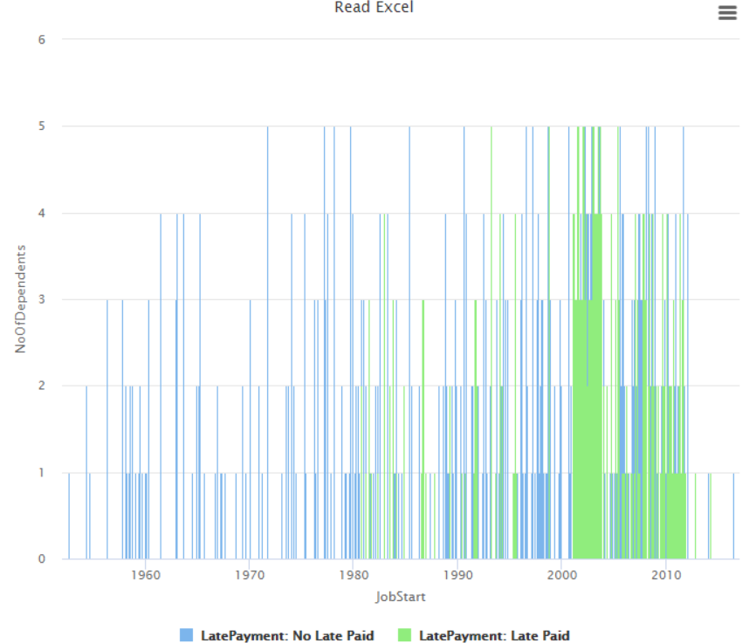
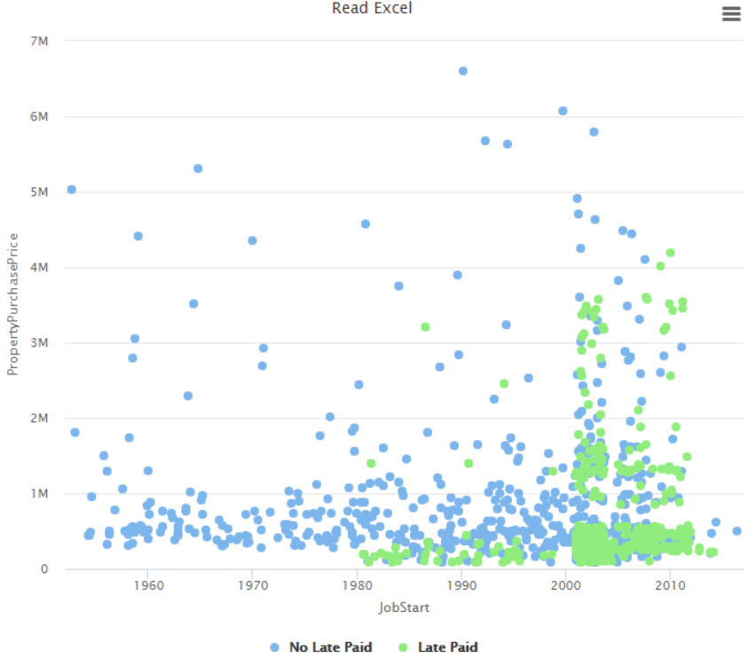
Feature Selection
Logic Regression Model – Result Improvement
PropertyPurchasePrice:
No.of Dependent:
Outcome of Feature Selection:
Attribute: Loan Taken after Job Start: Those who take housing loan after they started the Job, had more chances of Late Payment, compared to those who have worked more year and got housing loan.
Attributes: No of dependent, Loan StartDate & PropertyPurchase Price (after 1980 those who took loan with dependent has more chances of Late Payment)

Slide 14
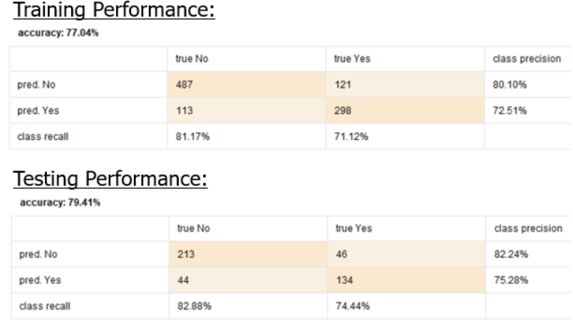
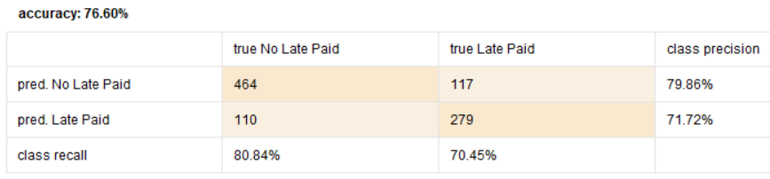
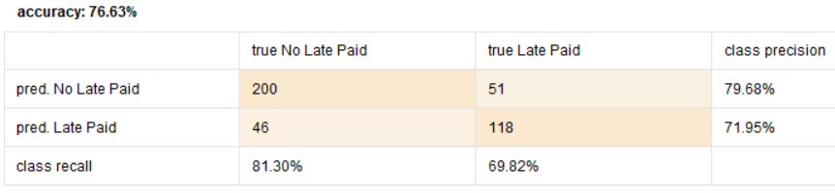
Data Quality Improve
Logic Regression Model – Result Improvement
Improve the Data Quality by removing the outlier and cleansing the data.
Original Data Source : 1456 data (599 Late Paid, 857 No Late Paid)
New Data source: 1385 data (565 Late Paid, 820 No Late Paid)
Training Performance: New Data
Testing Performance: New Data
Conclusion: With improved dataset the Training and Testing accuracy not much improved than the original dataset whereas the accuracy difference between Training and Testing has improved in New Dataset (0.03) compared to Original dataset (2.37).

Slide 15
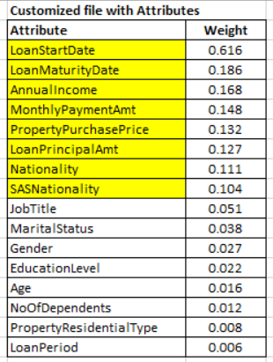
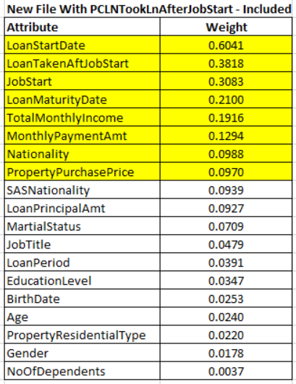
Logic Regression Model – Attributes
Comparing the Original Dataset and Improved Dataset(New) - Attributes
New Dataset:
Have more weightage on Loan Start Date, Loan taken after Job start, Loan Maturity date and so on.
By comparing the manual selected Attributes and New Dataset, added relevant attributes of Loan taken after job start (0.3818) where as in the manual selection there is a big difference between the top 2 attributes (~0.5).

Slide 16
Logic Regression Model – Outcome Improved
Analysis Outcome and Recommendation (New Data):
With the Accuracy of Prediction for Trained and Testing performance in new dataset, gives clear attributes of No. of Dependent, Property Purchasing Price (housing) and How many years of work has the customer had while applying for the loan determine the loan paying capacity.
From the database shows those who had taken after started their career after 1980 and purchased new house will go for late payment once in a while.
By knowing the Attributes the bank loan officer might minimize the loan payment amount per month (Increasing the loan period).

Slide 17
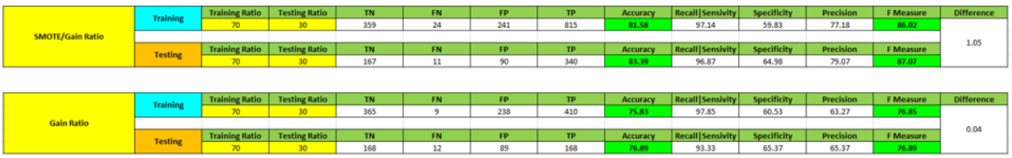
Compare Decision Tree with SMOTE vs Logic Regression Model
Decision Tree Model:
Logistic Regression Model:
Training Performance:
Testing Performance:
Conclusion:
By Analyzing the Decision tree with SMOTE (have balanced the data imbalance for Late Paid (No Cases and increased the database rows to 2055) and Logic Regression (1385), Accuracy mainly depend on the No Late Paid and Late Paid balancing.

Slide 18
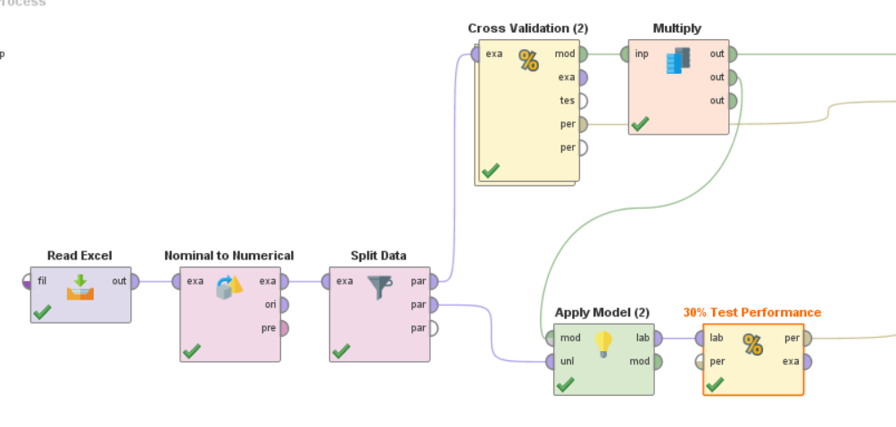
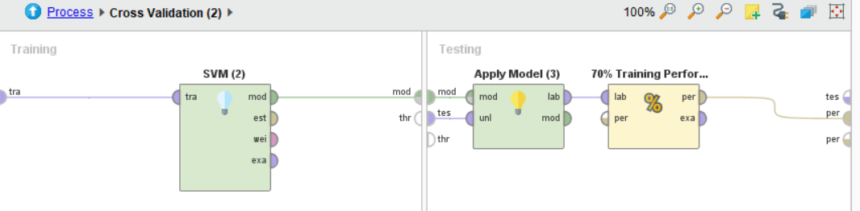
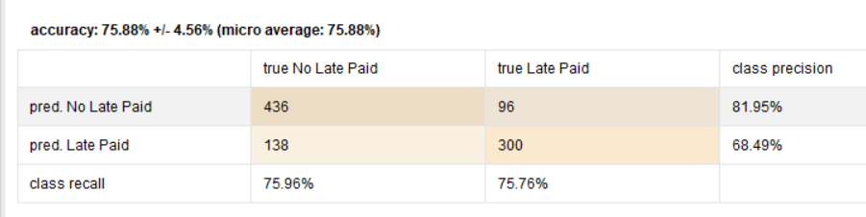
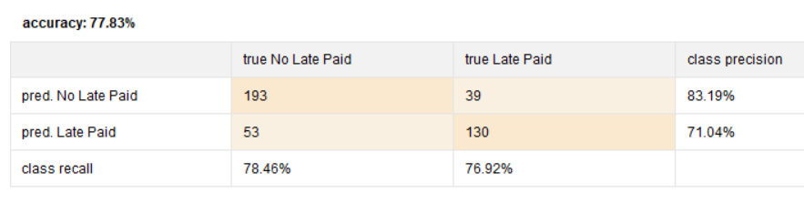
Cross Validation with SVM Model
Cross Validation
Cross Validation Sub process SVM
Training Performance
Testing Performance

Slide 19
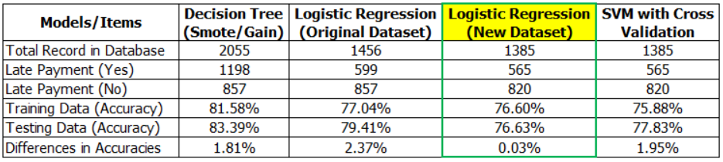
Result Comparison of all Models
Recommended Model:
Logistic Regression with accuracy differences between Training and Testing data is very much lesser compared to other models used. For Polynominal dataset to determine the Predicting Label, decision Tree is more opt, other than that can use Logistic regression follow by SVM models.

Slide 20
Data Understanding: Attributes of Interest
Gender - statistically, male has higher income than female
Age & Marital Status - if married (legal marriage age is 21 years old & up) to be legible for home ownership in Singapore (https://en.wikipedia.org/wiki/Matrimonial_law_of_Singapore) - if single, 35 years old & up to own property (https://hdb.gov.sg/cs/infoweb/residential/buying-a-flat/resale/single-singapore-citizen-scheme-or-joint-singles-scheme)
Number of Dependents - impact household expenditure
Nationality - people from different countries may have different view on default payment
Education Level - people from different education level may have different capability on their wealth generation & management
Residential Type - people from different education level may have different capability on their wealth generation & management

Slide 21
Things to Consider When Moving Forward
Data Imbalance
Overfitting/underfitting Issue
Explore various machine learning techniques
Accuracy of training & testing
Evaluate Confusion Matrix

Slide 22
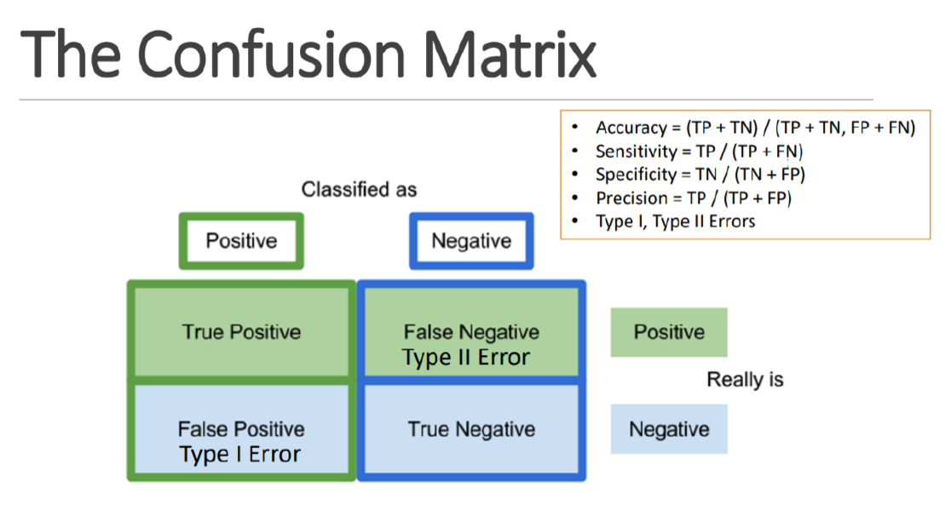
Evaluation

