Slide 1
Forecasting Inflation using Machine Learning Models: A Study on Consumer Price Index
Forecasting Inflation using Machine Learning Models: A Study on Consumer Price Index
Aditya Srikant, Mohana Krishnan, Suresh Nepal
Guide: Dr. Veeramani S

Slide 2
Introduction
Inflation is important macroeconomic indicator.
Machine learning (ML) algorithms are been used for time series analysis in different aspects of the economy.
For governments and policymakers to create successful macroeconomic policies, accurate inflation forecasting is essential.

Slide 3
Objectives
Basic analysis of the inflation data of India (2014-2022)
Obtain baseline with time series models such as ARIMA and SARIMA.
Determine how well selected machine learning algorithms (ML algorithms that are deemed better for economic data) do at prediction of inflation.

Slide 4
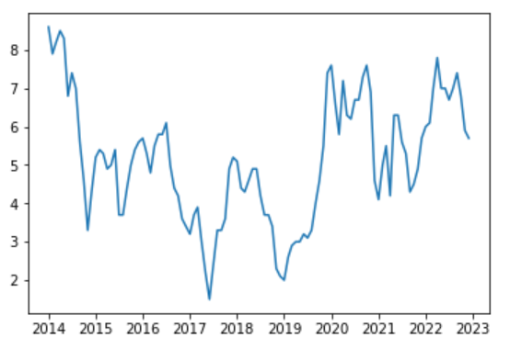
About the data
Data Source: World Bank website.
Date range: 2014-01-01 to 2022-12–01.
Monthly inflation based on Consumer Price Index(CPI).
Figure shows actual data.

Slide 5
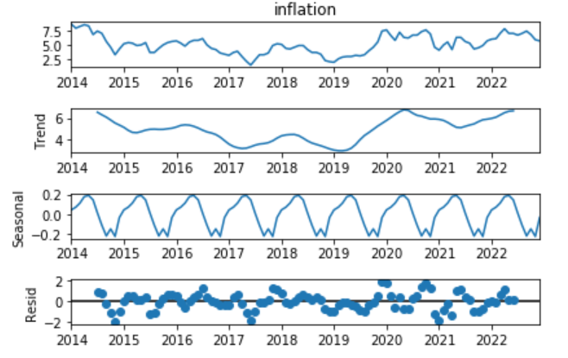
About the data contd.
Figure shows seasonal decomposition of the data.
Data is not stationary but becomes stationary after first order differencing

Slide 6
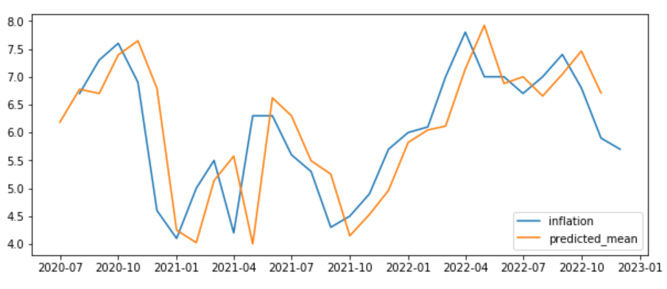
Determining Baseline
ARIMA(1,1,0) was used
Obtained MSE = 0.682

Slide 7
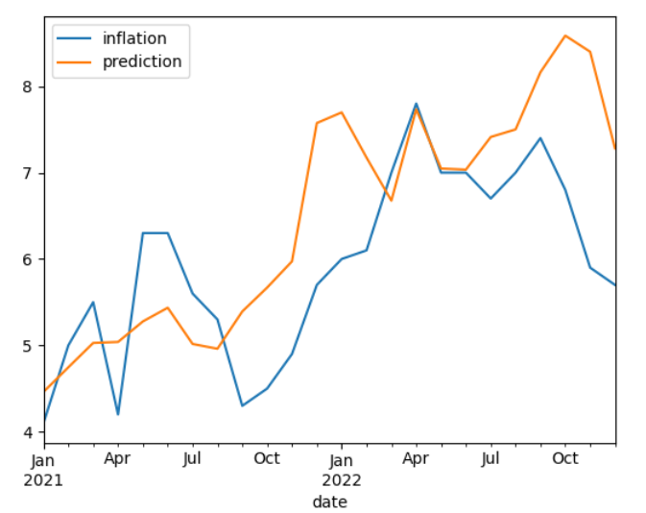
Determining Baseline contd.
SARIMA using Auto-Arima
Obtained MSE = 1.167
Notes:
SRIMA does not perform better duce to factors such as 1. Overfitting 2.irregular components

Slide 8
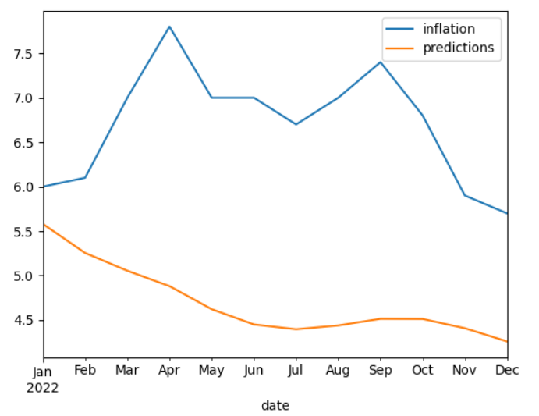
Long Short-Term Memory (LSTM)
LSTM is a type of recurrent neural network (RNN) well-suited for forecasting time series data.
Obtained MSE = 4.591

Slide 9
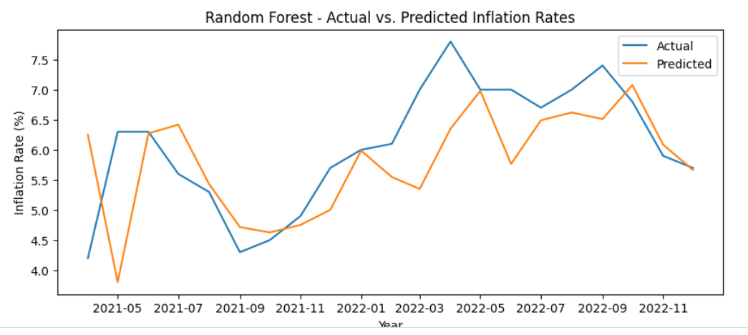
Random Forest Regressor
Combines multiple decision trees to make predictions
Works by treating future values as output and the past observations as input
MSE = 0.931

Slide 10
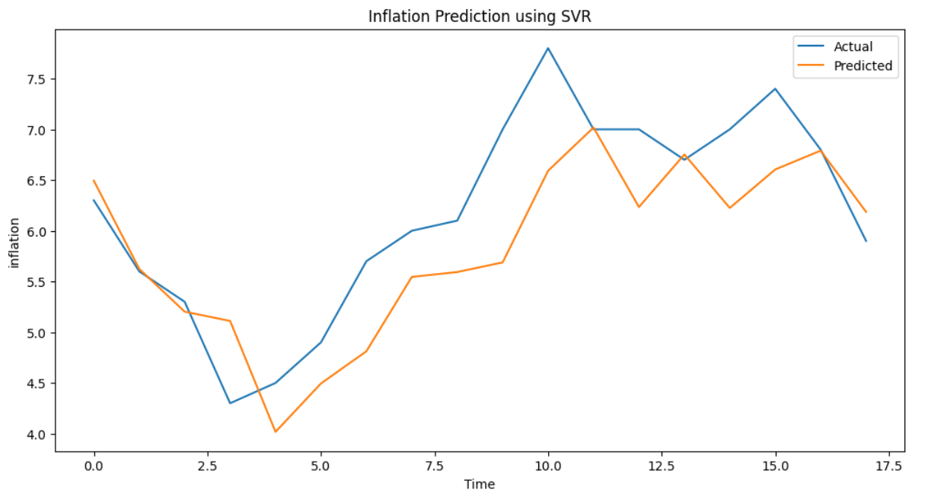
Support Vector Regressor
SVR uses the learned hyperplane and applies it to the new input data
MSE = 0.413

Slide 11
Result
Model | Performance (MSE)
ARIMA | 0.682
SARIMA | 1.167
LSTM | 4.591
Random Forest Regressor | 0.931
Support Vector Regressor | 0.413

Slide 12
Conclusion
Support Vector Regressor model had the lowest error score (0.4133), making it the most accurate for forecasting
Next suitable model is ARIMA. The SARIMA does not perform better than ARIMA despite the data having seasonal component
LSTM(RNN) performed poorly as time series data for inflation are only recorded monthly, even if we utilise 10 years' worth of data, there will only be 120 records. Hence there is less data for training the model. It is not suitable for forecasting economic data such as forecasting

Slide 13
THANK YOU

