Slide 1
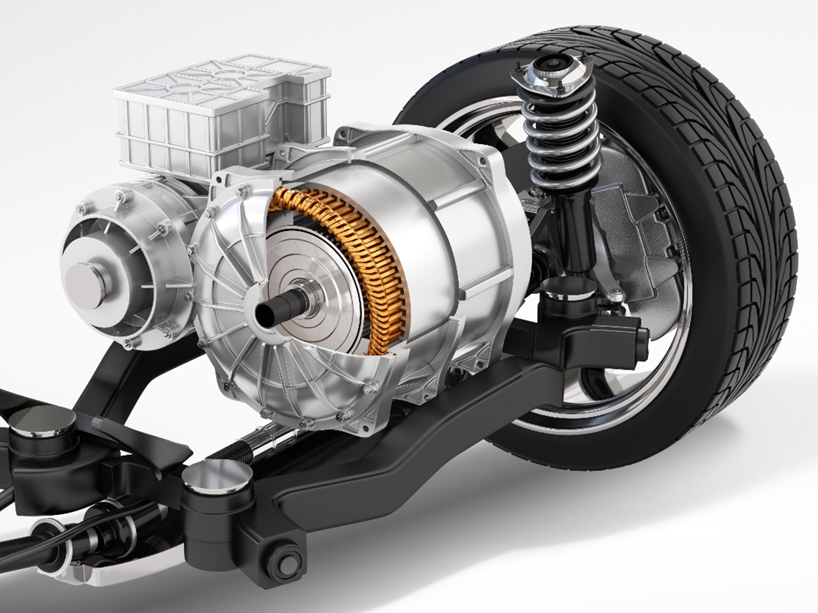
Design & Analysis of Interior Permanent Magnet Synchronous Motor using Finite Element Method
Mohana Segaran B
[immohanasegaran30@gmail.com]

Slide 2
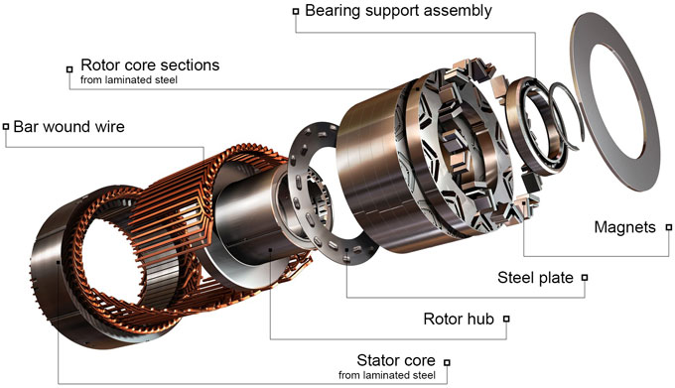
Introduction & Project goals:
Growing demand for efficient electric vehicle motors.
Focus on Interior Permanent Magnet Synchronous Motors (IPMSMs) due to their high efficiency and power density.
Project Objectives:
Rated output power: 110 kW
Rated torque output: 215 Nm
Rated speed: 4800 rpm
Target efficiency: 95%
Target power factor: 0.9
Size constraints (Diameter – 330 mm;
Length – 365 mm)

Slide 3
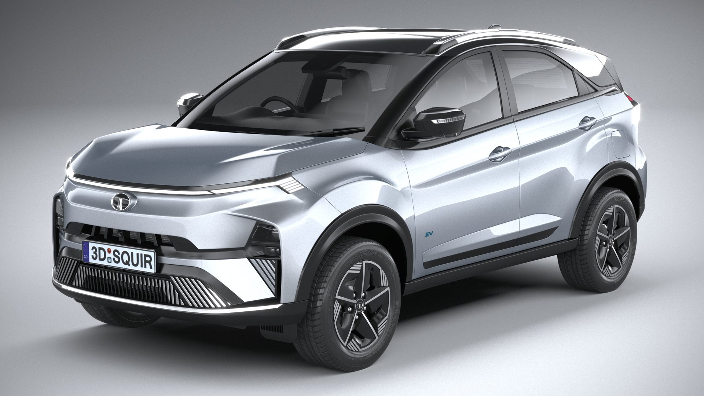
Design Specifications & Inspiration:
Performance specifications derived from the TATA Nexon EV 2024 (LR) and comparable machines.
Justification for chosen specifications: The performance specifications are derived from the manufacturer’s specification sheet of the commercial vehicle - TATA Nexon EV 2024 (LR), while others are selected based on comparable machines.
To ensure optimal efficiency across a wider range of driving conditions, including highway speeds, the base speed was selected to be higher than the approximately 4670 rpm required for the vehicle's top speed of 150 kmph. This allowed the motor to operate within its constant-torque region.

Slide 4
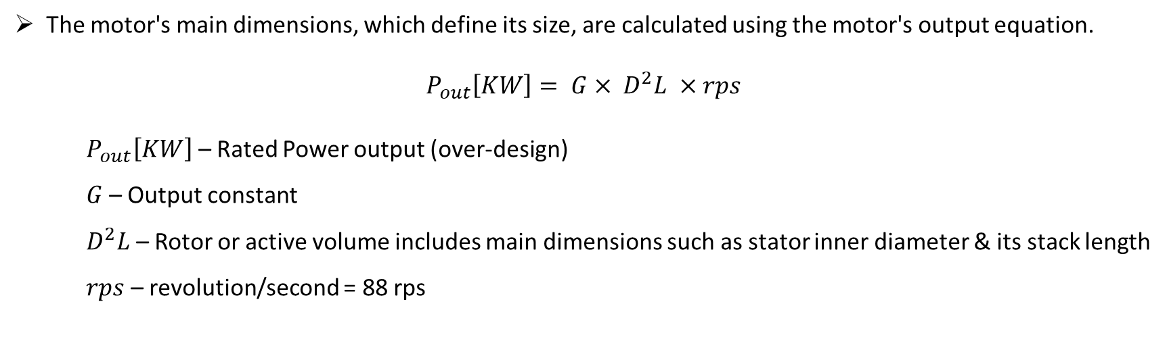
Analytical Design:
Overview of the analytical design process.
Key equations and parameters used:
The motor's main dimensions, which define its size, are calculated using the motor's output equation.
$$P_{out}\left[KW\right]= G× D^{2}L ×rps$$
$P_{out}\left[KW\right]$ – Rated Power output (over-design)
$G$ – Output constant
$D^{2}L$ – Rotor or active volume includes main dimensions such as stator inner diameter & its stack length
$rps$ – revolution/second = 88 rps

Slide 5
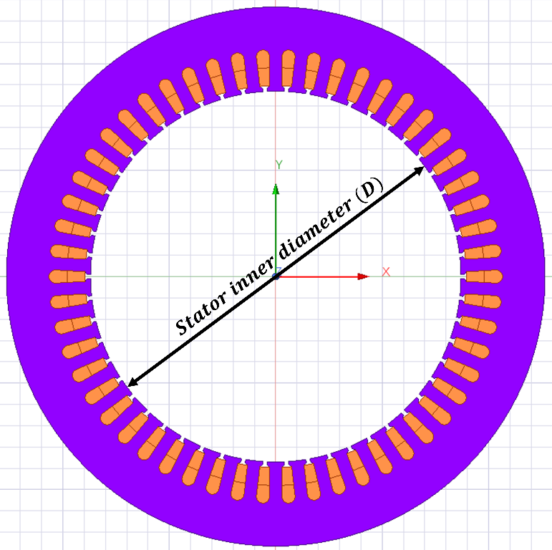
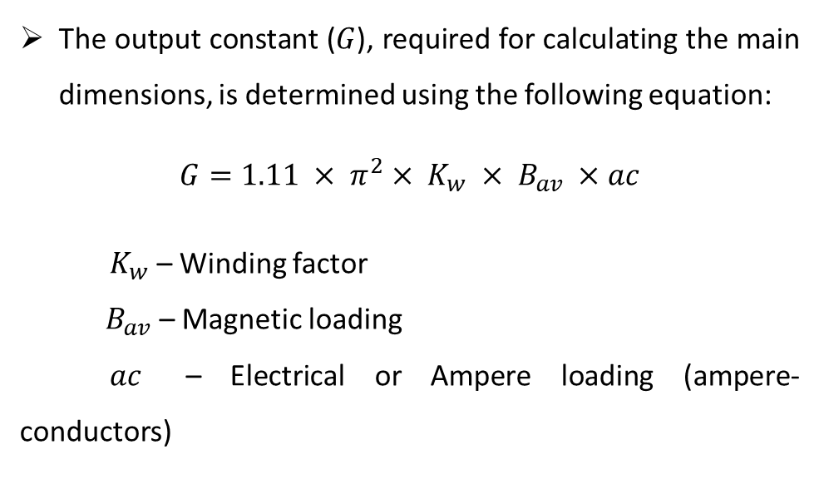
Analytical Design:
Key equations and parameters used:
The output constant ($G$), required for calculating the main dimensions, is determined using the following equation:
$$G=1.11 × π^{2}× K_{w} × B_{av} ×ac$$
${ K}_{w}$ – Winding factor
$B_{av}$ – Magnetic loading
$ac$ – Electrical or Ampere loading (ampere-conductors)

Slide 6
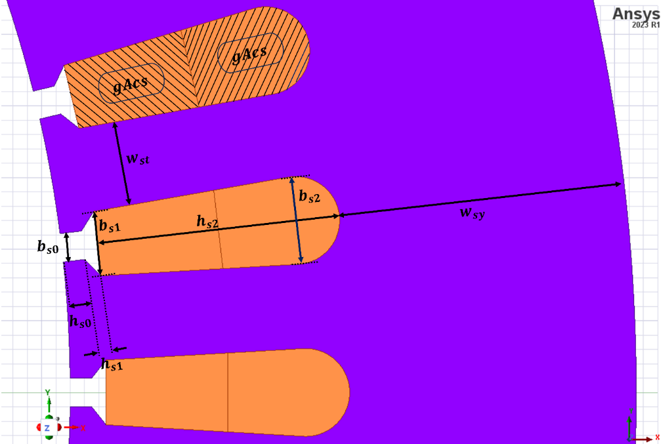
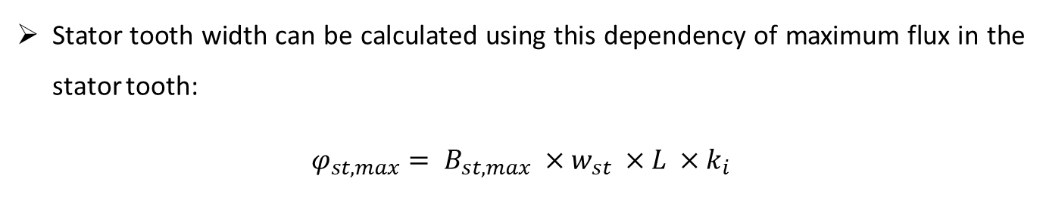
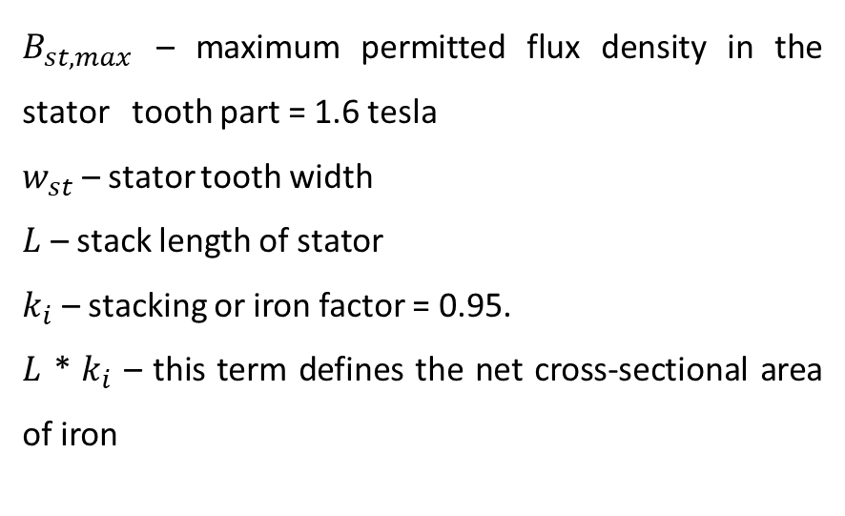
Analytical Design:
Key equations and parameters used:
Stator tooth width can be calculated using this dependency of maximum flux in the stator tooth:
$$φ_{st,max}= B_{st,max} ×w_{st} ×L ×k_{i}$$
$B_{st,max}$ – maximum permitted flux density in the stator tooth part = 1.6 tesla
$w_{st}$ – stator tooth width
$L$ – stack length of stator
$k_{i}$ – stacking or iron factor = 0.95.
$L$ * $k_{i}$ – this term defines the net cross-sectional area of iron

Slide 7
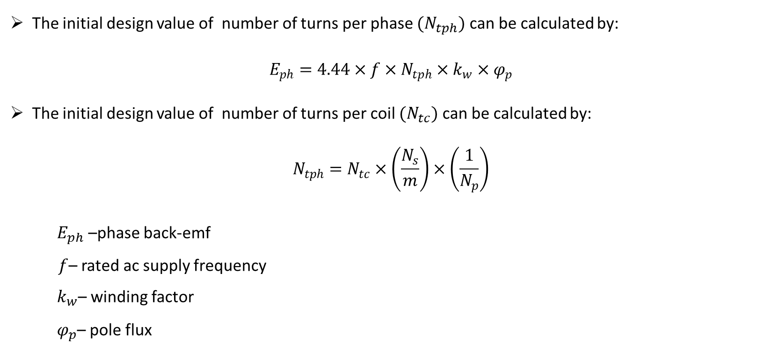
Analytical Design:
Key equations and parameters used:
The initial design value of number of turns per phase $(N_{tph})$ can be calculated by:
$$E_{ph}=4.44×f×N_{tph}×k_{w}×φ_{p}$$
The initial design value of number of turns per coil ${(N}_{tc})$ can be calculated by:
$$N_{tph}=N_{tc}×\left(\frac{N_{s}}{m}\right)×\left(\frac{1}{N_{p}}\right)$$
${ E}_{ph}$ –phase back-emf
$f$– rated ac supply frequency
${ k}_{w}$– winding factor
${ φ}_{p}$– pole flux

Slide 8
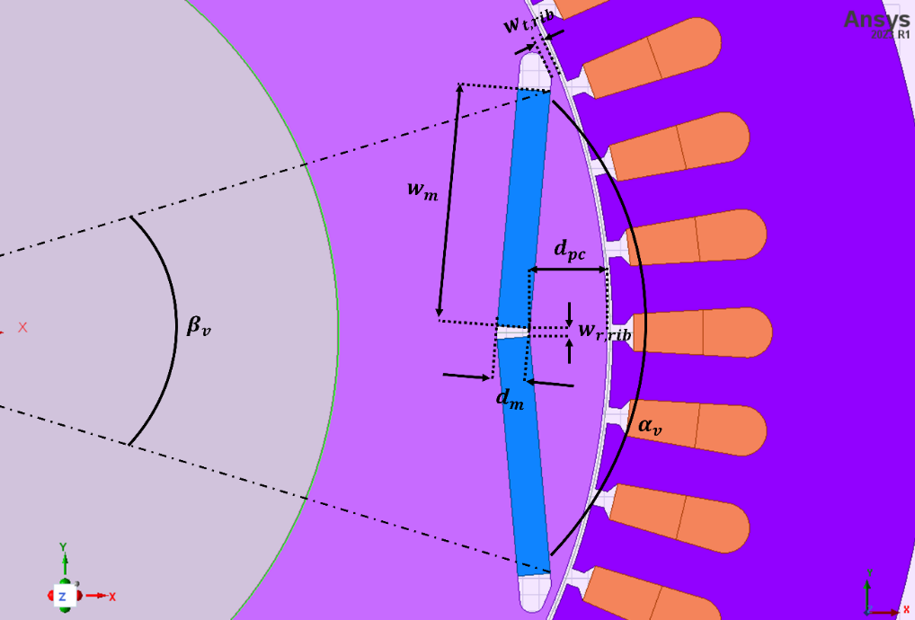
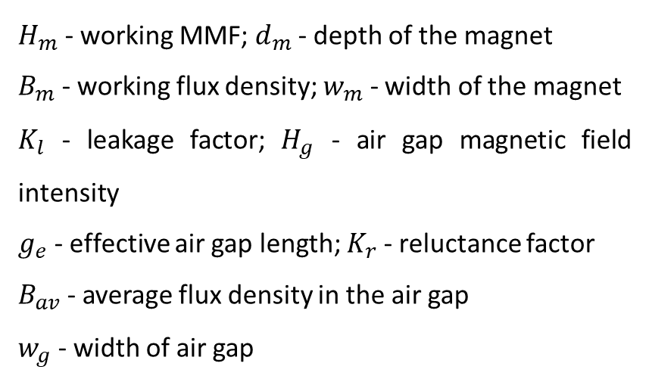
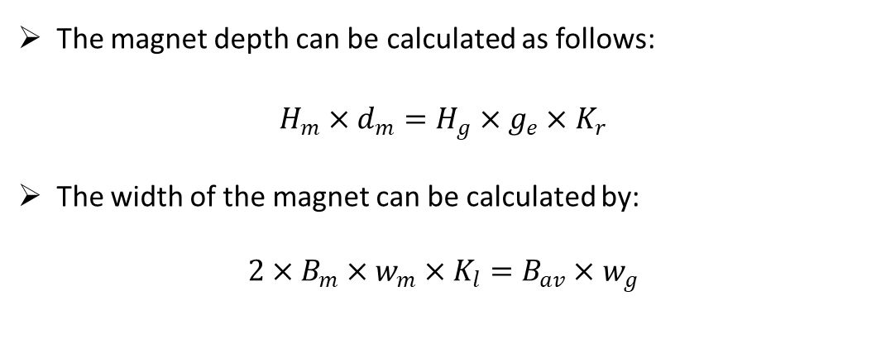
Analytical Design:
Key equations and parameters used:
The magnet depth can be calculated as follows:
$$H_{m}×d_{m}=H_{g}×g_{e}×K_{r}$$
The width of the magnet can be calculated by:
$$2×B_{m}×w_{m}×K_{l}=B_{av}×w_{g}$$
$H_{m}$ - working MMF; $d_{m}$ - depth of the magnet
$B_{m}$ - working flux density; $w_{m}$ - width of the magnet
$K_{l}$ - leakage factor; $H_{g}$ - air gap magnetic field intensity
$g_{e}$ - effective air gap length; $K_{r}$ - reluctance factor
$B_{av}$ - average flux density in the air gap
$w_{g}$ - width of air gap

Slide 9
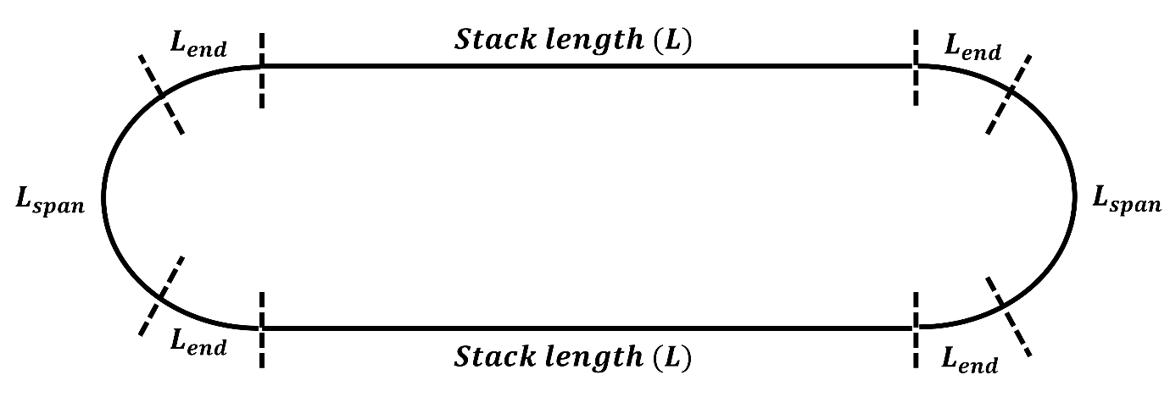

Analytical Design:
Key equations and parameters used:
The mean turn length of a single coil is calculated as follows:
$$L_{mt}=2×L+4×L_{end}+2×L_{span}$$

Slide 10
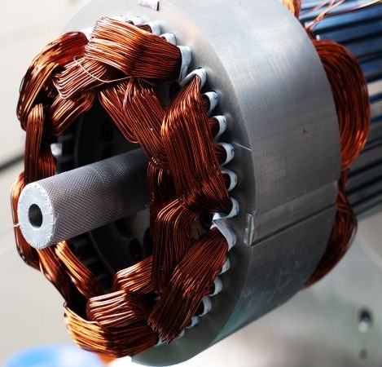
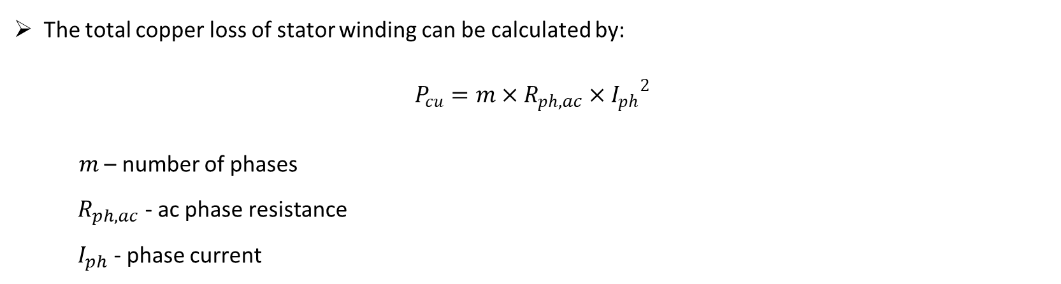
Analytical Design:
Key equations and parameters used:
The total copper loss of stator winding can be calculated by:
$$P_{cu}=m×R_{ph,ac}×{I_{ph}}^{2}$$
$m$ – number of phases
${ R}_{ph,ac}$ - ac phase resistance
${ I}_{ph}$ - phase current

Slide 11
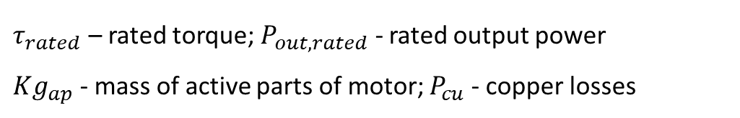
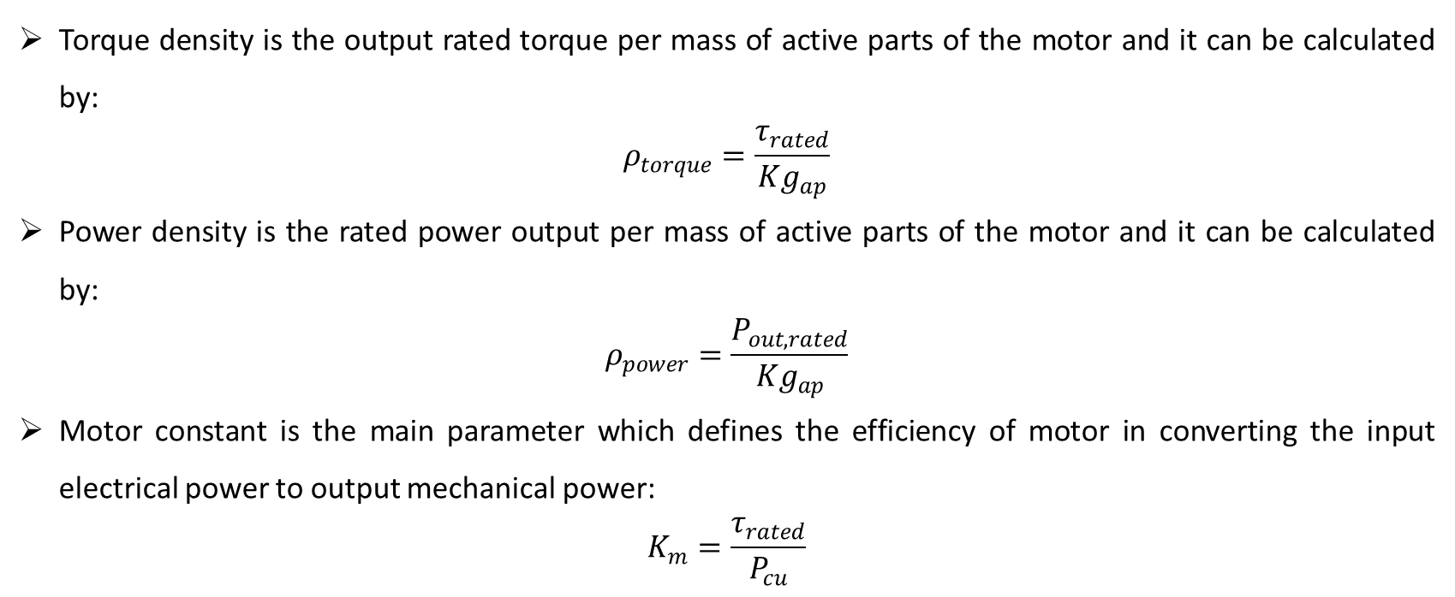
Analytical Design:
Key equations and parameters used:
Torque density is the output rated torque per mass of active parts of the motor and it can be calculated by:
$$ρ_{torque}=\frac{τ_{rated}}{{Kg}_{ap}}$$
Power density is the rated power output per mass of active parts of the motor and it can be calculated by:
$$ρ_{power}=\frac{P_{out,rated}}{{Kg}_{ap}}$$
Motor constant is the main parameter which defines the efficiency of motor in converting the input electrical power to output mechanical power:
$$K_{m}=\frac{τ_{rated}}{P_{cu}}$$
$τ_{rated}$ – rated torque; $P_{out,rated}$ - rated output power
${Kg}_{ap}$- mass of active parts of motor; $P_{cu}$- copper losses

Slide 12
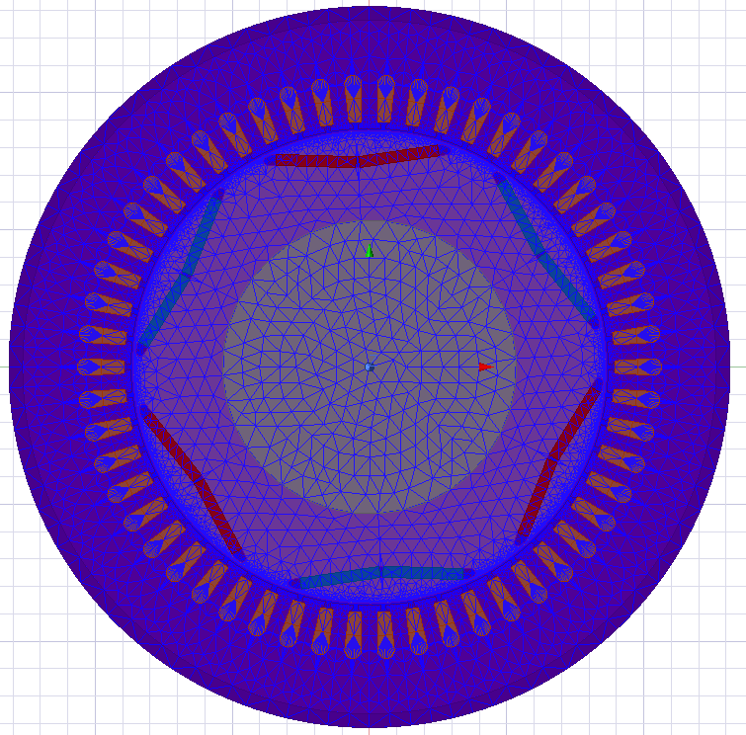
Finite Element Analysis:
FEA software used: Ansys Maxwell software uses a technique called Finite Element Analysis (FEA). This means it breaks down complex designs into smaller, simpler parts to calculate how electromagnetic fields behave within them.
Mesh details: The FEA used adaptive meshing technique which automatically refines the mesh in regions of high field gradients, ensuring accurate results. The final mesh consisted of approximately 24,794 elements, with a maximum element length of 0.7 mm in the air gap and 10 mm in the other regions of the electric motor.
Boundary conditions: A magnetic vector potential boundary condition was applied to the outer boundary of the model, effectively simulating an open boundary. The stator windings were excited with a sinusoidal current waveform corresponding to the rated current and frequency.

Slide 13
Analysis process:
Torque-Speed Curve Generation
Parametric Model Creation
Performance Mapping
FEA software implementation
Skew Study
Magnetic Loading Calculation
Losses & Efficiency Calculation
Armature Field Calculation
Back-EMF & Flux-Linkage Calculation
Demagnetization Study
Static Torque Calculation

Slide 14
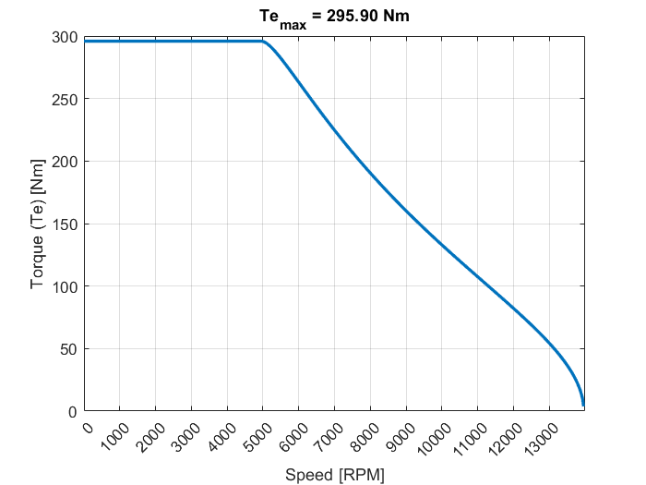
Torque-Speed Performance:
The curve shows a region of relatively constant torque at lower speeds. In this design, the motor maintains a consistent average peak torque of 296 Nm up to a speed of approximately 4900 rpm. This is slightly above the target rated speed of 4800 rpm, indicating that the motor meets its performance goals.
Beyond the constant torque region (approximately 4900 rpm), the curve enters the field weakening region. Here, the torque begins to decrease as the speed increases. This is a typical characteristic of IPMSMs, allowing them to operate at higher speeds beyond their base speed.
The motor can reach a maximum speed of 13,900 rpm. This extended speed range is achieved thanks to the field weakening capability of the IPMSM design.

Slide 15
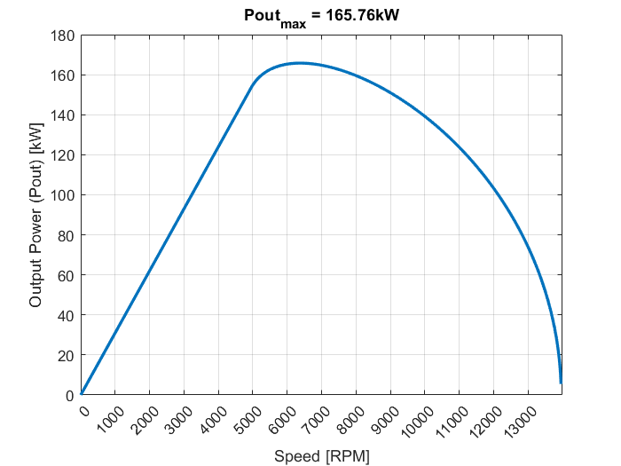
Power-Speed Performance:
The power output increases steadily as the motor's speed rises.
The motor reaches its maximum power output of 166 kW at a speed of 6380 rpm.
Beyond 6380 rpm, the motor enters the field-weakening region. In this region, the output power gradually decreases. This decrease is a direct result of the reduction in torque that occurs in the field-weakening zone.

Slide 16
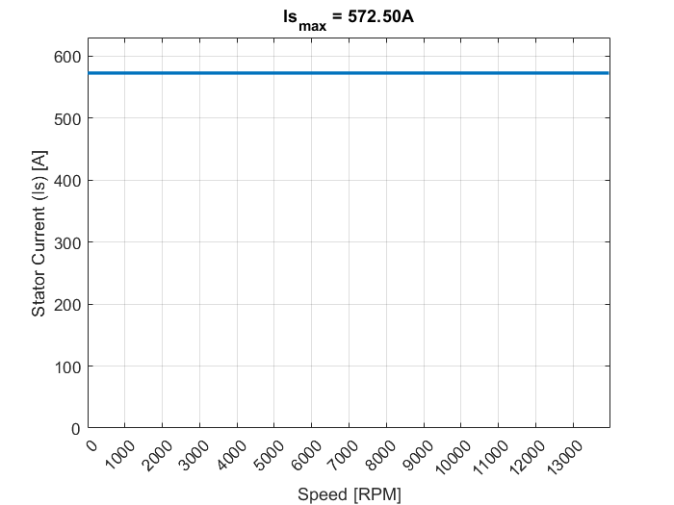
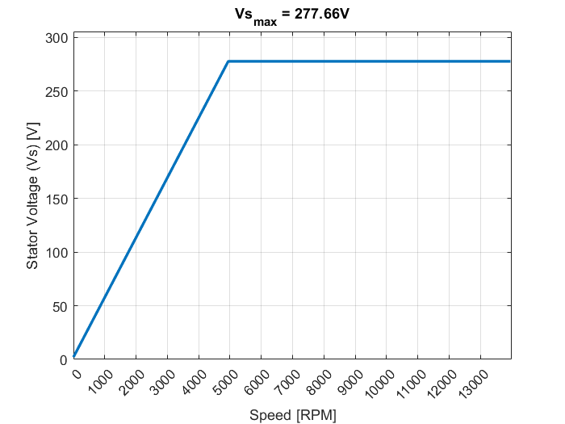
Current and Voltage Profiles:
The motor operates at a constant, rated current (Is, max = 572.5 A) across its entire speed range. This is done to achieve the maximum possible torque output.
As the motor's speed increases, the stator voltage also increases proportionally. This is due to the increasing back-EMF generated by the motor.
The supply voltage is held constant in the field-weakening region, which begins when the motor reaches its rated voltage (Vs, max = 277.7 V) at a speed of 4950 rpm. This strategy allows the motor to operate at higher speeds while maintaining a wide operating range.

Slide 17
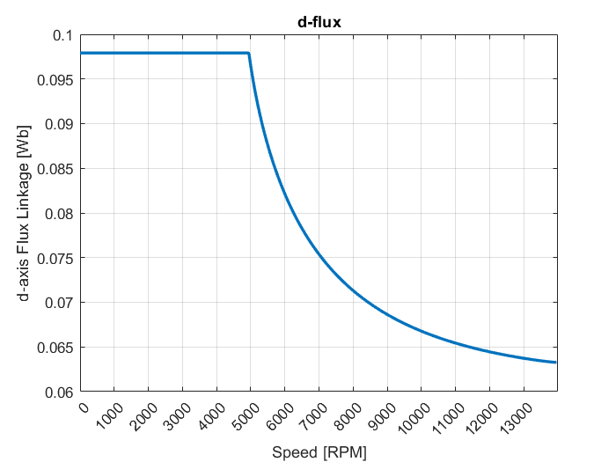
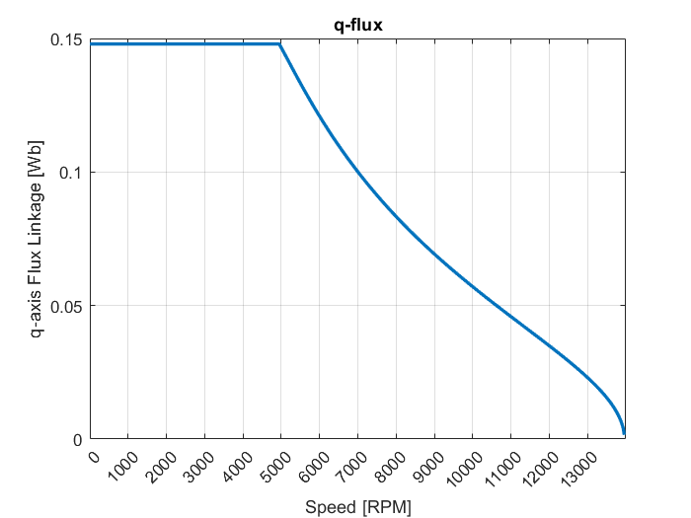
Flux Linkage Analysis:
Up to the rated speed, the flux linkages along the rotor's d- and q-axes are maintained at their maximum values. In this project those values are 0.098 Wb and 0.148 Wb, respectively.
Beyond the rated speed, as the motor enters the torque-reduction zone (field-weakening region), both d-axis and q-axis flux linkages begin to decrease.

Slide 18
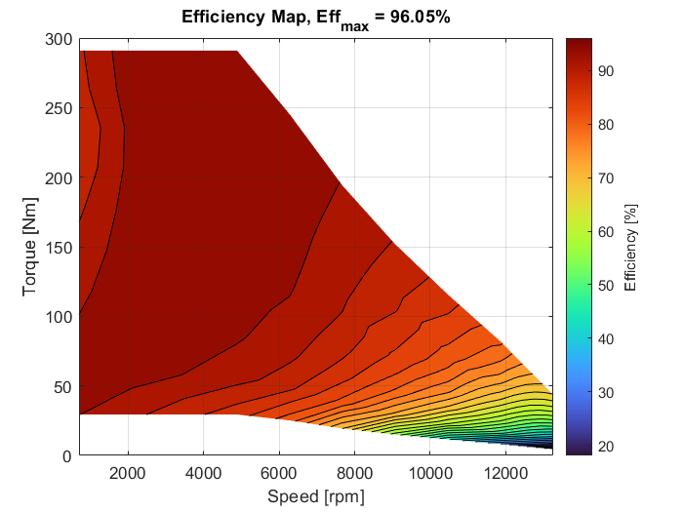
Efficiency Performance:
The motor achieves a maximum efficiency of 96%. This is considered a very high efficiency rating.
A large region of high efficiency (90-96%) is observed. This region spans up to approximately 9000 rpm and torque levels from roughly 30 Nm to 290 Nm. This indicates that the motor can maintain high efficiency across a wide range of operating conditions.
At low torque levels and high speeds (above 10,000 rpm), efficiency decreases. This is primarily due to increased iron losses. At very high torque levels (above 250 Nm), efficiency also decreases. This is mainly attributed to increased copper losses due to the higher current draw.
The motor operates most efficiently when there is a balance between speed and torque demand. This balance prevents overloading and minimizes heat generation and energy dissipation.

Slide 19
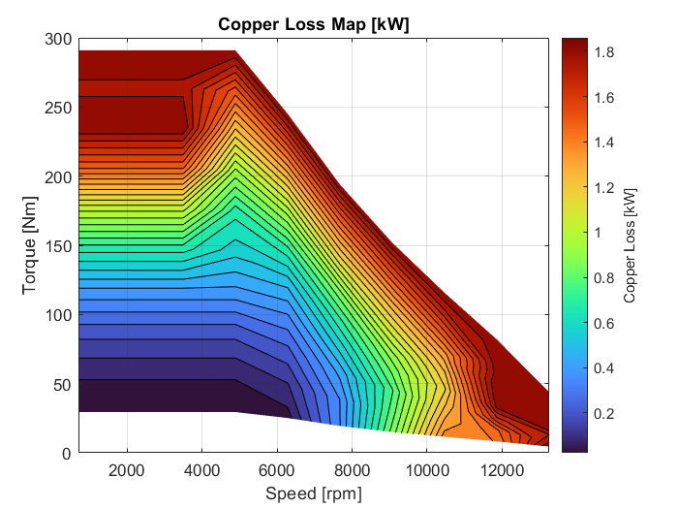
Loss Analysis (Copper):
In the low-speed (below 4,000 rpm) and high-torque (above 200 Nm) region, copper losses are high. This is primarily due to the increased current required to produce high torque, leading to significant resistance losses in the windings.
Copper losses are also notable in the high-speed (above 10,000 rpm) and moderate-torque (50-100 Nm) region.
Copper losses remain minimal up to speeds of 7,000 rpm and torques of 150 Nm. This region corresponds to the motor's peak efficiency zone.
Copper losses are dominant in regions with high current demand (high torque or moderate torque at high speeds).

Slide 20
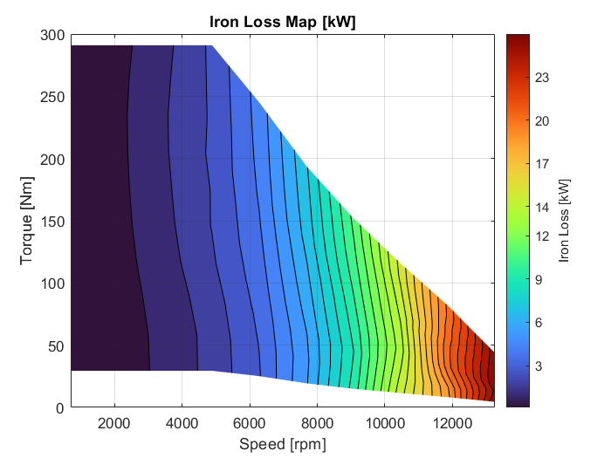
Loss Analysis (Iron):
Iron losses are significantly high at elevated speeds (above 11,000 rpm), even at lower torque levels. This is due to the frequency-dependent nature of iron losses, which include hysteresis and eddy current losses.
Iron losses are minimal at speeds up to 8,000 rpm, even at high torque levels. In this region, copper losses are the dominant factor.
Iron losses become significant at high speeds due to increased magnetic frequency.

Slide 21
Conclusion:
This study successfully designed and analyzed an IPMSM for electric vehicle applications, targeting performance comparable to motors used in commercially available EVs. The design, validated through finite element analysis (FEA), achieved a maximum efficiency of 96% and a peak torque of 296 Nm. Loss analysis highlighted the interplay between copper and iron losses across the motor's operating range, providing crucial information for optimizing motor control strategies. The performance characteristics demonstrated in this study suggest the designed IPMSM's potential for integration into a real-world EV powertrain. Future work may include prototype development and testing to validate these findings and assess the motor's performance in a complete vehicle system.
This work is licensed under the Creative Commons Attribution 4.0 International License. To view a copy of this license, visit https://creativecommons.org/licenses/by/4.0/. Copyright © 2025 Mohana Segaran B.

Slide 22
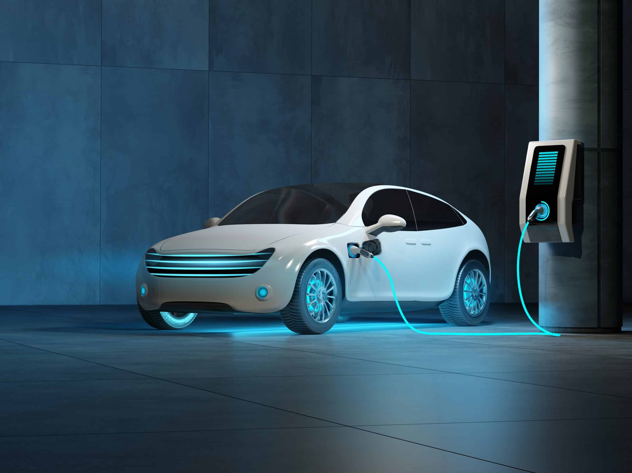
Thank you!

