Slide 1
Algorithms & Data Structure
In Python
Python Data Types
Lab_No-1
Basics of Python Programming

Slide 2
Programming Languages
High Level Programming Language: : Python, Java, C++, JavaScript
Assembly language: A low-level symbolic representation of machine instructions.
Machine language: Binary instructions executed directly by the processor: 0s and 1s.
Modern AI uses Natural Language Processing (NLP) to enable computers to analyze and generate human language.

Slide 3
Programs Execution
High Level Language
Python, Java, Cpp
Compiler / Interpreter
Machine Language

Slide 4
Algorithm Structures
Sequence
Decision
Repetition
1
INPUT
2
Process
Output
3

Slide 5
Representation of Algorithms
UML (Unified Modeling Language)
A visual way to represent the structure and flow of an algorithm or system.
Uses diagrams to show the main steps, decisions, actions, and relationships.
Helps learners understand the big picture without focusing on programming-language syntax.
Pseudocode
A text-based description of an algorithm written in simple, structured language.
Expresses the algorithm as steps, decisions, loops, inputs, and outputs.
Is independent of any programming language.

Slide 6


UML Algorithm Representation
Sequential Structures
Decision Structure
Repetition Structures of
Instruction 1
False
True
False
True
condition
condition
Instruction 2
Instruction
Instruction
Instruction
Instruction 3
Instruction
Instruction
Instruction
Instruction N

Slide 7
Pseudo Code Algorithm Representation
INPUT unit_price, quantity
REQUIRE unit_price ≥ 0
REQUIRE quantity ≥ 0
total ← unit_price × quantity
OUTPUT total
Start
Read unit_price, quantity
total ← unit_price × quantity
Display total
End
Predict first: unit_price = 12.5 and quantity = 3 → total = ?

Slide 8
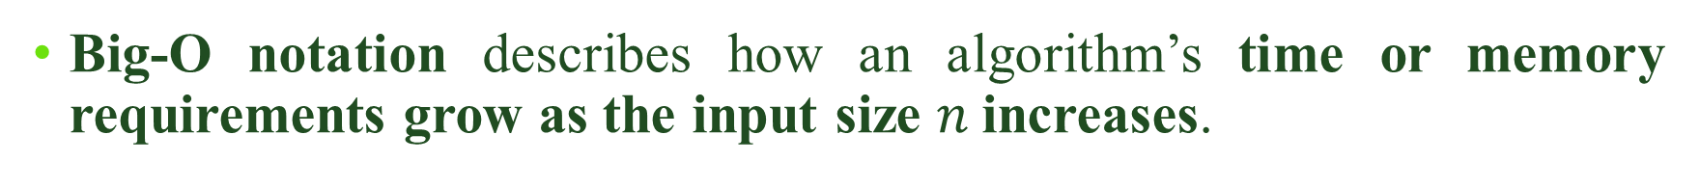
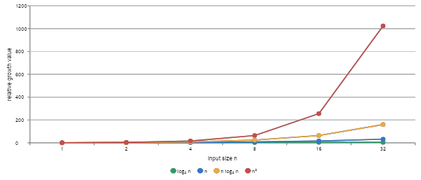
Big-O Notation
At n = 32, n² = 1024 while n log₂ n = 160.

Slide 9
Big-O Growth: How Algorithms Scale
1
2
4
8
16
32
At n = 1
Representative growth values
Growth (log scale)
O(1)
1
O(log₂ n)
0
O(n)
1
O(n log₂ n)
0
O(n²)
1
O(2ⁿ)
2
1
2
4
8
16
32
Different growth rates separate dramatically as n increases.
Input size n
Key idea
O(1)
O(log₂ n)
O(n)
O(n log₂ n)
O(n²)
O(2ⁿ)
Values illustrate growth functions, not measured execution time.

Slide 10
Big-O Growth: How Algorithms Scale
Select an input size n to compare representative growth values.
1
2
4
8
16
32
At n = 2
Representative growth values
Growth (log scale)
O(1)
1
O(log₂ n)
1
O(n)
2
O(n log₂ n)
2
O(n²)
4
O(2ⁿ)
4
1
2
4
8
16
32
Different growth rates separate dramatically as n increases.
Input size n
Key idea
O(1)
O(log₂ n)
O(n)
O(n log₂ n)
O(n²)
O(2ⁿ)
Values illustrate growth functions, not measured execution time.

Slide 11
Big-O Growth: How Algorithms Scale
Select an input size n to compare representative growth values.
1
2
4
8
16
32
At n = 4
Representative growth values
Growth (log scale)
O(1)
1
O(log₂ n)
2
O(n)
4
O(n log₂ n)
8
O(n²)
16
O(2ⁿ)
16
1
2
4
8
16
32
Different growth rates separate dramatically as n increases.
Input size n
Key idea
O(1)
O(log₂ n)
O(n)
O(n log₂ n)
O(n²)
O(2ⁿ)
Values illustrate growth functions, not measured execution time.

Slide 12
Big-O Growth: How Algorithms Scale
Select an input size n to compare representative growth values.
1
2
4
8
16
32
At n = 8
Representative growth values
Growth (log scale)
O(1)
1
O(log₂ n)
3
O(n)
8
O(n log₂ n)
24
O(n²)
64
O(2ⁿ)
256
1
2
4
8
16
32
Different growth rates separate dramatically as n increases.
Input size n
Key idea
O(1)
O(log₂ n)
O(n)
O(n log₂ n)
O(n²)
O(2ⁿ)
Values illustrate growth functions, not measured execution time.

Slide 13
Big-O Growth: How Algorithms Scale
Select an input size n to compare representative growth values.
1
2
4
8
16
32
At n = 16
Representative growth values
Growth (log scale)
O(1)
1
O(log₂ n)
4
O(n)
16
O(n log₂ n)
64
O(n²)
256
O(2ⁿ)
65,536
1
2
4
8
16
32
Different growth rates separate dramatically as n increases.
Input size n
Key idea
O(1)
O(log₂ n)
O(n)
O(n log₂ n)
O(n²)
O(2ⁿ)
Values illustrate growth functions, not measured execution time.

Slide 14
Big-O Growth: How Algorithms Scale
Select an input size n to compare representative growth values.
1
2
4
8
16
32
At n = 32
Representative growth values
Growth (log scale)
O(1)
1
O(log₂ n)
5
O(n)
32
O(n log₂ n)
160
O(n²)
1,024
O(2ⁿ)
4,294,967,296
1
2
4
8
16
32
Different growth rates separate dramatically as n increases.
Input size n
Key idea
O(1)
O(log₂ n)
O(n)
O(n log₂ n)
O(n²)
O(2ⁿ)
Values illustrate growth functions, not measured execution time.

Slide 15
ALGORITHMS
Search illustrates how data organization changes the algorithm
Linear search works on arbitrary sequences; binary search requires sorted data and repeatedly halves the remaining search interval.
Target = 19
Linear search
2
5
8
12
19
27
31
PYTHON
def linear_search(a, target): for i, value in enumerate(a): if value == target: return i return -1
checks from left to right → 5 comparisons here • worst case O(n)
Binary search
2
5
8
12
19
27
31
1st middle: 12 → go right
2nd middle: 27 → go left
3rd: 19 → found
halves the remaining interval • worst case O(log n)
Binary search is only correct when the data are sorted according to the same ordering used by the search.

Slide 16
From an Algorithm to Reliable Software
The same improvement cycle appears at every scale.
1
2
3
4
5
Problem
→
Algorithm
→
Python Code
→
Test
→
Improve
What must be solved?
Define the steps
Implement the solution
Check correctness
Learn and iterate
Agile
repeat in small increments
CI
automate build & tests
CD
automate delivery/deployment
software development is a continuous learning cycle, not a one-time sequence.

Slide 17
Application Development Cycle
Build small → test early → deliver often → learn continuously
Agile development with CI/CD
6
1
Monitor & Improve
Plan & Analyze
Feedback • performance
Problem • requirements
2
Design
Architecture • algorithms
5
AGILE
Iterate • Collaborate • Deliver Value
Release & Deploy (CD)
Package • deliver • deploy
3
4
Develop
Build & Test (CI)
Code • version control
Build • tests • checks
Algorithms & Data Structures in Python
Problem → Algorithm → Code → Test → Improve

Slide 18
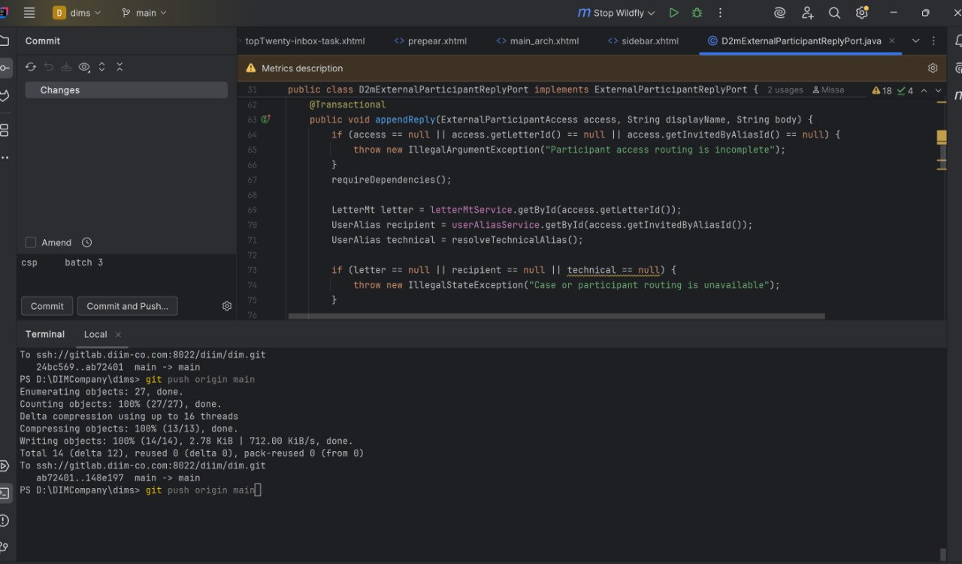

Slide 19
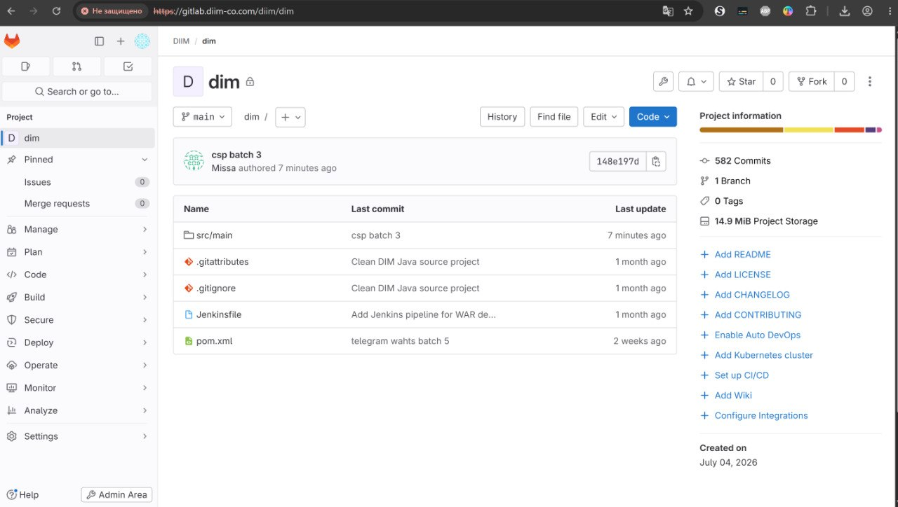

Slide 20
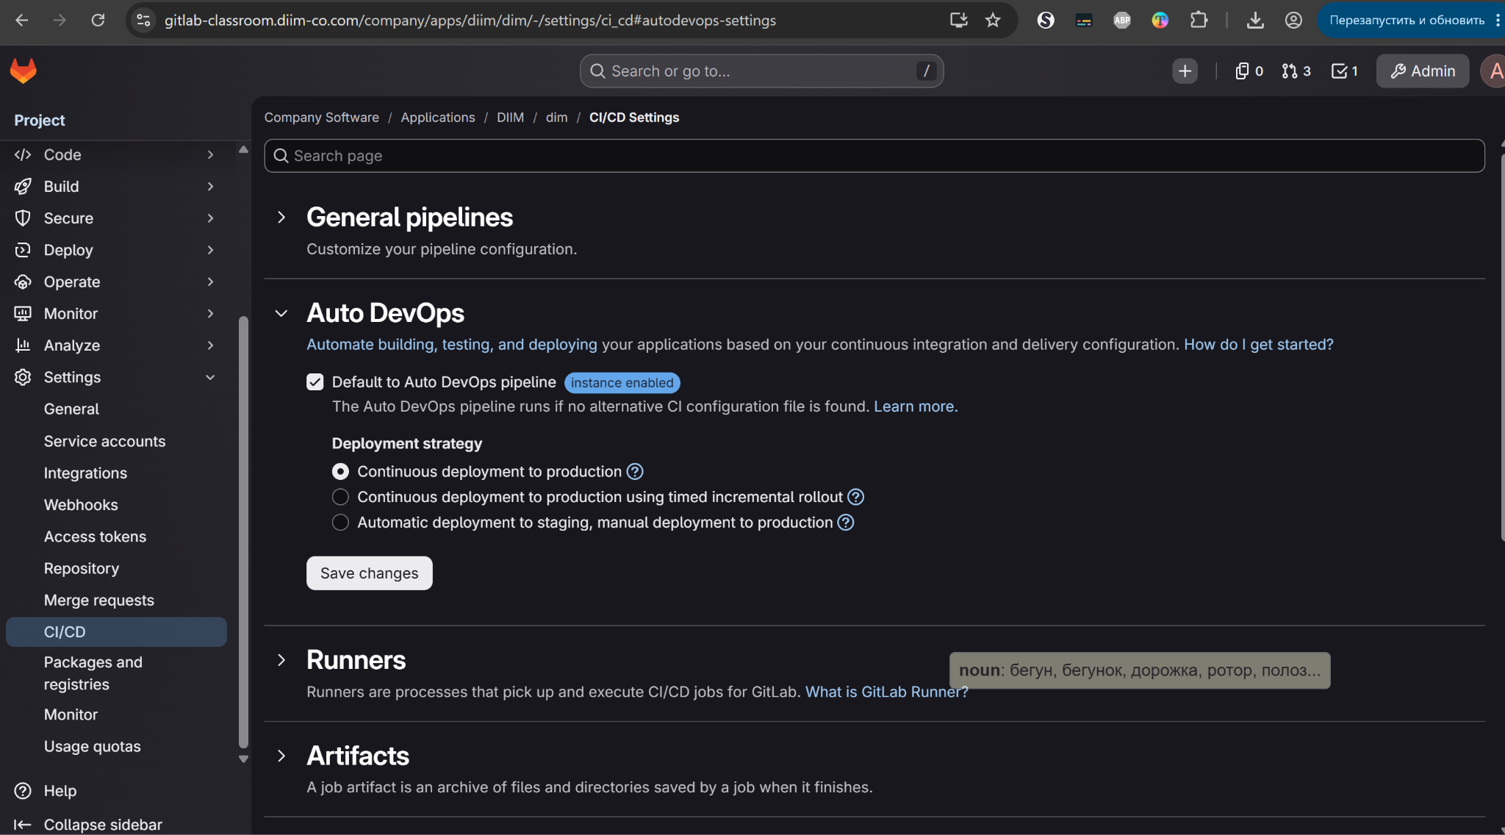

Slide 21
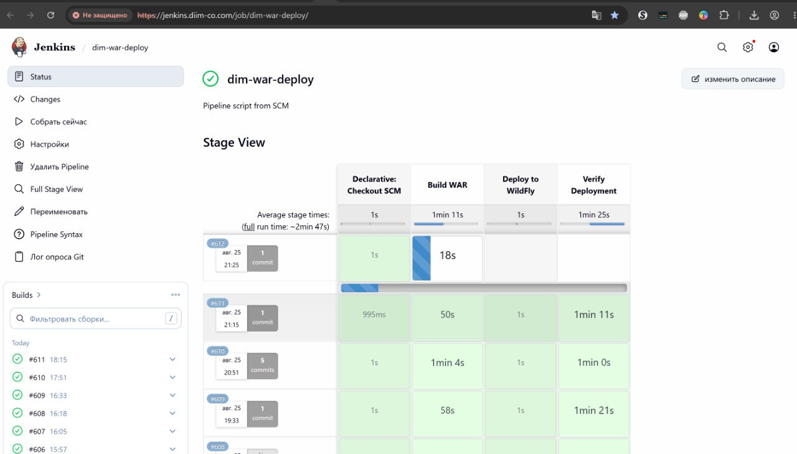

Slide 23
Python Programming Language

Slide 24

Python Execution
Python Code
Python Byte-Code
Python Virtual Machine
Linux
Windows
MACOS
Android

Slide 25

Jython Execution
Python Code
Java Byte-Code
Java Virtual Machine JVM
Linux
Windows
MACOS
Android

Slide 26
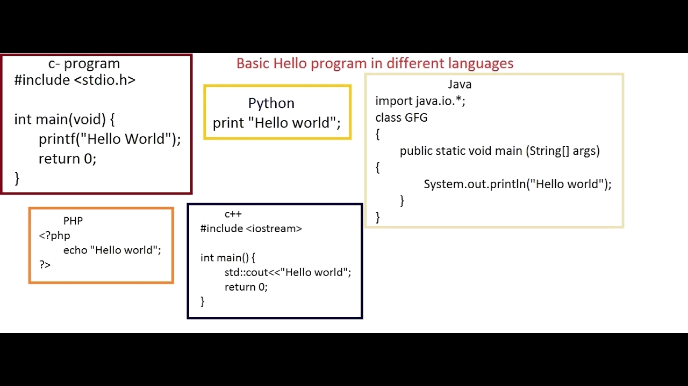
Compare

Slide 27
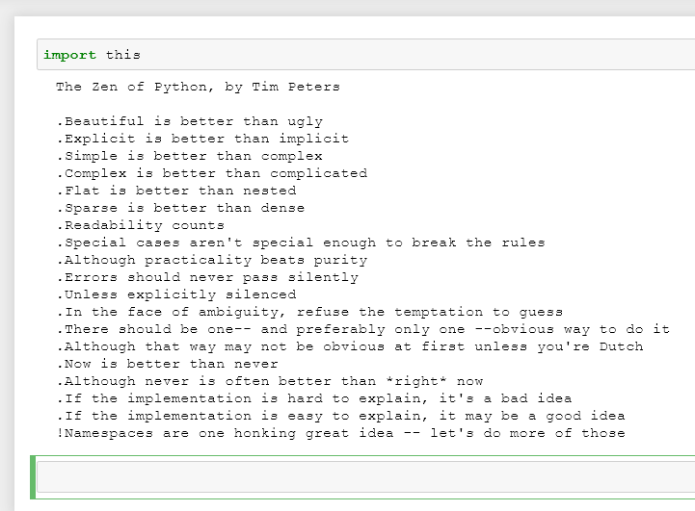
فلسفة البايثون

Slide 28
Why Learn Python
Python continues to be one of the most widely used programming languages,
with particularly strong adoption in AI, data science, and back-end development.
Easy to learn → Powerful ecosystem → Useful across many IT careers
🌐 Web Development : Build websites, web services, APIs, and back-end systems.
🤖 AI & Machine Learning: Develop intelligent systems, data models, computer vision, and automation.
📊 Data Science & Analytics: Analyze data, create visualizations, and support data-driven decisions.
🌐 Networking & Automation: Work with network protocols, sockets, system administration, and automated tasks.
🔐 Cybersecurity: Create security tools, automate testing, analyze networks, and support penetration-testing workflows.
🖥️ Desktop & Scientific Applications: Build desktop software, simulations, research tools, and engineering

Slide 29
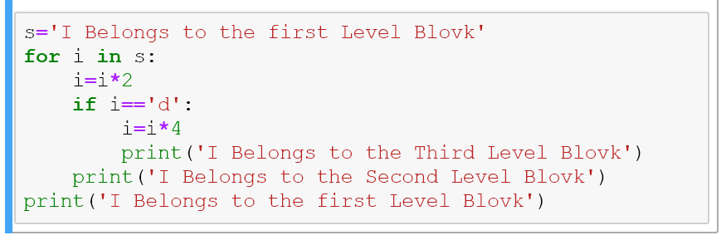
Python ident
Level1
Level2
Level3
Level1

Slide 30
تنصيب البايثون

Slide 31
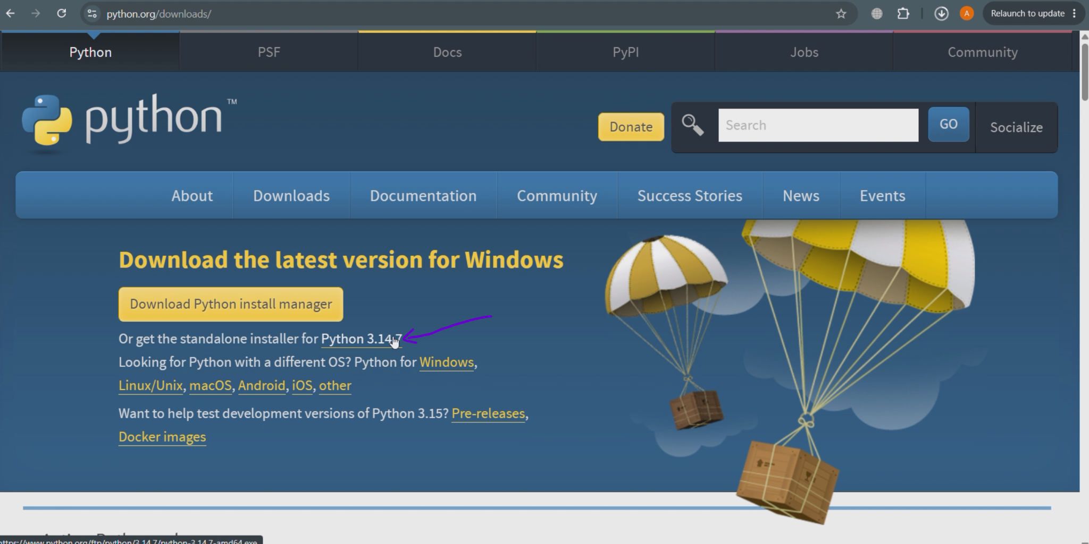
Install python

Slide 32
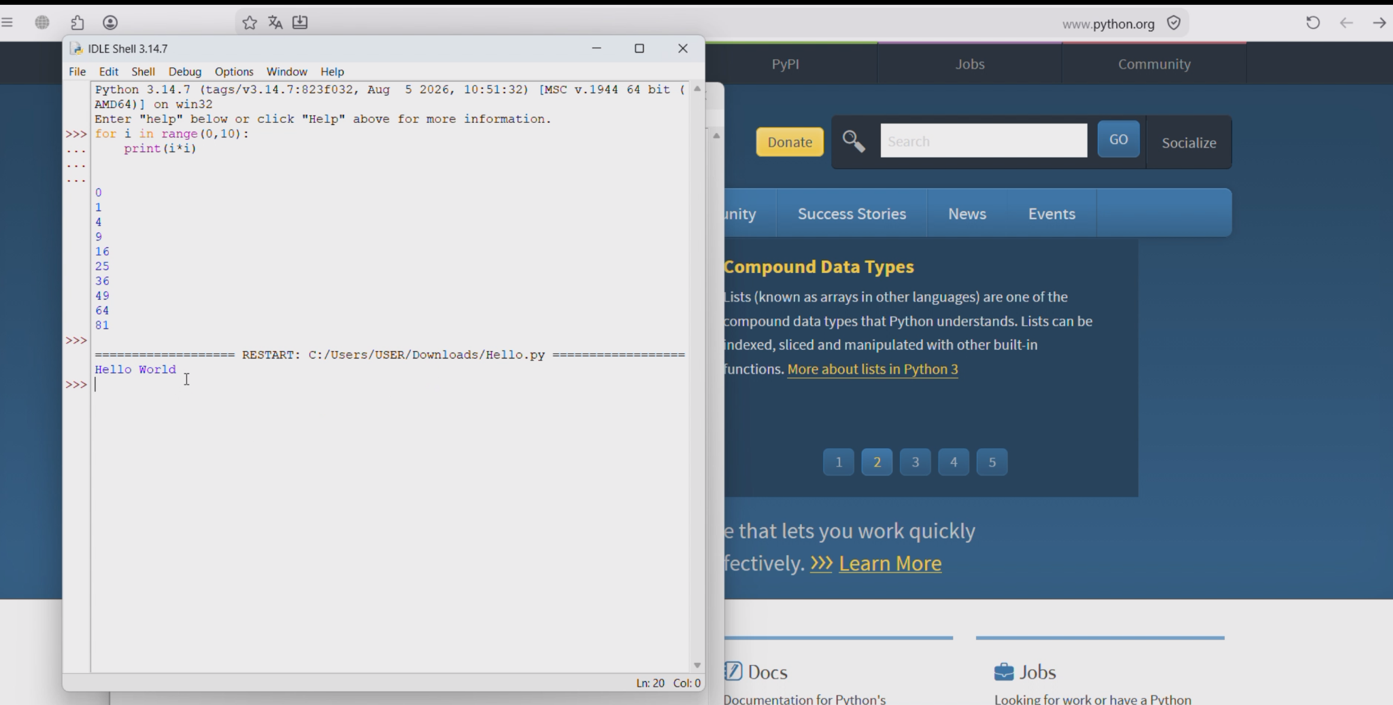
Default Python IDE “IDLE

Slide 33
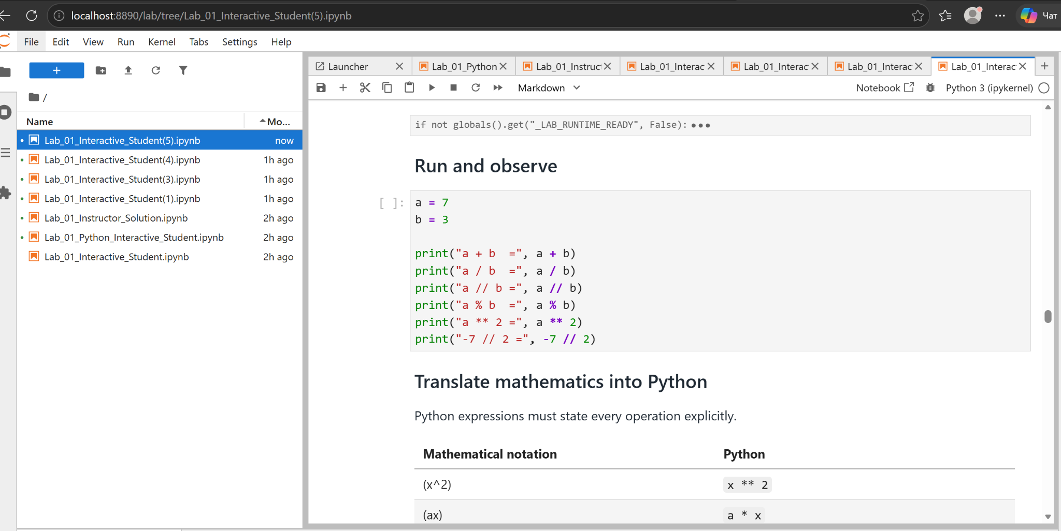
Install Jupyter LAB

Slide 34
Python Data Structure
Python
Python Iterations
Python decision
Python Data Types
For
While
IF
User Defined Data Types
Standard Data Types

Slide 35
Python Data Type
Python
Python Data Types
Python Loops
Python decision
For
While
IF
User Defined Data Types
Standard Data Types

Slide 36
Python Data Type
Standard Python Data Type
Mutable
Immutable
Dictionary
Set
List
Tuples
Strings
Numbers

Slide 37
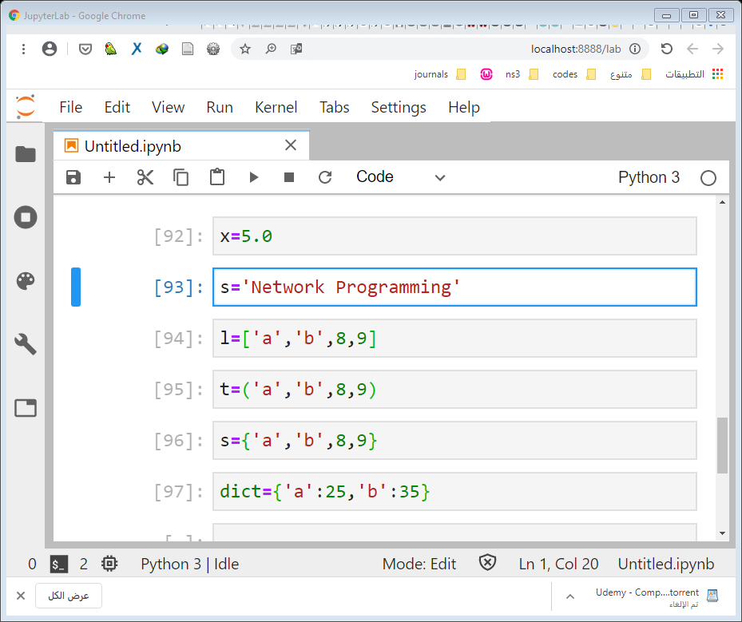
انماط البيانات الأساسية في بايثون

Slide 38
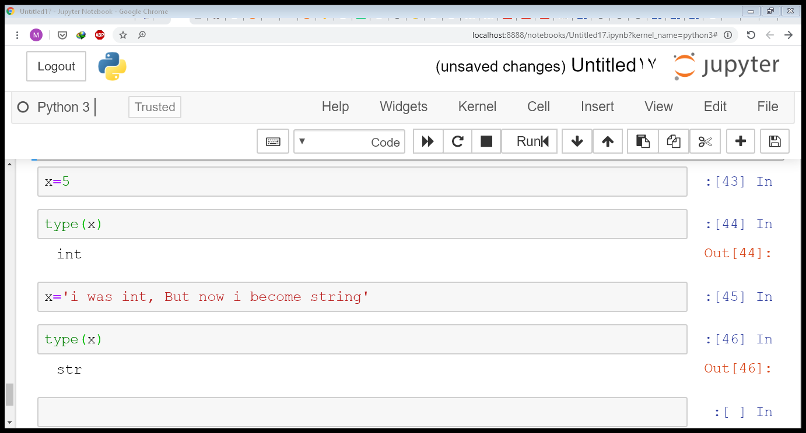
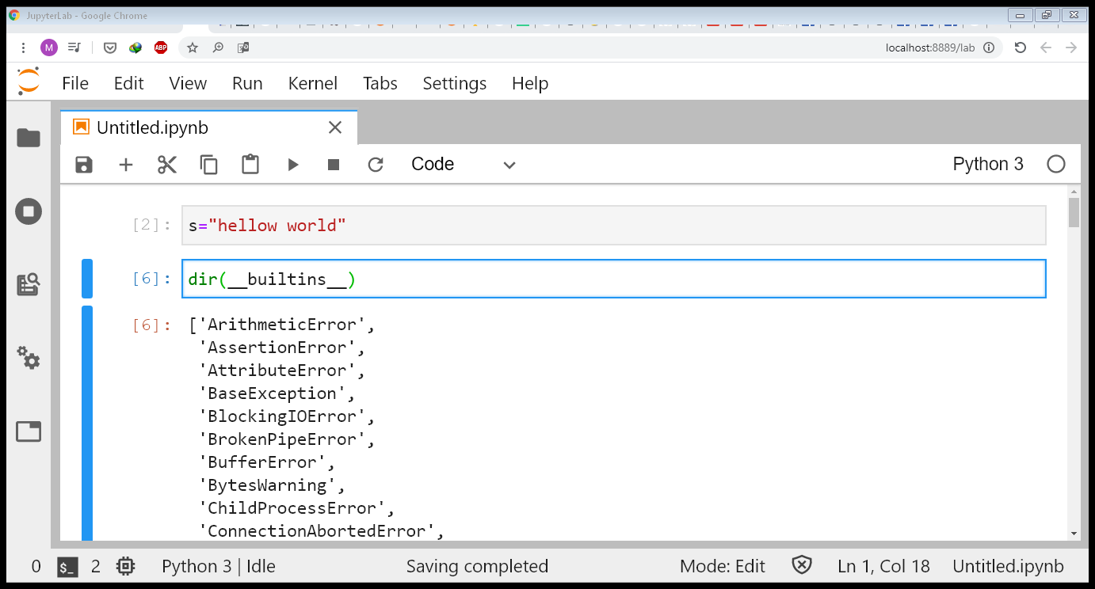
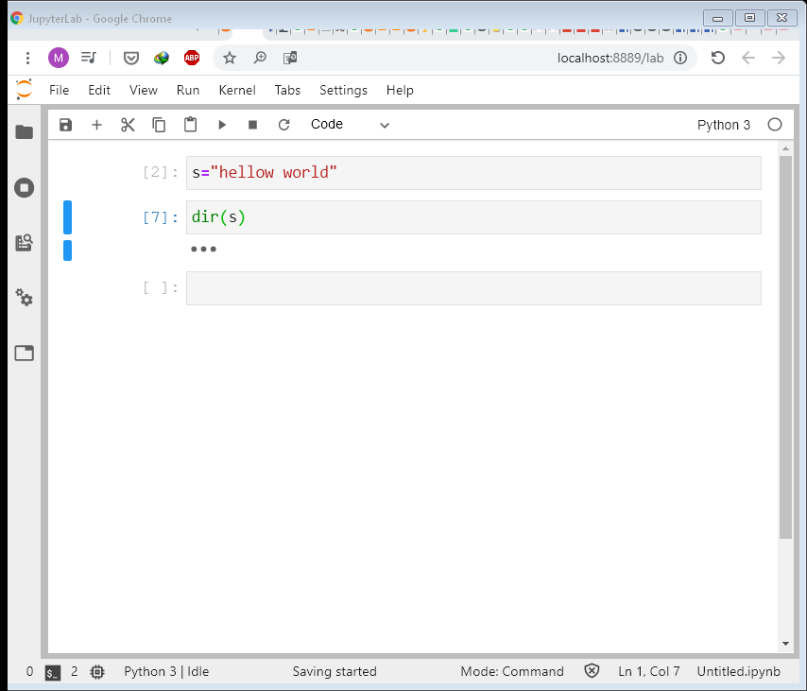
Python Data Types is Dynamics
Built-in Function
Built-in Function
اظهار التوابع الخاصة بنمط بيانات محدد

Slide 39
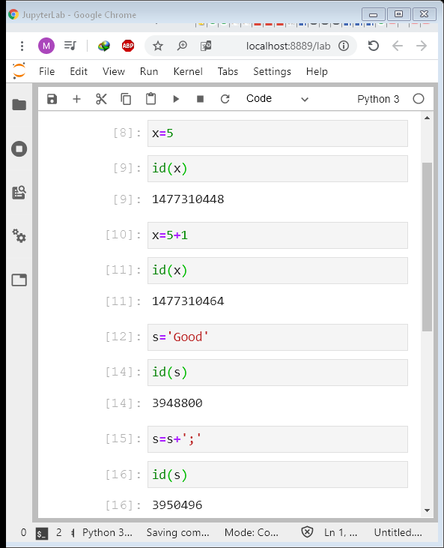
IMMutable Data Types Integer
X
..0448
5
X
..0464
6
Notes:
Comments 1. Names given to variables are sometimes referred to as identifiers. 2. A numeric expression is any combination of literals, variables, functions, and operators that can be evaluated to produce a number. A single literal or variable is a special case of an expression. 3. Numeric literals used in expressions or assigned to variables must not contain commas, dollar signs, or percent signs. Also, mixed numbers, such as 8 1/2, are not allowed. 4. When the number n is halfway between two successive whole numbers (such as 1.5, 2.5, 3.5, and 4.5), the round function rounds it to the nearest even number. For instance, round(2.5) is 2 and round(3.5) is 4. 5. In scientific notation, numbers are written in the form b # 10r, where b is a number of magnitude from 1 up to (but not including) 10, and r is an integer. Python often displays very large and very small numbers in scientific notation, where b # 10r is written as be+r or be-r. (The letter e is an abbreviation for exponent.) For instance, when the statement print(123.8 * (10 ** 25)) is executed, 1.238e+27 is displayed. 6. The functions discussed in this section are referred to as built-in functions since they are part of the Python language. Chapter 4 shows how we can create our own functions. Such functions are commonly referred to as user-defined functions. The term 2.1 Numbers ◆ 47 user-defined is a bit of a misnomer; such functions should really be called programmerdefined functions. 8. IDLE color codes the different types of elements. For instance, normal text is displayed in black and built-in functions (such as print, abs, int, and round) are displayed in purple. 9. The word "exception" is shorthand for "exceptional (that is, bad) event.

Slide 40
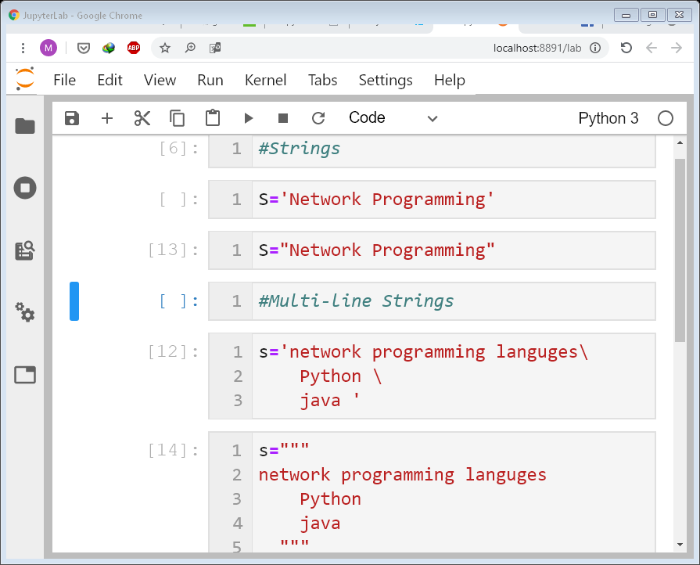
Strings

Slide 41
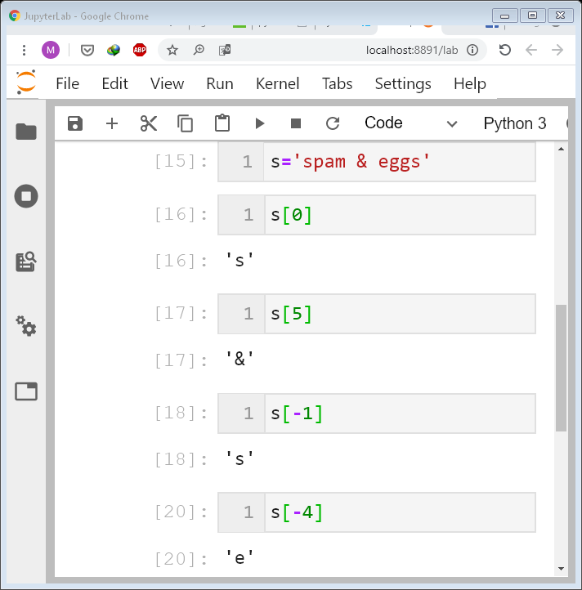
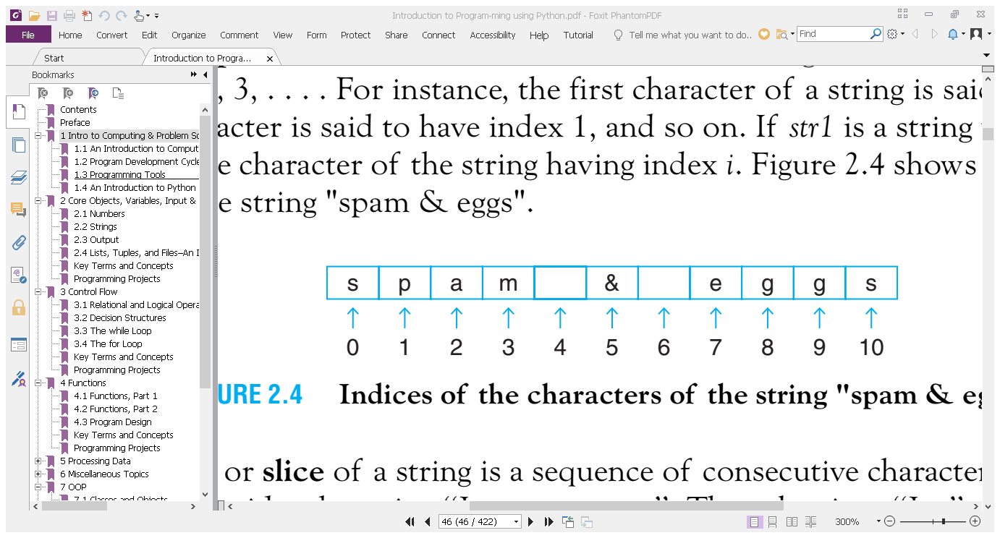
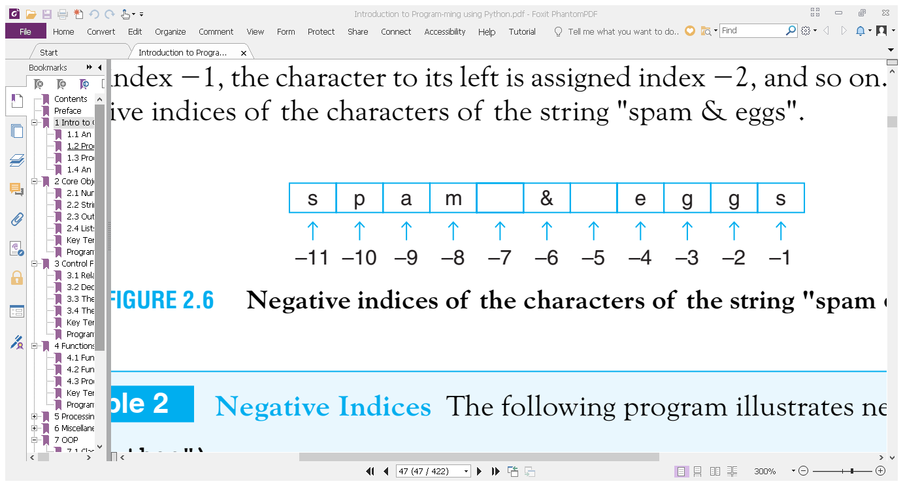
strings

Slide 42
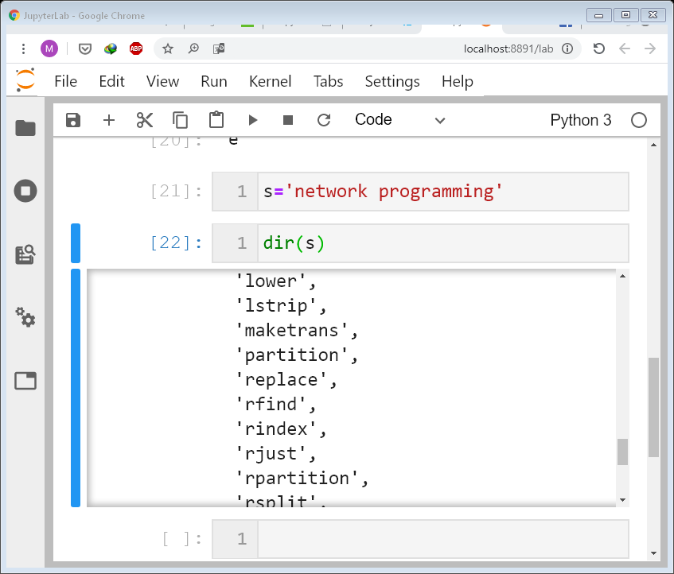
Strings function & methods

Slide 43
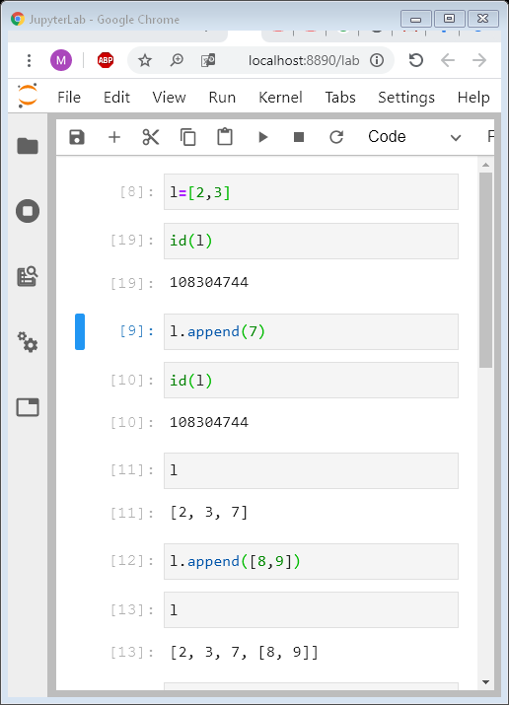
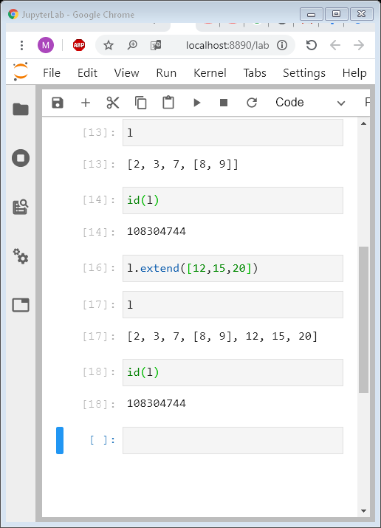
List

Slide 44
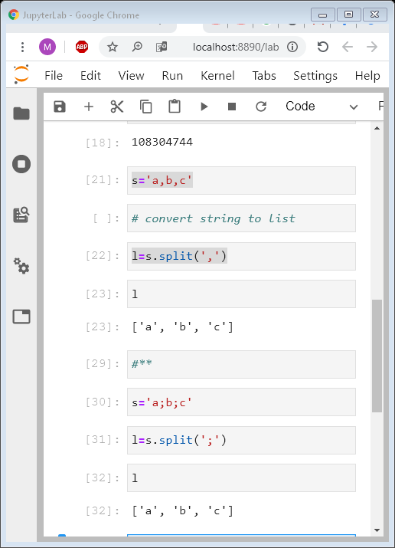
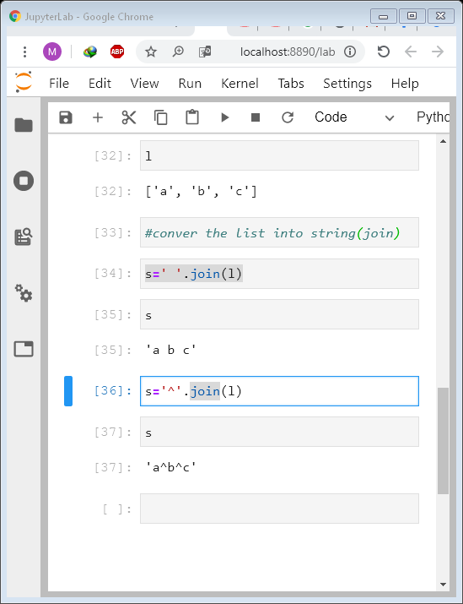
Split & join methods

Slide 45
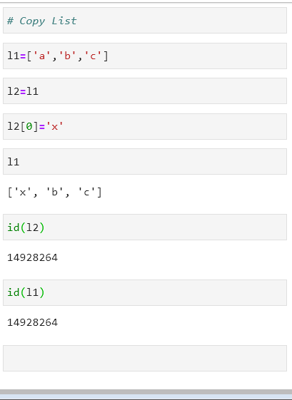
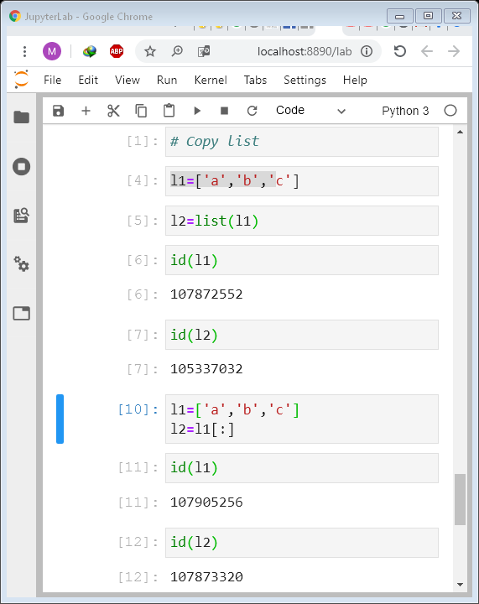
Copy list

Slide 46
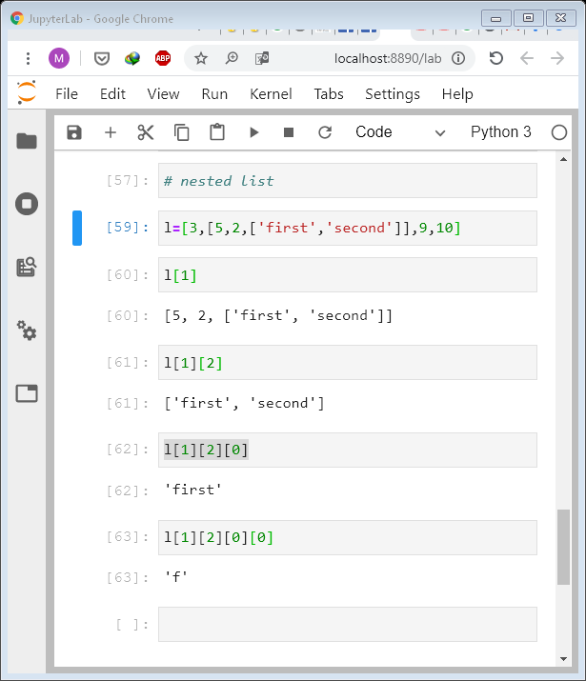
القوائم المتداخلة
Nested Lists

Slide 47
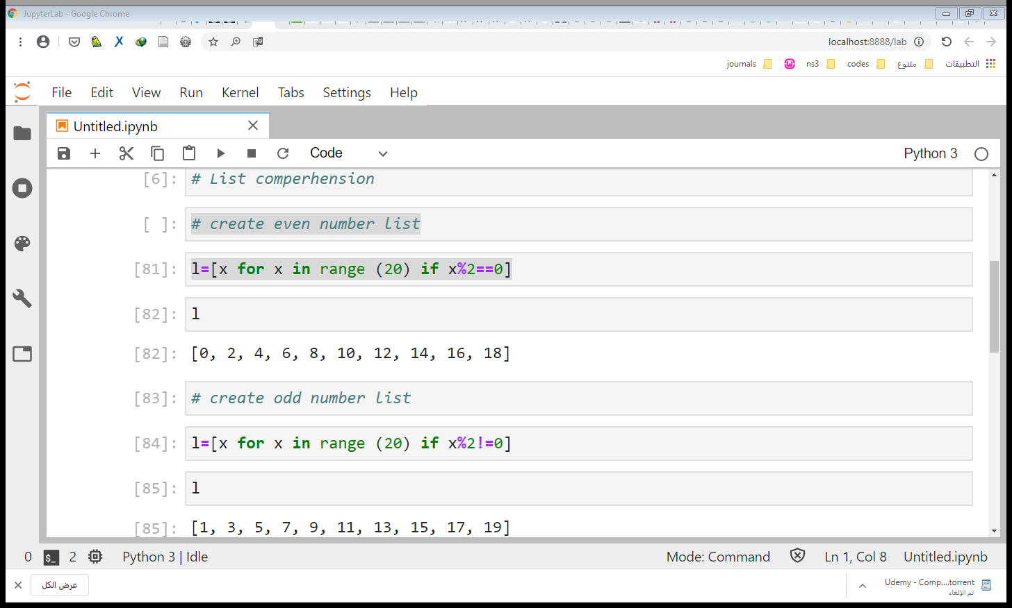
List Comprehension

Slide 48
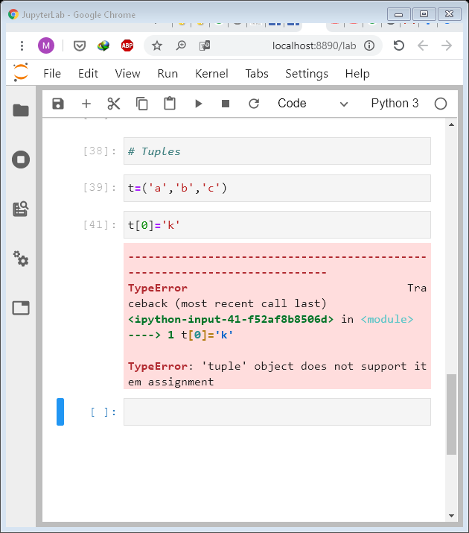
Tuples

Slide 49
Python Data Type
Python
Python Loops
Python decisions
Python Data Types
For
While
IF
Tuples
User Defined DT
Standard Data Types

Slide 50
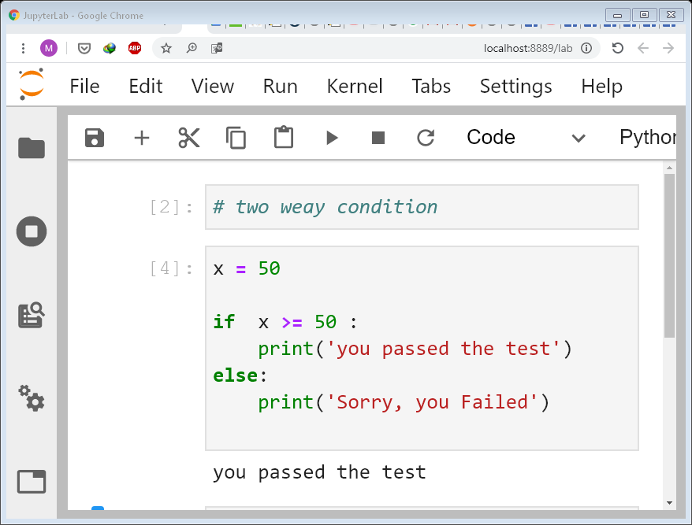

Slide 51
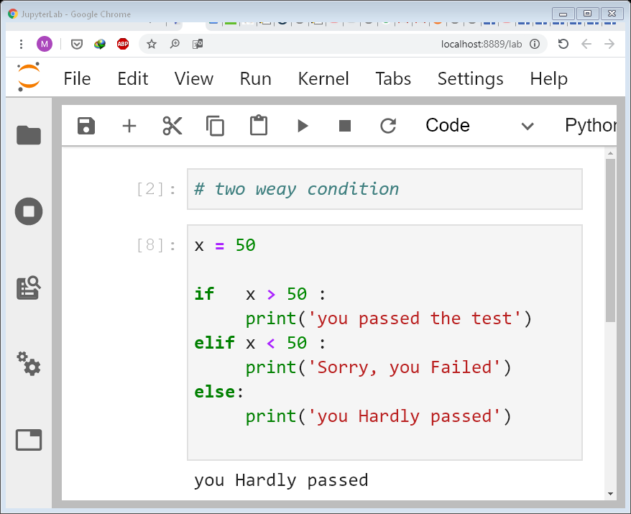
Notes:
x = 90
if isinstance(x, int):
if x >= 50 :
print('you passed the test')
else :
print('Sorry you failed')
else:
print('please inter integer number')

Slide 52
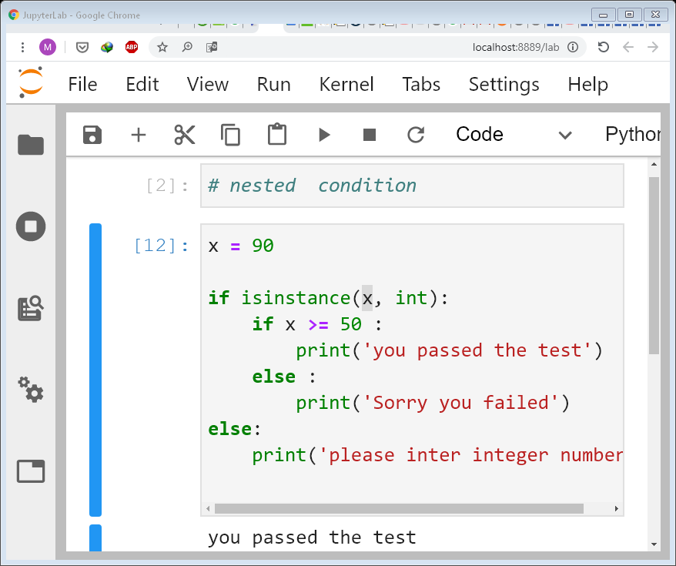
Nested Conditions

Slide 53
Python Data Type
Python
Python Loops
Python decision
Python Data Types
For
While
IF
Tuples
User Defined DT
Standard Data Types

Slide 54
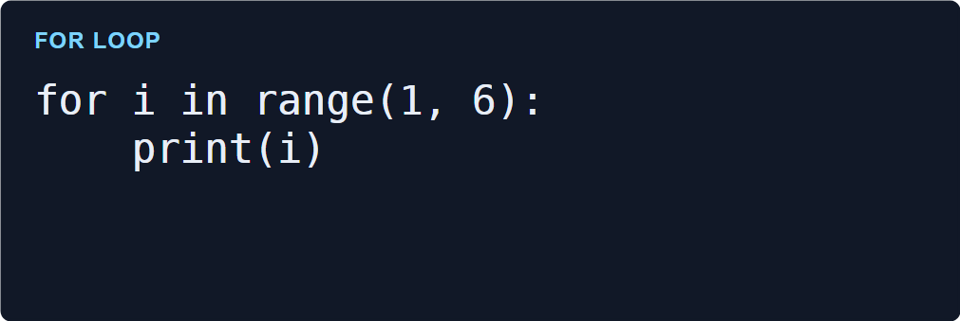
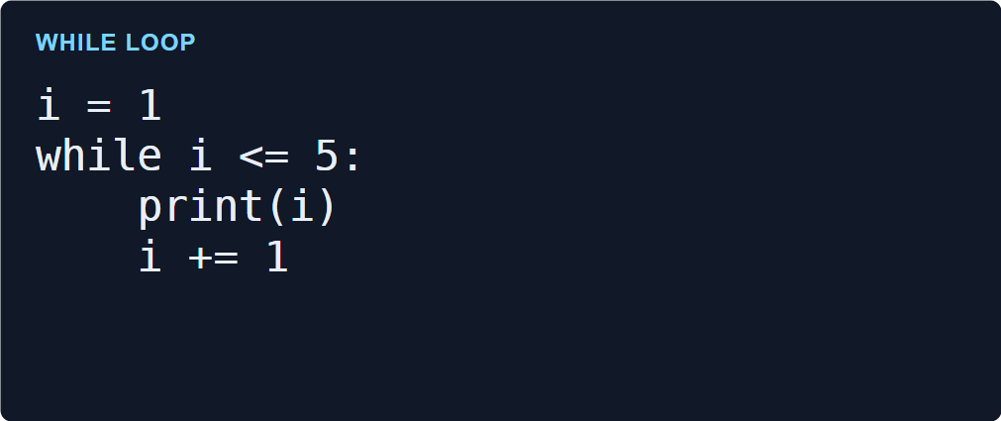
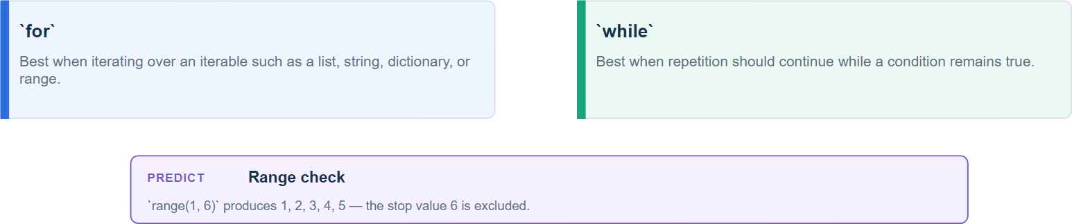
Python Iteration

Slide 55
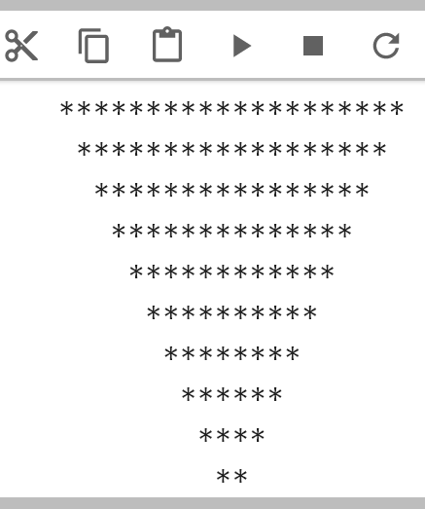
Do it In Python
Notes:
x=20
c=0;
for i in range(x):
if i%2==0:
print (' '*(c)+'*'*(x-i))
c=c+1;

