Slide 1

Design and implementation of Mobile Applications
Delever
Design Document

Slide 2

Project Description
Centralized delivery mobile application that supports vendors who run small businesses
through a delivery system that links drivers who can be dedicated drivers or just working part-time for some extra cash.
Delever
Drivers
Sellers

Slide 3
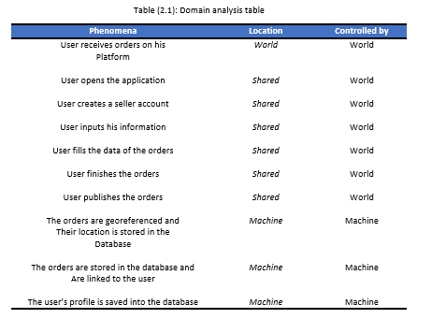
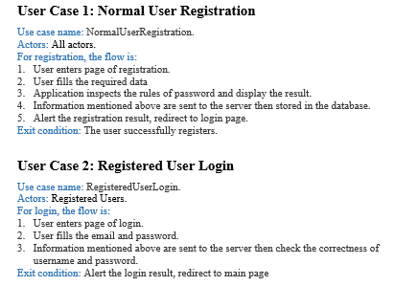
Requirements analysis and specifications
Overview
Goals
Domain
Analysis
Use cases

Slide 4
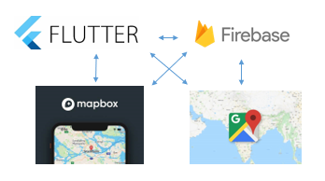
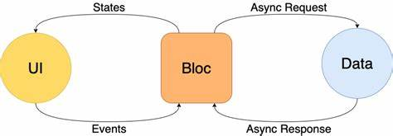
Design
Main schema
Architecture

Slide 5
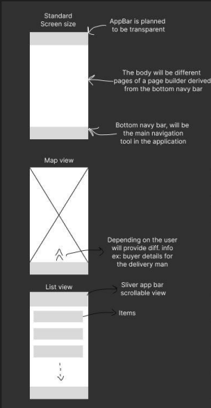
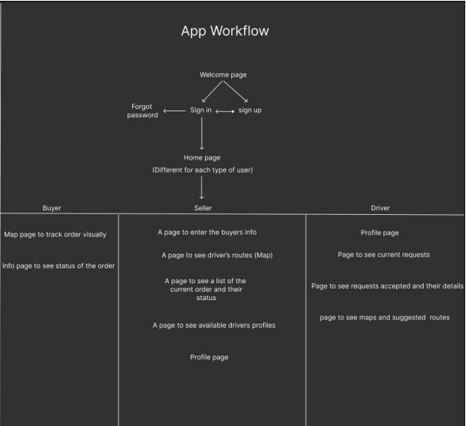
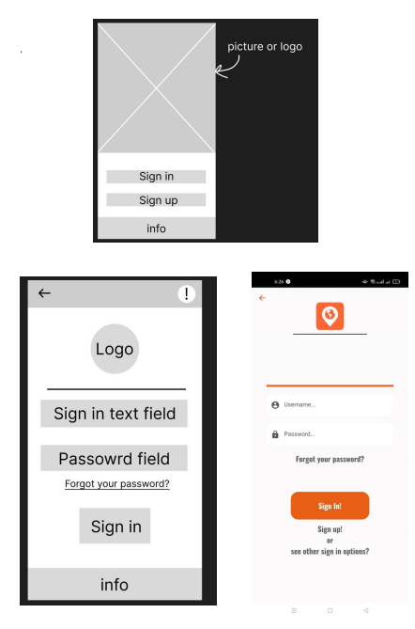
Design
Preliminary design phase

Slide 6
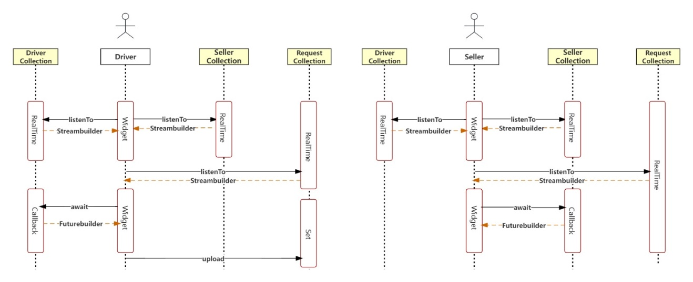
Design

Slide 7
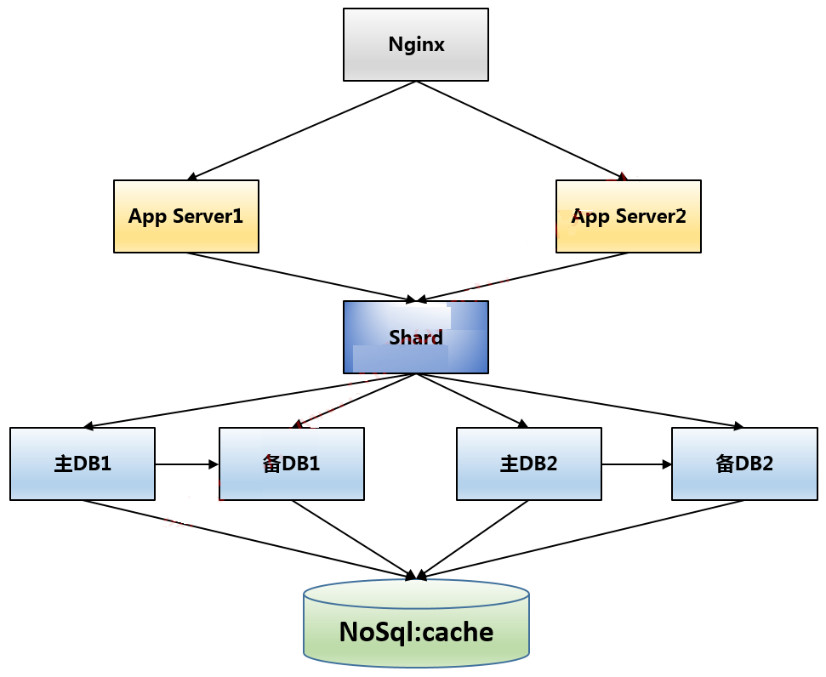
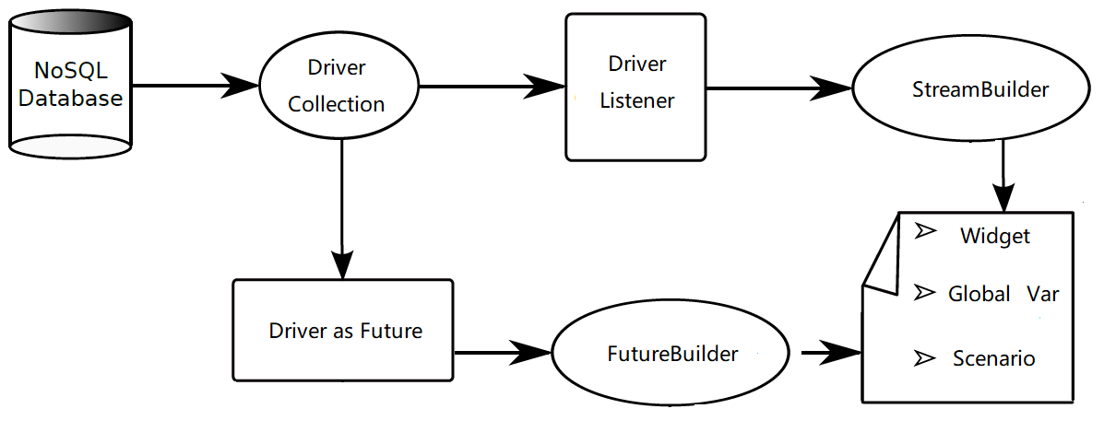
Design
Database

