Slide 1

Image Analysis and Computer Vision
Project Documentation
Mohanad Diab
10769366

Slide 2

Version 1.0 2023
Introduction
This project aims to solve the problem of musician hands recognition and position estimation, the plan is to use state-of-the-art computer vision techniques to accurately track and analyze the movement of a musician's hands while they play instruments such as piano, guitar, and accordion.
The use of computer vision in the music industry is not a new concept, but it has come a long way since its inception. In the past, computer vision was mainly used for simple tasks such as tracking the movement of a musician's fingers on a keyboard or frets on a guitar. However, with advancements in technology, computer vision has become much more sophisticated, allowing for more detailed analysis of a musician's technique and performance.

Slide 3
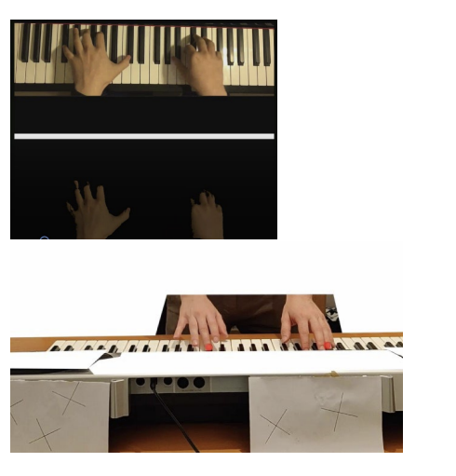
Version 1.0 2023
Requirements
Expected output:
the motion of the fingers in their 3 dimensions

Slide 4
Version 1.0 2023
Challenges
Input:
A series of stationary frames
Problem:
No stereographic vision!
No possibility of reconstructing a 3D model

Slide 5
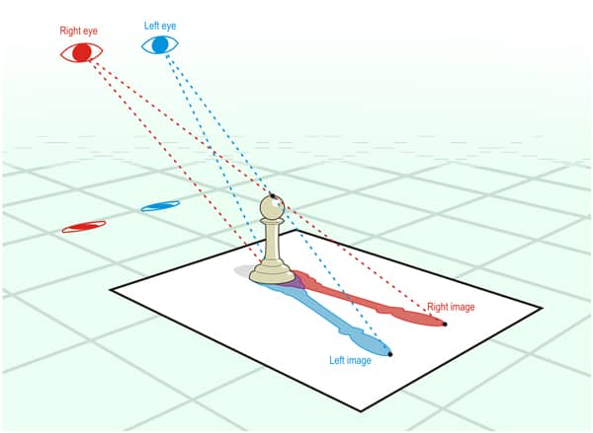
Version 1.0 2023
Challenges
Input:
A series of stationary frames
Problem:
No stereographic vision!
No possibility of reconstructing a 3D model

Slide 6
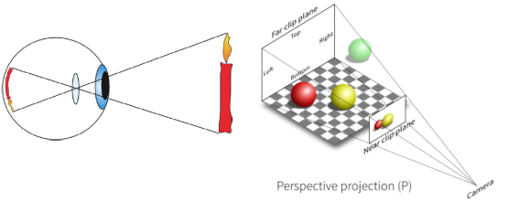
Version 1.0 2023
Challenges
Input:
A series of stationary frames
Problem:
No stereographic vision!
No possibility of reconstructing a 3D model

Slide 7
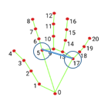
Version 1.0 2023
Challenges
Input:
A series of stationary frames
Solution:
Automatic hand recognition.
Geometric relations.

Slide 8
Version 1.0 2023
Preliminary research
Technologies & methods:
Haar classifiers
Mediapipe
Yolo model
Midas depth maps
Geometrical considerations

Slide 9
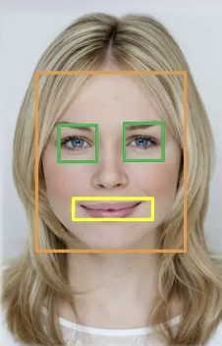
Version 1.0 2023
Preliminary research
Technologies & methods:
Haar classifiers
Mediapipe
Yolo model
Midas depth maps
Geometrical considerations

Slide 10
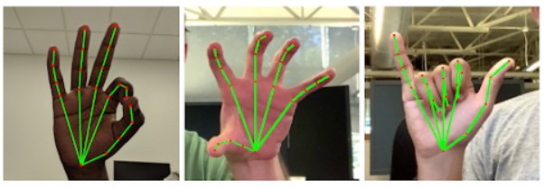
Version 1.0 2023
Preliminary research
Technologies & methods:
Haar classifiers
Mediapipe
Yolo model
Midas depth maps
Geometrical considerations

Slide 11
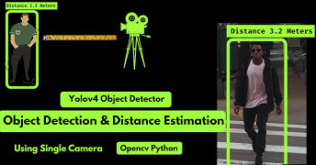
Version 1.0 2023
Preliminary research
Technologies & methods:
Haar classifiers
Mediapipe
Yolo model
Midas depth maps
Geometrical considerations

Slide 12
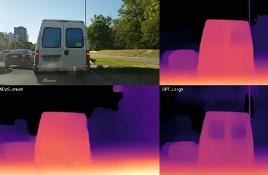
Version 1.0 2023
Preliminary research
Technologies & methods:
Haar classifiers
Mediapipe
Yolo model
Midas depth maps
Geometrical considerations

Slide 13
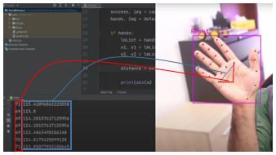
Version 1.0 2023
Preliminary research
Technologies & methods:
Haar classifiers
Mediapipe
Yolo model
Midas depth maps
Geometrical considerations

Slide 14
Version 1.0 2023
Design
Design approach:
Mediapipe for image referencing.
Geometrical relations for depth estimation.
Visualization in unity.

Slide 15
Version 1.0 2023
Design
Design approach:
Mediapipe for image referencing.
Geometrical relations for depth estimation.
Visualization in unity.
Mediapipe model:
Palm detection
Landmark detection

Slide 16
Version 1.0 2023
Design
Mediapipe model:
Palm detection
Encoder-decoder feature extractor.
95.7% model accuracy.
Landmark detection
Detection via regression.
Overcomes occlusion.

Slide 17
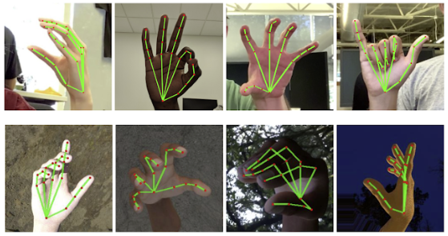
Version 1.0 2023
Design

Slide 18
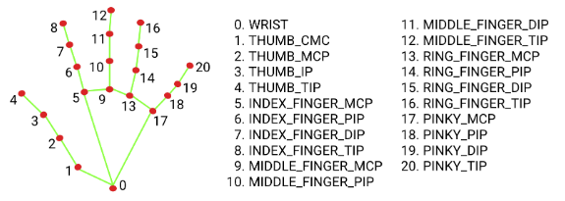
Version 1.0 2023
Design

Slide 19
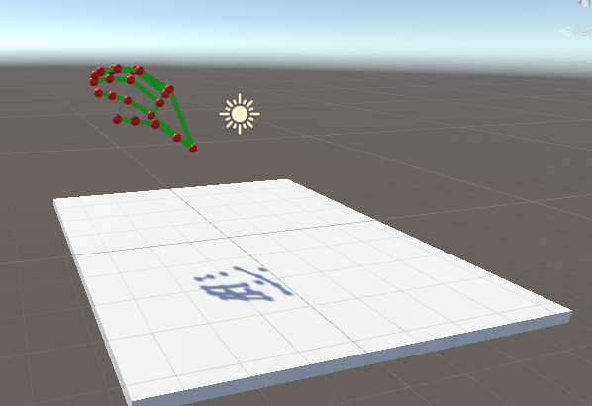
Version 1.0 2023
Design
Design approach:
Mediapipe.
Geometrical relations.
Visualization in Unity.

Slide 20
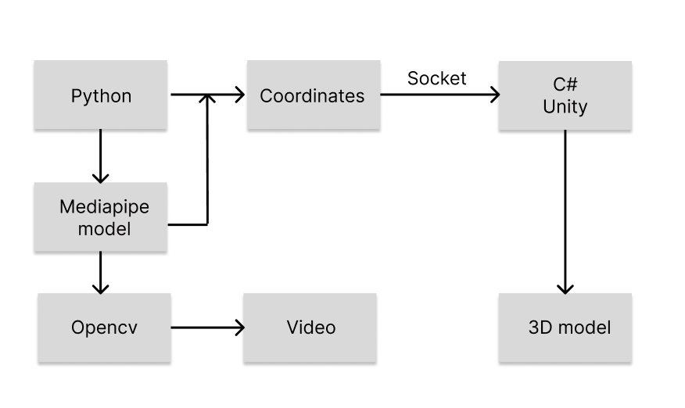
Version 1.0 2023
Implementation
Pipeline:
Python.
Opencv
Mediapipe
Socket stream
C# & Unity
3D model

Slide 21
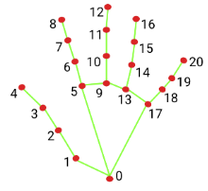
Version 1.0 2023
Implementation
Geometrical formulation:
How can one exploit the hand geometry to draw a depth relation?
How can it be generalized to the fingers and their articulations?

Slide 22
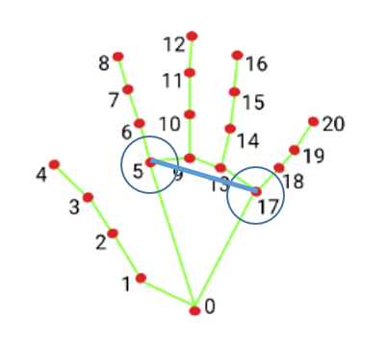
Version 1.0 2023
Implementation
Geometrical formulation:
How can one exploit the hand geometry to draw a depth relation?
How can it be generalized to the fingers and their articulations?

Slide 23

Version 1.0 2023
Implementation

Slide 24
Version 1.0 2023
Implementation
Geometrical formulation:
How can one exploit the hand geometry to draw a depth relation?
The line segment is fixed since the knuckle joints are stationary.

Slide 25
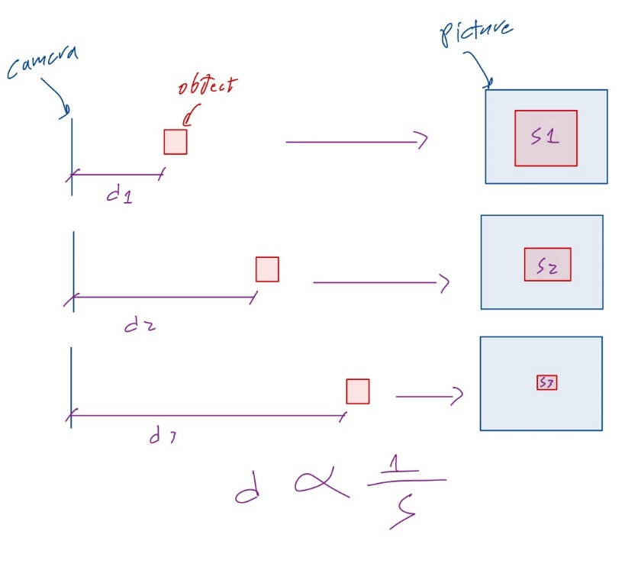
Version 1.0 2023
Implementation
Geometrical formulation:
How can one exploit the hand geometry to draw a depth relation?
The line segment is fixed since the knuckle joints are stationary.

Slide 26

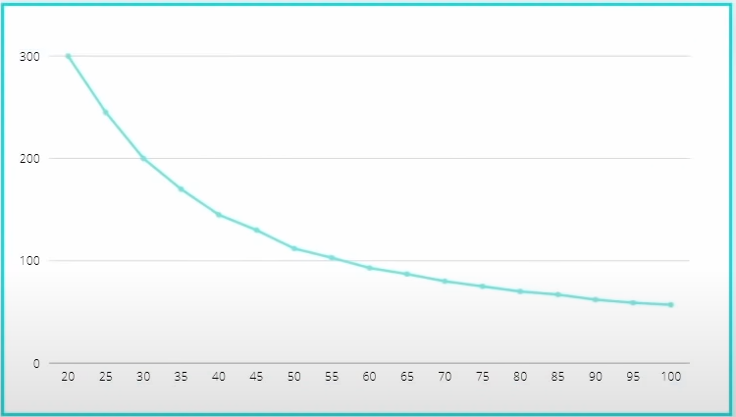
Version 1.0 2023
Implementation
Geometrical formulation:
How can one exploit the hand geometry to draw a depth relation?
Empirically determining the relation.

Slide 27
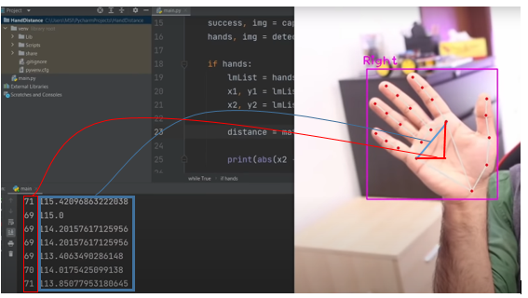
Version 1.0 2023
Implementation
Geometrical formulation:
How can one exploit the hand geometry to draw a depth relation?
Empirically determining the relation.

Slide 28
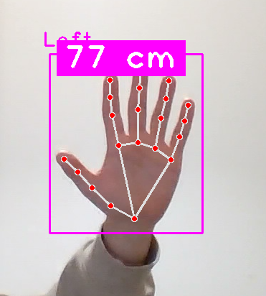
Version 1.0 2023
Implementation
Geometrical formulation:
How can one exploit the hand geometry to draw a depth relation?
How can it be generalized to the fingers and their articulations?

Slide 29
Version 1.0 2023
Implementation
Geometrical formulation:
How can one exploit the hand geometry to draw a depth relation?
How can it be generalized to the fingers and their articulations?

Slide 30
Version 1.0 2023
Implementation
Geometrical formulation:
How can it be generalized to the fingers and their articulations?
Robust solution?
Related to the palm plane depth?

Slide 31
Version 1.0 2023
Implementation
Geometrical formulation:
How can it be generalized to the fingers and their articulations?
One can still use the length of the segments connecting the joints, but this time it can be relative to the palm plane

Slide 32
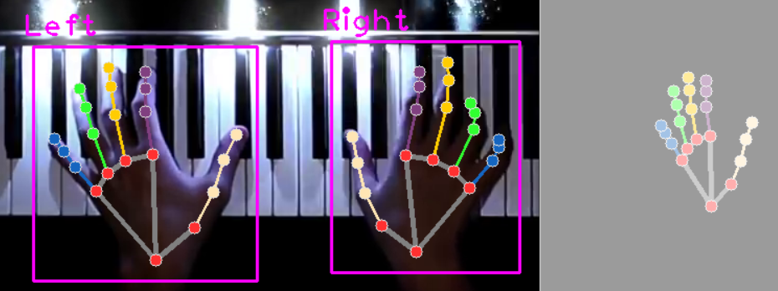

Version 1.0 2023
Implementation
Geometrical formulation:
How can it be generalized to the fingers and their articulations?
Robust solution?
Related to the palm plane depth?

Slide 33
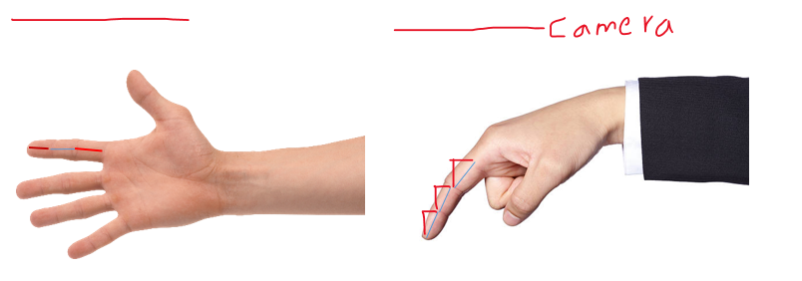
Version 1.0 2023
Implementation
Geometrical formulation:
How can it be generalized to the fingers and their articulations?
Robust solution?
Related to the palm plane depth?

Slide 34
Version 1.0 2023
Implementation
Geometrical formulation:
How can it be generalized to the fingers and their articulations?
Robust solution?
Related to the palm plane depth?
Geometrical formulation:
Average finger length:
the average thumb is 35 to 65 millimeters long. The index is 50 to 88 millimeters long and the ring finger is 42 to 96 millimeters long. The middle finger is 57 to 100 millimeters long and the pinky is 40 to 74 millimeters long.

Slide 35
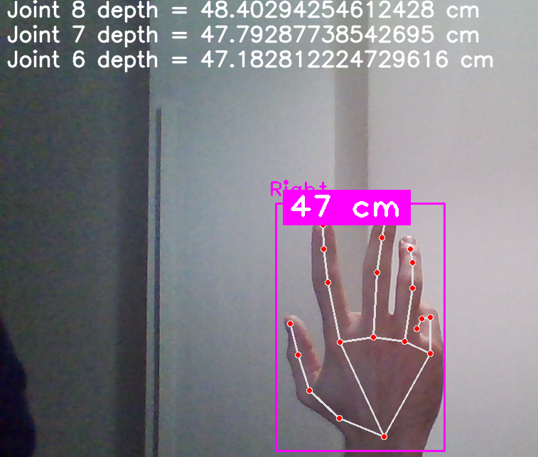

Version 1.0 2023
Implementation
Geometrical formulation:
How can it be generalized to the fingers and their articulations?
Robust solution?
Related to the palm plane depth?

Slide 36
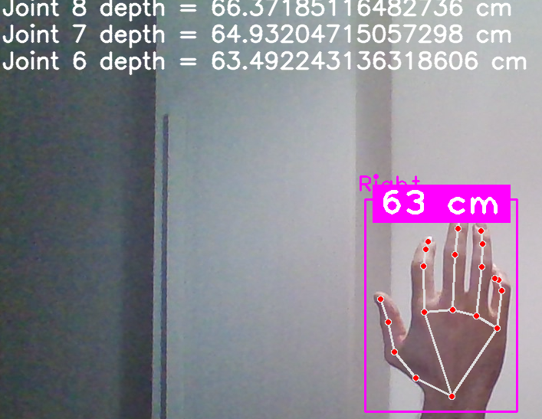
Version 1.0 2023
Implementation

Slide 37
Version 1.0 2023
Implementation
Geometrical formulation:
How can it be generalized to the fingers and their articulations?
The outcome of the musician playing a piano has been predicted and is printed on a text file on the directory.
This can be implemented on multiple videos of the same format not this one only.

Slide 38
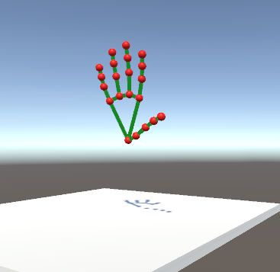
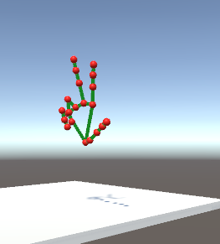
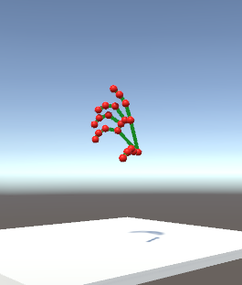
Version 1.0 2023
Extras
Unity:
Building a 3D environments
Coordinates are exported, and streamed.
Unity “listens” to the stream and displays.

Slide 39
Version 1.0 2023
Conclusion
In conclusion, this computer vision project successfully utilized deep learning and geometry to determine the position of a hand and individual fingers as well as their articulations.
The use of deep learning algorithms allowed for high accuracy in detecting and identifying the hand and fingers, while the incorporation of geometry provided a more robust understanding of the hand's position and movement.

Slide 40
Version 1.0 2023
Conclusion
The results of this project demonstrate the potential for these techniques to be applied in various practical applications such as robotics, virtual and augmented reality and Human-computer interaction.

Slide 41
Version 1.0 2023
Recommendations
Further research could focus on improving the robustness of the system in different lighting conditions and increasing the number of hand gestures that can be recognized. Overall, this project represents a step forward in the field of computer vision and its potential to enhance human-computer interaction.
Also further recommendations would be to take into account different scenarios where for instance the plane of the hand is not parallel to the plane of the camera or perpendicular or include all the cases in between.
And the problem where the musicians are playing instruments like the guitar and an accordion are still unsolved since the hands follow more complicated movements.

Slide 42
Version 1.0 2023
References
1 – Mediapipe website : Home | mediapipe (google.github.io)
2 – Mediapipe hand documentation: Hands | mediapipe (google.github.io)
3 – Hand landmarks: hand_landmarks.png (1543×538) (mediapipe.dev)
4 – Midas: MiDaS | PyTorch
5- Yolov5: https://github.com/ultralytics/yolov5

Slide 43
Version 1.0 2023
Thank you
Next, a demo!

