Slide 1
UIT2511 – Software Development Project - II Sleep Stage Classification to identify Sleep disorders using EEG Signals
Presentation By Lewin Jesudhas H – 3122 22 5002 064 Mohanakrishnaa R – 3122 22 5002 075
Guided By
Dr. V. Durgadevi
Assistant Professor, SSNCE

Slide 2
Problem Statement
Develop an automated system that accurately classifies sleep stages – Wake, REM, NREM -1,2, and 3 - using EEG signals and wavelet transform. To create a scalable solution that enhances the accuracy and efficiency of sleep monitoring, with potential applications in both consumer sleep trackers and clinical diagnostics.

Slide 3
EEG Signals
Electroencephalography (EEG) signals are electrical signals produced by the brain that are recorded by small sensors attached to the scalp during a painless test.
5 types namely:
delta (0.5 to 4Hz) – sleep, dreaming
theta (4 to 7Hz) – drowsiness
alpha (8 to 12Hz) – reflective, restful
beta (13 to 30Hz) – busy, active mind
gamma (30 to 45Hz) – problem solving, concentration

Slide 4
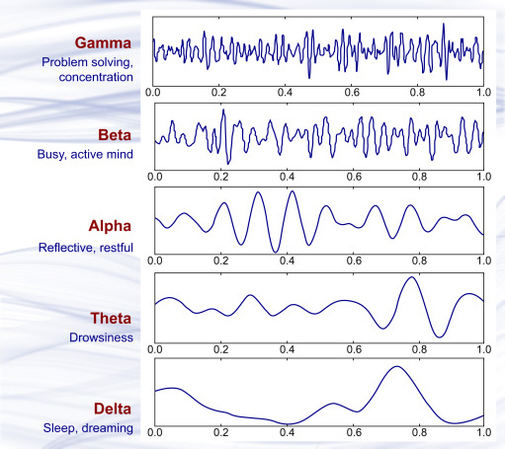
EEG Signals
Source: ScienceDirect.com

Slide 5
OBJECTIVES
To monitor the sleep of the subject and accurately classify their sleep based on the different stages using EEG data by using wavelet transform and delta parameter analysis for precise and real-time sleep monitoring.
Reliable and precise tracking and classification of their sleep stages (Wake, REM, NREM – 1,2,3) with high precision.
Analyze and understand the different sleeping patterns and identifying any irregularities or anomalies that could indicate potential sleep disorders or issues.

Slide 6
SCOPE
Data collection and Preprocessing:
Data containing EEG signals is obtained from sources like physionet.org and IEEEdataport and the signals are de-noised and filtered.
Wavelet transform is applied to decompose data into different frequency bands focusing on the delta frequency band.
Feature Engineering:
Delta parameter is extracted and measured using the wavelet transformed data.
Model Development:
Developing and training various ML models (eg. CNN, RNN) using the extracted features.
Model Evaluation and Validation:
Evaluated using standard metrics such as accuracy, precision, recall, and F1-score
Integration

Slide 7
LITERATURE REVIEW [1]
Sleep consists of REM (Rapid Eye Movement) and Non-REM (NREM) stages, with NREM further divided into light sleep (Stage 1 and 2) and deep sleep (Stage 3).
REM sleep is crucial for cognitive functions like memory consolidation, while deep sleep is vital for physical recovery.
Each sleep cycle lasts about 90 minutes and includes all stages of sleep, with deep sleep predominantly occurring in the first half of the night and REM sleep in the latter half.
Disturbances in these cycles can lead to various health issues, including impaired cognitive function and emotional instability.
Sleep stage classification system using two-stage Hidden Markov Models (HMMs) based on heart rate variability (HRV).

Slide 8
LITERATURE REVIEW [2]
Traditional sleep stage classification relies on polysomnography (PSG), is inconvenient for patients due to its intrusive nature and requirement for specialized sleep labs.
Need for in-home monitoring methods using physiological signals such as ECG and EEG.
Applied the Hamilton-Tompkins algorithm to detect R-wave onsets and construct RR interval series.
Used a polynomial Support Vector Machine (SVM) classifier trained on the selected features.
Conducted classification on both five-minute and one-minute signal segments to evaluate performance.

Slide 9
LITERATURE REVIEW [3]
Uses multivariate phase space reconstruction (MPSR) to construct covariance matrices on Riemannian manifolds. This approach effectively captures spatial relationships between different channels, improving sleep stage identification.
Covariance matrices in the Riemannian manifold are mapped to tangent spaces at the Riemannian geometric mean, simplifying feature extraction.
An ensemble learning classifier is used to recognize tangent feature vectors corresponding to different sleep stages, enhancing classification accuracy.
The proposed method demonstrates significant potential in improving the accuracy and efficiency of automatic sleep stage classification, particularly by incorporating inter-channel spatial information through the Riemannian manifold approach.

Slide 10
REFERENCES
[1] A two-step automatic sleep stage classification method with dubious
Range detection. Teresa Sousa N, Aniana Cruz, Sirvan Khalighi, Gabriel Pires, Urbano Nunes, Institute of Systems and Robotics (ISRUC), Electrical and Computer Engineering Department, University of Coimbra, Portugal
[2] A method of REM-NREM sleep distinction using ECG signal for unobtrusive personal monitoring. Jaspal Singh, R.K. Sharma, A.K Gupta, National Institute of Technology, Kurukshetra, Haryana, India
[3] Multivariate phase space reconstruction and Riemannian manifold for sleep
stage classification. Xueling Zhou, Bingo Wing-Kuen Ling, Waqar Ahmed, Yang Zhou, Yuxin Lin, Hongtao Zhang

Slide 11


