Slide 1
Covid-19 Analysis in India

Slide 2

Team - 07
Chinmayi Ambati
Mohan Krishna Alavala
Neelesh Saladi
Nooka Raju Boddu
Priyanka Bodapati
Sindhuja Valeti

Slide 3
Introduction
What is the main goal of our project?
To analyze Covid-19 situations of different states in India.
For this, we have collected Covid-19 data for India and analyzed various goals using visualization tools.
Mohan Krishna Alavala

Slide 4
Data set and it’s Attributes
We have collected data about the number of confirmed cases, death rates, number of recovered cases, and total tests conducted daily in each state.
Attributes: Date, State, Total cases confirmed, Deaths, Cured, and the number of tests conducted.
Mohan Krishna Alavala

Slide 5
Records in the data set and Tools used
Data is taken from Jan 30th 2020 to June 23rd 2020.
Total records in the data set:
Sheet 1 (Complete data) – Columns: 7, Rows: 3301
Sheet 2 (State-wise tests) – Columns: 5, Rows: 2366
The visualization tool we used in our project is Tableau.
Sindhuja Valeti

Slide 6
Introduction of Goals
Top 10 states death rates
Total Confirmed Cases by state
Recovered Cases By state
Total tests conducted in each state
Average positive test cases by state
Confirmed cases vs deaths – Top 10 states
Dashboard
Sindhuja Valeti

Slide 7
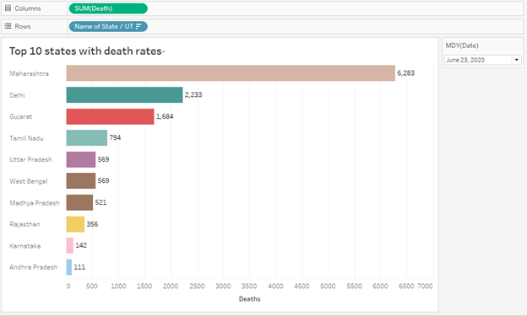
Top 10 states death rates
Neelesh Saladi

Slide 8
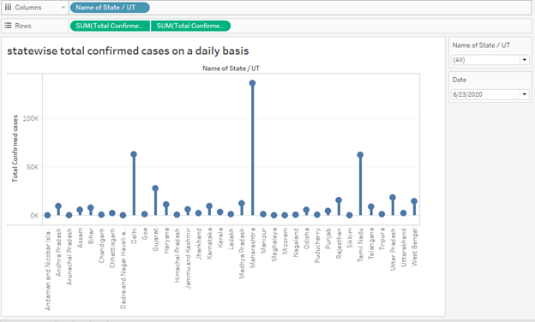
Total Confirmed Cases by State
Neelesh Saladi

Slide 9
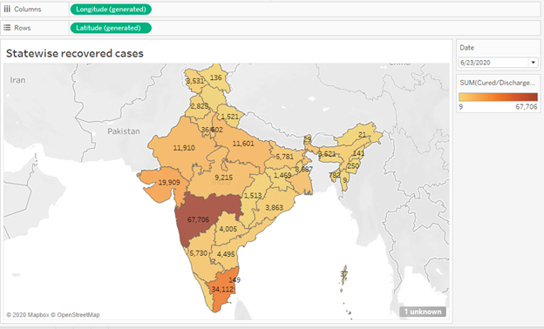
Recovered Cases By State
Priyanka Bodapati

Slide 10
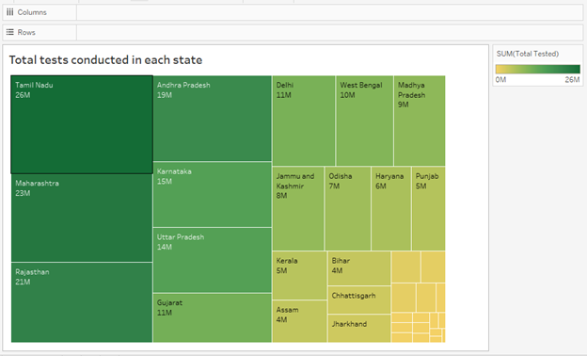
Total tests conducted in each state
Priyanka Bodapati

Slide 11
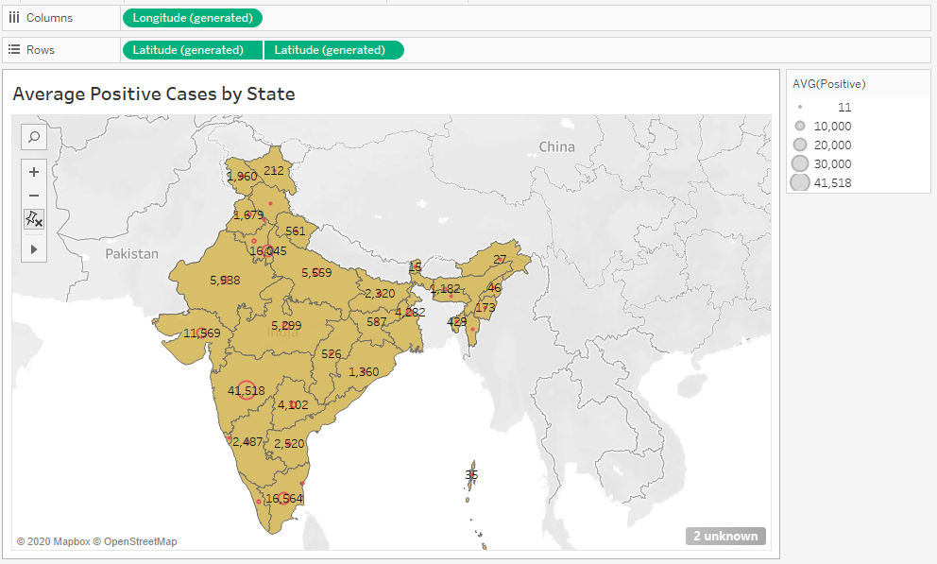
Average Positive Cases by State
Chinmayi Ambati

Slide 12
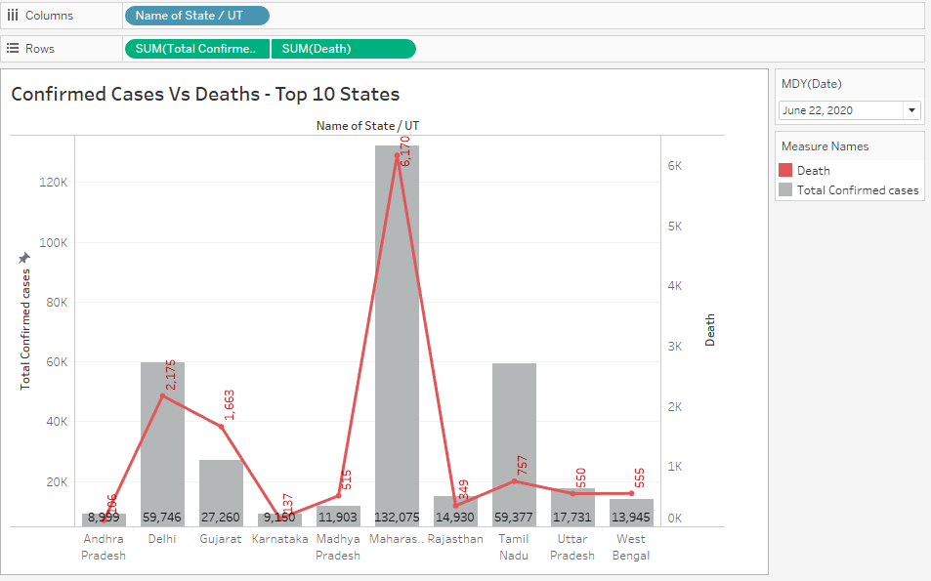
Confirmed Cases vs Deaths
Chinmayi Ambati

Slide 13
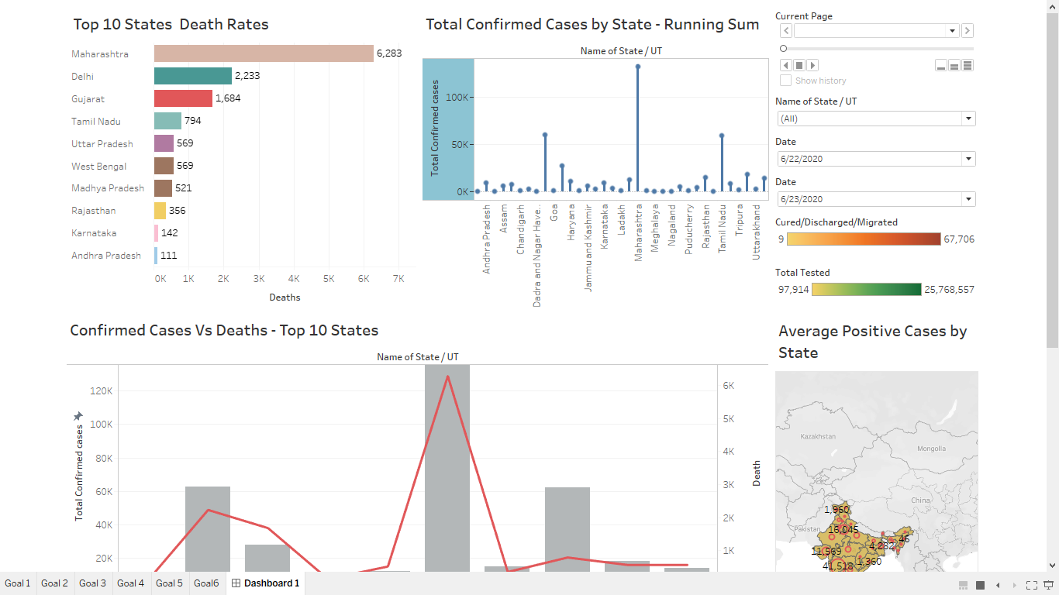
Dashboard
Nooka Raju Boddu

Slide 14
Lessons Learned
Collecting data from various sources
Cleaning data sets and transforming it into useful information
Visualizing the data and assembling charts, legends, data filtration using tools.
Gained tableau skills on creating quick interactive visualizations
We learned how to write a story with large data sets.
Nooka Raju Boddu

Slide 15
Conclusion
Cases are high in Maharashtra as of June 23rd , 2020
Comparison of death rates
Comparison of the number of tests conducted
Highest positive and lower positive cases
Nooka Raju Boddu

Slide 16


