Slide 1
Name : Tadi Mohanapavani
Email : mohanapavani03@gmail.com
College Name : NRI Institute of technology
Branch : InformationTechnology
Location : Guntur
Project Title : IMAGE STEGANOGRAPHY

Slide 2

IMAGE STEGANOGRAPHY

Slide 3
Introduction to Image Steganography:
Image steganography is the practice of hiding secret information within digital images. This technique exploits the redundancy in image data such as the least significant bits (LSBs) of pixel values to embed hidden messages without noticeably altering the image's appearance.

Slide 4
AGENDA
What is Image Steganography
Hiding Data
Invisible to the Eye
Secured Communication
Techniques Used in the Project
Demonstrating the Project with Sample Images
End Users

Slide 5
What is Image Steganography:
Image steganography involves embedding secret data such as text images or even files within the pixels of a digital image. The hidden data is concealed in a way that it is undetectable to the casual observer, making the image appear normal and unaltered. This technique allows for secure communication as the existence of the hidden data is hidden from anyone who is not aware of its presence.

Slide 6
Techniques Used in the Project:
Least Significant Bit (LSB) Insertion: One of the most straightforward and widely used techniques in image steganography. This method involves modifying the least significant bits of the pixels in a digital image to encode hidden information.

Slide 7
Example:
Image Pixels: Digital images are composed of pixels each represented by bits.
Grayscale Image: Each pixel is represented by 8 bits.
Color Image (RGB): Each pixel is represented by 24 bits (8 bits for red, 8 bits for green, and 8 bits for blue).
Least Significant Bit:
The least significant bit is the lowest bit in a byte. For example, in the byte 10110101, the least significant bit is the rightmost one (1).

Slide 8
Embedding Process:
To hide information, the least significant bit of each pixel’s color value is altered to match the bits of the secret message.
Example: If a pixel's red value is 11001010 and the secret message bit is 1, the red value is changed to 11001011.
Extracting Process:
The hidden information can be extracted by reading the least significant bits of the pixels in the same order they were modified.

Slide 9
WHO ARE THE END USERS of this project?
The primary end users for this steganography project include government and military personnel for secure communication, corporate executives for protecting proprietary data, and journalists sharing sensitive information discreetly. IT and cyber security teams can integrate this technique to enhance organizational data security. Additionally, this project is useful for anyone needing to send a secret message in a hidden format.

Slide 10
YOUR SOLUTION AND ITS VALUE PROPOSITION
Implementing Image Steganography with Python:
Image Manipulation:
Using Python's image processing libraries such as Pillow to read, manipulate, and save image files.
Data Embedding:
Algorithms are used to encode the secret data into the image's pixels ensuring it remains invisible.
Decoding and Extraction:
Complementary algorithms are employed to extract the hidden data from the image reverting the steganographic process.

Slide 11
How did you customize the project and make it your own
Input Image: An image used to hide the secret data.
Hidden Data: The information that will be embedded within the image.
Output Image: The image with the hidden data indistinguishable from the original.
Data Extraction: The process of retrieving the hidden data from the output image.

Slide 12
Libraries Used:
Pillow: For image manipulation.
NumPy: For numerical operations.
OpenCV: For advanced image processing.

Slide 13
MODELLING
Encoding and Decoding Process:
Encoding Process:
Load the image.
Convert the message into binary format.
Modify the image's pixel values to encode the message.
Decoding Process:
Load the encoded image.
Extract the binary data from pixel values.
Convert binary data back to the original message.

Slide 14
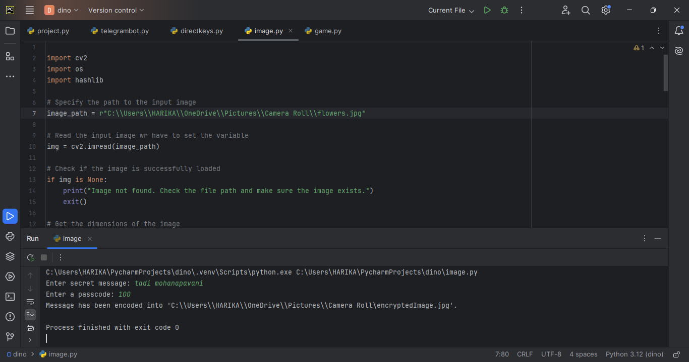
Results

Slide 15


encoded image
original image

Slide 16
LINKS
https://github.com/Mohanapavani03/image-steganography

Slide 17
Conclusion:
This project demonstrates the effectiveness of image steganography for secure communication by hiding and retrieving secret messages within digital images.
Thank You!

