Slide 1

RESULT MANAGEMENT
SYSTEM
USING HTML, CSS & JAVASCRIPT
Name: G.Mohana priya
Subject: FSD / Web Technology
01

Slide 2


MODERN
MANAGEMENT
MODERN MANAGEMENT
WEB-BASED ACADEMIC SOLUTIONS
A centralized interface designed to efficiently manage student academic records through modern web protocols.
▶
Stores student personal details and marks securely using client-side LocalStorage.
▶
Automates the calculation of grades and final results to ensure 100% accuracy.
▶
Provides a seamless, responsive user experience with modern frontend technologies.
"Efficiency is the foundation of progress in the digital academic era."
DATA INTEGRITY MEETS DESIGN
02

Slide 3

STRATEGIC OBJECTIVES
01
SIMPLIFY MANAGEMENT
02
REDUCE ERRORS
Optimizing academic workflows
Ensuring absolute data integrity
03
FAST & ACCURATE
04
IMPROVE SKILLS
High-performance processing
Mastering frontend technologies
03

Slide 4


STACK: JS/HTML/CSS/LS
CORE TECH STACK
THE BLUEPRINT OF THE SYSTEM
The application is built on a pure frontend architecture, leveraging modern web standards for performance and persistence.
HTML5
CSS3
Semantic structure and the backbone of the interface.
Responsive styling and cyberpunk visual aesthetics.
JAVASCRIPT
LOCALSTORAGE
Core logic, calculations, and interactive elements.
Persistent client-side data storage without a backend.
CODE IS THE NEW FUNDAMENTAL BLOCK
The synergy of structure, style, and logic creates a robust digital ecosystem.
04

Slide 5


SYSTEM
ARCHITECTURE
LOGIC + DATA
CORE OPERATIONAL MODULES
LOGIN PAGE
ADD STUDENT
Secure administrative access point and authentication gateway.
Registration module for creating new student profiles.
ADD MARKS
VIEW RESULTS
Interface for linking academic performance to student records.
Dynamic reporting dashboard for comprehensive result analysis.
MODULAR DESIGN ENSURES SCALABILITY AND CLARITY
05

Slide 6


LOGIN &
DASHBOARD
status:// access_granted
THE GATEWAY TO SYSTEM CONTROL
A streamlined authentication interface designed for administrative access, ensuring a secure entry point to the management environment.
Simple login interface (no backend required)
Instant redirection to the main dashboard hub
auth_token: verified
Centralized navigation for all system modules
"Access is the first step toward total system management— where data becomes actionable insight."
06

Slide 7


STUDENT REGISTRATION
PERSISTENT DATA ENTRY
INITIALIZING DATA PROFILES
INITIALIZING DATA PROFILES
INITIALIZING DATA PROFILES
The registration module serves as the primary gateway for capturing essential student information and committing it to memory.
CORE IDENTITY
Captures unique Roll Numbers and Full Names to establish student records.
ACADEMIC CONTEXT
Records Semester details to categorize academic performance chronologically.
PERSISTENT STORAGE
Utilizes LocalStorage for instant, client-side data persistence without a server.
DATA INTEGRITY SECURED
07

Slide 8

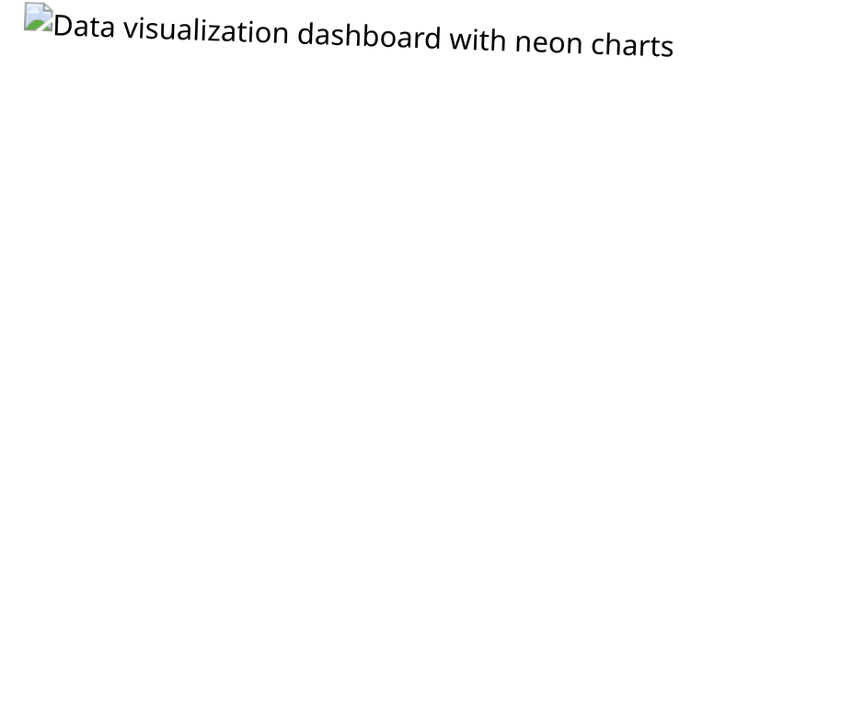
Real-time data synchronization ensures that every mark entered is instantly mapped to the correct student profile.
PERFORMANCE TRACKING
PRECISION DATA ENTRY INTERFACE
The core engine for academic assessment. Link subject-specific marks to unique student identities with automated validation protocols.
ROLL NUMBER LINKAGE
Ensures marks are attributed to the correct student record via unique identifiers.
SUBJECT-WISE METRICS
Input fields for Subject Name, Obtained Marks, and Total Marks for granular tracking.
STUDENT VALIDATION
Real-time system check to verify student existence before allowing data persistence.
"Data integrity is the heartbeat of academic transparency."
08

Slide 9

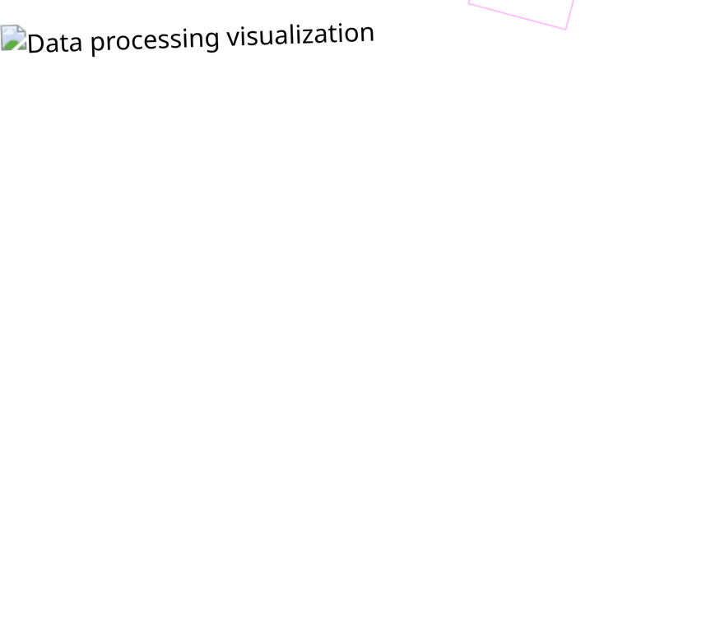
"Algorithms transform raw data into academic truth, eliminating human bias and error."
AUTOMATED
AUTOMATED
AUTOMATED
LOGIC
ENGINE
THE CALCULATION LAYER
The system processes academic metrics through a predefined logic matrix to determine final outcomes instantly.
PERCENTAGE
GRADING
STATUS
Obtained / Total * 100
A (75+), B (50+), F (<50)
Pass / Fail Determination
By automating the assessment process, the system ensures consistency across all student records, providing a reliable foundation for academic reporting and analysis.
09

Slide 10

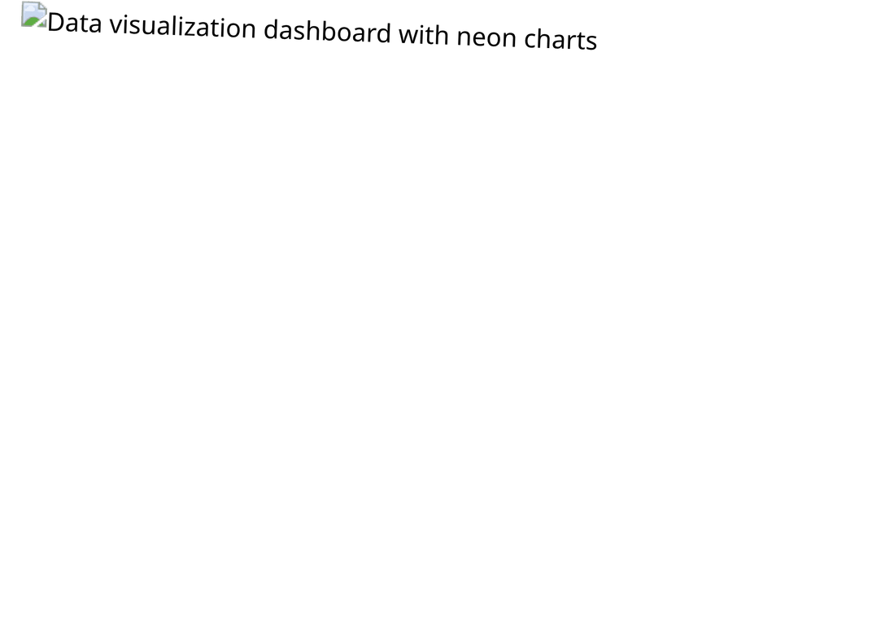
DYNAMIC RESULT
PRESENTATION
100%
COMPREHENSIVE PERFORMANCE REPORTING
75%
The final output layer where raw data is transformed into visual clarity—presenting student achievements in a structured, high-performance interface.
50%
TABULAR DATA
Organized display of Roll Number, Student Name, and Subject for easy identification.
ANALYTIC METRICS
Clear visibility of Marks, Grade, and final Result status (Pass/Fail) for every entry.
INSTANT RETRIEVAL
"The presentation of data is as critical as the data itself—clarity drives decision-making."
Dynamic scanning of student outcomes with a focus on administrative efficiency.
10

Slide 11

FEATURES &
CONSTRAINTS
FEATURES & CONSTRAINTS
SYSTEM STRENGTHS
▶
Simple & Intuitive User Interface
▶
High-Speed Client-Side Performance
▶
Fully Responsive Cyberpunk Design
CURRENT LIMITATIONS
▷
No Backend Database Integration
▷
Limited Data Security Protocols
▷
Absence of Edit/Delete Functionality
"Every system is defined as much by its boundaries as by its capabilities."
DEFINING THE SCOPE OF DIGITAL LOGIC
11

Slide 12

SYSTEM
COMPLETE
FUTURE VISION & ENHANCEMENT
Efficient academic management through modern web logic.
A robust foundation for full-stack evolution.
THANK YOU FOR EXPLORING THE FUTURE.
12

