Slide 1
Employee Data Analysis using Excel
STUDENT NAME: MOHANA PRIYA .P
REGISTER NO:122202444
DEPARTMENT:B.COM (CORPORATE SECRETARYSHIP)
COLLEGE:DR.MGR.JANAKI COLLEGE OF ARTS AND SCIENCE FOR WOMEN

Slide 2
PROJECT TITLE
Employee Performance Analysis using Excel

Slide 3


INDEX
Problem Statement
Project Overview
End Users
Our Solution and Proposition
Dataset Description
Results and Discussion
Conclusion
3/21/2024 Annual Review

Slide 4

PROBLEM STATEMENT
A problem statement in performance analysis for employees is a clear and concise description of a specific issue or opportunity for improvement related to an individual's performance

Slide 5

PROJECT OVERVIEW
Employee data analysis is a analyzing the performance of the employee by considering the Various factors like gender, performance level, Ratings , and their achievements. In order to Identify the trends and patterns of different category of employees like high ,medium and low

Slide 6
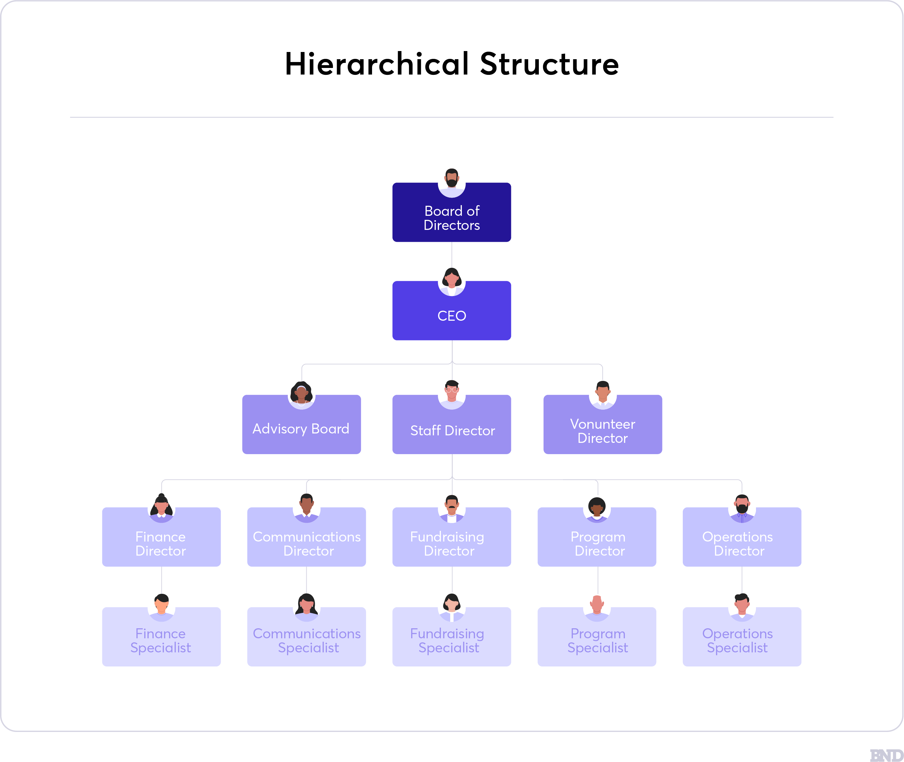

WHO ARE THE END USERS?

Slide 7

OUR SOLUTION AND ITS VALUE PROPOSITION
CONDITIONAL FORMATTING : MISSING ON EXCEL
FILTER : REMOVE BLACK SPACE IN EXIT DATA
FORMULA : USING FORMULA FOR FIND EMPLOYEE PERFORMANCE VALUE
PIVOT TABLE : SUMMARY
GRAPH :FOR DATA VISUALIZATION

Slide 8
Dataset Description
I have downloaded the employee data set from kaggle. In that data set it has 26 features is there, but I consider 10 features for performance analysis. The features are:
EMPLOYEE ID
NAME
GENDER
DEPARTMENT
SALARY
START DATE
EMPLOYEE CLASSIFICATION TYPE
PERFORMANCE SCORE
EMPLOYEE RATING
PERFORMANCE LEVEL

Slide 9

THE "WOW" IN OUR SOLUTION
PERFORMANCE LEVEL
=IFS(Z8>=5,"VERY HIGH",28>=4,"HIGH" 28>=3,"MED", TRUE, "LOW")
3/21/2024 Annual Review
9

Slide 10
RESULTS
10

Slide 11
conclusion
By comparing the performances of the employee, the numbers of employees are higher in number with low performances employee in training department. We need to motive the employee to improve the performances in the organization and to improve their skills for better outcome.

