Slide 1


Introduction to
Robotic Process Automation
Automated Pizza Ordering Bot With Voice Assistance
Register No. : 210701164
Name : Mohanapriya E
Guide Name : DuraiMurugan N
Assistant Professor (SG), Department of Computer Science And Engineering

Slide 2
Abstract
This project aims to develop an innovative solution to streamline the pizza ordering process through the integration of robotic process automation (RPA) and voice assistance technologies. The primary objectives include automating the steps involved in ordering pizza from a delivery website and incorporating voice assistance to enhance user interaction.
The Automated Pizza Ordering Bot with Voice Assistance in UiPath represents a successful fusion of automation and voice technologies, offering a modern solution to streamline the pizza ordering experience. The project contributes to the evolution of RPA applications and provides a foundation for future innovations in human-machine interaction.

Slide 3
Need for the Proposed System
Traditional online ordering processes may involve multiple steps, clicks, and form entries.
The proposed system aims to streamline and automate these processes using UiPath, reducing the time and effort required for users to place an order.
Introducing voice assistance adds a layer of natural language interaction, making the ordering process more intuitive and user-friendly. This caters to a broader audience, including those who may not be as comfortable with traditional interfaces or those with accessibility needs.

Slide 4
Advantages of the Proposed System
The proposed system offers advantages such as efficiency, enhanced user experience, accessibility, personalization, innovation, adaptability, and a competitive edge in the online food ordering market.
Automation can lead to cost savings for businesses by reducing manual labor and potential errors in the ordering process. This efficiency can contribute to overall operational cost reductions.
The integration of UiPath automation and voice assistance represents an innovative solution in the online food ordering domain.

Slide 5
Literature Survey
The literature surrounding the integration of UiPath automation, voice assistance, and user interaction in the context of an Automated Pizza Ordering Bot reveals a dynamic landscape of innovation and technological convergence.
Studies on Robotic Process Automation (RPA) emphasize the transformative impact of tools like UiPath in streamlining intricate workflows across various industries.
The literature survey should provide a comprehensive understanding of the existing knowledge landscape, help identify gaps that the proposed system aims to fill, and support the rationale behind the integration of UiPath automation and voice assistance technologies in the context of pizza ordering.

Slide 6
Main Objective
The main objective is to create a highly efficient, user-friendly, and innovative system that leverages automation and voice assistance technologies to transform the pizza ordering experience, ultimately redefining the landscape of user-centric automation applications in the online food ordering domain.
Enable users to interact with the bot using natural language voice commands, transcending conventional user interfaces and enhancing accessibility.

Slide 7
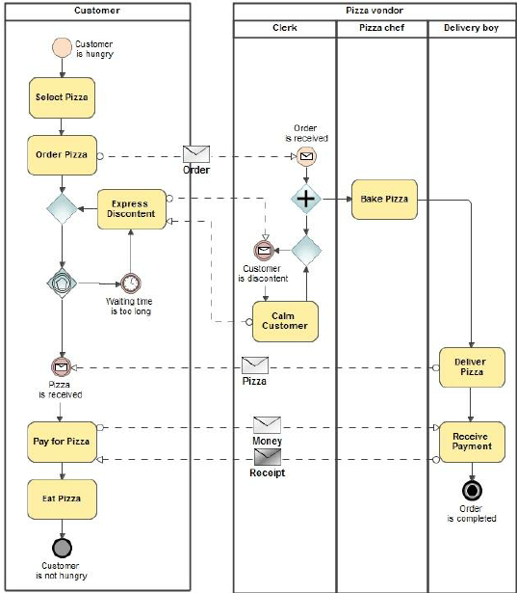
Architecture

Slide 8
System Requirements
Hardware
  Processor – Intel Core i3
  RAM – 4 GB RAM
  Hard Disk – 256 GB
Software
  UiPath Studio
  Xampp

Slide 9
Functional Description
Users can access the pizza ordering system through a user-friendly web interface.
The interface displays available pizza options, customization choices, and order summary.
This functional description provides an overview of the key features and capabilities of the Automated Pizza Ordering Bot with Voice Assistance in UiPath. It emphasizes the seamless integration of UiPath automation and voice assistance technologies to redefine the user experience in the domain of online food ordering.

Slide 10
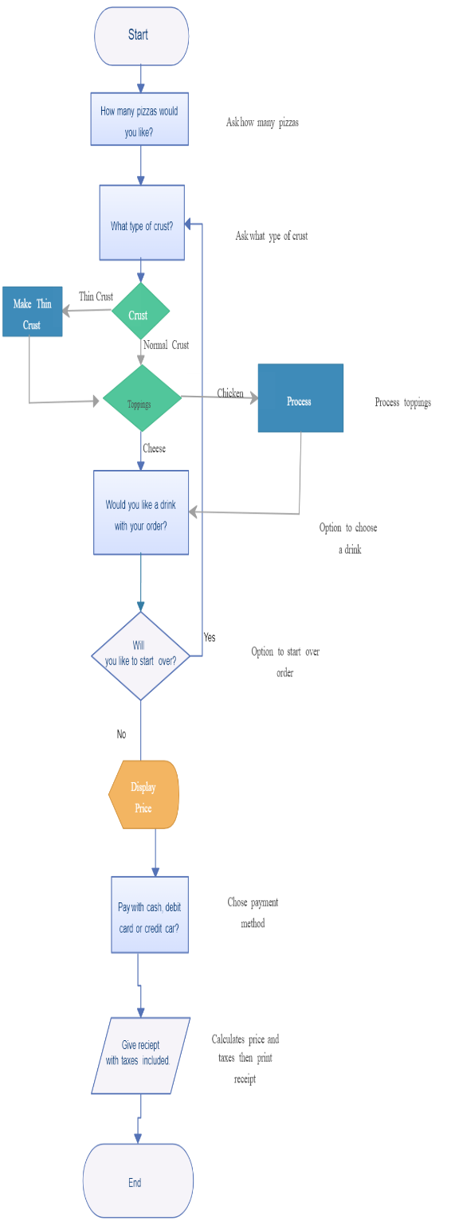
Table Design
ERD

Slide 11
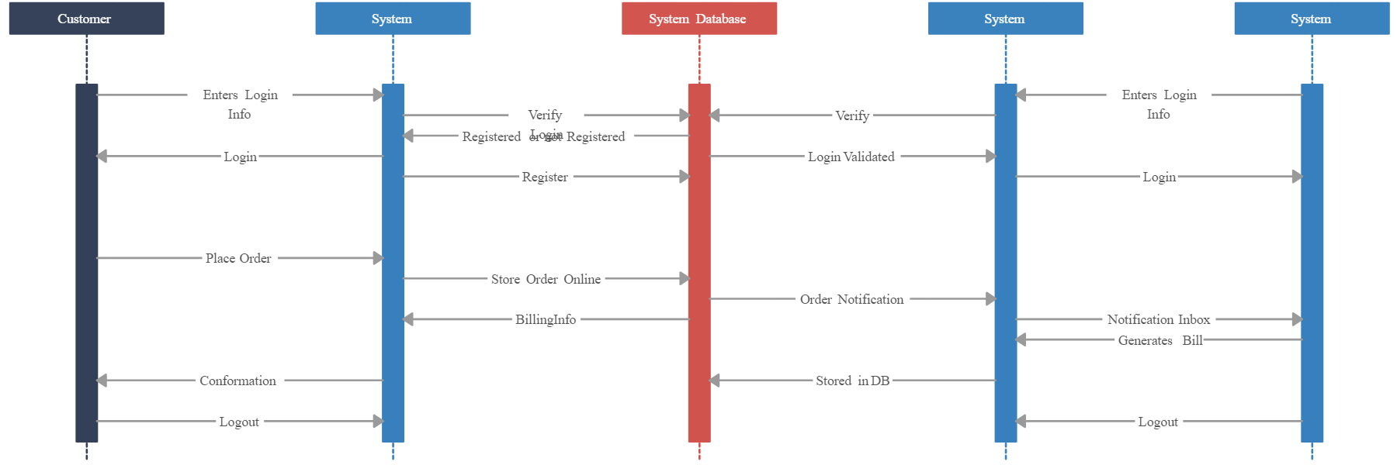
Process Design
Main Process

Slide 12
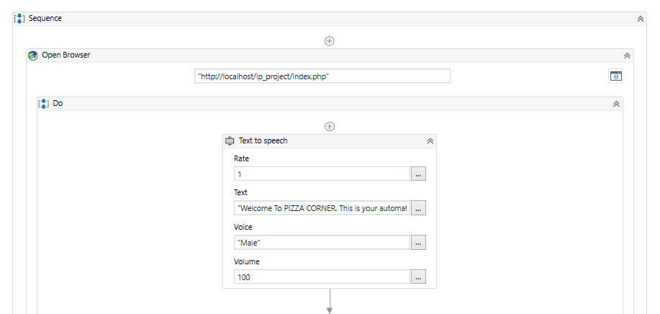
Implementation
Implementation of Module 1
  The Bot is set to take the project name as an input from the user and, then open the browser and create a project using the respective command.

Slide 13
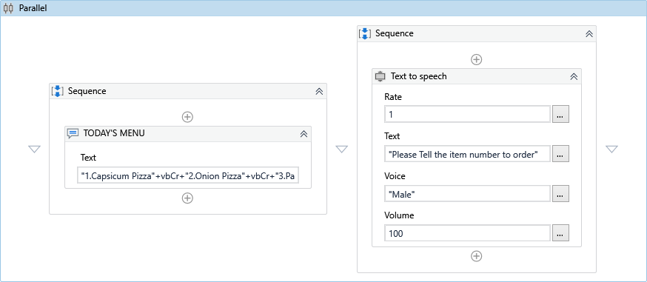
Implementation
Implementation Of Module 2
  After creating a project, the user can create multiple apps inside it and along with it, all the files will be simultaneously updated that needs to be changed.

Slide 14
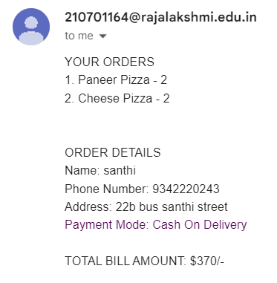
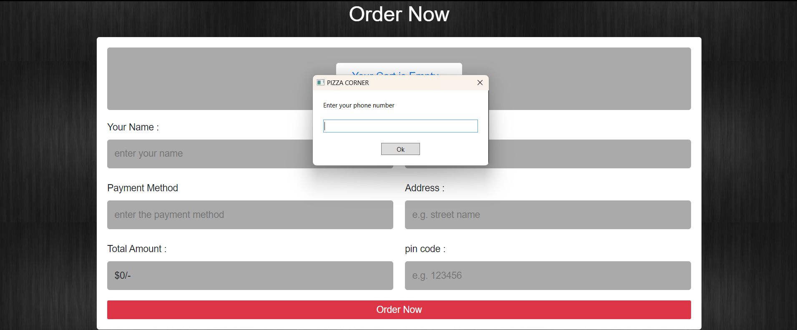
Testing
Conducting a thorough testing process, including both automated and manual testing, is essential to identify and rectify any issues before the system is deployed to production.

Slide 15
Conclusions
In conclusion, the development of the Automated Pizza Ordering Bot with Voice Assistance in UiPath represents a transformative leap in enhancing user experiences within the realm of online food ordering. By seamlessly integrating UiPath's powerful automation capabilities with sophisticated voice recognition technology, this innovative application redefines the pizza ordering process. The meticulous planning, encompassing the definition of project scope, research, and iterative design, has resulted in a user-centric interface that streamlines the complexities of pizza customization and ordering.

Slide 16
Future Enhancement
Enhanced Voice Commands: Improve the system's understanding of natural language voice commands through advancements in NLP. This can involve incorporating machine learning models to better interpret user intent and context.
Extend to Mobile Applications: Develop mobile applications to expand the accessibility of the system, allowing users to place orders and interact with the bot using their smartphones.
Chatbot for Customer Support: Implement a chatbot for customer support to assist users in real-time, answering queries, providing order updates, and addressing common concerns.

Slide 17
References
Bicking, I. 2014. Virtualenv. Consulted 01.08.2016 https://virtualenv.pypa.io/en/latest/
Davidson, M. 2010. MySQL Server Hardening http://security.stackexchange.com/questions/1138/mysql-server- hardening
"Mastering UiPath" by Alok Mani Tripathi: This book covers advanced UiPath concepts and best practices.
"UiPath Robotic Process Automation - Second Edition" by Carl Daniel: A comprehensive guide to UiPath RPA development.
"Robotic Process Automation - Simple Steps to Win, Insights and Opportunities for Maxing Out Success" by Gerard Blokdijk: Explores RPA implementations and strategies.

Slide 18
Queries

Slide 19
Demonstration

Slide 20
Thank You

