Slide 1


K.RAMAKRISHNAN COLLEGE OF TECHNOLOGY
(AUTONOMOUS), TRICHY.
DEPARTMENT OF
COMPUTER SCIENCE AND ENGINEERING
20CS5501 DESIGN PROJECT-1
Batch No. : 09
Date : 06.12.2024

Slide 2
PUBLIC PORTFOLIO
Guided by Team
Mr. A. Malarmannan Keerthivasan S J (811722104074)
Assistant Professor, CSE Logeshwaran P J (811722104082)
Mohana Rengan N (811722104090)

Slide 3
OBJECTIVE OF THE PROJECT
User-Friendly Interface: Provide users with an intuitive platform to easily enter, edit, and manage their personal information, such as photos, skills, and employment history
Comprehensive Showcase: Allow users to present a complete professional profile, including certifications, education, and contact details, in a well-organized manner.
Public Accessibility: Offer a publicly accessible page where others can view the user’s portfolio and, if permitted, contribute by adding additional details or endorsements.
Dynamic Content Management: Implement features that allow users to regularly update and maintain their portfolios, keeping their profiles up-to-date with the latest achievements and skills
To Support Career Advancement and Professional Growth: Support users’ career advancement and professional growth by providing a platform that showcases their skills and experience to potential employers and collaborators.

Slide 4
ABSTRACT
Portfolio Management project is a unique and user-friendly platform that allows users to create and showcase their professional portfolios. The public can view the portfolios, but only the logged-in user can edit their own data. This platform is designed to highlight a user’s skills, experience, languages, education, and certifications, making it an essential tool for job interviews and professional growth. With Portfolio Management, users can easily manage and update their portfolios, ensuring that their online presence accurately reflects their professional brand. This platform is accessible to everyone, and its user-friendly interface makes it easy to navigate and use. By using Portfolio Management, users can take control of their professional narrative and increase their visibility in the job market. Overall, Portfolio Management is a valuable tool for anyone looking to advance their career and showcase their skills and experience.

Slide 5
LITERATURE SURVEY
TITLE OF THE PAPER | AUTHOR (S) | PUBLISHER | PAPER GIST | TECHNOLOGY USED
Dynamic Web Based Portfolio System (2023) | Sharma , Gupta , Rao | Springer | Explores the development of portfolio systems to showcase skills, experience, and certifications dynamically with easy access and management. | HTML, CSS, Django, SQLite
Responsive and Accessible Portfolio Design (2023) | Johnson, M., Patel, K. | IEEE | Discusses the importance of responsive design for public accessibility and optimizing user experience across devices. | Django, JavaScript

Slide 6
LITERATURE SURVEY
TITLE OF THE PAPER | AUTHOR (S) | PUBLISHER | PAPER GIST | TECHNOLOGY USED
Open-Source Portfolio Management Systems (2023) | Verma, T., Singh, R. | Open Source | Investigates open-source solutions for portfolio management, enabling developers to customize features for public access and secure edits. | Django, Open Source
User-Friendly Portfolio Interfaces (2020) | Kim, S., Zhang, L. | Elsevier | Examines methods for creating intuitive and easy-to-use portfolio platforms for public viewing and user management | CSS3, Django

Slide 7
LITERATURE SURVEY
TITLE OF THE PAPER | AUTHOR (S) | PUBLISHER | PAPER GIST | TECHNOLOGY USED
Skills and Experience Tracking System (2019) | Roberts, A., Lee, D. | Wiley | Details frameworks for tracking and showcasing users' skills, education, certifications, and languages known in an organized way. | Python, Django ORM

Slide 8

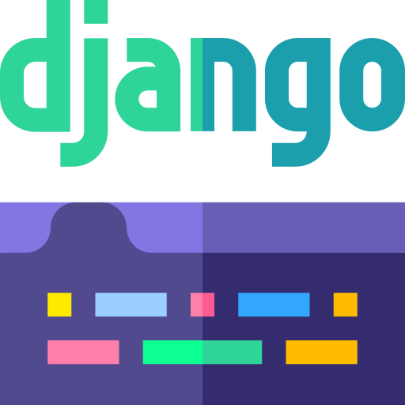




PROPOSED SYSTEM ARCHITECTURE
Django Admin
User Interface
SQLite Database
Authentication
Edit Profile
User Profile

Slide 9




EXISTING SYSTEM ARCHITECTURE
User Interface
Applications
MySQL Database
Project Work of the User
Authenticate

Slide 10
SOFTWARE AND HARDWARE REQUIREMENTS
HARDWARE
SOFTWARE
Desktop /Laptop
Processor: Dual-core CPU (e.g., Intel Core i3)
RAM: 4 GB
Storage: 50 GB free disk space
Display: 1280x800 resolution
Mobile Devices
RAM: 2 GB
OS: Latest iOS or Android
Display: 720p resolution
Web Browser
Google Chrome
Mozilla Firefox
Microsoft Edge
Safari (for macOS users)
Internet Connection
Stable internet connection for accessing and interacting with the web application
Development Tools

Slide 11
MODULES
User Authentication Module
Profile Management
Edit And Update Module
Data Storage
Feedback And Colloboration Module (Future Scope)

Slide 12
SUMMARY OF MODULE-1
User Authentication
Key Features
Sign Up: User registration with secure data validation.
Login: Secure access for registered users with anti-brute-force measures.
Logout: Ends user session with session termination.
Password Reset: Email verification and MFA for password recovery.
Responsibilities:
User Access Management: Control secure access through authentication protocols.
Security: Data protection with encryption, hashed passwords, and optional 2FA.

Slide 13
SUMMARY OF MODULE-2
Profile Management
Key Features
Create Profile: Users can add personal information, skills, certifications,
Update Profile: Modify and update user data as needed.
Delete Profile: Remove user profiles securely.
Responsibilities
User Data Management: Efficiently handle personal information, skills, certifications,
Data Integrity: Ensure secure and accurate storage and updating of profile details.

Slide 14
SUMMARY OF MODULE-3
Edit And Update
Key Features
Media Upload Support:Users To Upload Images,Videos and Certificaates.
Version Control:Tracks And Saves Previous Changes for rollback if needed.
Dynamic Content Editing: Allow User to Update Skills,Experience in real time.
Responsibilities
Data Validation:Ensures all inputs are Correctly Formated and free of errors
Content Synchronization:Updates Public View Instantly & Maintaining Data Integrity.

Slide 15
SUMMARY OF MODULE-4
Data Storage
Key Features
Store Information: Securely store user data such as profiles, skills, and
certifications.
Retrieve Data: Efficiently fetch user information when required.
Responsibilities
Database Management: Handle operations for storing, updating, and
deleting profiles and related data.
Data Security: Ensure secure storage and protection of user information.

Slide 16
SUMMARY OF MODULE-5
Feedback And Colloboration (Future Scope)
Key Features
Real Time Feedback: Users can Provide Comments And on portfolio website.
Notification System:Alert Users of New Feedback,Colloboration Requests.
Skill Endorsements: Public Users can Send Endorse Skills to enhance credibility.
Responsibilities
Feedback Moderation:All Feedback is appropriate to Community Guidelines.
Colloboration Management:Handles Colloboration Requests for Project Updates.

Slide 17
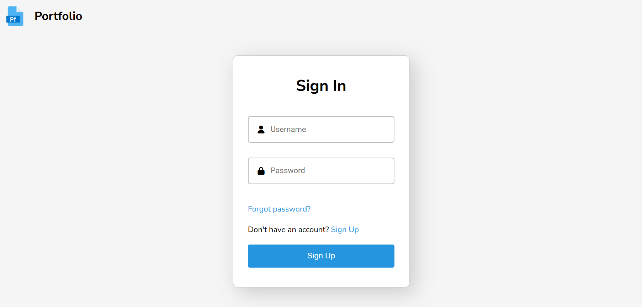
RESULTS AND DISCUSSION

Slide 18
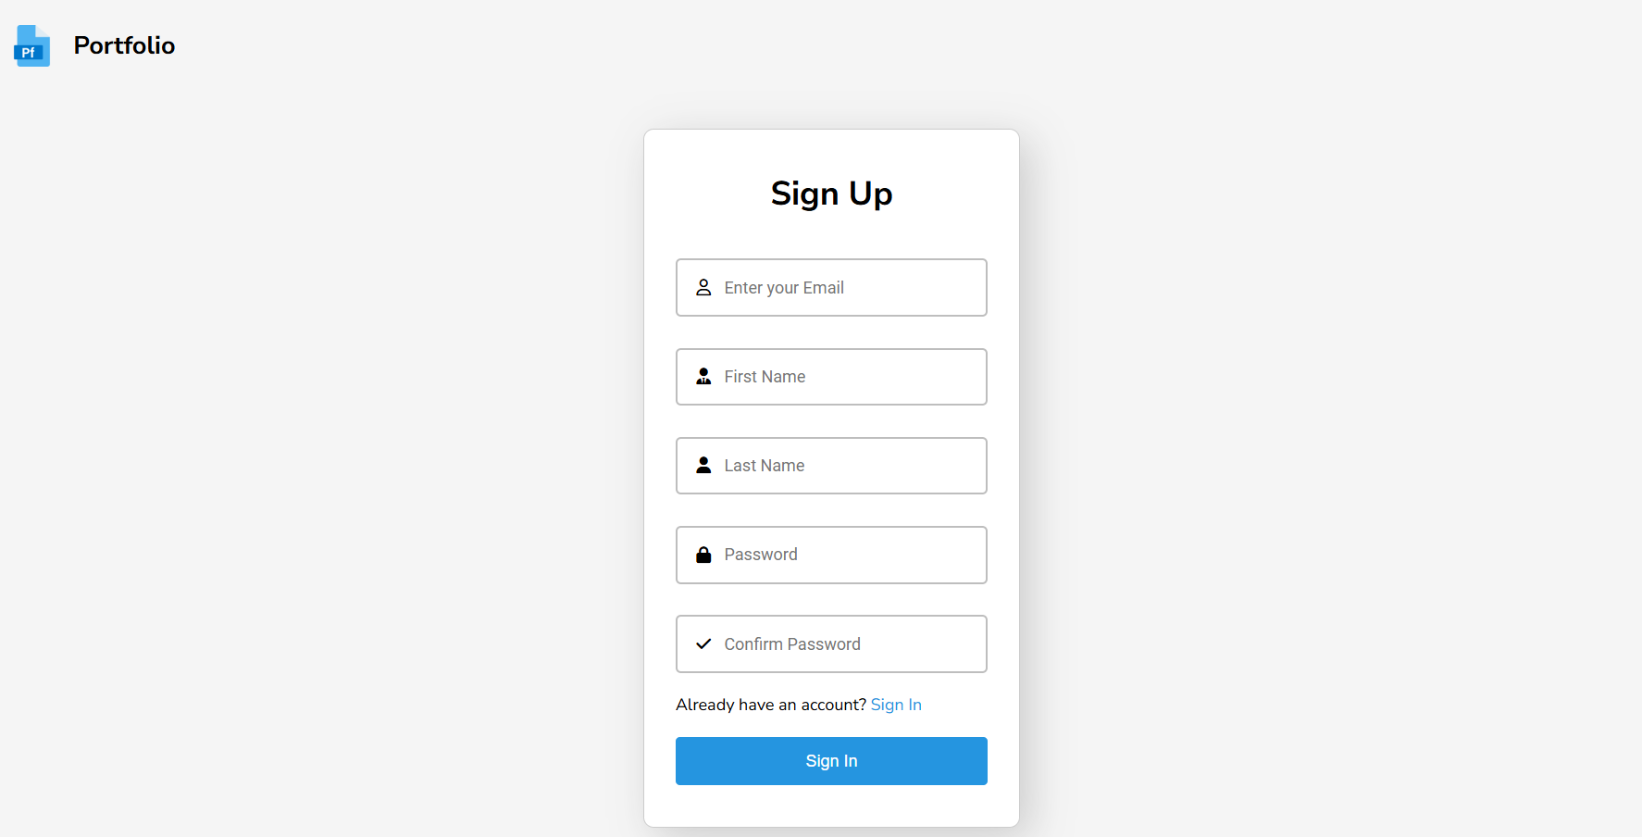
RESULTS AND DISCUSSION

Slide 19
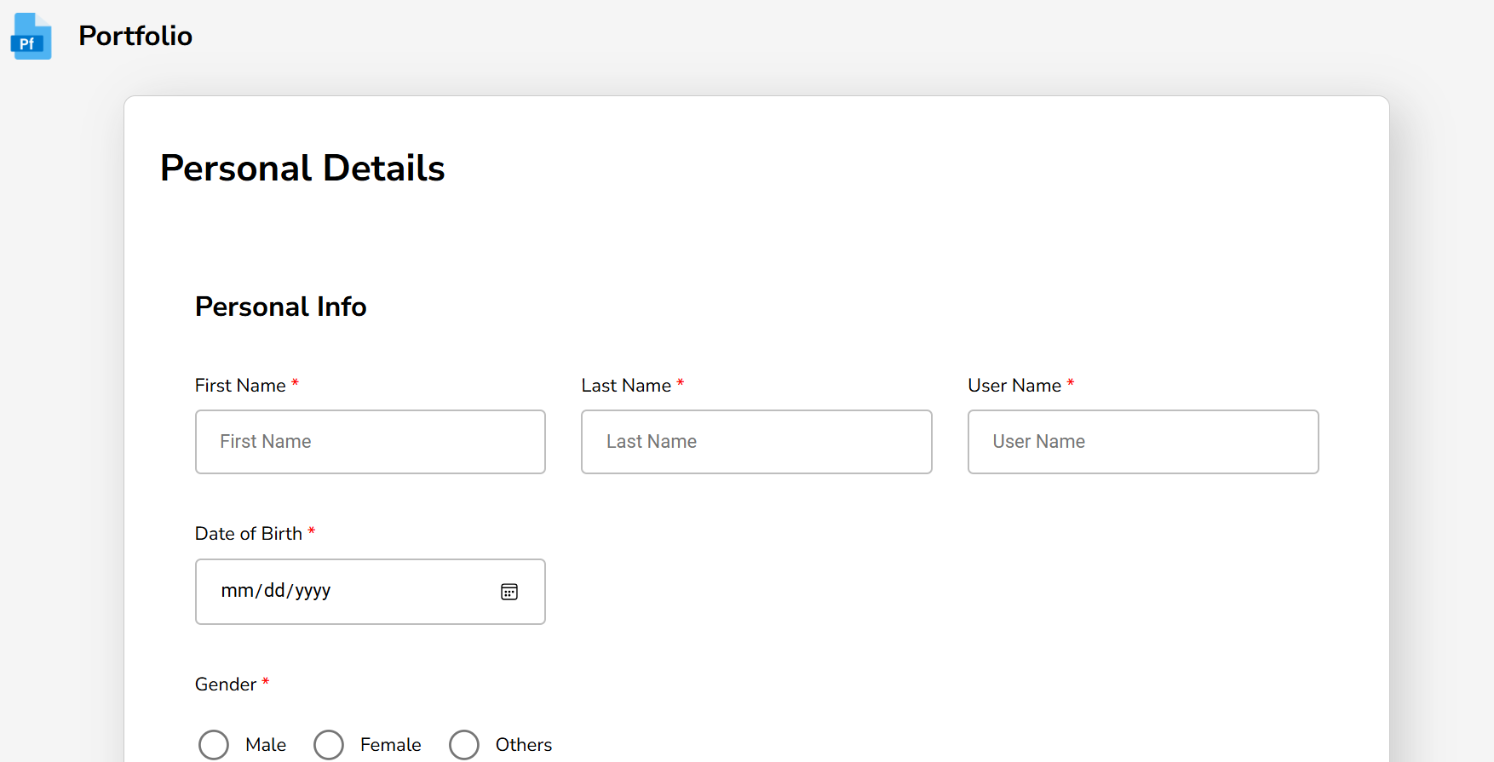
RESULTS AND DISCUSSION

Slide 20
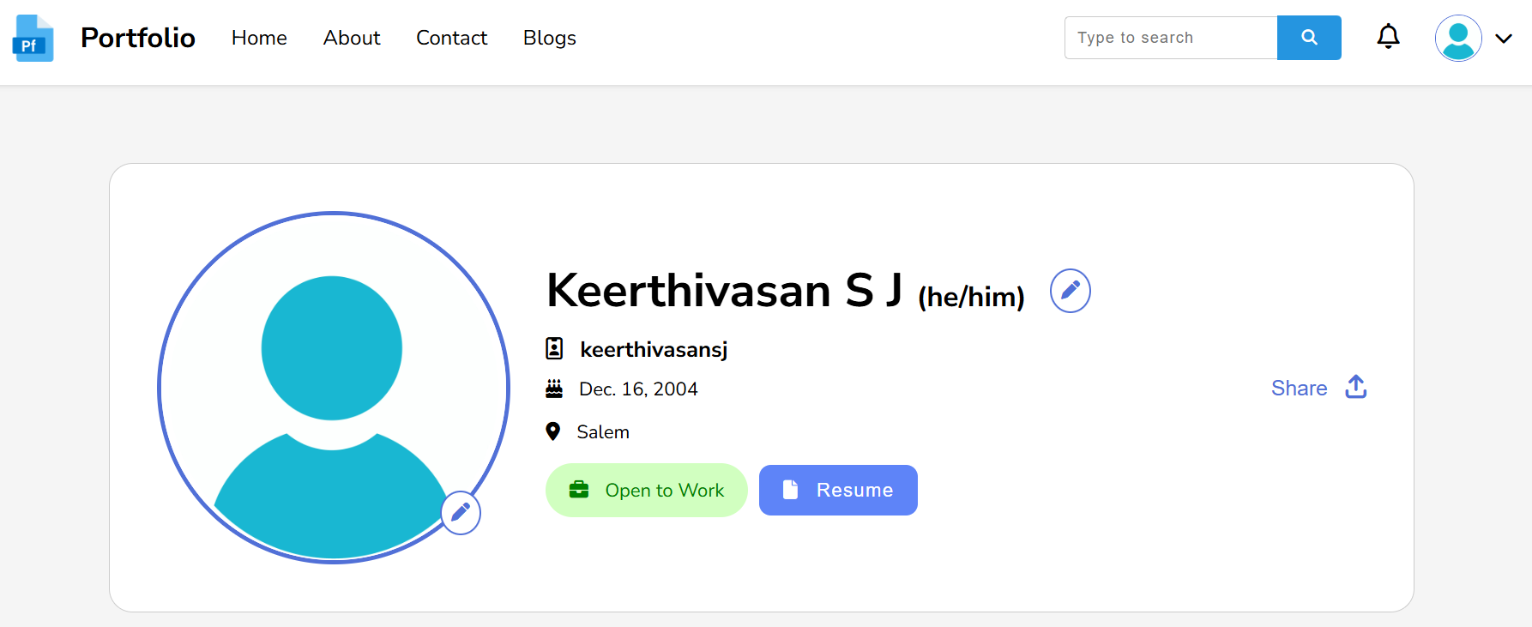
RESULTS AND DISCUSSION

Slide 21
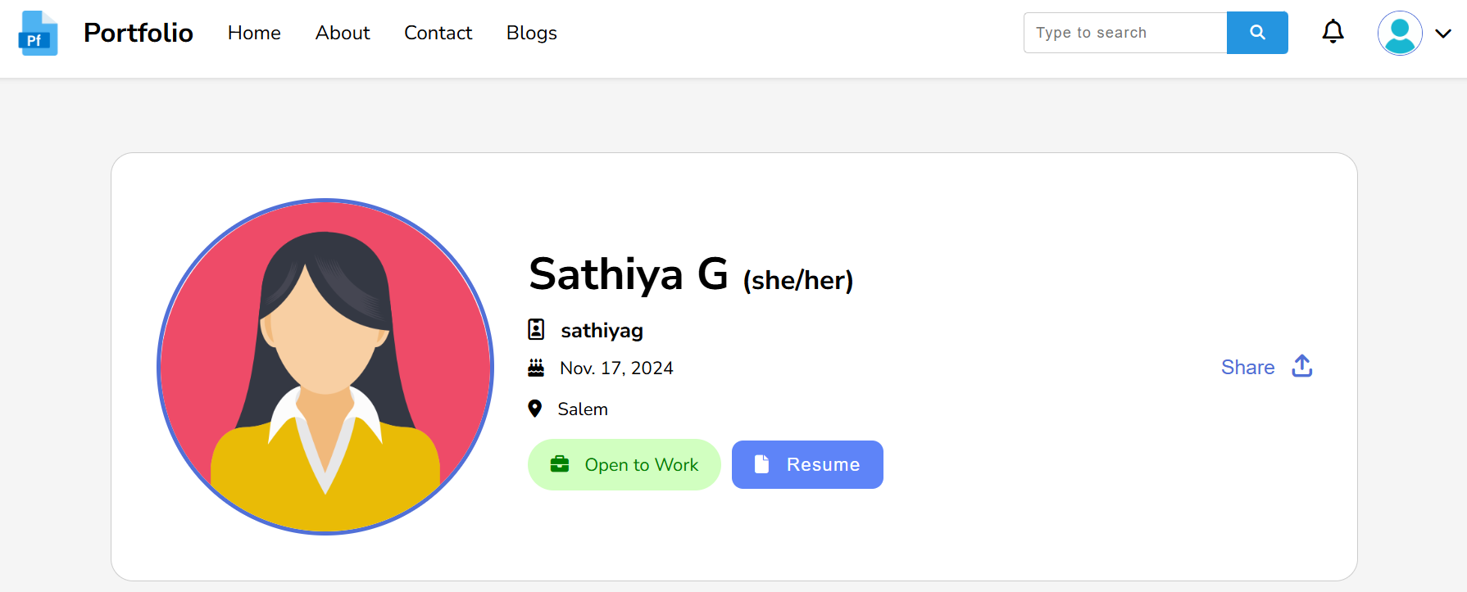
RESULTS AND DISCUSSION

Slide 22
CONCLUSION
User-Friendly Interface: Ensures easy navigation and accessibility for all users.
Secure Role Management: Differentiates public viewing and user editing rights effectively.
Responsive and Professional Design: Optimized for devices and ATS compatibility.
Dynamic Portfolio Updates: Simplifies content management through Django’s backend.
Future-Ready Framework: Scalable and maintainable for long-term use and upgrades.

Slide 23
THANK YOU

